Slide 1
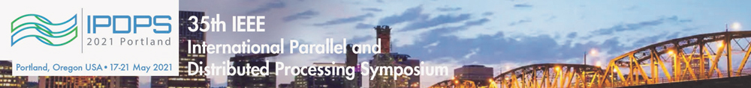
TileSpMV: A Tiled Algorithm for Sparse Matrix-Vector Multiplication on GPUs
Yuyao Niu¹, Zhengyang Lu¹, Meichen Dong¹, Zhou Jin¹, Weifeng Liu¹, Guangming Tan²
1. Super Scientific Software Laboratory, China University of Petroleum-Beijing, China
2. Institute of Computing Technology, Chinese Academy of Sciences, China
2021.05.18
Notes:
不同学者有不同分类方法；光滑分层流：流速低时，油水两相间存在光滑界面；波浪分层流：流速增大，油水两相界面出现波浪；带有液滴层的波浪分层流：油水液滴通过界面，界面模糊；油滴分散层-水层流：油相以液滴形式存在于水相顶部；水滴分散层-油层流：水相以液滴形式存在于油相底部；油包水状分散流：油相为连续相，水滴纵向分布于整个管道；水包油状分散流：水相为连续相，油滴纵向分布于整个管道

Slide 2
01
Background & Motivation
02
TileSpMV
Outline
03
Experimental Results
04
Conclusion
Notes:
不同学者有不同分类方法；光滑分层流：流速低时，油水两相间存在光滑界面；波浪分层流：流速增大，油水两相界面出现波浪；带有液滴层的波浪分层流：油水液滴通过界面，界面模糊；油滴分散层-水层流：油相以液滴形式存在于水相顶部；水滴分散层-油层流：水相以液滴形式存在于油相底部；油包水状分散流：油相为连续相，水滴纵向分布于整个管道；水包油状分散流：水相为连续相，油滴纵向分布于整个管道

Slide 3
01
Background & Motivation
02
TileSpMV
Outline
03
Experimental Results
04
Conclusion
Notes:
不同学者有不同分类方法；光滑分层流：流速低时，油水两相间存在光滑界面；波浪分层流：流速增大，油水两相界面出现波浪；带有液滴层的波浪分层流：油水液滴通过界面，界面模糊；油滴分散层-水层流：油相以液滴形式存在于水相顶部；水滴分散层-油层流：水相以液滴形式存在于油相底部；油包水状分散流：油相为连续相，水滴纵向分布于整个管道；水包油状分散流：水相为连续相，油滴纵向分布于整个管道

Slide 4

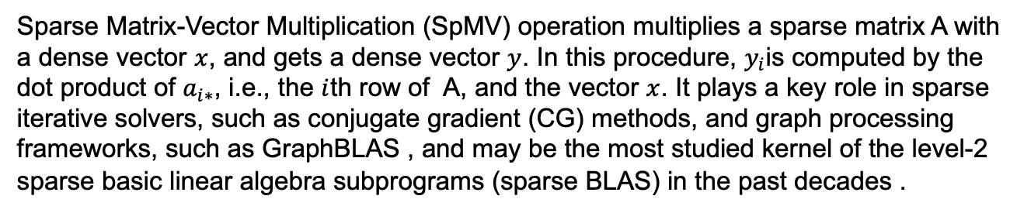
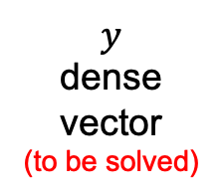
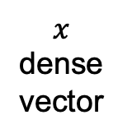





Parallel Sparse Matrix-Vector Multiplication (SpMV)
Sparse Matrix-Vector Multiplication (SpMV) operation multiplies a sparse matrix A with a dense vector $x$, and gets a dense vector $y$. In this procedure, $y_{i}$is computed by the dot product of $a_{i∗}$, i.e., the $i$th row of A, and the vector $x$. It plays a key role in sparse iterative solvers, such as conjugate gradient (CG) methods, and graph processing frameworks, such as GraphBLAS , and may be the most studied kernel of the level-2 sparse basic linear algebra subprograms (sparse BLAS) in the past decades .
1
2
a
$${ y}_{0}$$
3
4
b
$${ y}_{1}$$
$$×$$
$$=$$
5
c
$${ y}_{2}$$
6
7
d
$${ y}_{3}$$
A (4x4)
sparse
7 nonzeros
$$x$$
dense vector
$$y$$
dense vector
(to be solved)
Notes:
不同学者有不同分类方法；光滑分层流：流速低时，油水两相间存在光滑界面；波浪分层流：流速增大，油水两相界面出现波浪；带有液滴层的波浪分层流：油水液滴通过界面，界面模糊；油滴分散层-水层流：油相以液滴形式存在于水相顶部；水滴分散层-油层流：水相以液滴形式存在于油相底部；油包水状分散流：油相为连续相，水滴纵向分布于整个管道；水包油状分散流：水相为连续相，油滴纵向分布于整个管道

Slide 5

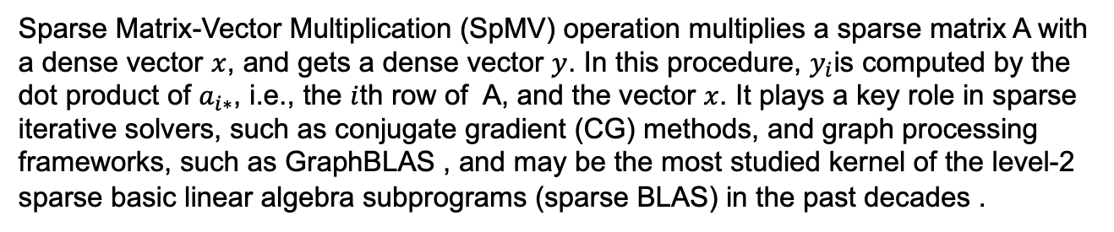

Parallel Sparse Matrix-Vector Multiplication (SpMV)
Sparse Matrix-Vector Multiplication (SpMV) operation multiplies a sparse matrix A with a dense vector $x$, and gets a dense vector $y$. In this procedure, $y_{i}$is computed by the dot product of $a_{i∗}$, i.e., the $i$th row of A, and the vector $x$. It plays a key role in sparse iterative solvers, such as conjugate gradient (CG) methods, and graph processing frameworks, such as GraphBLAS , and may be the most studied kernel of the level-2 sparse basic linear algebra subprograms (sparse BLAS) in the past decades .
1
2
a
$${ y}_{0}$$
${ y}_{0}$ = 1$×$a + 2$×$c
3
4
b
$${ y}_{1}$$
$$×$$
$$=$$
5
c
$${ y}_{2}$$
6
7
d
$${ y}_{3}$$
A (4x4)
sparse
7 nonzeros
$$x$$
dense vector
$$y$$
dense vector
(to be solved)
Notes:
不同学者有不同分类方法；光滑分层流：流速低时，油水两相间存在光滑界面；波浪分层流：流速增大，油水两相界面出现波浪；带有液滴层的波浪分层流：油水液滴通过界面，界面模糊；油滴分散层-水层流：油相以液滴形式存在于水相顶部；水滴分散层-油层流：水相以液滴形式存在于油相底部；油包水状分散流：油相为连续相，水滴纵向分布于整个管道；水包油状分散流：水相为连续相，油滴纵向分布于整个管道

Slide 6


Parallel Sparse Matrix-Vector Multiplication (SpMV)
Sparse Matrix-Vector Multiplication (SpMV) operation multiplies a sparse matrix A with a dense vector $x$, and gets a dense vector $y$. In this procedure, $y_{i}$is computed by the dot product of $a_{i∗}$, i.e., the $i$th row of A, and the vector $x$. It plays a key role in sparse iterative solvers, such as conjugate gradient (CG) methods, and graph processing frameworks, such as GraphBLAS , and may be the most studied kernel of the level-2 sparse basic linear algebra subprograms (sparse BLAS) in the past decades .
1
2
a
$${ y}_{0}$$
${ y}_{0}$ = 1$×$a + 2$×$c
3
4
b
$${ y}_{1}$$
${ y}_{1}$ = 3$×$a + 2$×b$
$$×$$
$$=$$
5
c
$${ y}_{2}$$
6
7
d
$${ y}_{3}$$
A (4x4)
sparse
7 nonzeros
$$x$$
dense vector
$$y$$
dense vector
(to be solved)
Notes:
不同学者有不同分类方法；光滑分层流：流速低时，油水两相间存在光滑界面；波浪分层流：流速增大，油水两相界面出现波浪；带有液滴层的波浪分层流：油水液滴通过界面，界面模糊；油滴分散层-水层流：油相以液滴形式存在于水相顶部；水滴分散层-油层流：水相以液滴形式存在于油相底部；油包水状分散流：油相为连续相，水滴纵向分布于整个管道；水包油状分散流：水相为连续相，油滴纵向分布于整个管道

Slide 7


Parallel Sparse Matrix-Vector Multiplication (SpMV)
Sparse Matrix-Vector Multiplication (SpMV) operation multiplies a sparse matrix A with a dense vector $x$, and gets a dense vector $y$. In this procedure, $y_{i}$is computed by the dot product of $a_{i∗}$, i.e., the $i$th row of A, and the vector $x$. It plays a key role in sparse iterative solvers, such as conjugate gradient (CG) methods, and graph processing frameworks, such as GraphBLAS , and may be the most studied kernel of the level-2 sparse basic linear algebra subprograms (sparse BLAS) in the past decades .
1
2
a
$${ y}_{0}$$
${ y}_{0}$ = 1$×$a + 2$×$c
3
4
b
$${ y}_{1}$$
${ y}_{1}$ = 3$×$a + 2$×b$
$$×$$
$$=$$
5
c
$${ y}_{2}$$
${ y}_{2}$ = 5$×$c
6
7
d
$${ y}_{3}$$
A (4x4)
sparse
7 nonzeros
$$x$$
dense vector
$$y$$
dense vector
(to be solved)
Notes:
不同学者有不同分类方法；光滑分层流：流速低时，油水两相间存在光滑界面；波浪分层流：流速增大，油水两相界面出现波浪；带有液滴层的波浪分层流：油水液滴通过界面，界面模糊；油滴分散层-水层流：油相以液滴形式存在于水相顶部；水滴分散层-油层流：水相以液滴形式存在于油相底部；油包水状分散流：油相为连续相，水滴纵向分布于整个管道；水包油状分散流：水相为连续相，油滴纵向分布于整个管道

Slide 8

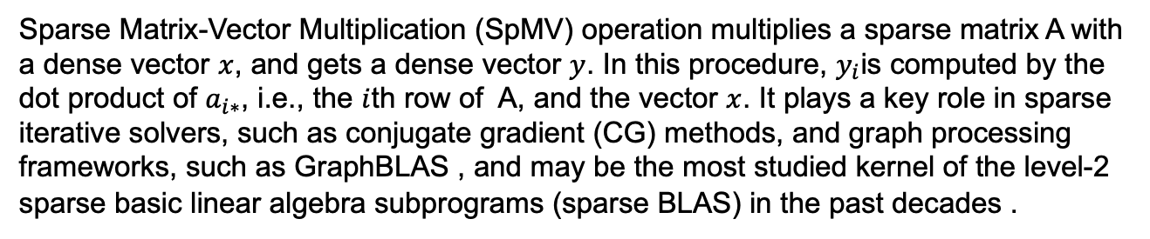


Parallel Sparse Matrix-Vector Multiplication (SpMV)
Sparse Matrix-Vector Multiplication (SpMV) operation multiplies a sparse matrix A with a dense vector $x$, and gets a dense vector $y$. In this procedure, $y_{i}$is computed by the dot product of $a_{i∗}$, i.e., the $i$th row of A, and the vector $x$. It plays a key role in sparse iterative solvers, such as conjugate gradient (CG) methods, and graph processing frameworks, such as GraphBLAS , and may be the most studied kernel of the level-2 sparse basic linear algebra subprograms (sparse BLAS) in the past decades .
1
2
a
$${ y}_{0}$$
${ y}_{0}$ = 1$×$a + 2$×$c
3
4
b
$${ y}_{1}$$
${ y}_{1}$ = 3$×$a + 2$×$b
$$×$$
$$=$$
5
c
$${ y}_{2}$$
${ y}_{2}$ = 5$×$c
6
7
d
$${ y}_{3}$$
${ y}_{3}$ = 6$×$a + 7$×$d
A (4x4)
sparse
7 nonzeros
$$x$$
dense vector
$$y$$
dense vector
(to be solved)
Notes:
不同学者有不同分类方法；光滑分层流：流速低时，油水两相间存在光滑界面；波浪分层流：流速增大，油水两相界面出现波浪；带有液滴层的波浪分层流：油水液滴通过界面，界面模糊；油滴分散层-水层流：油相以液滴形式存在于水相顶部；水滴分散层-油层流：水相以液滴形式存在于油相底部；油包水状分散流：油相为连续相，水滴纵向分布于整个管道；水包油状分散流：水相为连续相，油滴纵向分布于整个管道

Slide 9

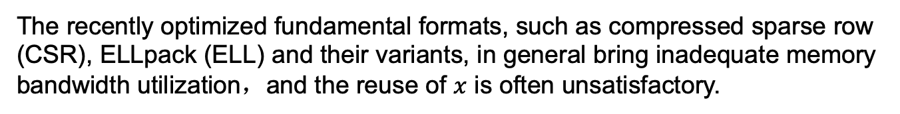
Motivation 1 : Optimization of data locality and reuse of $x$
The recently optimized fundamental formats, such as compressed sparse row (CSR), ELLpack (ELL) and their variants, in general bring inadequate memory bandwidth utilization，and the reuse of $x$ is often unsatisfactory.
1
2
a
$${ y}_{0}$$
${ y}_{0}$ = 1$×$a + 2$×$c
3
4
b
$${ y}_{1}$$
${ y}_{1}$ = 3$×$a + 2$×$b
$$×$$
$$=$$
5
c
$${ y}_{2}$$
${ y}_{2}$ = 5$×$c
6
7
d
$${ y}_{3}$$
${ y}_{3}$ = 6$×$a + 7$×$d
Notes:
不同学者有不同分类方法；光滑分层流：流速低时，油水两相间存在光滑界面；波浪分层流：流速增大，油水两相界面出现波浪；带有液滴层的波浪分层流：油水液滴通过界面，界面模糊；油滴分散层-水层流：油相以液滴形式存在于水相顶部；水滴分散层-油层流：水相以液滴形式存在于油相底部；油包水状分散流：油相为连续相，水滴纵向分布于整个管道；水包油状分散流：水相为连续相，油滴纵向分布于整个管道

Slide 10
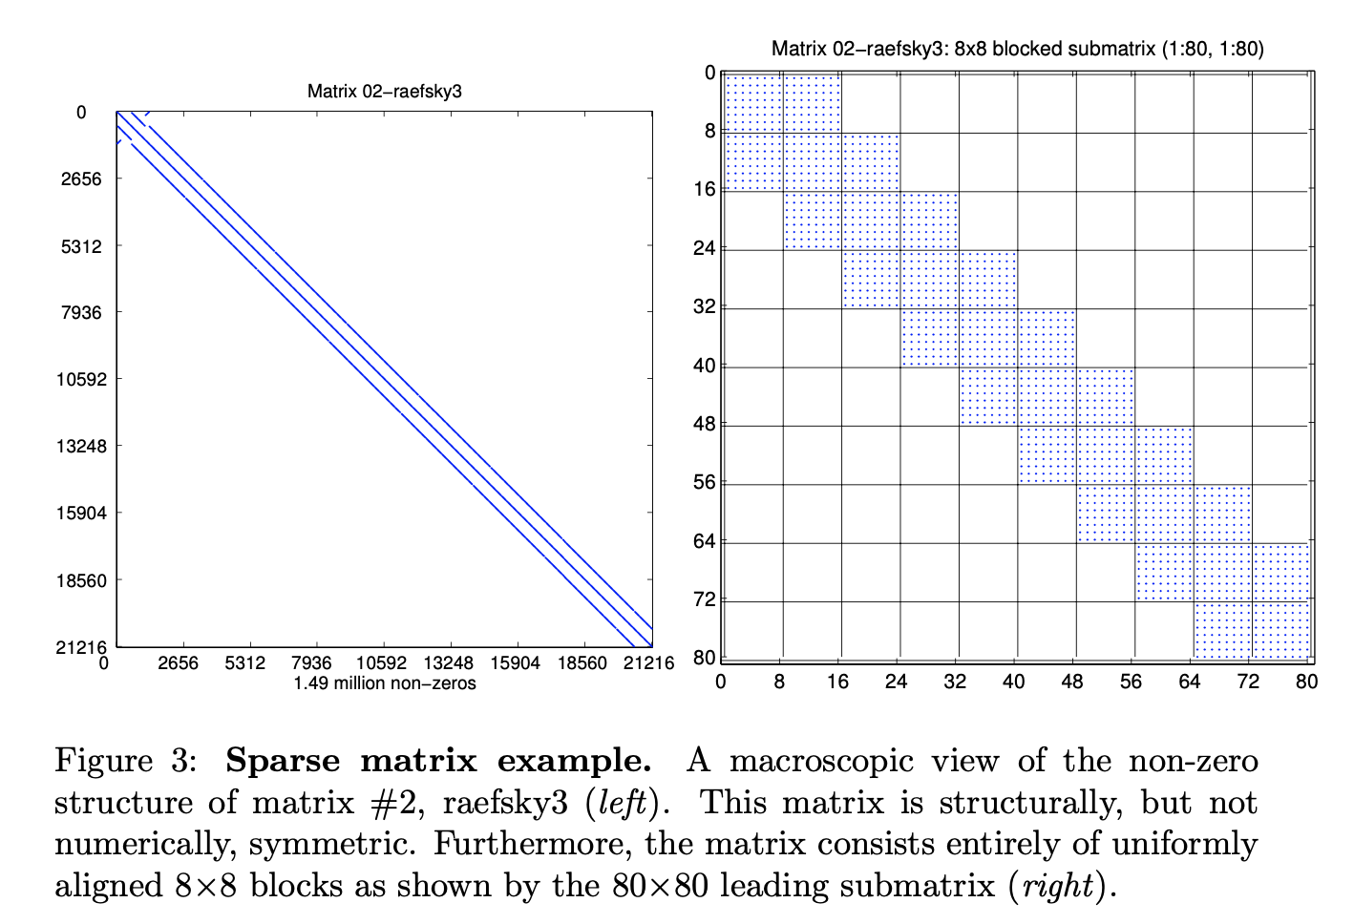
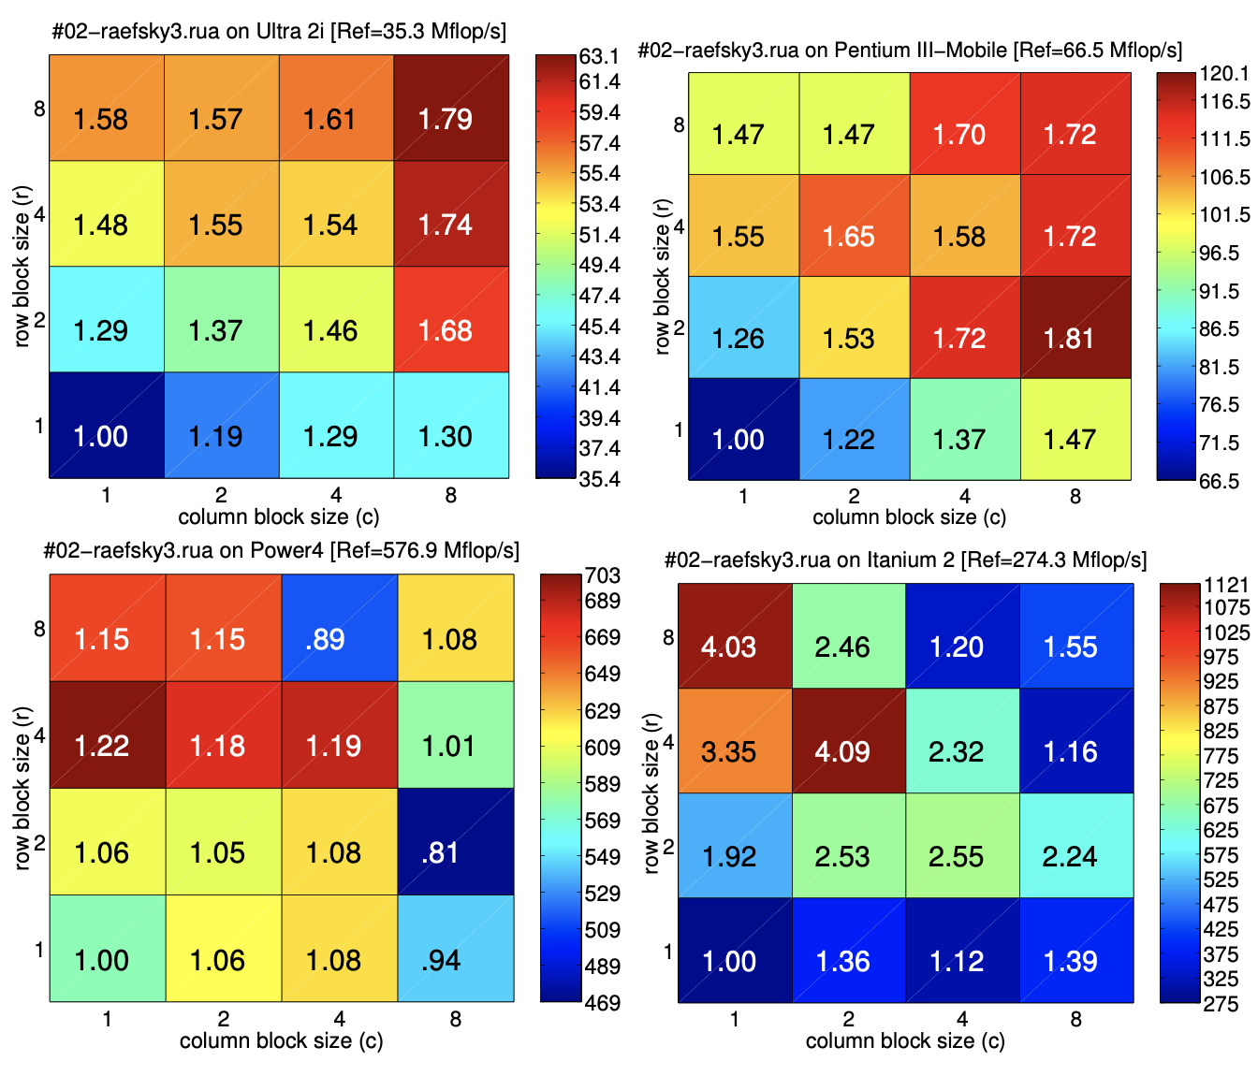
Motivation 1 : Optimization of data locality and reuse of $x$
The recently optimized fundamental formats, such as compressed sparse row (CSR), ELLpack (ELL) and their variants, in general bring inadequate memory bandwidth utilization，and the reuse of $x$ is often unsatisfactory.
E.-J. Im, K. Yelick, and R. Vuduc, “Sparsity: Optimization framework for sparse matrix kernels,” The International Journal of High Performance Computing Applications, 2004.

Slide 11
Motivation 2 : Optimization of on-chip small matrices
There lacks SpMV implementations optimized for very small sparse matrices that can be completely stored in the on-chip scratchpad memories.
H. Anzt, T. Cojean, C. Yen-Chen, J. Dongarra, G. Flegar, P. Nayak, S. Tomov, Y. M. Tsai, and W. Wang, “Load-balancing sparse matrix vector product kernels on GPUs,” ACM Trans. Parallel Comput., vol. 7, no. 1, 2020.
Y. Zhao, W. Zhou, X. Shen, and G. Yiu, “Overhead-conscious format selection for SpMV-based applications,” in Proceedings of the 2018 IEEE 32th International Parallel and Distributed Processing Symposium , 2018.
C.Yang,A.Buluç, and J.D.Owens,“Implementing push-pullefficiently in GraphBLAS,” in Proceedings of the 47th International Conference on Parallel Processing, 2018.
A. Elafrou, V. Karakasis, T. Gkountouvas, K. Kourtis, G. Goumas, and N. Koziris, “Sparsex: A library for high-performance sparse matrix- vector multiplication on multicore platforms,” ACM Trans. Math. Softw., vol. 44, no. 3, 2018.
Y. Zhao, J. Li, C. Liao, and X. Shen, “Bridging the gap between deep learning and sparse matrix format selection,” in Proceedings of the 23rd ACM SIGPLAN Symposium on Principles and Practice of Parallel Programming, 2018.
Notes:
不同学者有不同分类方法；光滑分层流：流速低时，油水两相间存在光滑界面；波浪分层流：流速增大，油水两相界面出现波浪；带有液滴层的波浪分层流：油水液滴通过界面，界面模糊；油滴分散层-水层流：油相以液滴形式存在于水相顶部；水滴分散层-油层流：水相以液滴形式存在于油相底部；油包水状分散流：油相为连续相，水滴纵向分布于整个管道；水包油状分散流：水相为连续相，油滴纵向分布于整个管道

Slide 12
Motivation 3 : Optimization for micro-structure using ML
Although the format and algorithm selection techniques using machine learning have been proven effective in SpMV, they have only been used for the whole matrix, and the micro structures of a sparse matrix have not obtained benefits from the techniques.
Y. Zhao, W. Zhou, X. Shen, and G. Yiu, “Overhead-conscious format selection for SpMV-based applications,” in Proceedings of the 2014 IEEE 28th International Parallel and Distributed Processing Symposium , 2018.
N. Sedaghati, T. Mu, L. Pouchet, S. Parthasarathy, and P. Sadayappan, “Automatic selection of sparse matrix representation on gpus,” in Proceedings of the 29th ACM International Conference on Super-computing, 2015.
A. Benatia, W. Ji, Y. Wang, and F. Shi, “Sparse matrix format selection with multiclass svm for SpMV on GPU,” in
in Proceedings of the 45th International Conference on Parallel Processing, 2016.
Y. Zhao, J. Li, C. Liao, and X. Shen, “Bridging the gap between deep learning and sparse matrix format selection,” in Proceedings of the 23rd ACM SIGPLAN Symposium on Principles and Practice of Parallel Programming, 2018.
J. Li, G. Tan, M. Chen, and N. Sun, “Smat: An input adaptive auto-tuner for sparse matrix-vector multiplication,” in Proceedings of the 34th ACM SIGPLAN conference on Programming language design and implementation, 2013.
Notes:
不同学者有不同分类方法；光滑分层流：流速低时，油水两相间存在光滑界面；波浪分层流：流速增大，油水两相界面出现波浪；带有液滴层的波浪分层流：油水液滴通过界面，界面模糊；油滴分散层-水层流：油相以液滴形式存在于水相顶部；水滴分散层-油层流：水相以液滴形式存在于油相底部；油包水状分散流：油相为连续相，水滴纵向分布于整个管道；水包油状分散流：水相为连续相，油滴纵向分布于整个管道

Slide 13
01
Background & Motivation
02
TileSpMV
Outline
03
Experimental Results
04
Conclusion
Notes:
不同学者有不同分类方法；光滑分层流：流速低时，油水两相间存在光滑界面；波浪分层流：流速增大，油水两相界面出现波浪；带有液滴层的波浪分层流：油水液滴通过界面，界面模糊；油滴分散层-水层流：油相以液滴形式存在于水相顶部；水滴分散层-油层流：水相以液滴形式存在于油相底部；油包水状分散流：油相为连续相，水滴纵向分布于整个管道；水包油状分散流：水相为连续相，油滴纵向分布于整个管道

Slide 14
Two-Level Storage Structure
TileSpMV first divides an input matrix A into a number of sparse tiles of the same size (16-by-16 in this work), and uses a sparse tile as the basic working unit. After the partitioning, two levels of information represented as a group of arrays are generated for storing the sparse tiles. The two levels of the information store the tile structure of the matrix, and the internal information of each sparse tile, respectively.
Notes:
不同学者有不同分类方法；光滑分层流：流速低时，油水两相间存在光滑界面；波浪分层流：流速增大，油水两相界面出现波浪；带有液滴层的波浪分层流：油水液滴通过界面，界面模糊；油滴分散层-水层流：油相以液滴形式存在于水相顶部；水滴分散层-油层流：水相以液滴形式存在于油相底部；油包水状分散流：油相为连续相，水滴纵向分布于整个管道；水包油状分散流：水相为连续相，油滴纵向分布于整个管道

Slide 15
Two-Level Storage Structure
The tilePtr array of size tilemA+1
The tileColIdx array of size numtileA
The tileNnz array of size numtileA + 1
The format array of size numtileA
Notes:
不同学者有不同分类方法；光滑分层流：流速低时，油水两相间存在光滑界面；波浪分层流：流速增大，油水两相界面出现波浪；带有液滴层的波浪分层流：油水液滴通过界面，界面模糊；油滴分散层-水层流：油相以液滴形式存在于水相顶部；水滴分散层-油层流：水相以液滴形式存在于油相底部；油包水状分散流：油相为连续相，水滴纵向分布于整个管道；水包油状分散流：水相为连续相，油滴纵向分布于整个管道

Slide 16
Two-Level Storage Structure
Seven selections: CSR, COO, ELL, HYB, dense (Dns), dense row (DnsRow), and dense column (DnsCol).
Notes:
不同学者有不同分类方法；光滑分层流：流速低时，油水两相间存在光滑界面；波浪分层流：流速增大，油水两相界面出现波浪；带有液滴层的波浪分层流：油水液滴通过界面，界面模糊；油滴分散层-水层流：油相以液滴形式存在于水相顶部；水滴分散层-油层流：水相以液滴形式存在于油相底部；油包水状分散流：油相为连续相，水滴纵向分布于整个管道；水包油状分散流：水相为连续相，油滴纵向分布于整个管道

Slide 17
Tile-Wise SpMV Algorithms
warp-level COO-SpMV algorithm
The 32 threads in a warp are assigned to process all the nonzeros, and the resulting partial sums are added together in shared memory by using the atomicAdd operation.
Notes:
不同学者有不同分类方法；光滑分层流：流速低时，油水两相间存在光滑界面；波浪分层流：流速增大，油水两相界面出现波浪；带有液滴层的波浪分层流：油水液滴通过界面，界面模糊；油滴分散层-水层流：油相以液滴形式存在于水相顶部；水滴分散层-油层流：水相以液滴形式存在于油相底部；油包水状分散流：油相为连续相，水滴纵向分布于整个管道；水包油状分散流：水相为连续相，油滴纵向分布于整个管道

Slide 18
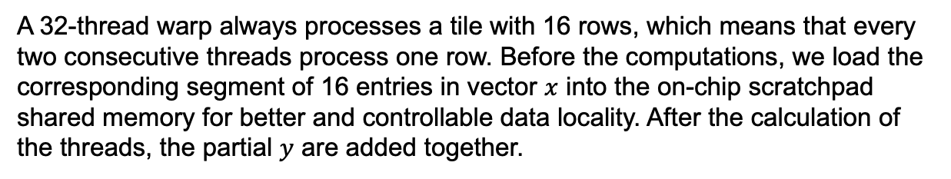
Tile-Wise SpMV Algorithms
warp-level CSR-SpMV algorithm,
A 32-thread warp always processes a tile with 16 rows, which means that every two consecutive threads process one row. Before the computations, we load the corresponding segment of 16 entries in vector $x$ into the on-chip scratchpad shared memory for better and controllable data locality. After the calculation of the threads, the partial $y$ are added together.
Notes:
不同学者有不同分类方法；光滑分层流：流速低时，油水两相间存在光滑界面；波浪分层流：流速增大，油水两相界面出现波浪；带有液滴层的波浪分层流：油水液滴通过界面，界面模糊；油滴分散层-水层流：油相以液滴形式存在于水相顶部；水滴分散层-油层流：水相以液滴形式存在于油相底部；油包水状分散流：油相为连续相，水滴纵向分布于整个管道；水包油状分散流：水相为连续相，油滴纵向分布于整个管道

Slide 19
Tile-Wise SpMV Algorithms
warp-level DnsRow-SpMV algorithm,
The reduction-sum operation is required, and the corresponding $x$ should be loaded into the registers.
Notes:
不同学者有不同分类方法；光滑分层流：流速低时，油水两相间存在光滑界面；波浪分层流：流速增大，油水两相界面出现波浪；带有液滴层的波浪分层流：油水液滴通过界面，界面模糊；油滴分散层-水层流：油相以液滴形式存在于水相顶部；水滴分散层-油层流：水相以液滴形式存在于油相底部；油包水状分散流：油相为连续相，水滴纵向分布于整个管道；水包油状分散流：水相为连续相，油滴纵向分布于整个管道

Slide 20
Tile-Wise SpMV Algorithms
warp-level DnsCol-SpMV algorithm,
The task assignment for threads is similar to the Dns-SpMV
Notes:
不同学者有不同分类方法；光滑分层流：流速低时，油水两相间存在光滑界面；波浪分层流：流速增大，油水两相界面出现波浪；带有液滴层的波浪分层流：油水液滴通过界面，界面模糊；油滴分散层-水层流：油相以液滴形式存在于水相顶部；水滴分散层-油层流：水相以液滴形式存在于油相底部；油包水状分散流：油相为连续相，水滴纵向分布于整个管道；水包油状分散流：水相为连续相，油滴纵向分布于整个管道

Slide 21
Tile-Wise SpMV Algorithms
warp-level ELL-SpMV algorithm,
A warp of 32 threads is used to process nonzero entries stored in the column- major. Each thread in a half warp of 16 threads is assigned to a row, and the computation completes when the ELL width is reached.
Notes:
不同学者有不同分类方法；光滑分层流：流速低时，油水两相间存在光滑界面；波浪分层流：流速增大，油水两相界面出现波浪；带有液滴层的波浪分层流：油水液滴通过界面，界面模糊；油滴分散层-水层流：油相以液滴形式存在于水相顶部；水滴分散层-油层流：水相以液滴形式存在于油相底部；油包水状分散流：油相为连续相，水滴纵向分布于整个管道；水包油状分散流：水相为连续相，油滴纵向分布于整个管道

Slide 22
Tile-Wise SpMV Algorithms
warp-level HYB-SpMV algorithm,
Two steps respectively calculating the ELL and COO parts are used.
Notes:
不同学者有不同分类方法；光滑分层流：流速低时，油水两相间存在光滑界面；波浪分层流：流速增大，油水两相界面出现波浪；带有液滴层的波浪分层流：油水液滴通过界面，界面模糊；油滴分散层-水层流：油相以液滴形式存在于水相顶部；水滴分散层-油层流：水相以液滴形式存在于油相底部；油包水状分散流：油相为连续相，水滴纵向分布于整个管道；水包油状分散流：水相为连续相，油滴纵向分布于整个管道

Slide 23
Tile-Wise SpMV Algorithms
warp-level Dns-SpMV algorithm,
A 32-thread warp need to process a dense tile of 16-by-16 and finish the work after eight rounds, and each thread processes 8 elements. After calculating, results are stored to sum for each thread and shuffle will be used to add the sum value of threads processing the same row.
Notes:
不同学者有不同分类方法；光滑分层流：流速低时，油水两相间存在光滑界面；波浪分层流：流速增大，油水两相界面出现波浪；带有液滴层的波浪分层流：油水液滴通过界面，界面模糊；油滴分散层-水层流：油相以液滴形式存在于水相顶部；水滴分散层-油层流：水相以液滴形式存在于油相底部；油包水状分散流：油相为连续相，水滴纵向分布于整个管道；水包油状分散流：水相为连续相，油滴纵向分布于整个管道

Slide 24
Format Selection Method
On top of the storage structure and basic warp-level SpMV kernels, we implement three TileSpMV algorithms to validate the effectiveness of utilizing the variety of formats:
TileSpMV_CSR method
(2) TileSpMV_ADPT method
(3) TileSpMV_DeferredCOO method
Notes:
不同学者有不同分类方法；光滑分层流：流速低时，油水两相间存在光滑界面；波浪分层流：流速增大，油水两相界面出现波浪；带有液滴层的波浪分层流：油水液滴通过界面，界面模糊；油滴分散层-水层流：油相以液滴形式存在于水相顶部；水滴分散层-油层流：水相以液滴形式存在于油相底部；油包水状分散流：油相为连续相，水滴纵向分布于整个管道；水包油状分散流：水相为连续相，油滴纵向分布于整个管道

Slide 25
Format Selection Method
On top of the storage structure and basic warp-level SpMV kernels, we implement three TileSpMV algorithms to validate the effectiveness of utilizing the variety of formats:
TileSpMV_CSR method
(2) TileSpMV_ADPT method
(3) TileSpMV_DeferredCOO method
Notes:
不同学者有不同分类方法；光滑分层流：流速低时，油水两相间存在光滑界面；波浪分层流：流速增大，油水两相界面出现波浪；带有液滴层的波浪分层流：油水液滴通过界面，界面模糊；油滴分散层-水层流：油相以液滴形式存在于水相顶部；水滴分散层-油层流：水相以液滴形式存在于油相底部；油包水状分散流：油相为连续相，水滴纵向分布于整个管道；水包油状分散流：水相为连续相，油滴纵向分布于整个管道

Slide 26
Format Selection Method
・COO : Very sparse tiles (nnz <=12), the nonzero entries are distributed not evenly among the rows.
・Dns : nnz >=128, only values are recorded.
・DnsRow/DnsCol : A tile has a form that all nonzero entries are in certain rows/columns, and all the other rows/columns are empty,
The flow chart of our format selection method for TileSpMV_ALL.
Notes:
不同学者有不同分类方法；光滑分层流：流速低时，油水两相间存在光滑界面；波浪分层流：流速增大，油水两相界面出现波浪；带有液滴层的波浪分层流：油水液滴通过界面，界面模糊；油滴分散层-水层流：油相以液滴形式存在于水相顶部；水滴分散层-油层流：水相以液滴形式存在于油相底部；油包水状分散流：油相为连续相，水滴纵向分布于整个管道；水包油状分散流：水相为连续相，油滴纵向分布于整个管道

Slide 27
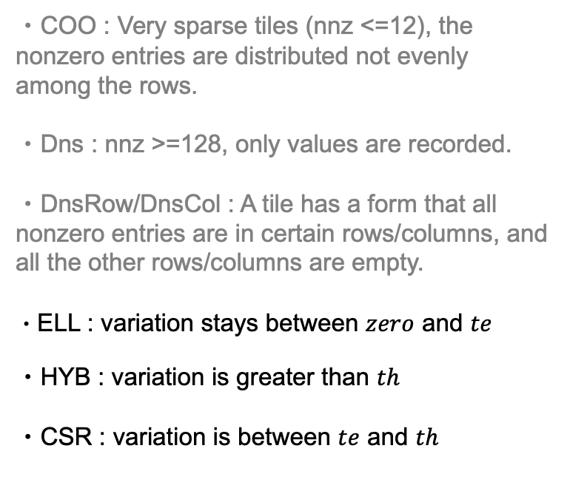


Format Selection Method
・COO : Very sparse tiles (nnz <=12), the nonzero entries are distributed not evenly among the rows.
・Dns : nnz >=128, only values are recorded.
・DnsRow/DnsCol : A tile has a form that all nonzero entries are in certain rows/columns, and all the other rows/columns are empty.
・ELL : variation stays between $zero$ and $te$
・HYB : variation is greater than $th$
・CSR : variation is between $te$ and $th$
$te$=0.2
$th$=1.0
The flow chart of our format selection method for TileSpMV_ALL.
Notes:
不同学者有不同分类方法；光滑分层流：流速低时，油水两相间存在光滑界面；波浪分层流：流速增大，油水两相界面出现波浪；带有液滴层的波浪分层流：油水液滴通过界面，界面模糊；油滴分散层-水层流：油相以液滴形式存在于水相顶部；水滴分散层-油层流：水相以液滴形式存在于油相底部；油包水状分散流：油相为连续相，水滴纵向分布于整个管道；水包油状分散流：水相为连续相，油滴纵向分布于整个管道

Slide 28
Format Selection Method
On top of the storage structure and basic warp-level SpMV kernels, we implement three TileSpMV algorithms to validate the effectiveness of utilizing the variety of formats:
TileSpMV_CSR method
(2) TileSpMV_ADPT method
(3) TileSpMV_DeferredCOO method
Notes:
不同学者有不同分类方法；光滑分层流：流速低时，油水两相间存在光滑界面；波浪分层流：流速增大，油水两相界面出现波浪；带有液滴层的波浪分层流：油水液滴通过界面，界面模糊；油滴分散层-水层流：油相以液滴形式存在于水相顶部；水滴分散层-油层流：水相以液滴形式存在于油相底部；油包水状分散流：油相为连续相，水滴纵向分布于整个管道；水包油状分散流：水相为连续相，油滴纵向分布于整个管道

Slide 29
Format Selection Method
=
+
Notes:
不同学者有不同分类方法；光滑分层流：流速低时，油水两相间存在光滑界面；波浪分层流：流速增大，油水两相界面出现波浪；带有液滴层的波浪分层流：油水液滴通过界面，界面模糊；油滴分散层-水层流：油相以液滴形式存在于水相顶部；水滴分散层-油层流：水相以液滴形式存在于油相底部；油包水状分散流：油相为连续相，水滴纵向分布于整个管道；水包油状分散流：水相为连续相，油滴纵向分布于整个管道

Slide 30
Format Selection Method
Call CSR5-SpMV
=
+
Notes:
不同学者有不同分类方法；光滑分层流：流速低时，油水两相间存在光滑界面；波浪分层流：流速增大，油水两相界面出现波浪；带有液滴层的波浪分层流：油水液滴通过界面，界面模糊；油滴分散层-水层流：油相以液滴形式存在于水相顶部；水滴分散层-油层流：水相以液滴形式存在于油相底部；油包水状分散流：油相为连续相，水滴纵向分布于整个管道；水包油状分散流：水相为连续相，油滴纵向分布于整个管道

Slide 31
Format Selection Method
Call CSR5-SpMV
=
+
Call TileSpMV_ADPT
Notes:
不同学者有不同分类方法；光滑分层流：流速低时，油水两相间存在光滑界面；波浪分层流：流速增大，油水两相界面出现波浪；带有液滴层的波浪分层流：油水液滴通过界面，界面模糊；油滴分散层-水层流：油相以液滴形式存在于水相顶部；水滴分散层-油层流：水相以液滴形式存在于油相底部；油包水状分散流：油相为连续相，水滴纵向分布于整个管道；水包油状分散流：水相为连续相，油滴纵向分布于整个管道

Slide 32
01
Background & Motivation
02
TileSpMV
Outline
03
Experimental Results
04
Conclusion
Notes:
不同学者有不同分类方法；光滑分层流：流速低时，油水两相间存在光滑界面；波浪分层流：流速增大，油水两相界面出现波浪；带有液滴层的波浪分层流：油水液滴通过界面，界面模糊；油滴分散层-水层流：油相以液滴形式存在于水相顶部；水滴分散层-油层流：水相以液滴形式存在于油相底部；油包水状分散流：油相为连续相，水滴纵向分布于整个管道；水包油状分散流：水相为连续相，油滴纵向分布于整个管道

Slide 33
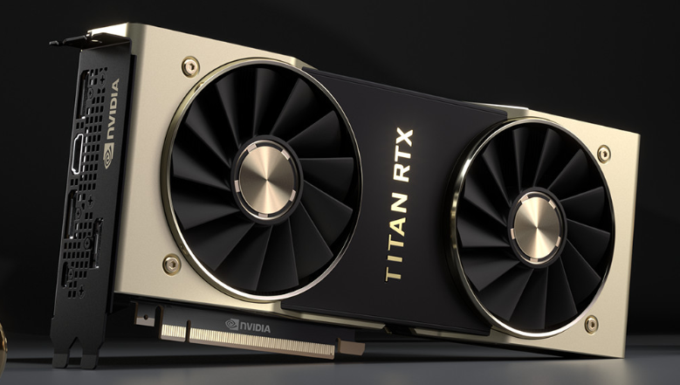
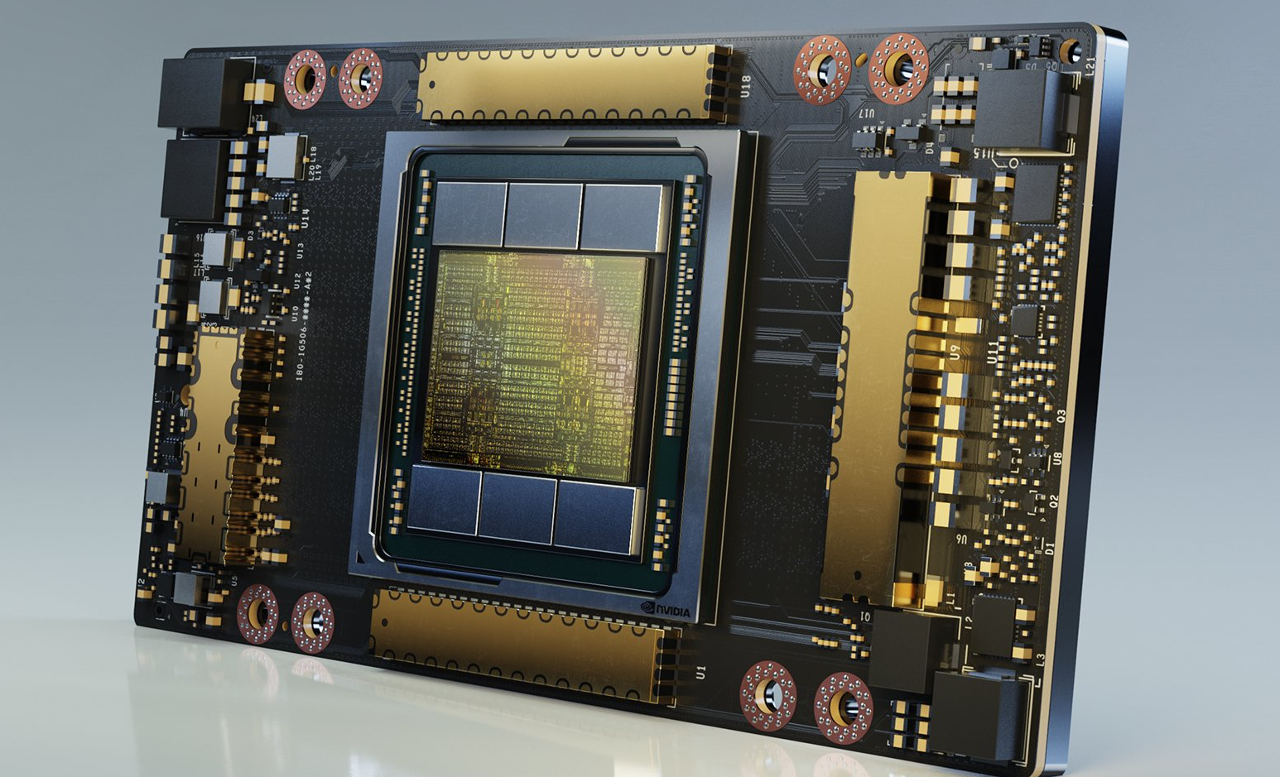
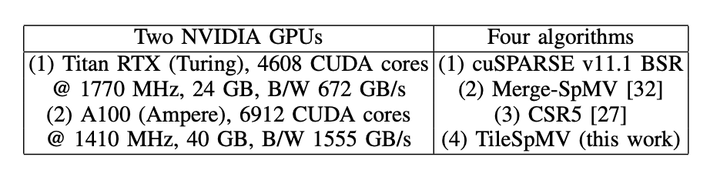
Experimental Setup
Notes:
不同学者有不同分类方法；光滑分层流：流速低时，油水两相间存在光滑界面；波浪分层流：流速增大，油水两相界面出现波浪；带有液滴层的波浪分层流：油水液滴通过界面，界面模糊；油滴分散层-水层流：油相以液滴形式存在于水相顶部；水滴分散层-油层流：水相以液滴形式存在于油相底部；油包水状分散流：油相为连续相，水滴纵向分布于整个管道；水包油状分散流：水相为连续相，油滴纵向分布于整个管道

Slide 34
Effectiveness of Adaptive Format Selection
Even though there are many tiles in the COO format, the non-zero number ratio of COO format is not high relative to COO tiles ratio.
The ratio of tiles in different formats
The ratio of nonzero entries in different formats
Notes:
不同学者有不同分类方法；光滑分层流：流速低时，油水两相间存在光滑界面；波浪分层流：流速增大，油水两相界面出现波浪；带有液滴层的波浪分层流：油水液滴通过界面，界面模糊；油滴分散层-水层流：油相以液滴形式存在于水相顶部；水滴分散层-油层流：水相以液滴形式存在于油相底部；油包水状分散流：油相为连续相，水滴纵向分布于整个管道；水包油状分散流：水相为连续相，油滴纵向分布于整个管道

Slide 35
Effectiveness of Adaptive Format Selection
Even though there are many tiles in the COO format, the non-zero number ratio of COO format is not high relative to COO tiles ratio.
Storing COO data as a tile can be a choice of wasting computational resources.
The ratio of tiles in different formats
The ratio of nonzero entries in different formats
Notes:
不同学者有不同分类方法；光滑分层流：流速低时，油水两相间存在光滑界面；波浪分层流：流速增大，油水两相界面出现波浪；带有液滴层的波浪分层流：油水液滴通过界面，界面模糊；油滴分散层-水层流：油相以液滴形式存在于水相顶部；水滴分散层-油层流：水相以液滴形式存在于油相底部；油包水状分散流：油相为连续相，水滴纵向分布于整个管道；水包油状分散流：水相为连续相，油滴纵向分布于整个管道

Slide 36
Effectiveness of Adaptive Format Selection
After the format selection, the performance of TileSpMV_ADPT can be 6.75x faster than TileSpMV_CSR, and the advantage becomes more obvious as the size of matrices increase.
Notes:
不同学者有不同分类方法；光滑分层流：流速低时，油水两相间存在光滑界面；波浪分层流：流速增大，油水两相界面出现波浪；带有液滴层的波浪分层流：油水液滴通过界面，界面模糊；油滴分散层-水层流：油相以液滴形式存在于水相顶部；水滴分散层-油层流：水相以液滴形式存在于油相底部；油包水状分散流：油相为连续相，水滴纵向分布于整个管道；水包油状分散流：水相为连续相，油滴纵向分布于整个管道

Slide 37
Effectiveness of Adaptive Format Selection
After the format selection, the performance of TileSpMV_ADPT can be 6.75x faster than TileSpMV_CSR, and the advantage becomes more obvious as the size of matrices increase.
When the size is larger than a certain size (1.8M in our work), the advantage of TileSpMV_DeferredCOO begins to become prominent. It further achieves up to 7.02x speedup than TileSpMV_ADPT.
Notes:
不同学者有不同分类方法；光滑分层流：流速低时，油水两相间存在光滑界面；波浪分层流：流速增大，油水两相界面出现波浪；带有液滴层的波浪分层流：油水液滴通过界面，界面模糊；油滴分散层-水层流：油相以液滴形式存在于水相顶部；水滴分散层-油层流：水相以液滴形式存在于油相底部；油包水状分散流：油相为连续相，水滴纵向分布于整个管道；水包油状分散流：水相为连续相，油滴纵向分布于整个管道

Slide 38
Performance Comparison over Existing Work
Compared with these three methods, our method is faster than Merge-SpMV on 1813 matrices, faster than CSR5 on 2040 matrices, and faster than BSR on 1638 matrices, and achieves up to 2.61x, 3.96x and 426.59x over them.
Notes:
不同学者有不同分类方法；光滑分层流：流速低时，油水两相间存在光滑界面；波浪分层流：流速增大，油水两相界面出现波浪；带有液滴层的波浪分层流：油水液滴通过界面，界面模糊；油滴分散层-水层流：油相以液滴形式存在于水相顶部；水滴分散层-油层流：水相以液滴形式存在于油相底部；油包水状分散流：油相为连续相，水滴纵向分布于整个管道；水包油状分散流：水相为连续相，油滴纵向分布于整个管道

Slide 39
Performance Comparison over Existing Work
Compared with these three methods, our method is faster than Merge-SpMV on 1813 matrices, faster than CSR5 on 2040 matrices, and faster than BSR on 1638 matrices, and achieves up to 2.61x, 3.96x and 426.59x over them.
Notes:
不同学者有不同分类方法；光滑分层流：流速低时，油水两相间存在光滑界面；波浪分层流：流速增大，油水两相界面出现波浪；带有液滴层的波浪分层流：油水液滴通过界面，界面模糊；油滴分散层-水层流：油相以液滴形式存在于水相顶部；水滴分散层-油层流：水相以液滴形式存在于油相底部；油包水状分散流：油相为连续相，水滴纵向分布于整个管道；水包油状分散流：水相为连续相，油滴纵向分布于整个管道

Slide 40
Space cost comparison
Compared with the standard CSR format (red line), our TileSpMV_CSR (blue line) basically occupies the same or less memory space on most matrices. But for a small number of matrices, there are obvious higher memory consumption.
Notes:
不同学者有不同分类方法；光滑分层流：流速低时，油水两相间存在光滑界面；波浪分层流：流速增大，油水两相界面出现波浪；带有液滴层的波浪分层流：油水液滴通过界面，界面模糊；油滴分散层-水层流：油相以液滴形式存在于水相顶部；水滴分散层-油层流：水相以液滴形式存在于油相底部；油包水状分散流：油相为连续相，水滴纵向分布于整个管道；水包油状分散流：水相为连续相，油滴纵向分布于整个管道

Slide 41
Space cost comparison
Compared with the standard CSR format (red line), our TileSpMV_CSR (blue line) basically occupies the same or less memory space on most matrices. But for a small number of matrices, there are obvious higher memory consumption.
In TileSpMV_ADPT (green line), the memory footprint is overall improved, although some cases still occupy more space than the CSR format.
Notes:
不同学者有不同分类方法；光滑分层流：流速低时，油水两相间存在光滑界面；波浪分层流：流速增大，油水两相界面出现波浪；带有液滴层的波浪分层流：油水液滴通过界面，界面模糊；油滴分散层-水层流：油相以液滴形式存在于水相顶部；水滴分散层-油层流：水相以液滴形式存在于油相底部；油包水状分散流：油相为连续相，水滴纵向分布于整个管道；水包油状分散流：水相为连续相，油滴纵向分布于整个管道

Slide 42
01
Background & Motivation
02
TileSpMV
Outline
03
Experimental Results
04
Conclusion
Notes:
不同学者有不同分类方法；光滑分层流：流速低时，油水两相间存在光滑界面；波浪分层流：流速增大，油水两相界面出现波浪；带有液滴层的波浪分层流：油水液滴通过界面，界面模糊；油滴分散层-水层流：油相以液滴形式存在于水相顶部；水滴分散层-油层流：水相以液滴形式存在于油相底部；油包水状分散流：油相为连续相，水滴纵向分布于整个管道；水包油状分散流：水相为连续相，油滴纵向分布于整个管道

Slide 43
Conclusion
An efficient tiled algorithm called TileSpMV for parallel SpMV on modern GPUs.
Optimized warp-level SpMV kernels for small sparse matrices represented as sparse tiles.
An adaptive selection method to find the best storage format and kernel for each sparse tile.
Obvious speedups over state-of-the-art SpMV methods on the newest GPUs.
Notes:
不同学者有不同分类方法；光滑分层流：流速低时，油水两相间存在光滑界面；波浪分层流：流速增大，油水两相界面出现波浪；带有液滴层的波浪分层流：油水液滴通过界面，界面模糊；油滴分散层-水层流：油相以液滴形式存在于水相顶部；水滴分散层-油层流：水相以液滴形式存在于油相底部；油包水状分散流：油相为连续相，水滴纵向分布于整个管道；水包油状分散流：水相为连续相，油滴纵向分布于整个管道

Slide 44
Thanks !
TileSpMV: A Tiled Algorithm for Sparse Matrix-Vector Multiplication on GPUs
Thanks!
Contact us: 2019211256@student.cup.edu.cn
Notes:
不同学者有不同分类方法；光滑分层流：流速低时，油水两相间存在光滑界面；波浪分层流：流速增大，油水两相界面出现波浪；带有液滴层的波浪分层流：油水液滴通过界面，界面模糊；油滴分散层-水层流：油相以液滴形式存在于水相顶部；水滴分散层-油层流：水相以液滴形式存在于油相底部；油包水状分散流：油相为连续相，水滴纵向分布于整个管道；水包油状分散流：水相为连续相，油滴纵向分布于整个管道

