Slide 1
PALBBD: A Parallel ArcLength Method Using Bordered Block Diagonal Form for DC Analysis
Zhou Jin¹, Tian Feng¹, Yiru Duan¹, Xiao Wu², Minghou Cheng², Zhenya Zhou² and Weifeng Liu¹
1. Super Scientific Software Laboratory,
Department of Computer Science and Technology, China University of Petroleum-Beijing
2. Huada Empyrean Software Co. Ltd, Beijing
June 24, 2021

Slide 2
Presentation Layout
Background
Motivation
Parallel Arclength Method Using BBD Form
Performance
2
Notes:
更多模板下载地址：http://www.1ppt.com（复制链接到浏览器打开）

Slide 3
Background
01
SPICE-like circuit simulator is used worldwide as an essential computer-aided for circuit designs^{[1]}.
HSPICE
SPECTRE
SmartSpice
SPICE-like Simulators
PSpice A/D
They all use the SPICE simulation algorithm developed by the University of California, Berkeley.
[1]X. Wu, Z. Jin, D. Niu and Y. Inoue, “PTA method using numerical integrationalgorithms with artificial damping for solving nonlinear DC circuits,” IEICE NOLTA, vol.E5-N, No.4, pp. 512–522, Oct. 20
Notes:
SPICE-like circuit simulator is the most widely used computer aided tool for circuit designs. The simulation cores of these software are similar, because they all use the well-known spice simulation algorithm developed by the University of California, Berkeley. And now, SPICE simulator inspires and serves as a basis for many other circuit simulation programs in academia, in industry, and in commercial products.

Slide 4
Motivation
02
For VLSI (Very Large Scale Integration) circuits, the feature size is gradually scaling down but the amount of devices can easily reach several millions especially after parasitic extraction ^{[2]}.
Time consuming !
[2]X. Chen, Y. Wang and H. Yang, “Parallel sparse direct solver for integrated circuit simulation,” Springer International Publishing, 2017.
Notes:
With the rapid increase in design scale and the continuous improvement of design process complexity, especially the rapid increase in the scale of parasitic devices in post-imitation circuits brought about by the complex FinFET process, traditional SPICE simulation tools have encountered unprecedented challenges in functional verification. The first is that the simulation time is too long, and many designs take days or even weeks to run; the second is that the simulation capacity is huge, which has exceeded the processing capacity of traditional simulation tools.

Slide 5
Motivation
02
K. W. Chan, “Parallel algorithms for direct solution of large sparse power system matrix equations,” in IEEE Proceedings - Generation, Transmission and Distribution, vol. 148, no. 6, pp. 615–622, Nov. 2001. | parallel solving linear systems
D. P. Koester, S. Ranka and G. C. Fox, “Parallel block-diagonal-bordered sparse linear solvers for electrical power system applications,” Proceedings of Scalable Parallel Libraries Conference, Mississippi State, MS, USA, pp. 195–203, 1993.
N. Frohlich, B. M. Riess, U. A. Wever and Q. Zheng, “A new approach for parallel simulation of VLSI circuits on a transistor level,” IEEE TCS. I: Fundam. Theory Appl., vol. 45(6), pp. 601—613, 1998. | parallel model evaluation
E .Ikeno and A. Ushida, “The arc-length method for the computation of characteristic curves,” IEEE TCAS, vol. 23(3), pp. 181–183, 1976. | enlarge the Jacobian matrix structure
X. Chen, Y. Wang and H. Yang, “Parallel sparse direct solver for integrated circuit simulation,” Springer International Publishing, 2017. | the number of calculations required continues to increase
Three major challenges:
1. How to solve the DC problem efficiently in parallel?
2. Conventional arclength method needs to enlarge the Jacobian matrix structure. How to provide a good interface to the existing software?
3. How to remove unnecessary calculations?

Slide 6
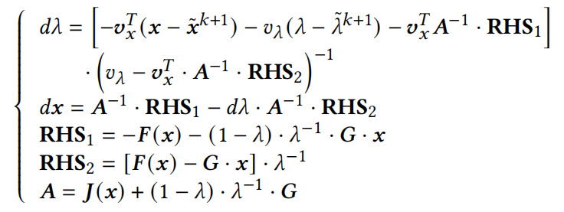
Parallel Arclength Method Using BBD Form
03
Feature 1: proposing a two-step algorithm for DC analysis
the original equation m $×$ m dimension
step 1
Maintain the Jacobian matrix structure!
step 2
NR iteration
m+1 $×$ m+1 dimension

Slide 7
Parallel Arclength Method Using BBD Form
03
Feature 2: parallel computing by using BBD form
The computation tasks of each sub-partition can be done completely in parallel!
B₁
B…
A
B…
B_{k-1}

Slide 8
Parallel Arclength Method Using BBD Form
03
Feature 3: proposing a new bypass strategy
Correction equation:
Notes:
Moreover, we propose a new bypassing strategy with a correction equation to replace the Schur complement and ensure the accuracy. Different from all conventional bypassing approaches, substitution for converged sub-partitions and even part device evaluation for not-converged sub-partitions could also be bypassed in our approach. When internal nodes and external nodes of some subpartitions are stable, these partitions are regarded as convergent and do not need to be updated and calculated. The NR iteration of these partitions can be bypassed in PALBBD, and the remaining not-convergent sub-partitions will continue to iterate until all of them are converged.

Slide 9
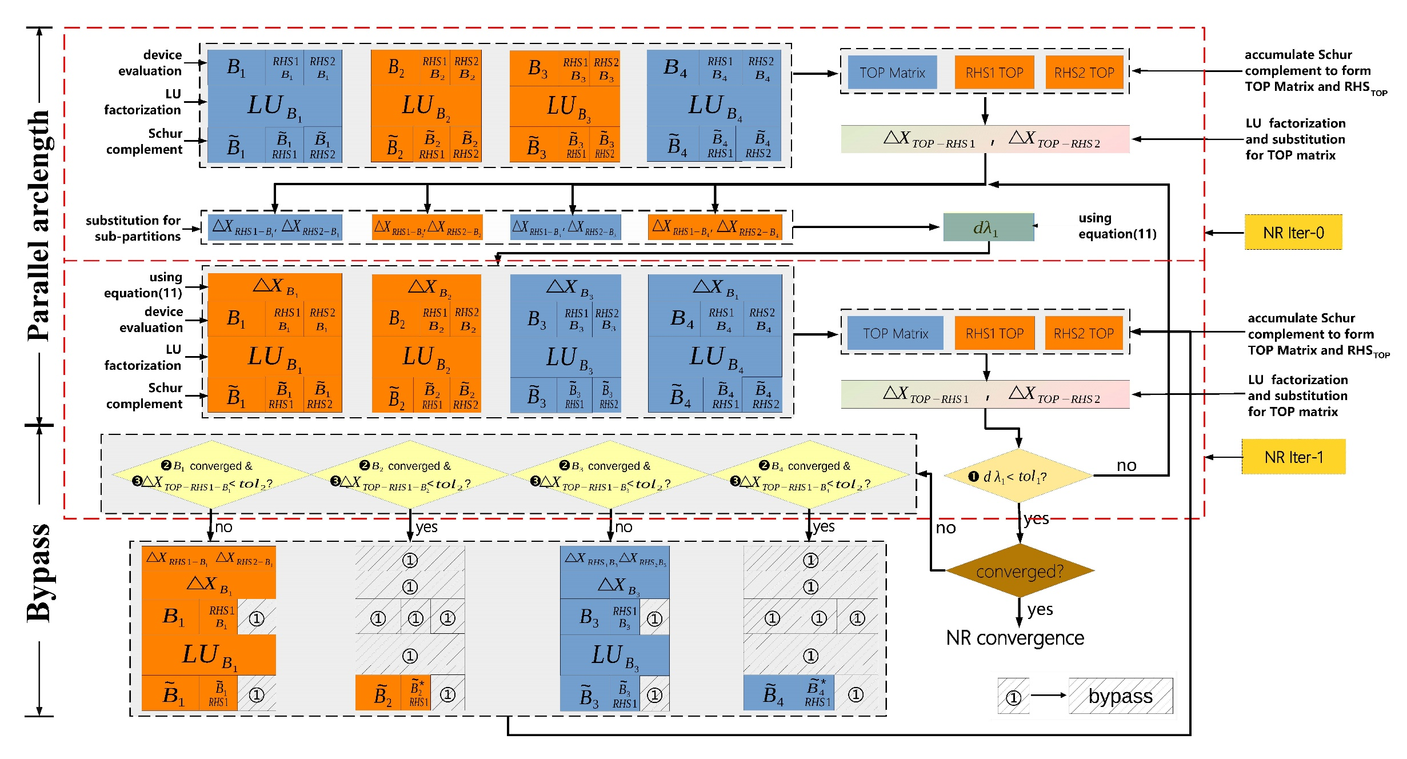
Parallel Arclength Method Using BBD Form
03
Notes:
approximate calculation

Slide 10
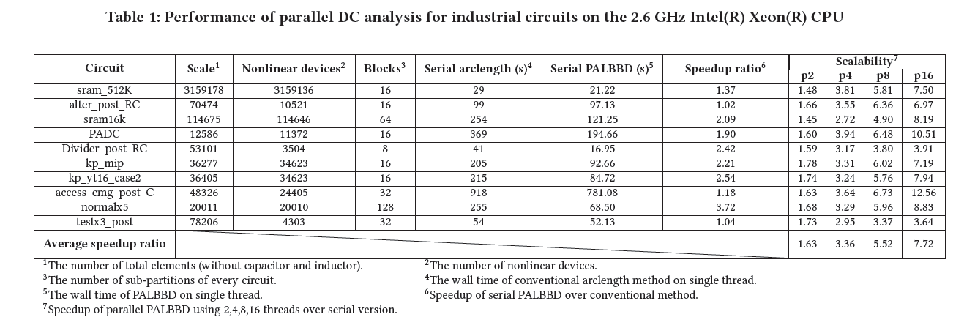
Performance
04
Parallel Speed-up and Scalability
Good speedup and strong scalability!
Notes:
Comparisons are illustrated between a conventional serial arclength method without BBD-form partition and the PALBBD with 1, 2, 4, 8 and 16 threads. Ten real-world circuits are tested, and the speedup ratios are shown in Table 1. The total number of elements vary from 12,586 to 3,159,178 and the average speedup ratio of serial PALBBD over conventional serial arclength method is 1.95X (the maximum speedup ratio is 3.72X). What’s more, the average speed-up ratio of PALBBD on 16 (8, 4, 2) threads over serial version is 7.72X (5.52X, 3.36X, 1.63X) showing strong scalability, while the maximum speedup ratio reaches 12.56X (6.73X, 3.94X, 1.78X).

Slide 11
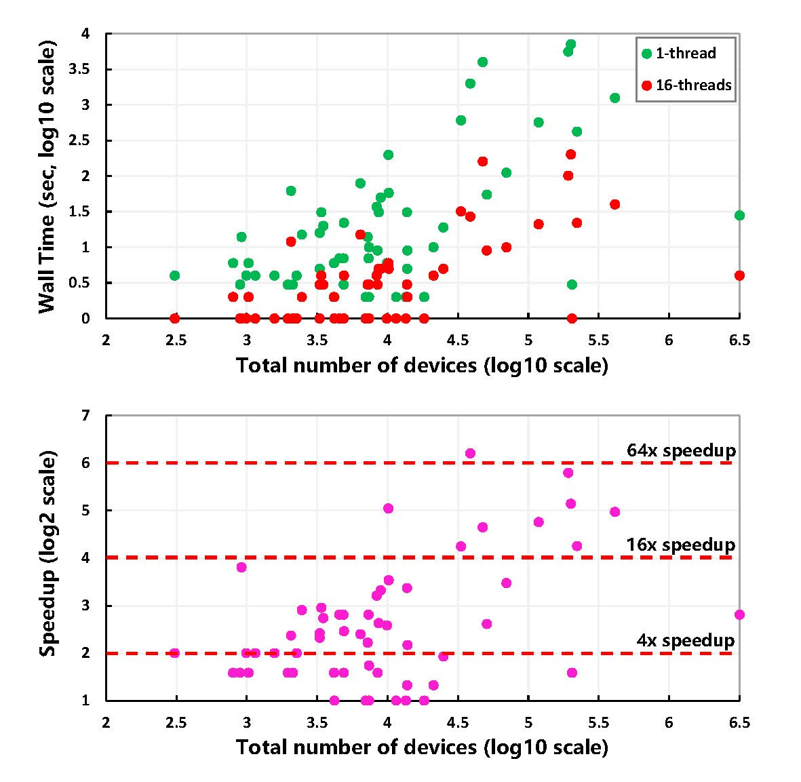
Performance
04
Parallel Speed-up and Scalability
73.93
Efficiency comparison of PALBBD on 16 threads and conventional serial method for 62 large-scale circuits
Good Speed-up!
Notes:
Moreover, another 62 large-scale circuits are also tested and results are shown in Fig. 6, the average (maximum) speedup ratio of PALBBD on 16 threads over conventional serial arclength is 10.2X (73.93X).

Slide 12
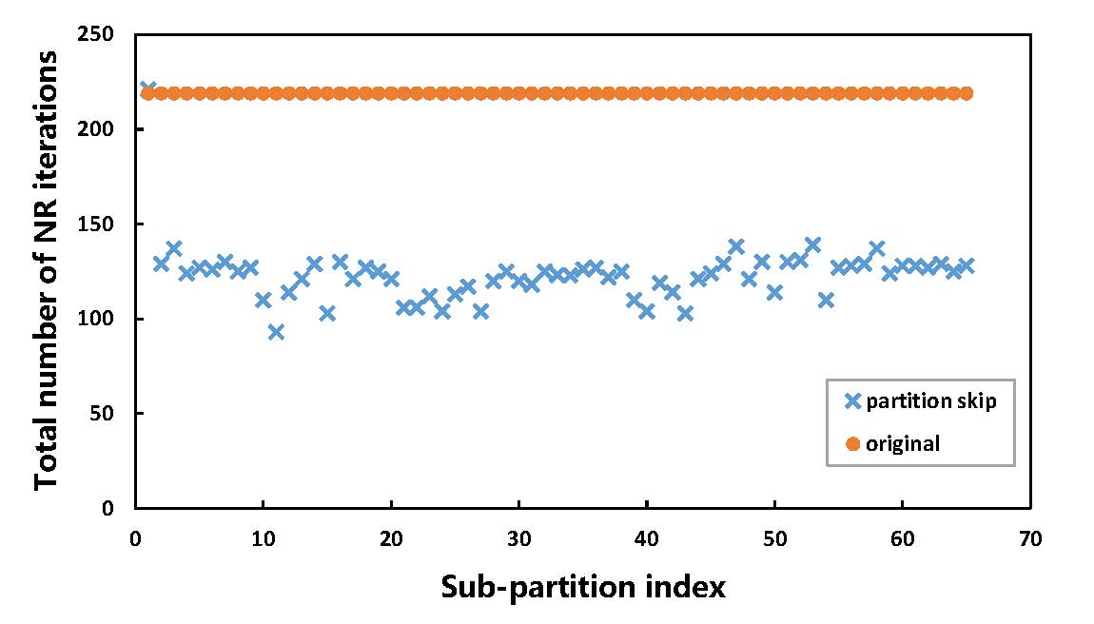
Performance
04
Bypass Efficiency
Comparison of the proposed PALBBD scheme and the conventional scheme on the total NR iteration numbers for each sub-partition using a 512Kx40bit SRAM circuit
Elements:
1151188 resistors
10 diodes
135129 MOSFETS
64 sub-partitions
Converged after 84 arclength iterations
Notes:
A 512Kx40bit SRAM is shown here to demonstrate the accelerating effect of the proposed bypassing method. This circuit has 1151188 resistors, 10 diodes and 135,129 MOSFETs. The circuit is partitioned into 64 sub-partitions. After 84 arclength iterations, the circuit converged to the solution. This figure shows the comparisons of total number of NR iteration steps for each sub-partition between our proposed bypassing scheme and the one without bypassing. As you can see, it almost reduces the number of iterations by half.

Slide 13
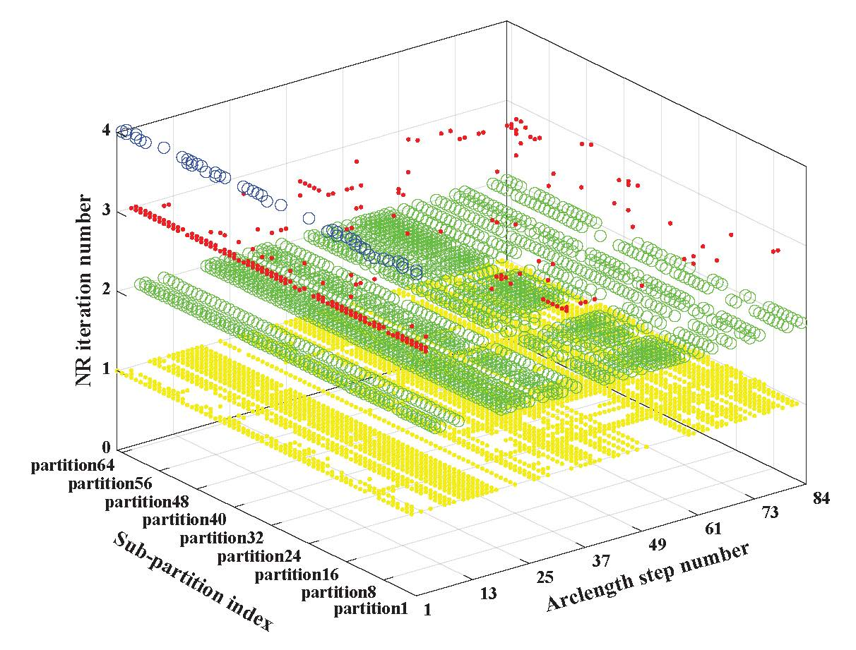
Performance
04
Bypass Efficiency
Comparison of the proposed PALBBD scheme and the conventional scheme on the total NR iteration numbers for each sub-partition using a 512Kx40bit SRAM circuit
Circuits:
the memory
PLL
mixed analog/digital circuits
Average acceleration: 35%
Maximum acceleration: 45%
Elements:
1151188 resistors
10 diodes
135129 MOSFETS
64 sub-partitions
Converged after 84 arclength iterations
Notes:
As shown in Fig. 8, the number of NR iterations for each sub-partition at each arclength step by using the proposed bypassing strategy. The four colors represent those sub-partitions converged after 1, 2, 3 or 4 NR iterations respectively at current arclength step. Many sub-partitions only need 1 or 2 NR iterations at each arclength step such as the yellow and green. The top-partition and a few difficult sub-partitions need 3 or 4 NR iterations. The speedup of the proposed bypassing strategy relies on the type of circuit and the partitioning method. As we tested, the memory, PLL, and some mixed analog/digital circuits can achieve an average acceleration of 35% and a maximum acceleration of 45%.

Slide 14
Thanks for your listening!
Any questions?

