Slide 1
Accelerating Nonlinear DC Circuit Simulation with Reinforcement Learning
Zhou Jin¹, Haojie Pei¹, Yichao Dong², Xiang Jin³, Xiao Wu⁴, Wei W.Xing³ and Dan Niu²
1. Super Scientific Software Laboratory, China University of Petroleum-Beijing
2. School of Automation, Southeast University
3. Beihang University
4.Huada Empyrean Software Co. Ltd

Slide 2
Outline
Background
Motivation
Two-stage framework to accelerating DC analysis
Initial parameters prediction with active learning
Reinforcement learning for time stepping in numerical integration
Performance
Conclusions

Slide 3
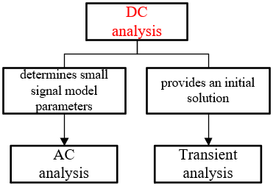
01 Background
DC analysis for transistor-level circuit simulation
Along with the relentless semiconductor scaling and ever increasing device integration, transistor-level circuit simulation is one of the most widely used and also most important EDA tools for integrated circuit design and verification.
Direct current (DC) analysis, which locates DC operating points, is an important step to evaluate integrated circuits and is performed prior to any other analysis in SPICE-like transistor-level circuit simulators.

Slide 4
01 Background
PTA(Pseudo Transient Analysis) is the currently most powerful and promising continuation approach to deal with the non-convergence in DC analysis caused by discontinuity and strong non-linearity.
What is Pseudo-Transient Analysis(PTA) Solver?
Original Circuit
Pseudo Circuit
PTA Solution
DC Solution
Insert pseudo elements
Nonlinear algebraic equations
Ordinary differential equations
C, L
Form ODE system
Solve ODE system
Transient analysis with initial solution $x^{0}$
Same solution
Numerical integration
Steady state
Non-Convergence and time-consuming
Notes:
Despite the quick advancements in PTA methods for DC analysis, the gains from many prior heuristics quickly fall behind the demands of simulations because of growth of device non-linearity and number of parasitics.

Slide 5
02 Motivation
Zhou Jin, Meiping Liu, Xiao Wu. An adaptive dynamic-element PTA method for solving nonlinear DC operating point of transistor circuits [C]//2018 IEEE 61st International Midwest Symposium on Circuits and Systems (MWSCAS). IEEE, 2018: 37-40. | Dynamic value for pseudo elements
Wu X, Jin Z, Niu D, et al. An adaptive time-step control method in damped pseudo-transient analysis for solving nonlinear DC circuit equations[J]. IEICE Transactions on Fundamentals of Electronics, Communications and Computer Sciences, 2017, 100(2): 619-628. | Stepping strategy for PTA
Wu X, Jin Z, Niu D, et al. A PTA method using numerical integration algorithms with artificial damping for solving nonlinear DC circuits[J]. Nonlinear Theory and Its Applications, IEICE, 2014, 5(4): 512-522.
Two challenges remain the main obstacles for applications of PTA methods:
How to set optimally initial parameters for given circuit?
How to choose optimal stepping strategy for different circuits?

Slide 6
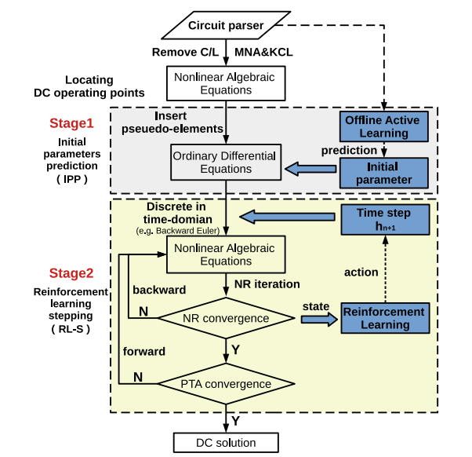
03 Two-stage framework to accelerating DC analysis
Two-stage framework for DC analysis
Challenge1: How to set optimally initial parameters
First stage, we implement an offline active learning with online prediction to provide a solver with fine initial parameters, which forms a fine environment for our RL setup.
Challenge2: How to choose optimal stepping strategy
Second stage, we propose an RL scheme to accelerate PTA iterative process with TD3 actor-critic agents.

Slide 7
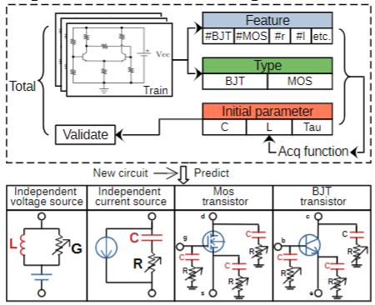
03 Initial parameters prediction with active learning
Bayesian Active Learning
We aim to seek a function:
$$z^{∗}\left(ξ\right)={argmin}_{z∈X}η(z,ξ)$$
Where $z^{∗}(ξ)$is the optimal PTA solver parameters for any given netlist $ξ$, and $X$ is the feasible domain for $z$.
Offline Training
$$z^{∗}\left(ξ\right)={argmin}_{z∈X}η(z,ξ)$$
Online Predicting
where 𝜂 is a surrogate model approximating 𝜂 based on data D
Notes:
Note that this is not an optimization problem because we are not allowed to run 𝜂(z, 𝝃 ) for an unseen circuit. Instead, our goal is to find the mapping z∗ (𝝃 ), which is
a straightforward supervised learning problem given that we have
sufficient data

Slide 8
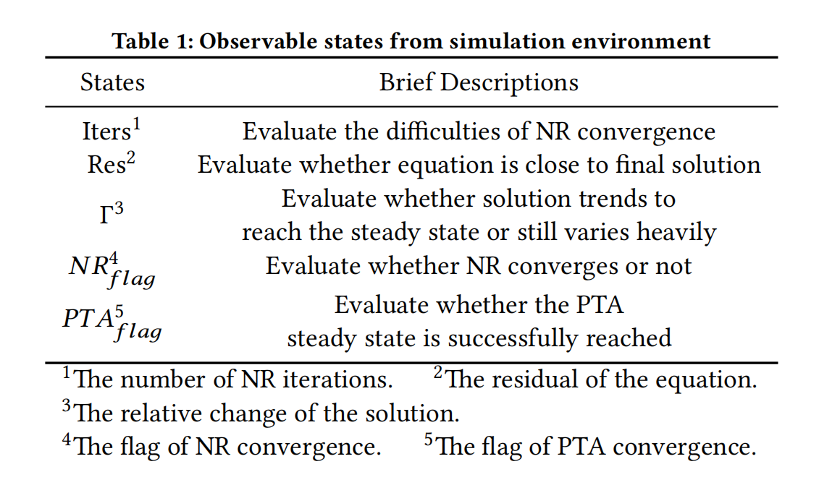
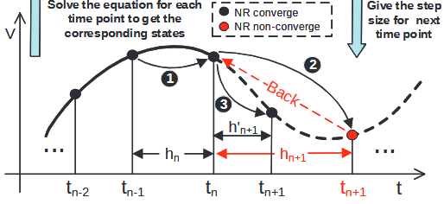
03 Reinforcement learning stepping in numerical integration
TD3-based Reinforcement Learning
Markov-like properties
Mapping PTA into MDP!
$$A_{t_{n−1}}$$
$$S_{t_{n−1}}$$
$$S_{t_{n}}$$
Notes:
Considering the whole simula
tion as the environment, aiming at fast convergence, RL-S explores
a fast stepping strategy so that the ODE system reaches the steady
state sufficiently fast. Regarding the iterative solution trace process
of PTA as MDPs, at each time-point 𝑡𝑛, we can get a simulation
state 𝑆𝑛, defined by the number of NR iterations, residual of equa
tion 𝑭 (𝒙), relative change of solution compared with previous step
and two flags to demonstrate the convergence performance of NR it
erations and PTA iterations, respectively, as shown in Table. 1. Such
simulation state could help evaluate wheather the simulation trends
to convergence gradually or not, representing a “convergence dis
tance”. Then an action 𝑎 is determined by an actor network to give a
time-step size ℎ𝑛+1 for next time-point iteration as shown in Fig.3. Considering sufficiently fast convergence is our final goal, any
action leads to better simulation state, defined as better trends to fi
nal solution, deserves higher reward. The most powerful indicator of
circuit simulation strategy is the time spent in simulation.

Slide 9
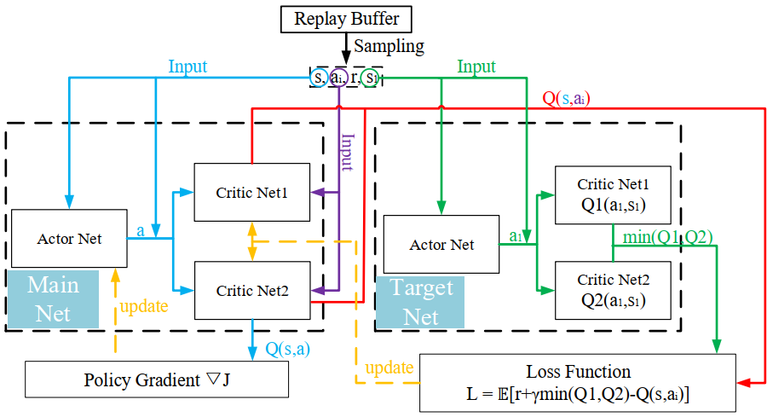
03 Accelerating DC analysis with reinforcement learning
TD3-based Reinforcement Learning
TD3
We choose Actor-Critic based TD3 algorithm as reinforcement learning model to achieve this goal.
Among the numerous reinforcement learning algorithms, TD3 demonstrates a more stable and smooth performance for training.

Slide 10
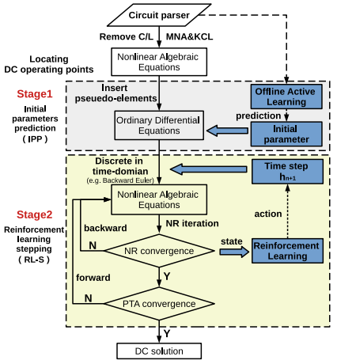
03 Accelerating DC analysis with reinforcement learning
TD3-based Reinforcement Learning
However, three sub-challenges are needed to resolve.
Set optimally
initial parameters
Sub-challenge | Reason | Solution
Samples are unbalanced | Simulation feature | Dual agents
Samples become sparse | Dual agents | Collaborative learning
Network converges slow | Insufficient utilization of key samples | Priority sampling

Slide 11
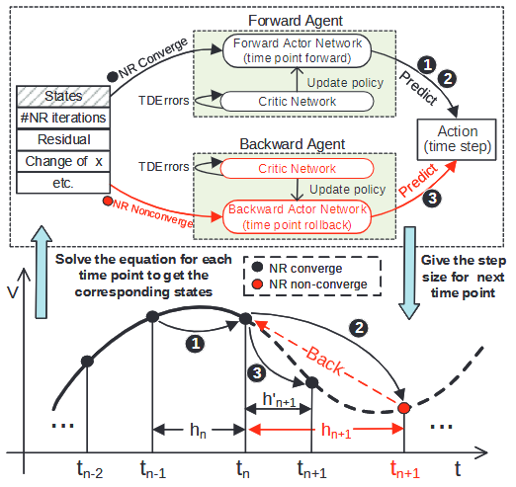
03 Accelerating DC analysis with reinforcement learning
Dual agents for forward/backward stepping
samples are unbalanced
During simulation, most training data are collected from the converged phase with larger time steps. However, in a few cases, small step size is required to ensure its convergence, i.e. circuits with high loop gain. Unfortunately, it happens to be very limited.
v

Slide 12
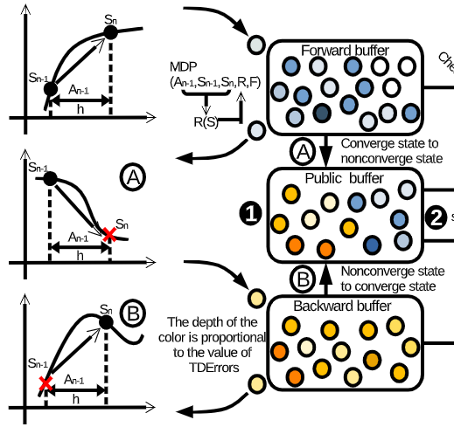
03 Accelerating DC analysis with reinforcement learning
Collaborative learning via public sample buffer
Due to dual agents, samples become sparse
Forward agent
Converge state
v
Forward agent
Non-converge state
The dual agents mentioned in the previous section can improve the professionalism of handling different circumstances, but also dilute the sample buffer since it divided the past experiences into two parts.
We found that this experience that forward agent causes the convergence failure of next NR iteration could also benefit the backward agent, which makes it more radically shorten the original step size to avoid such kind of low reward action.
Back agent
Converge state
Fortunately
Forward agent
Non-converge state

Slide 13
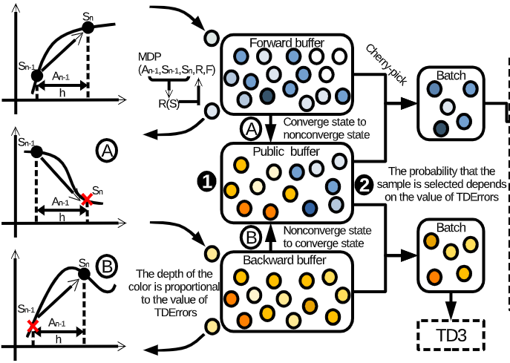
03 Accelerating DC analysis with reinforcement learning
Priority sampling for fast convergence
The convergence speed of the model during online training is critic.
For the gradient update of the Critic network and the Actor network in the TD3 algorithm, larger TD error (Temporal-Difference error) will contribute more for the Critic network update.
v
Notes:
inefficient utilization of key samples
network converges slow
Solution3: priority sampling

Slide 14
04 Performance
Initial Parameters Prediction(IPP)
Training data: 43 circuits from benchmark suite
7 practical circuits (including two MOS circuits and five bipolar junction transistor circuits) are tested
Simulation efficiency of initial parameters prediction.(# of NR)
Steady 1.5X-3X speedup!
Convergence improvement
A steady 1.5X-3X NR iterations speedup without performance degradation
IPP can make non-convergence case converge

Slide 15
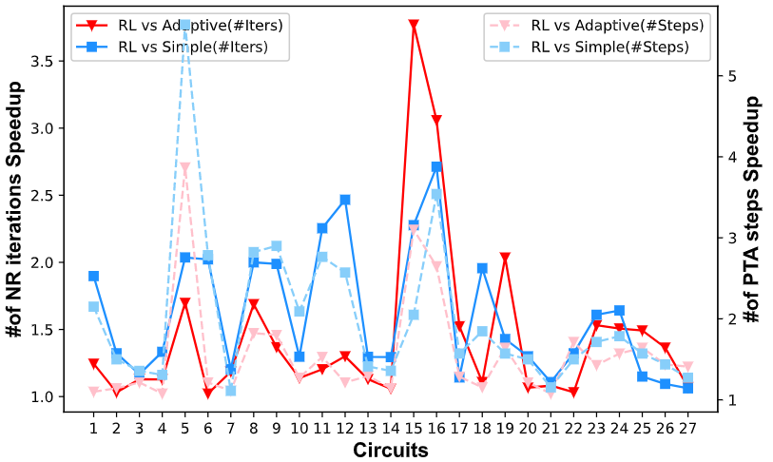
04 Performance
Reinforcement Learning Stepping(RL-S) under CEPTA
Compared with adaptive stepping (widely used SOTA PTA stepping) and the simple stepping, RL-S scheme consistently outperforms adaptive stepping up to 3.77X and simple stepping 2.71X in terms of NR iterations in CEPTA.
Similar speedups are observed for the numbers of PTA steps, indicating that our RL-S method can achieve both inter- and outer-NR loops speedup and will not cause degeneration.

Slide 16
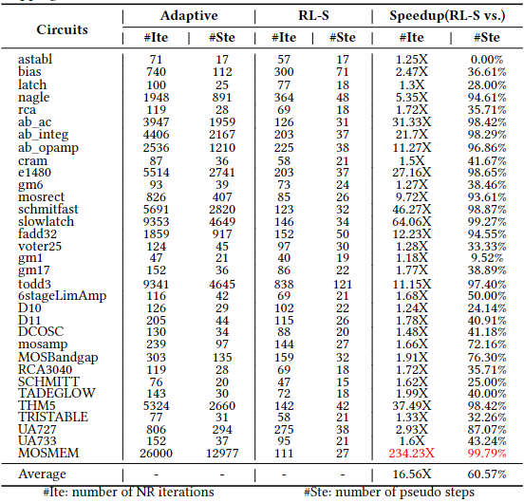
04 Performance
Reinforcement Learning Stepping(RL-S) under DPTA
RL-S is compatible to all kinds of PTA solver.
The RL-DPTA demonstrated 16.56X speedup in average while achieved 234.23X maximum compared with SOTA DPTA with adaptive stepping strategy.
Compared with CEPTA (where discontinuity may occur), DPTA ensures continuity and has a smoother solution curve, which shows better applicability with RL-S.

Slide 17
05 Conclusions
A two-stage machine learning enhanced framework is proposed for accelerating DC analysis of transistor-level nonlinear circuit simulation.
An initial parameter prediction model using active learning is proposed to form better a better ODE system for PTA solver.
A deep reinforcement learning approach based on TD3 is proposed for time step size controlling in numerical integration while solving the ODE system.
Simulation efficiency is demonstrated compared with SOTA CEPTA and DPTA methods.

Slide 18
Thanks for your listening!
Any questions?

