Slide 1
CoGNN: Efficient Scheduling for Concurrent GNN Training on GPUs
Qingxiao Sun¹, Yi Liu¹, Hailong Yang¹, Ruizhe Zhang¹, Ming Dun¹, Mingzhen Li¹, Xiaoyan Liu¹,
Wencong Xiao², Yong Li², Zhongzhi Luan¹, Depei Qian¹
School of Computer Science and Engineering, Beihang University¹
Unaffiliated²
Notes:
Hello, everyone. Sorry to present our work remotely. I am Qingxiao Sun from Beihang University. Now, I will introduce our work, CoGNN: Efficient Scheduling for Concurrent GNN Training on GPUs.

Slide 2
Outline
Background & Motivation
Graph Neural Network & GNN Computational Patterns
GPU Sharing for Deep Learning Tasks
Observations on GNN Computations
Design & Methods
Task Management & Memory Consumption Estimation
Scheduling Policies & Implementation Details
Evaluation
Experiment Setup
Performance Analysis
Related Work
Conclusion
Notes:
The presentation is organized as 5 sections. Firstly, I will introduce the background and motivation. And then, I will present our design and methods. After that, I will present the evaluation results. Finally, I will show some related works and make a conclusion.

Slide 3
Outline
Background & Motivation
Graph Neural Network & GNN Computational Patterns
GPU Sharing for Deep Learning Tasks
Observations on GNN Computations
Design & Methods
Task Management & Memory Consumption Estimation
Scheduling Policies & Implementation Details
Evaluation
Experiment Setup
Performance Analysis
Related Work
Conclusion
Notes:
Next, I will present the background and motivation, including introduction to graph neural networks and GNN computational patterns, also GPU sharing for deep learning tasks, and observations on GNN computations.

Slide 4
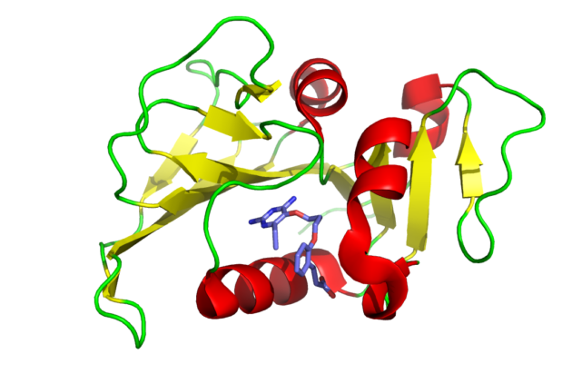
Graph Neural Network
Medical Diagnosis
Biochemistry
Machine Translation
Recommendation System
Graph Neural Network
GCNConv
GCNConv
Graph
Adjacent matrix
Output probabilities
GCN Equation
ReLU
…
ReLU
$$X^{k+1}=σ(\hat{A}X^{k}W^{k})$$
…
…
GNNs are widely adopted in graph-based prediction tasks due to the powerful node representation
GNN takes graph-structured data as input, where each node is associated with a feature vector
Notes:
Graph neural networks are widely adopted graph-based prediction tasks due to the powerful node representation, such as medical diagnosis, biochemistry, machine translation and recommendation system.
Unlike dense objects (such as image and text) handled by traditional deep learning models, GNN takes graph-structured data as input, where each node is associated with a feature vector. Edges between nodes indicate the graph topology.
This figure shows an example of graph convolution network for node classification. GCN alleviates the problem of overfitting on local neighborhood structures for graphs. GCN with sum reduction can be abstracted as the equation in the right, where X is the feature matrix, W is the weight matrix, and A is the adjacency matrix.
The equations of other popular GNNs (such as SAGE, GAT, GIN) can be found in our paper.

Slide 5
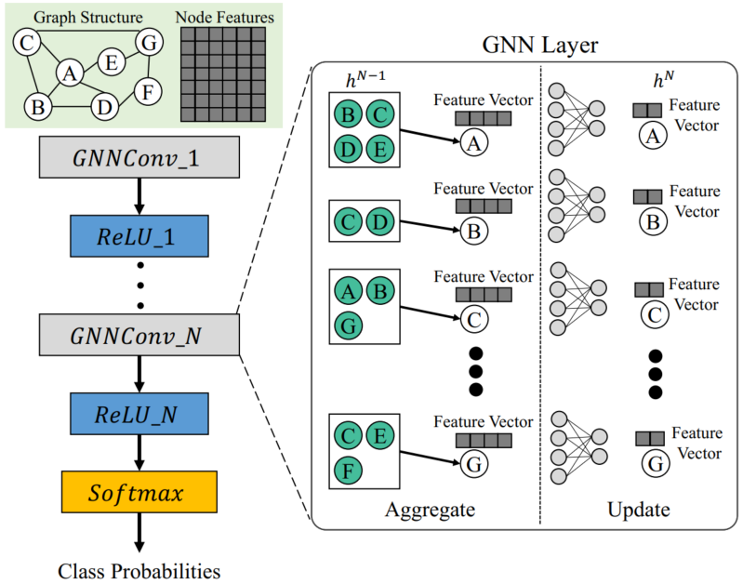
GNN Computational Patterns
Graph structure
PyG
C
A
Edge list
Generate messages
B
D
1
1
1
2
2
2
3
3
4
4
2
3
4
1
3
4
1
2
1
2
Reduce
Feature vector
Src
Fetch from feature matrix
Reduce
Dst
DGL
A GNN layer typically consists of two phases that combine graph operations and neural computations
GNN Frameworks: ① DGL fetches data from the feature matrix and then performs reduction with SpMM-like operations to update the node features simultaneously; ② PyG explicitly generates messages on all edges via MessagePassing and then performs separate reductions
Both PyG and DGL have their limitations in fully utilizing GPU (e.g., low access efficiency and computation stalls). To overcome this, the co-location mechanism of GNN training tasks can be exploited to maximize GPU throughput.
Notes:
A GNN layer typically consists of two phases that combine graph operations and neural computations. Popular GNN frameworks process graph operations according to the graph structure, where an edge indicates data transfer. DGL employs node-wise parallelization with a central-neighbor pattern. It fetches data from the feature matrix and then performs reduction with SpMM-like operations to update the node features simultaneously. PyG employs edge-wise parallelization with the MessagePassing abstraction. It explicitly generates messages on all edges via MessagePassing and then performs separate reductions.
However, Both DGL and PyG are limited by insufficient utilization of GPU computation resources. DGL achieves low memory access efficiency because of the irregularity of the graph structure. PyG improves memory efficiency by implementing separate updates of nodes through aggregation kernels, but the time-consuming data movements cause computation stalls.
To overcome this, the co-location mechanism of GNN training tasks can be exploited to maximize GPU throughput.

Slide 6
GPU Sharing for Deep Learning
Temporal sharing dedicating GPU memory and cores to a single execution of a specific duration, thereby reducing latency by overlapping data preprocessing and computations
Coarse-grained time slicing and static memory partitioning by Gandiva [OSDI’18], pipelined model transfers and active-standby workers by PipeSwitch [OSDI’20], etc.
Limitations: 1) not improving training throughput; 2) idle resources for a long time.
Spatial sharing can provide higher training throughput on GPU by concurrent execution
Salus [MLSys’20] designs scheduling strategies via fast job switching and memory sharing; Zico [ATC’21] overlaps the execution of concurrent tasks according to the cyclic patterns.
Limitations: 1) require data of all models preloaded; 2) only support pairwise co-location.
The above mechanisms fail to consider the impact of irregular graphs on memory consumption. In addition, to support the co-location of massive training tasks (e.g., hyper-parameter tuning), it is necessary to combine temporal sharing and spatial sharing to achieve more efficient scheduling strategies on GPUs.
Notes:
Existing works propose mechanisms based on temporal or spatial sharing to achieve co-location of deep learning tasks on GPUs. Temporal sharing dedicating GPU memory and cores to a single execution of a specific duration, thereby reducing latency by overlapping data preprocessing and computations. However, temporal sharing can hardly improve the training throughput on GPU, where the computation resources still tend to be idle for a long time.
Spatial sharing can provide higher training throughput on GPU by concurrent execution, where the representative works include Salus and Zico. However, Salus requires data of all models preloaded to GPU, thus restricting temporal sharing opportunities. Zico only supports pairwise co-location and cannot handle massive tasks.
The above mechanisms fail to consider the impact of irregular graphs on memory consumption. In addition, to support the co-location of massive training tasks (e.g., hyper-parameter tuning), it is necessary to combine temporal sharing and spatial sharing to achieve more efficient scheduling strategies on GPUs.

Slide 7
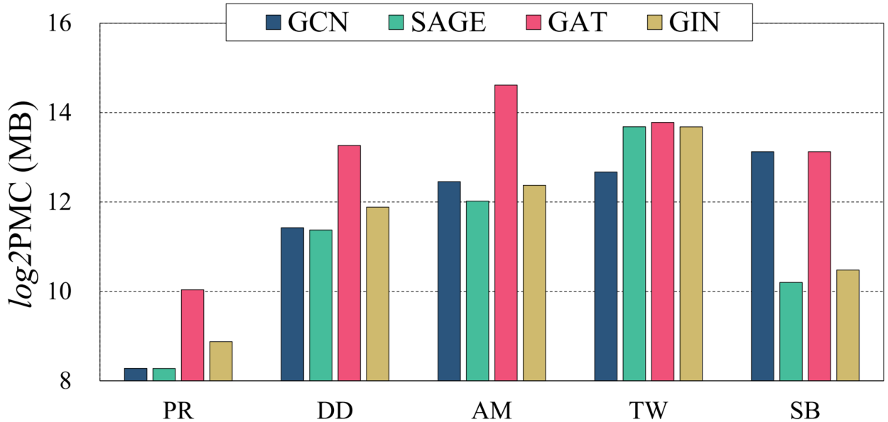
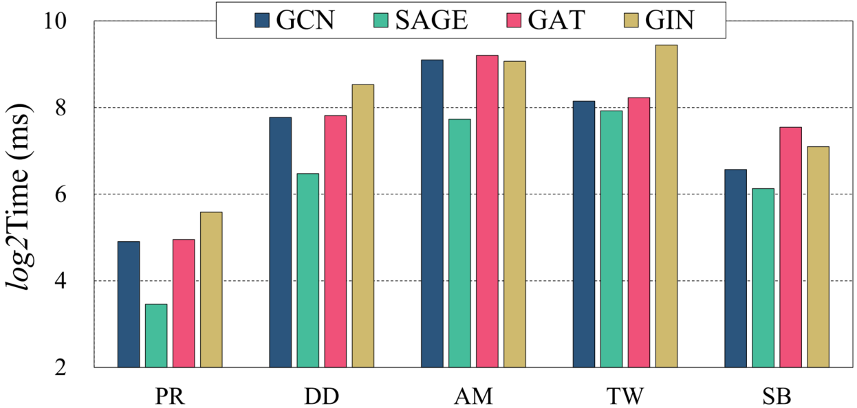
Performance Impact of Graph Input
Peak memory consumption (PMC)
Per-epoch execution time
GNN training can be regarded as input-sensitive, whose working set size and
execution time are closely related to the graph input.
Even with the same model, there is a large discrepancy (30.7×) in PMCs with different datasets
The irregularities of the input graphs may exponentially increase (18.5×) the per-epoch training time
Notes:
These figures show the peak memory consumption and per-epoch time of GNN training with different datasets. As seen, even with the same model structure, there is a large discrepancy in PMCs with different datasets, 30.7× on average. In addition, the irregularities of the input graphs may exponentially increase the per-epoch training time, 18.5× on average.
The results indicate that GNN training can be regarded as input-sensitive, whose working set size and execution time are closely related to the graph input.

Slide 8
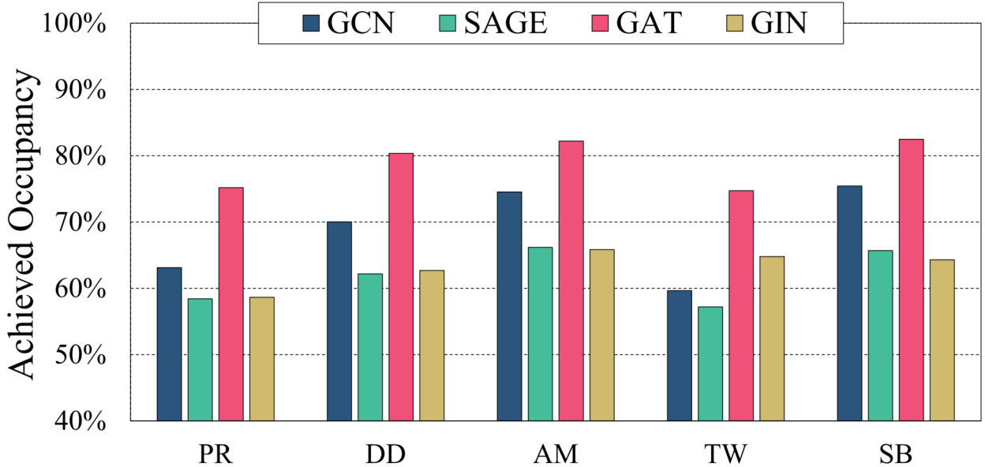
Low GPU Utilization for GNN Training
Achieved occupancy of GNN training with different datasets on GPU
The achieved occupancies of GCN, SAGE, GAT, and GIN are 68.6%, 61.9%, 79.0%, and 63.3%
The fully connected layers involved in GAT elevate the low utilization of graph operations
Except for optimizing a single GNN task, concurrently training multiple GNN tasks on a single GPU is also a promising direction to improve GPU utilization.
Notes:
This figure shows the achieved occupancy of GNN training with different datasets on GPU. As seen, the achieved occupancies of GCN, SAGE, GAT, and GIN are 68.6%, 61.9%, 79.0%, and 63.3%. For GAT, although the introduction of fully connected layers to compute the attention coefficients results the relative high occupancy, it still maintains a low occupancy compared to traditional DNN training.
The results indicate that except for optimizing a single GNN task, concurrently training multiple GNN tasks on a single GPU is also a promising direction to improve GPU utilization.

Slide 9
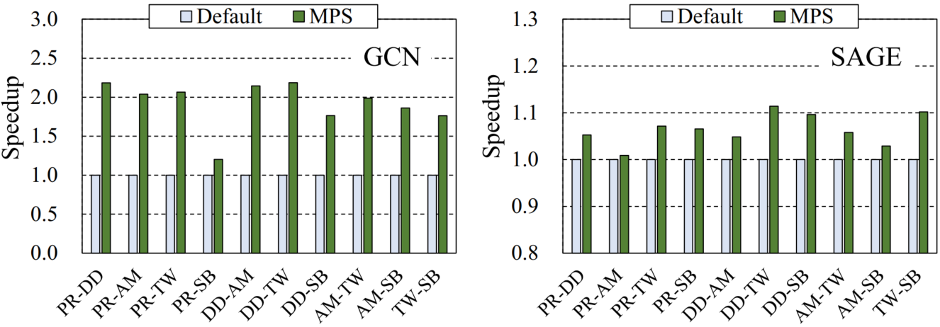
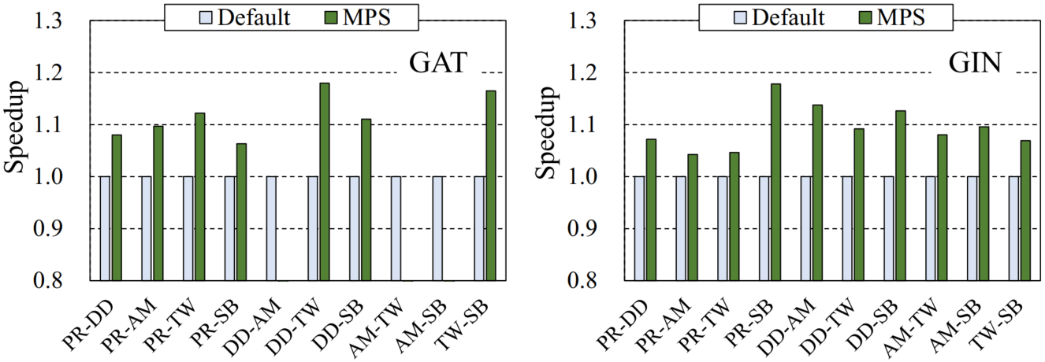
Opportunity and Challenge for Concurrent Training
GNN training performance of MPS normalized to that of default mode (Default) on GPU
MPS achieves average speedups of 1.92×, 1.06×, and 1.09× for GCN, SAGE, and GIN over Default
DD-AM, AM-TW, and TW-SB of GAT obtain an average of 9.87× slowdown due to UVM overhead
MPS might suffer from memory oversubscription due to UVM overhead. Estimating the PMCs in advance is necessary for enabling concurrent training tasks.
Notes:
This figure shows GNN training performance of MPS normalized to that of default mode on GPU. As seen, MPS achieves average speedups of 1.92×, 1.06×, and 1.09× for GCN, SAGE, and GIN over Default. However, DD-AM, AM-TW, and TW-SB of GAT obtain an average of 9.87× slowdown due to UVM overhead.
Further, MPS still has highly frequent tensor allocations and deallocations, thus deteriorating the training performance. In addition, MPS might suffer from memory oversubscription due to UVM overhead. Therefore, estimating the PMCs in advance is necessary for enabling concurrent training tasks.

Slide 10
Outline
Background & Motivation
Graph Neural Network & GNN Computational Patterns
GPU Sharing for Deep Learning Tasks
Observations on GNN Computations
Design & Methods
Task Management & Memory Consumption Estimation
Scheduling Policies & Implementation Details
Evaluation
Experiment Setup
Performance Analysis
Related Work
Conclusion
Notes:
Next, I will present our design and methods, including task management mechanism, memory consumption estimation, scheduling policies, and implementation details.

Slide 11
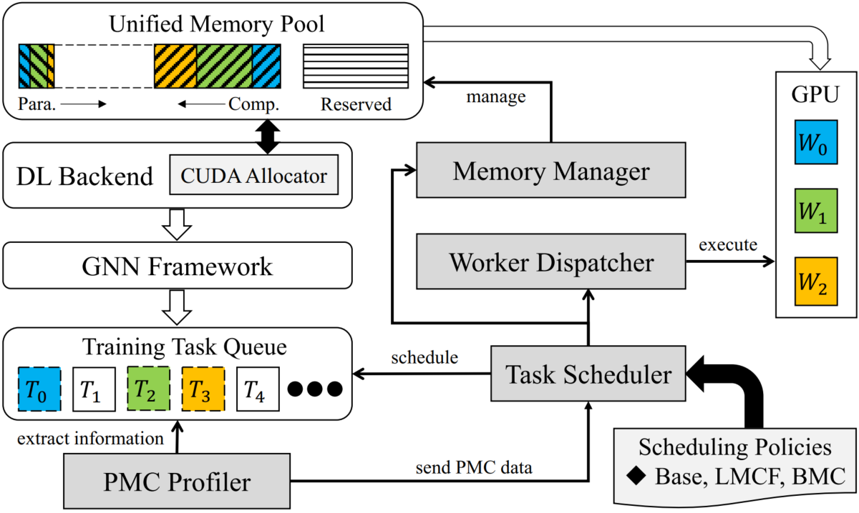
Design Overview
Memory manager: maintains a unified memory pool and allocates memory on demand
PMC profiler: extracts runtime information to estimate the memory consumption of tasks
Task scheduler: determines the grouping and task execution order according to the scheduling policies (Base, MLCF and BMC)
Worker dispatcher: binds the training tasks to the specific workers and returns the results after execution
CoGNN combines spatial sharing and temporal sharing for more flexible task management. On the other hand, CoGNN designs various scheduling policies to reduce makespan, job completion time (JCT) or queuing time (QT).
Notes:
This figure shows the design overview of CoGNN. The CoGNN consists of four important components, including memory manager, PMC profiler, task scheduler, and worker dispatcher. The memory manager maintains a unified memory pool and allocates memory on demand. The PMC profiler extracts runtime information to estimate the memory consumption of training tasks. The task scheduler determines the grouping and task execution order according to the scheduling policies, where the task groups are submitted to GPU in a temporal-sharing manner. The worker dispatcher binds the training tasks to the specific workers and returns the results after execution, where the workers execute tasks within a group in a spatial-sharing manner.
Note that CoGNN combines spatial sharing and temporal sharing for more flexible task management. On the other hand, CoGNN designs various scheduling policies to reduce makespan, job completion time (JCT) or queuing time (QT).

Slide 12
Task Management Mechanism
Unified Memory Pool
Reserved memory: stores framework-internal data such as CUDA context and model workspace
Para. buffer: stores persistent tensors such as weights and biases, whose dimensions are known after model loading
Comp. buffer: stores tensors produced at task runtime such as layer outputs
Para. buffer
Allocated
Comp. buffer
Reserved
Task Queue
group
advance to next group
Insert comp. buffers
Dispatch workers
overlap
Insert para. buffers
Transmit para.
synchronize
Execute tasks
Return results
Clear buffers
CoGNN creates two processes that handle computation and parameter-related operations:
1) inserts computation buffers into allocated memory and dispatches workers for computations
2) inserts parameter buffers from the opposite end and conducts the H2D parameter transmission
CoGNN overlaps the processes to improve pipelining efficiency. After returning the training results, CoGNN clears all buffers and advances to the next group.
Notes:
The key to spatial sharing of concurrent tasks lies in the fine-grained management of GPU memory. In view of the characteristics of DL tasks, we partition the memory pool into reserved memory and allocated memory. The reserved memory stores framework-internal data such as CUDA context and model workspace, typically pre-allocated before task execution. The CoGNN inserts parameter buffers and computation buffers from both ends of the allocated memory to ensure full occupancy. Parameter buffer stores persistent tensors such as weights and biases, whose dimensions are known after model loading. Computation buffer stores tensors produced at task runtime such as layer outputs.
This figure shows the overall workflow of task management. CoGNN creates two processes, where one process inserts computation buffers into allocated memory and dispatches workers for computations, another process inserts parameter buffers from the opposite end and conducts the H2D parameter transmission.
CoGNN overlaps the processes to improve pipelining efficiency. After returning the training results, CoGNN clears all buffers and advances to the next group.

Slide 13
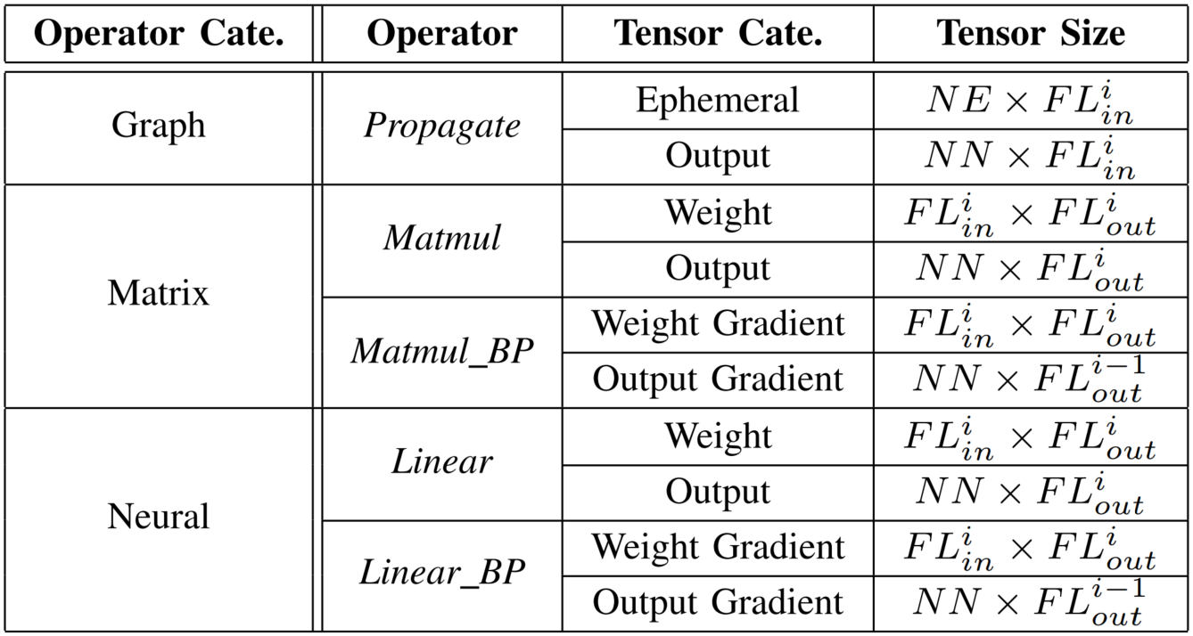
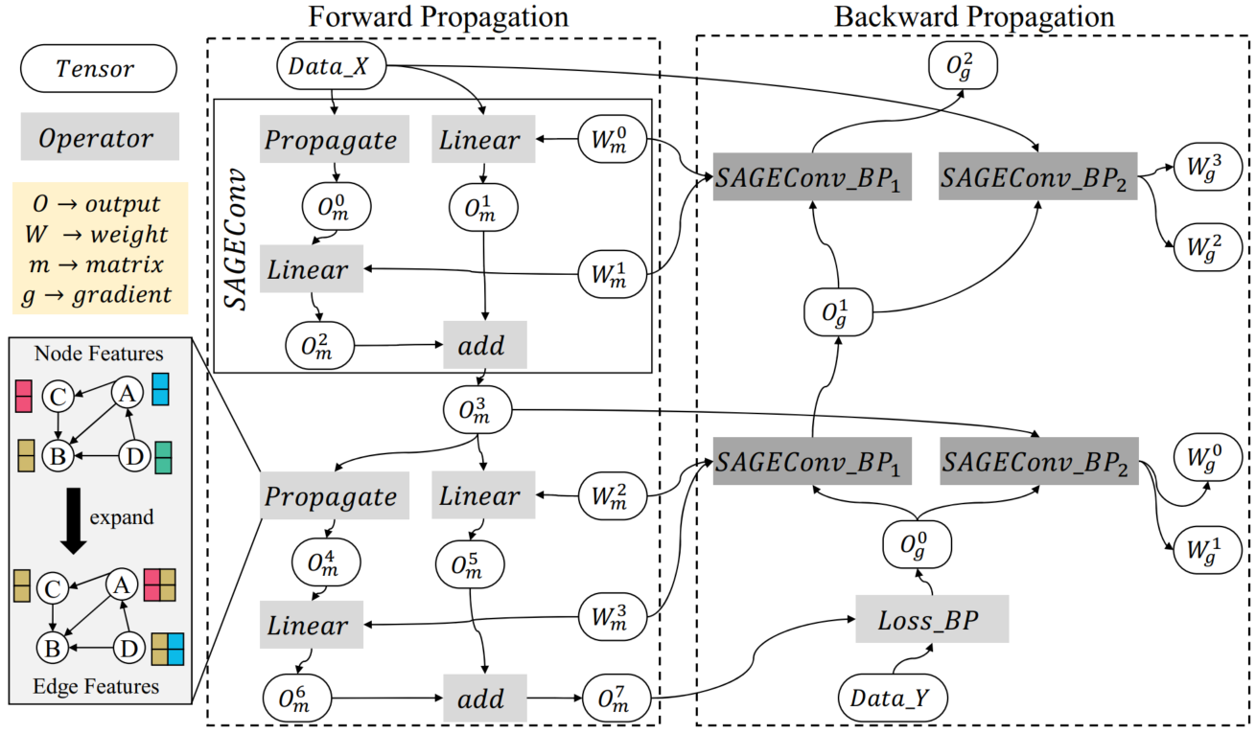
Memory Consumption Estimation
Allocated tensors and their sizes
DAG for training a two-layer SAGE model
Memory cost function (MCF)
Estimating GPU memory consumption can be formalized as the memory required for each operator (deduced by MCF) on the computation graph according to the topological traversal
The MCFs return allocated tensors with category and shape (deduced by the input dimension)
CoGNN can be easily adapted to other GNNs by modifying the computation graph or introducing MCFs. Refer to our paper for more details.
Notes:
We formulate the computation graph of GNN training as a DAG, where each node is an operator representing a mathematical invocation, and each edge specifies the execution dependency. This figure shows the DAG for training a two-layer SAGE model. As seen, The SAGE layer (SAGEConv) consists of both graph and neural operators including Propagate and Linear. During backward propagation, SAGEConvBP operators compute output gradients to update the SAGEConv weights. Estimating GPU memory consumption can be formalized as the memory required for each operator (deduced by memory cost functions) on the computation graph according to the topological traversal.
This table shows the allocated tensors and their sizes of operators. The memory cost functions return allocated tensors with category and shape, which are deduced by the input dimension and shape inference.
CoGNN can be easily adapted to other GNNs by modifying the computation graph or introducing MCFs. Refer to our paper for more details about memory consumption estimation.

Slide 14
Scheduling Policies
Task Queue (in-order)
Execution Order (task group iterations)
$$T_{0}$$
$$T_{1}$$
$$T_{2}$$
$$T_{3}$$
$$T_{4}$$
$$T_{5}$$
$$T_{0}$$
$$T_{1}$$
$$T_{2}$$
$$T_{3}$$
$$T_{4}$$
$$T_{5}$$
Base
PMC Ascending Queue (out-of-order)
$$T_{3}$$
$$T_{1}$$
$$T_{5}$$
$$T_{0}$$
$$T_{2}$$
$$T_{4}$$
LMCF
$$T_{3}$$
$$T_{1}$$
$$T_{5}$$
$$T_{0}$$
$$T_{2}$$
$$T_{4}$$
$$T_{3}$$
$$T_{4}$$
$$T_{1}$$
$$T_{2}$$
$$T_{5}$$
$$T_{0}$$
BMC
Note that all policies work with “safety” condition to ensure that the memory usage of concurrent tasks does not exceed the GPU memory capacity. Besides, the maximum size of a task group equals the number of workers.
Base policy: follows in-order scheduling and greedily packs more tasks into the same group
LMCF (lowest-memory-consumption-first) policy: sorts the task indices in ascending order of PMCs, and then traverses the sorting to generate task groups
BMC (balanced-memory-consumption) policy: group tasks with high and low PMCs into a group, thereby reducing the performance interference of concurrent execution
Notes:
We implement three scheduling policies including Base policy, lowest-memory-consumption-first (LMCF) policy and balanced-memory-consumption (BMC) policy to improve memory efficiency. All policies work with “safety” condition to ensure that the memory usage of concurrent tasks does not exceed the GPU memory capacity. Fortunately, the CoGNN can estimate the PMCs of training tasks and accumulate them to keep each task group under “safety” condition. Moreover, the maximum size of a task group equals the number of workers.
The Base policy is an extension of the first-in-first-out (FIFO) algorithm. It follows in-order scheduling and greedily packs more tasks into the same group. However, The Base policy might cause short-term tasks to suffer long queuing latencies while waiting for large ongoing tasks to complete. To address this issue, the LMCF policy adopts the non-preemptive mechanism based on out-of-order scheduling, given that the PMCs are positively correlated with computation intensity for GNN training. Specifically, it sorts the task indices in the queue in ascending order of PMCs, and then traverses the sorting to generate task groups.
Although the LMCF policy alleviates the queuing latency of short-term tasks, grouping together training tasks with high PMCs may lead to increased resource conflicts. Therefore, we propose the BMC policy to balance makespan and queuing time. The principle is to group tasks with high and low computation intensity into a group, thereby reducing the performance interference of concurrent execution.

Slide 15
Implementation Details
GNN Training Task Queue
PyTorch
Geometric
Unified Memory Pool
CUDA
IPC
Client
PyTorch
request tasks via TCP
insert caches &
transmit parameters
maintain
load models
Co-located Tasks
CoGNN
Server
send hash
indices
GPU
profile PMCs
Scheduler Process
Worker Process
group tasks
execute tasks
The system prototype of CoGNN is built on top of PyG and PyTorch, where the PyTorch allocator module is extended with CUDA IPC API to enable explicit management of GPU memory pool
Scheduler process: 1) receives task requests from client; 2) load model structures and profile PMCs; 3) group tasks according to policies and send the hash indices to worker process
Worker process: responsible for task execution, identifies tasks and dispatch them to worker threads
Notes:
The system prototype of CoGNN is built on top of PyG and PyTorch, where the PyTorch allocator module is extended with CUDA IPC API to enable explicit management of GPU memory pool. However, the ideas behind CoGNN are general to be adapted to other GNN frameworks or DL backends.
The CoGNN consists of the scheduler process and worker process. The scheduler process listens for task requests sent from the client through the TCP port. After that, the schedule process loads model structures and profiles PMCs, groups tasks according to policies and sends the hash indices to worker process.
The worker process is responsible for task execution, it identifies tasks according to the hash indices and dispatches them to worker threads. Each worker thread loads the corresponding GNN model and attaches it to the CUDA stream. After the results of co-located tasks return, the scheduler process iterates to the execution of the next group.

Slide 16
Outline
Background & Motivation
Graph Neural Network & GNN Computational Patterns
GPU Sharing for Deep Learning Tasks
Observations on GNN Computations
Design & Methods
Task Management & Memory Consumption Estimation
Scheduling Policies & Implementation Details
Evaluation
Experiment Setup
Performance Analysis
Related Work
Conclusion
Notes:
Next, I will introduce the evaluation of our methods, including experiment setup and performance analysis.

Slide 17
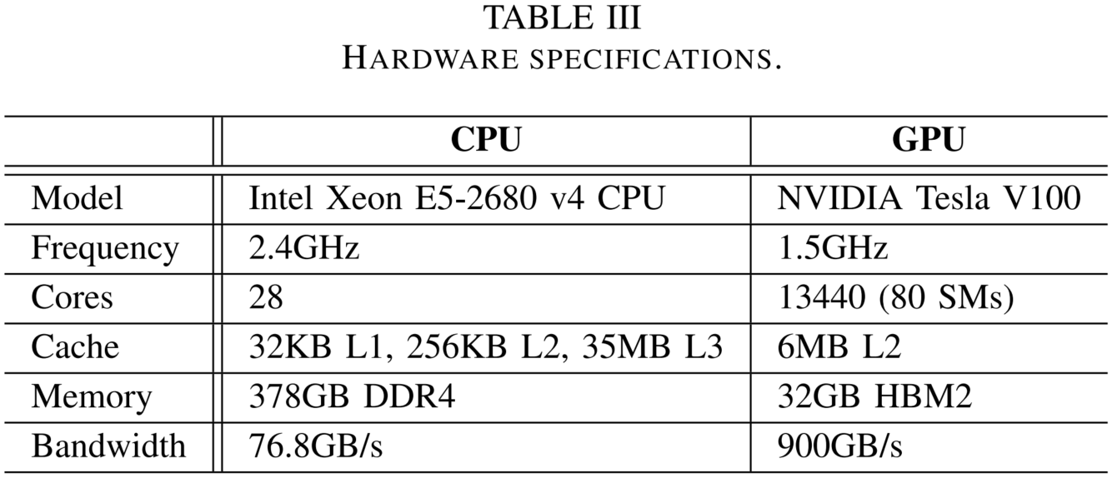
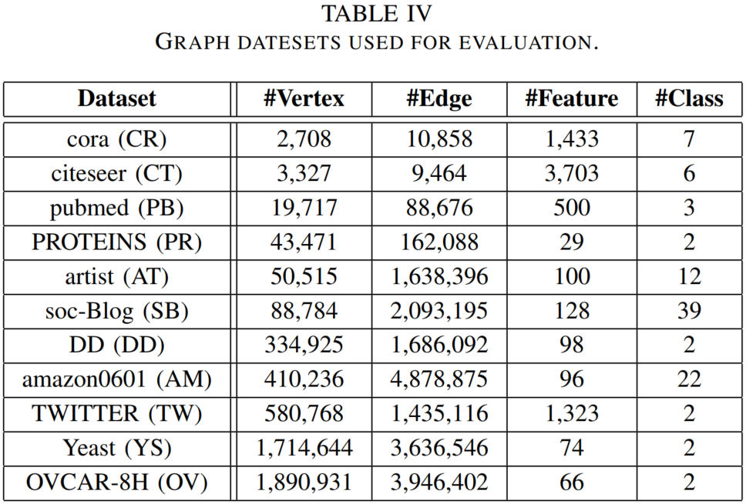
Experiment Setup
Hardware and Software Configurations
Ubuntu 20.04 with CUDA v11.1
PyTorch v1.8, PyG v1.7
Graph Datasets and Task Queues
Hidden length (64), layer number (4~10)
200 epoches, 20 models within each queue
Five queues (GCN, SAGE, GAT, GIN, Mix)
Methods for Comparison
Spatial sharing: MPS, MIG with UVM enabled
Temporal sharing: PipeSwitch [Bai et al., OSDI’20]
Hybrid: CoGNN with Base, LMCF and BMC policies
Comparison Metrics
Performance: SM utilization, makespan, JCT, QT
PMC Estimation: relative error (RE)
Notes:
The hardware specifications are presented in Table III. PyTorch is modified to support explicit task colocation and memory management for CoGNN.
The graph datasets used for experiments are presented in Table IV, which are representative and have diverse graph dimensions and feature lengths. We set the hidden length to 64, the number of layers in the range of 4~10 and train for 200 epoches. The layer number and graph dataset are uniformly combined to generate a task queue consisting of 20 models for each GNN including GCN, SAGE, GAT, and GIN. Furthermore, we sample 20 models from the combinations to obtain a task queue with distinct GNNs (called Mix task queue). We compare CoGNN with three scheduling policies including Base, LMCF, and BMC against Default, MPS, MIG, and PipeSwitch. PipeSwitch executes GNN tasks in a temporal-sharing manner. MPS and MIG execute GNN tasks in a spatial-sharing manner.
To determine task execution efficiency, we select four key metrics including SM utilization, makespan, job completion time, and queuing time for comparison. We use relative error to evaluate the accuracy of PMC estimation.

Slide 18
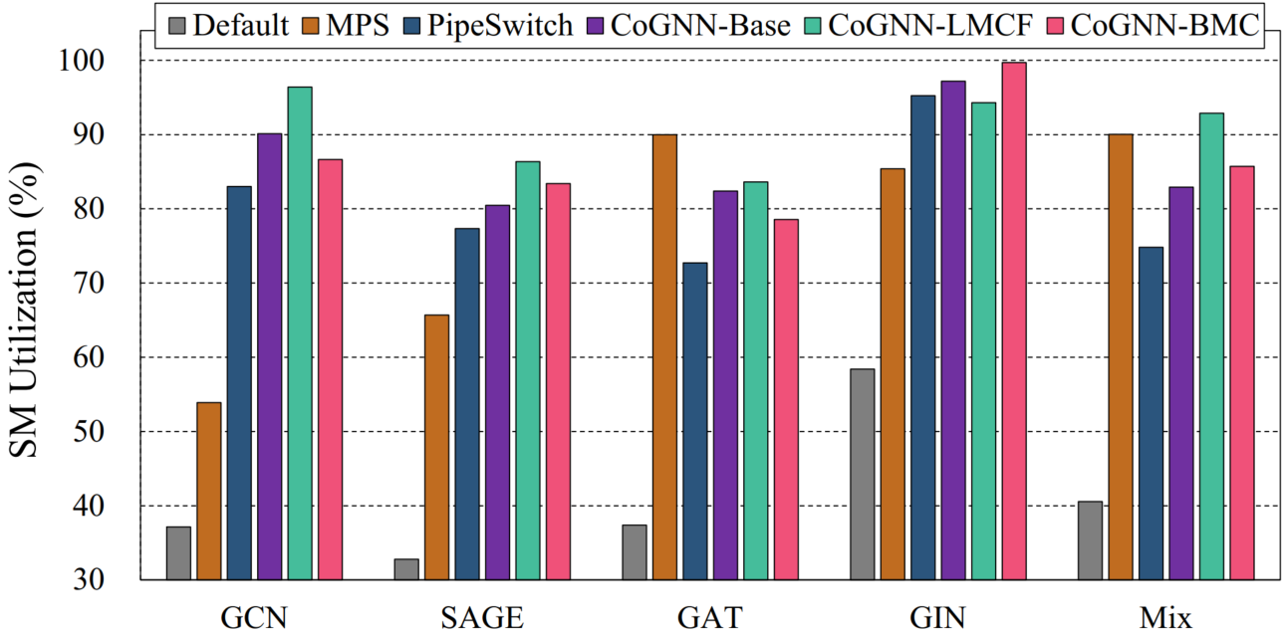
Overall Performance Comparison
SM utilization comparison of different methods on V100 GPU
The results indicate that executing GNN training tasks in a spatial-sharing
manner with CoGNN can fully utilize GPU resources.
NVIDIA System Management Interface (nvidia-smi) is utilized to obtain the SM utilization results
CoGNN and MPS achieve higher SM utilization (88% and 77%) due to the ability of spatial sharing
Notes:
This figure shows the SM utilization comparison of different methods on V100 GPU, where the NVIDIA System Management Interface (nvidia-smi) is utilized to obtain the SM utilization results. As seen, CoGNN and MPS achieve higher SM utilization such as 88% and 77% due to the ability of spatial sharing. The results indicate that executing GNN training tasks in a spatial-sharing manner with CoGNN can fully utilize GPU resources.

Slide 19
Overall Performance Comparison
Performance comparison of different methods on V100 GPU
CoGNN-BMC achieves the shortest makespans for most task queues (i.e., SAGE, GAT, and Mix), whereas CoGNN-LMCF achieves significant reductions for both average JCTs and QTs
For CoGNN, tasks within a group improve overall training throughput through spatial sharing, whereas different groups reduce pipelining latency by overlapping data preprocessing and computation
Notes:
This table shows the performance comparison of different methods on V100 GPU. As seen, CoGNN-BMC achieves the shortest makespans for most task queues such as SAGE, GAT, and Mix, whereas CoGNN-LMCF achieves significant reductions for both average JCTs and QTs. For CoGNN, tasks within a group improve overall training throughput through spatial sharing, whereas different groups reduce pipelining latency by overlapping data preprocessing and computation.

Slide 20
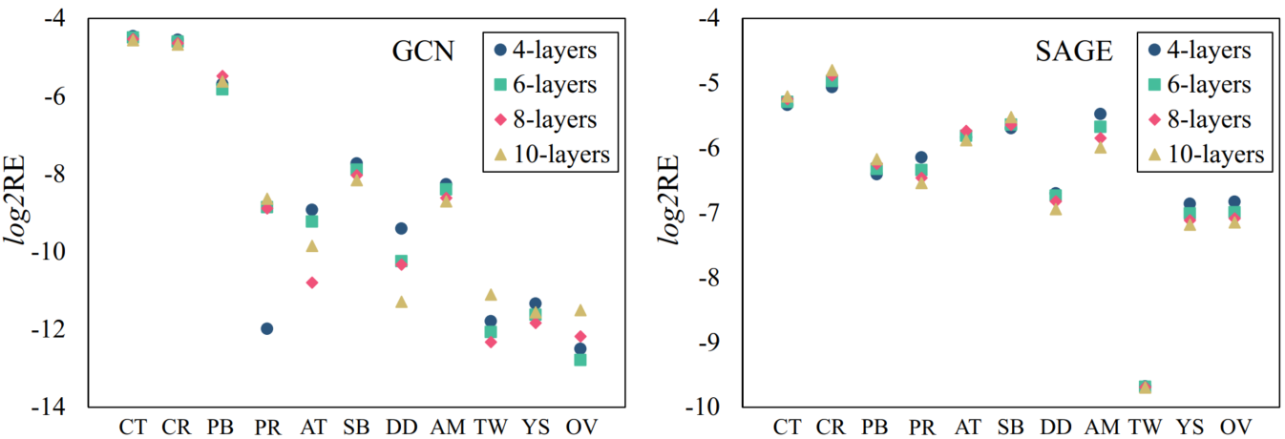
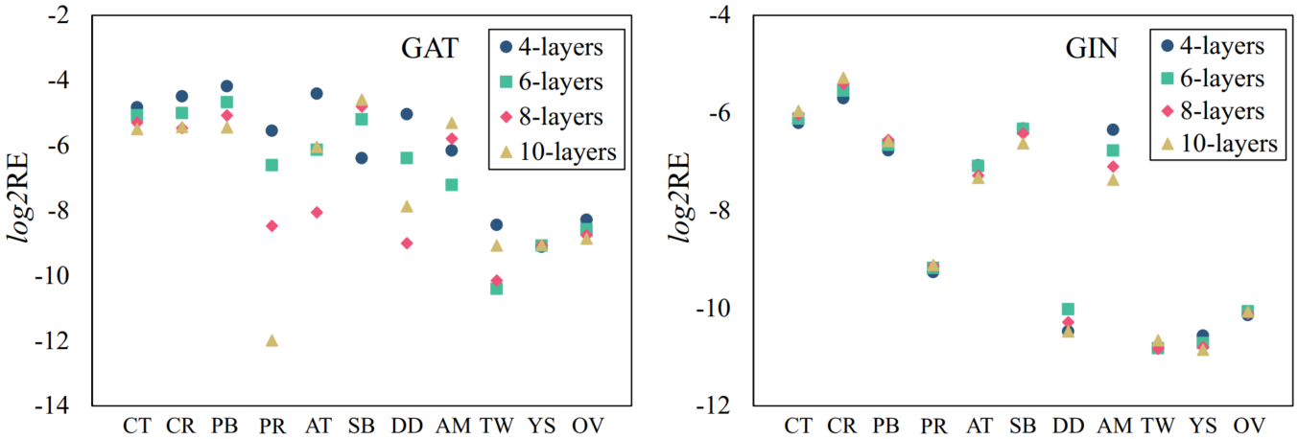
PMC Estimation Accuracy
Relative errors (REs) of PMC estimation for GNN training tasks with varying layer numbers
CoGNN achieves a RE of less than 6% for all tasks (less than 1% RE for large graph datasets)
CoGNN achieves stable accuracy results with changes in the number of GNN layers
The results indicate that CoGNN can accurately estimate PMCs by traversing the DAG generated according to the network structure with operator basis.
Notes:
This figure shows the relative errors of PMC estimation for GNN training tasks. As seen, CoGNN achieves a RE of less than 6% for all tasks, whereas less than 1% RE for large graph datasets. In addition, CoGNN achieves stable accuracy results with changes in the number of GNN layers. The results indicate that CoGNN can accurately estimate PMCs by traversing the DAG generated according to the network structure with operator basis.

Slide 21
Beyond Pairwise
Performance of CoGNN with three workers normalized to that with two workers
Adding workers may lead to exacerbate cache thrashing (GCN) or make better use of memory bandwidth (GAT). In addition, spatial sharing of various GNNs (Mix) may achieve performance improvements because of different resource demands.
3-workers CoGNN achieves 1.18×, 1.14×, and 1.10× increases for GCN, whereas achieves 1.02×, 1.06×, and 1.11× reductions for GAT in makespan, ave JCT, and ave QT
3-workers also achieves 1.01×, 1.04×, and 1.08× reductions for Mix in makespan, ave JCT and ave QT
Notes:
This figure shows the performance of CoGNN with three workers normalized to that with two workers. As seen, 3-workers CoGNN achieves 1.18×, 1.14×, and 1.10× makespan increases for GCN, whereas achieves 1.02×, 1.06×, and 1.11× makespan reductions for GAT.
CoGNN achieves 1.01×, 1.04×, and 1.08× reductions for Mix in makespan, ave JCT, and ave QT. The reason is that adding workers may lead to exacerbate cache thrashing (such as GCN) or make better use of memory bandwidth (such as GAT). In addition, spatial sharing of various GNNs (such as Mix) may achieve performance improvements because of different resource demands.

Slide 22
Applying to other GPU Hardware
Performance comparison of Different methods on A100 GPU
CoGNN achieves better performance than Default, MIG, MPS, PipeSwitch on all metrics on A100 GPU
CoGNN-BMC achieves 1.12× makespan reductions compared to PipeSwitch for Mix queue on A100
The results indicate that CoGNN can be adapted to other GPU architectures with stable performance improvement. In addition, we believe that CoGNN has greater potential on future GPU architectures with more resources (e.g., NVIDIA H100).
Notes:
To demonstrate the generality of our approach, we evaluate CoGNN on NVIDIA A100 GPU with 40GB memory. This table shows the performance comparison of different methods on A100 GPU. As seen, CoGNN achieves better performance than Default, MIG, MPS, and PipeSwitch on all metrics on A100 GPU. In addition, CoGNN-BMC achieves 1.12× makespan reductions compared to PipeSwitch for Mix queue on A100.
The results indicate that CoGNN can be adapted to other GPU architectures with stable performance improvement. In addition, we believe that CoGNN has greater potential on future GPU architectures with more resources (e.g., NVIDIA H100).

Slide 23
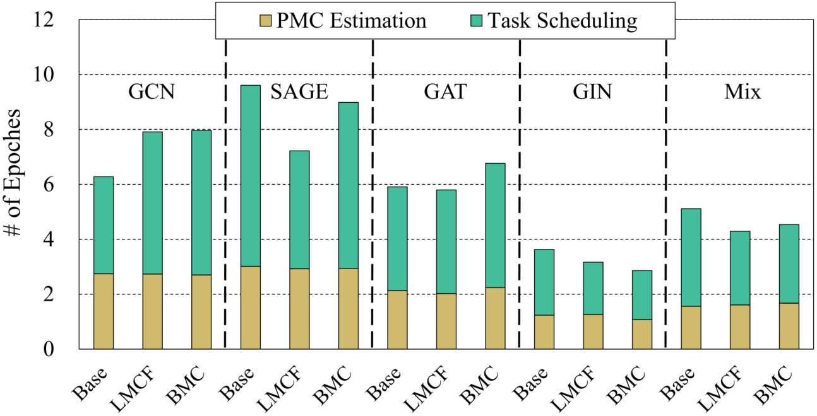
Overhead Analysis
Performance breakdown of CoGNN processing normalized to one-epoch execution time
Task grouping time is less than 0.001 epoches, which is negligible compared to GNN training
PMC estimation and task scheduling take an average of 2.1 and 3.9 epoches across all task queues
In production scenarios, thousands of epoches are often required to improve prediction accuracy, indicating the CoGNN overhead is acceptable.
Notes:
This figure shows the performance breakdown of CoGNN processing normalized to one-epoch execution time. The CoGNN overhead can be divided into three parts including PMC estimation, task grouping, and task scheduling. Task grouping time is less than 0.001 epoches, which is negligible compared to GNN training, therefore not shown in this figure. PMC estimation and task scheduling take an average of 2.1 and 3.9 epoches across all task queues. In production scenarios, thousands of epoches are often required to improve prediction accuracy, indicating the CoGNN overhead is acceptable.

Slide 24
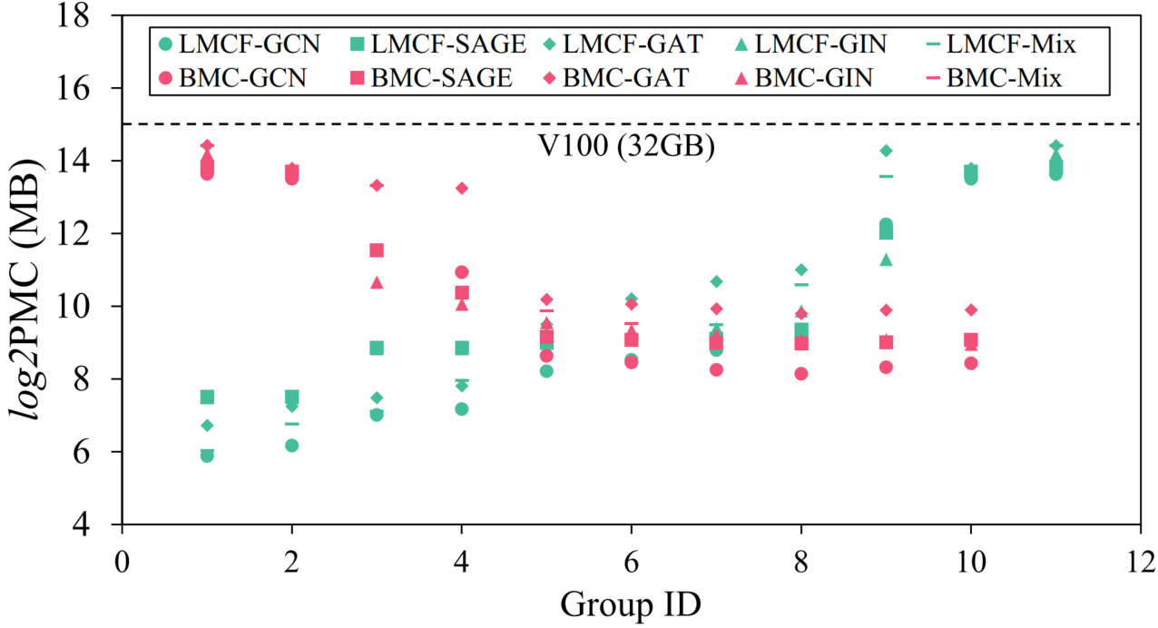
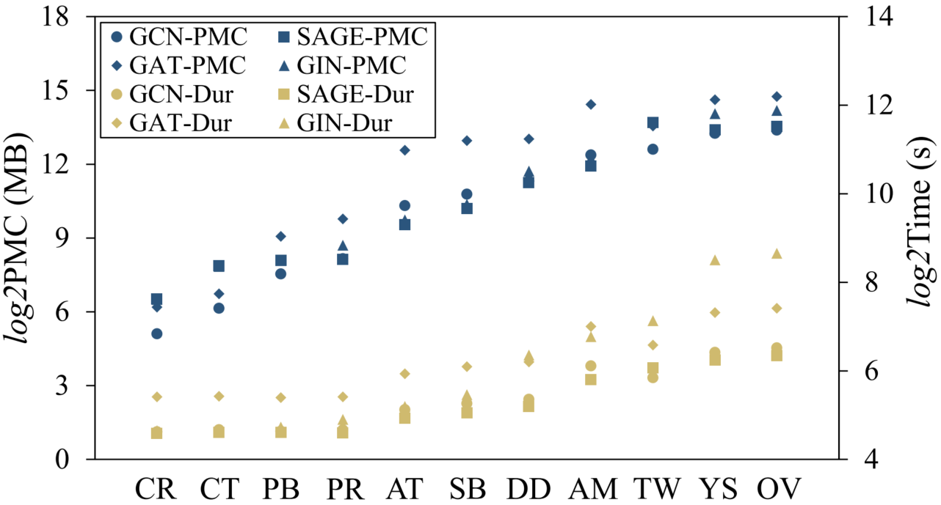
Auxiliary Analysis
PMC distribution of task groups
Correlation of PMC and execution time
The PMCs of certain task groups are close to the V100 capacity (GPU memory is fully utilized)
PMC is positively correlated with execution time (consistent with the CoGNN assumption)
1) CoGNN generates groups adaptively to avoid exceeding GPU memory capacity;
2) Larger input sizes result in larger output tensors and more arithmetic operations.
Notes:
The left figure shows the runtime memory consumption of CoGNN. The PMCs of certain task groups are close to the V100 capacity, indicating the GPU memory is fully utilized. The right figure shows the correlation of PMC and execution time. The PMC is positively correlated with execution time, which is consistent with our assumption.
The results indicate that CoGNN generates groups adaptively to avoid exceeding GPU memory capacity. Also, the positive correlation is because that larger input sizes generally result in larger output tensors and more arithmetic operations, leading to larger PMC and longer execution time.

Slide 25
Outline
Background & Motivation
Graph Neural Network & GNN Computational Patterns
GPU Sharing for Deep Learning Tasks
Observations on GNN Computations
Design & Methods
Task Management & Memory Consumption Estimation
Scheduling Policies & Implementation Details
Evaluation
Experiment Setup
Performance Analysis
Related Work
Conclusion
Notes:
Next, I will show some previous works related to our paper.

Slide 26
Related Work
GNN Acceleration on GPUs
Recent research works deeply mine the computation features of GNNs to enable fine-grained optimizations for GPU architectures, such as [Huang et al., SC’20], [Hu et al., SC’20], [Huang et al., PPoPP’21], [Wang et al., OSDI’21], etc.
These works are orthogonal to this paper that targets concurrent GNN training scheduling.
Memory Management for Training
Since limited memory capacity restricts the scale of network training, research works generally utilize re-computation or swapping to manage GPU memory, such as [Wang et al., PPoPP’18], [Shriram et al., IPDPS’19], [Peng et al., ASPLOS’20], [Ren et al., HPCA’21], etc.
These approaches are effective against memory oversubscription and serve as references for processing larger graph inputs on GPUs.
To the best of our knowledge, this is the first work that targets the scheduling optimization and memory management for concurrent GNN training.
Notes:
We divide the related works into GNN acceleration on GPUs and memory management for training.
Recent research works deeply mine the computation features of GNNs to enable fine-grained optimizations for GPU architectures. These works are orthogonal to this paper that targets concurrent GNN training scheduling.
Since limited memory capacity restricts the scale of network training, research works generally utilize re-computation or swapping to manage GPU memory. These approaches are effective against memory oversubscription and serve as references for processing larger graph inputs on GPUs.
To the best of our knowledge, this is the first work that targets the scheduling optimization and memory management for concurrent GNN training.

Slide 27
Outline
Background & Motivation
Graph Neural Network & GNN Computational Patterns
GPU Sharing for Deep Learning Tasks
Observations on GNN Computations
Design & Methods
Task Management & Memory Consumption Estimation
Scheduling Policies & Implementation Details
Evaluation
Experiment Setup
Performance Analysis
Related Work
Conclusion
Notes:
Finally, I will make the conclusion.

Slide 28
Conclusion
Scheduling for Concurrent GNN Training
Task management & memory allocation
Temporal/spatial sharing inter/intra task groups
Reserved memory & allocated memory with buffer insertion
Memory consumption estimation
DAG generation & graph traversal
Memory cost function & tensor liveness analysis
Task scheduling policies
In-order (Base), out-of-order (LMCF, BMC)
Experiment Results
Overall performance comparison
Over Default: Higher GPU utilization (2.1×) and shorter makespans (2.8×)
Estimation Accuracy
Low relative errors (less than 6%)
Notes:
In this work, we propose a concurrent GNN training framework that can efficiently manage massive GNN training tasks co-located on GPUs. Our framework organizes the tasks in a queue and estimates the memory consumption of each task based on cost functions at operator basis. We also implement various scheduling policies to generate task groups, which are iteratively submitted to GPU for execution. The experiment results show that CoGNN can achieve higher GPU utilization and shorter makespans for training tasks from diverse GNN models.

Slide 29
Thanks! Q&A
Notes:
This concludes the presentation, and I am available for questions.

