Slide 1




DASP: Specific Dense Matrix
Multiply-Accumulate Units Accelerated
General Sparse Matrix-Vector Multiplication
Yuechen Lu, Weifeng Liu
Super Scientific Software Laboratory (SSSLab)
China University of Petroleum-Beijing
DENVER, CO · NOV 16
https://github.com/SuperScientificSoftwareLaboratory/DASP

Slide 2



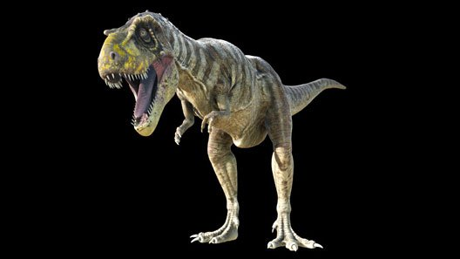
DASP: Specific Dense Matrix Multiply-Accumulate Units Accelerated General Sparse Matrix-Vector Multiplication

Slide 3
1
Introduction and Related Work
2
Data Structure and Algorithm of DASP
OUTLINE
3
Performance Evaluation
4
Conclusion

Slide 4
Introduction
· Sparse Matrix-Vector Multiplication（SpMV）: multiply a sparse matrix A with a dense vector x and get a dense vector y.
· Wide Applications: computational science and engineering, graph processing and machine learning.
a
b
1
2a+7b
c
d
2
1c+4d
e
f
3
4e+6f
g
h
X
4
=
3g+8h
i
j
k
5
2i+5j+6k
l
6
4l
m
n
7
5m+7n
o
p
q
8
1o+3p+8q
A
x
y

Slide 5
Introduction
SpMV: memory-bound kernel
Not reach the upper limit of the machine
Much research has focused on improving its memory access and making workload balanced.
Still has room to improve !
Fig1: Bandwidth throughput of CSR5 and cuSPARSE SpMV approaches. Running the largest matrices with more than 10⁷ nonzeros in the SuiteSparse Matrix Collection on an A100 GPU.

Slide 6
Introduction
SpMV: memory-bound kernel
Much research has focused on improving its memory access and making workload balanced.
Fig1: Bandwidth throughput of three double-precision SpMV approaches, CSR5, cuSPARSE and DASP (this work)

Slide 7
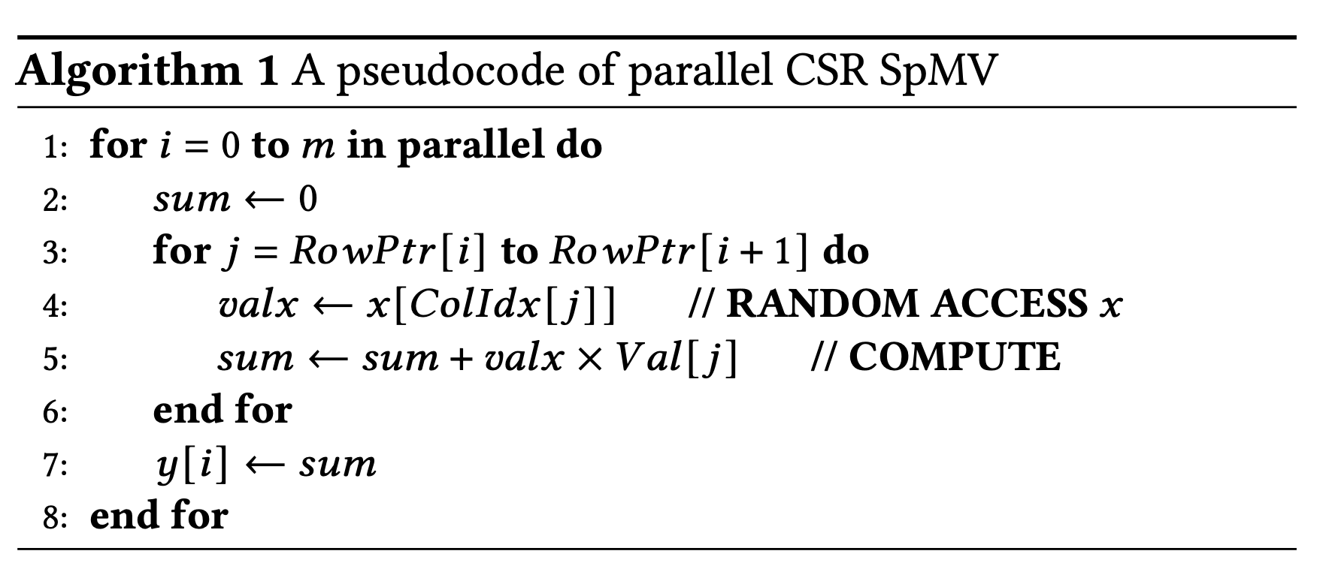
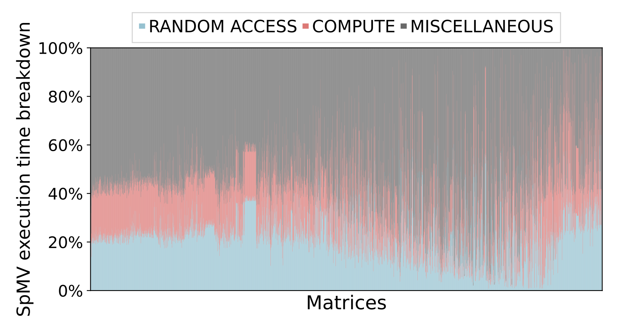
Introduction
Three parts of SpMV costs：
(1) RANDOM ACCESS on the vector 𝑥
(2) COMPUTE of inner products of nonzeros in 𝐴 and corresponding 𝑥
(3) Reading and writing other arrays
· The average proportions of RANDOM ACCESS, COMPUTE and MISCELLANEOUS parts in the entire execution time of SpMV are 25.1%, 21.1% and 53.8%, respectively.
Existing work largely ignored optimizing the COMPUTE part !

Slide 8
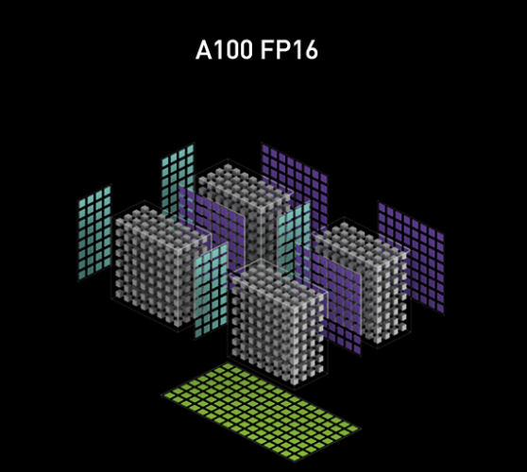
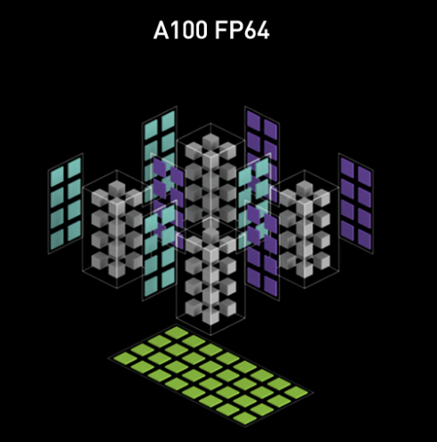
Introduction
The advent of specific matrix multiplication-accumulated (MMA) units has led to significant increases in the computational power of some parallel processors.
Mainstream MMA units: NVIDIA Tensor Cores, AMD Matrix Core, Apple Matrix Co-processors (AMX), Intel Xe Matrix Extensions (XMX) , Advanced Matrix Extensions (AMX) and IBM Power Matrix Math Accelerator (MMA), etc.
Other fundamental algorithms, such as reduction and scan, stencil, FFT, and SpMM, have also been improved through using MMA units.
MMA_N
fragB
MMA_K
MMA_K
fragA
fragC
MMA_M
Compute layout of the double precision mma_m8n8k4 instruction
Schematic of Tensor Core

Slide 9
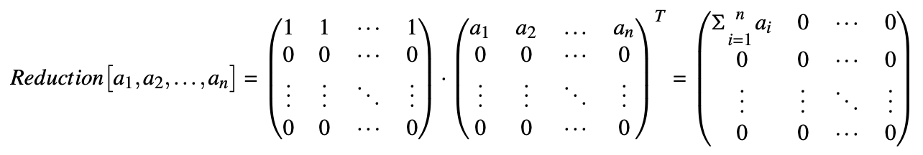
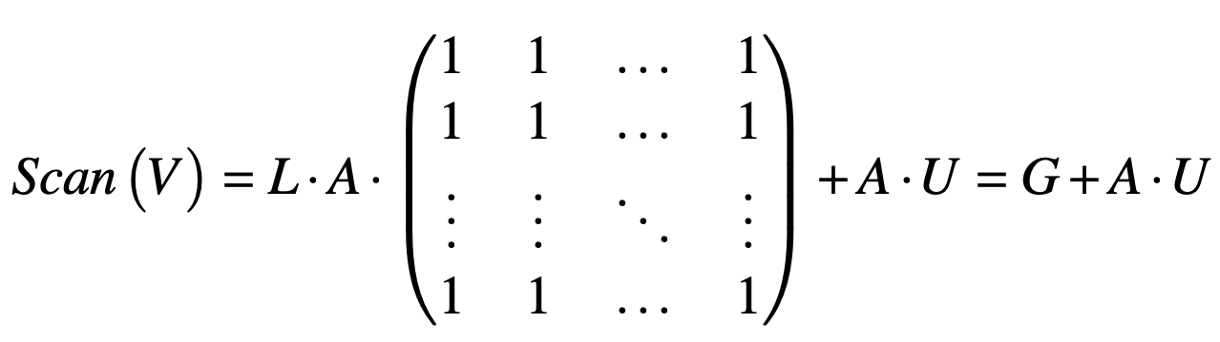
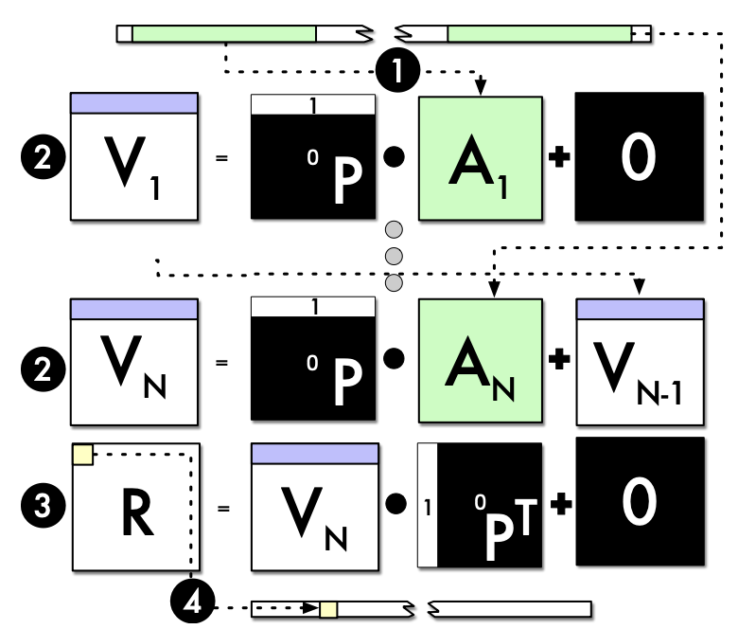
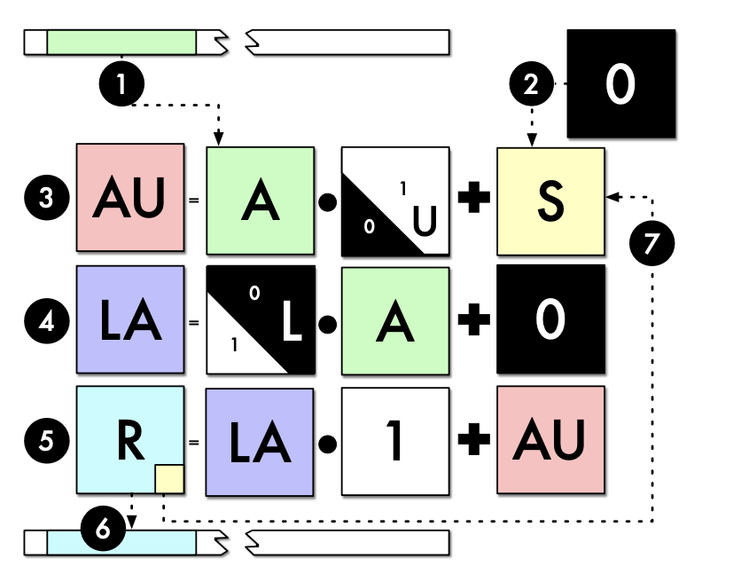
Related Work (Reduction and Scan on Tensor Core)
A. Dakkak, C. Li, J. Xiong, I. Gelado, and W.-m. Hwu. Accelerating Reduction and Scan Using Tensor Core Units. In ICS '19, pages 46–57, 2019.

Slide 10
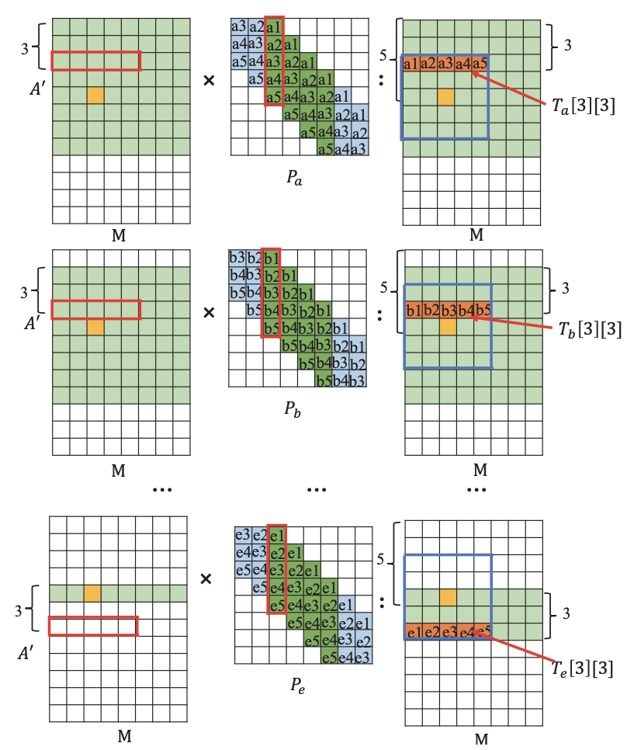
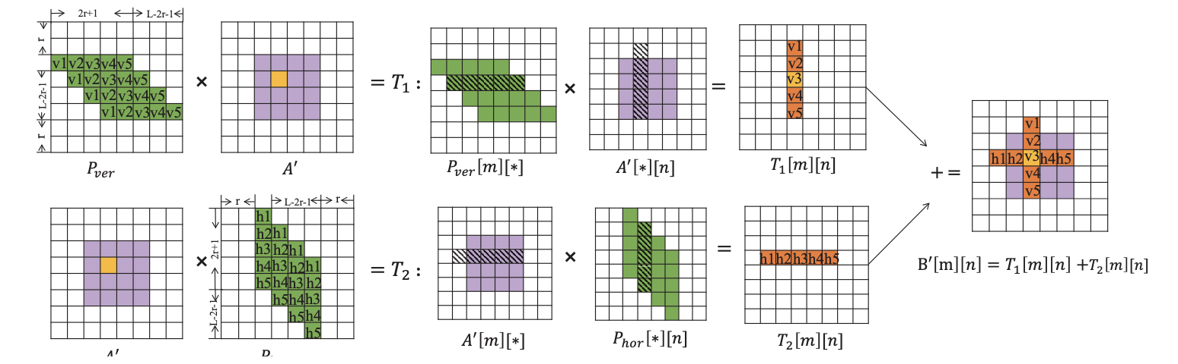
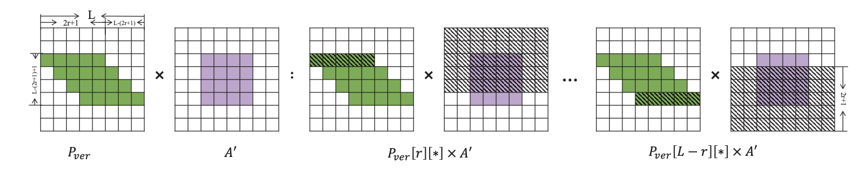
Related Work (Stencil on Tensor Core)
X. Liu, Y. Liu, H. Yang, J. Liao, M. Li, Z. Luan, and D. Qian. Toward Accelerated Stencil Computation by Adapting Tensor Core Unit on GPU. In ICS '22, pages 1–12, 2022.

Slide 11
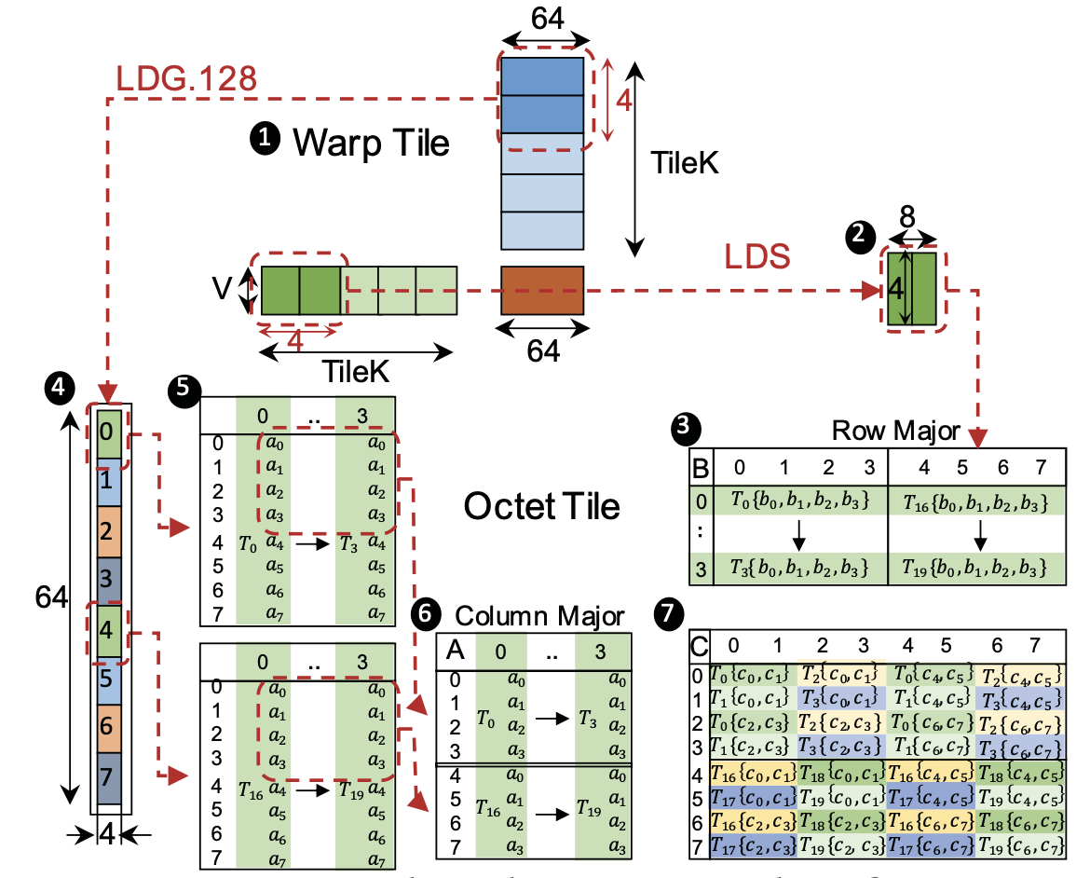
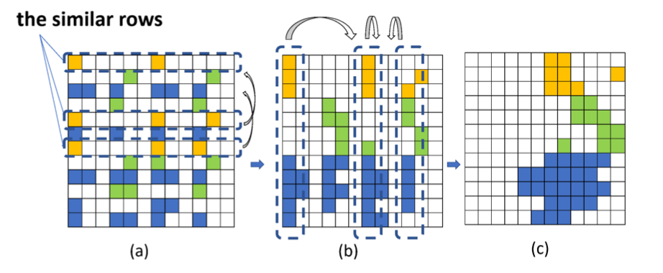
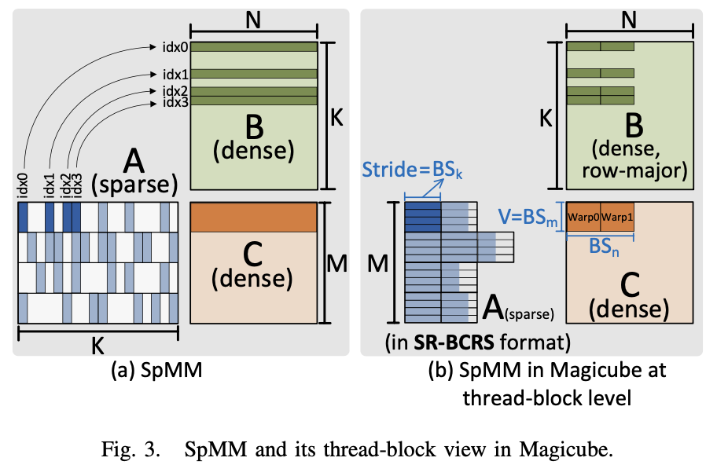
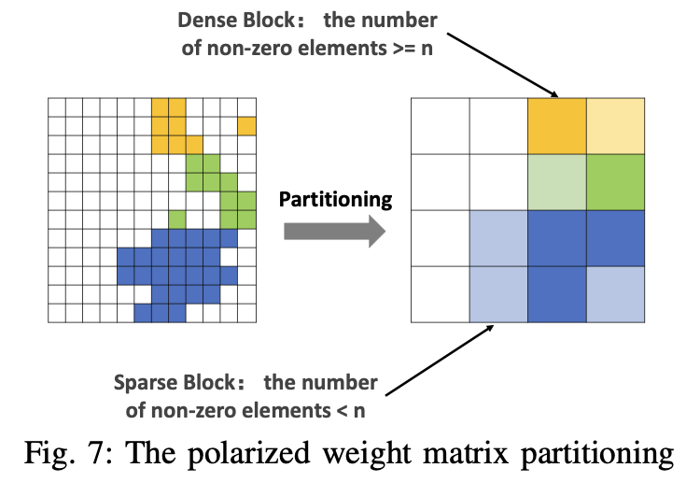
Related Work (SpMM and SDDMM on Tensor Core)
Z. Chen, Z. Qu, L. Liu, Y. Ding, and Y. Xie. Efficient Tensor Core-Based GPU Kernels for Structured Sparsity under Reduced Precision. In SC '21, pages 1–13, 2021.
S. Li, K. Osawa, and T. Hoefler. Efficient Quantized Sparse Matrix Operations on Tensor Cores. In SC '22, pages 509–523, 2022.
Y. Sun, L. Zheng, Q. Wang, X. Ye, Y. Huang, P. Yao, X. Liao, and H. Jin. Accelerating Sparse Deep Neural Network Inference Using GPU Tensor Cores. In HPEC '22, pages 1–7, 2022.

Slide 12
DASP - Problem Description
MMA_N
2
1
4
3
2
4
5
1
fragB
fragX
MMA_K
7
4
6
8
5
7
3
6
8
a
b
1
MMA_K
c
d
2
a
b
e
f
3
c
d
g
h
X
4
=
e
f
i
j
k
5
fragA
fragC
g
fragA
fragY
MMA_M
h
l
6
i
j
k
m
n
7
l
o
p
q
8
m
n
A
x
y
o
p
q
Compute layout of the double precision mma_m8n8k4 instruction
Compute 8x8 SpMV
using mma instruction
Example of SpMV for
a matrix A of size 8x8

Slide 13
DASP - Problem Description
MMA_N
fragB
MMA_K
MMA_K
？
fragA
fragC
MMA_M
Compute layout of the double precision mma_m8n8k4 instruction
A larger and more complex matrix

Slide 14

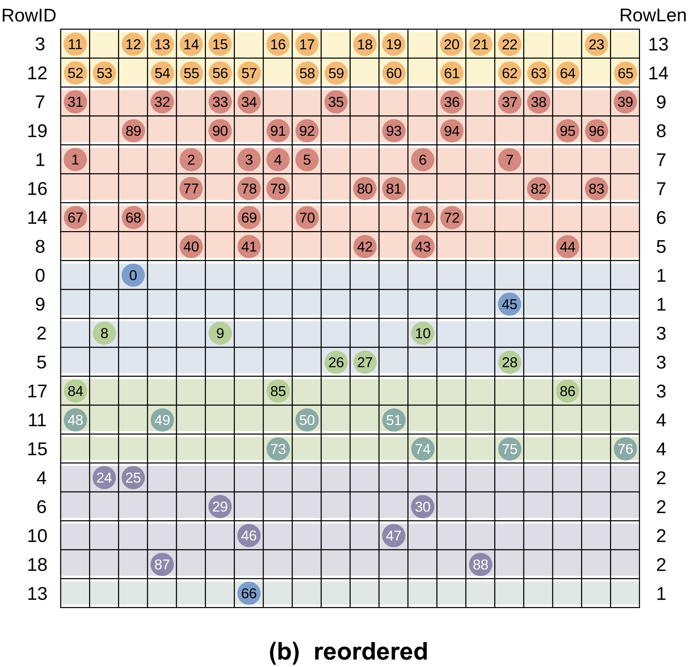
DASP - Reordering
· Analyze the distribution of nonzeros in each row of the sparse matrix 𝐴, and group all rows into three categories according to the number of nonzeros in each row:
Long Rows: arranged as the original order, MAX_LEN(256) represent its minimum length;
Medium Rows: arranged in descending order of the number of nonzeros;
Short Rows: arranged by row lengths of 1, 3, 4, 2；
Long Rows
row_len ≥ MAX_LEN
Medium Rows
4<row_len<MAX_LEN
Short Rows
row_len ≤ 4

Slide 15
DASP - Data Structure
For Long Rows, the nonzeros in each row will be divided into several groups, and the number of non-zeros in each group is 2xMMA_MxMMA_K. If the number of nonzeros in a row is not enough to be an integer multiple of the group, it will be filled with zero elements.
Each group has 16 elements, and the two long rows are divided into two groups.
(Take the corresponding mma instruction layout as m2n2k4 for example)

Slide 16
DASP - Data Structure
row-major in block
For Medium Rows, each MMA_M rows is considered as a row-block, and each row-block is divided into some smaller blocks of size MMA_M * MMA_K according to the parameter threshold(=0.75) .
Regular part: the number of nonzeros in a block space is larger than MMA_M*MMA_K*threshold;
Irregular part: the number of nonzeros in a block space is less than MMA_M*MMA_K*threshold;
(Take the corresponding mma instruction layout as m2n2k4 for example)

Slide 17
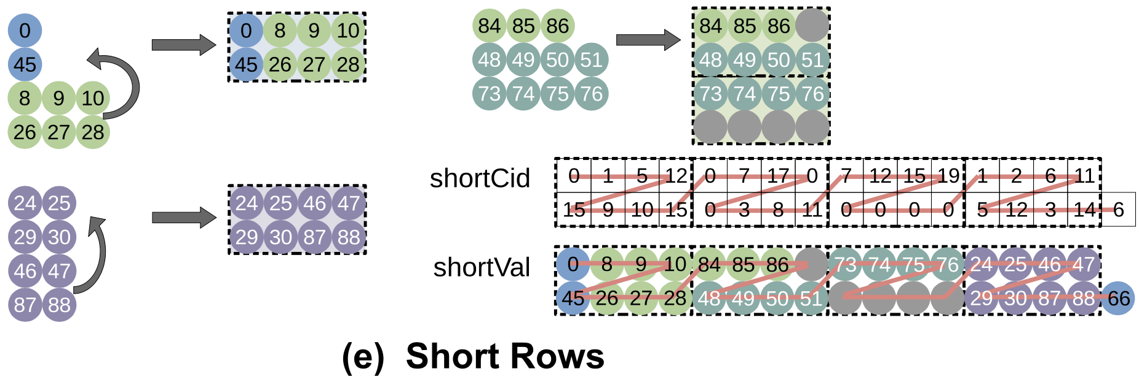
DASP - Data Structure
Short Rows: Piecing Strategy
· piece rows of 1 and 3 nonzeros together to obtain rows of 4 nonzeros;
· piece 2 rows of 2 nonzeros together to obtain rows of 4 nonzeros;
Row lengths are fixed, so there is no need to store the offset.
· For rows of 3 remaining after piecing (not enough to form a block), they are treated as rows of 4 by filling a zero element.
· For rows of 1 remaining after piecing, place them at the end of all short row elements.
All data in the short rows are divided into four categories:
（1）1&3 pieced rows; （2）rows of row_len = 4;
（3）2&2 pieced rows; （4）rows of row_len = 1.
(Take the corresponding mma instruction layout as m2n2k4 for example)

Slide 18
DASP - Algorithm
Long Rows: Each row is computed by several warps (depending on the number of groups per row).
(Take the corresponding mma instruction layout as m8n8k4 for example)

Slide 19
DASP - Algorithm
Long Rows: Each row is computed by several warps (depending on the number of groups per row).
① On each warp, load a block-sized data from global memory to each thread's registers fragA and fragX;
(Take the corresponding mma instruction layout as m8n8k4 for example)

Slide 20
DASP - Algorithm
Long Rows: Each row is computed by several warps (depending on the number of groups per row).
① On each warp, load a block-sized data from global memory to each thread's registers fragA and fragX;
(Take the corresponding mma instruction layout as m8n8k4 for example)
② Each warp calls the mma instruction 2 times to perform GEMM operation of m8n8k4 and obtain 8 meaningful results;

Slide 21
DASP - Algorithm
Long Rows: Each row is computed by several warps (depending on the number of groups per row).
① On each warp, load a block-sized data from global memory to each thread's registers fragA and fragX;
(Take the corresponding mma instruction layout as m8n8k4 for example)
③ Sum the 8 results within the Warp by the Shuffle instruction and storing the results in the global memory array warpVal;
② Each warp calls the mma instruction 2 times to perform GEMM operation of m8n8k4 and obtain 8 meaningful results;

Slide 22
DASP - Algorithm
Long Rows: Each row is computed by several warps (depending on the number of groups per row).
① On each warp, load a block-sized data from global memory to each thread's registers fragA and fragX;
(Take the corresponding mma instruction layout as m8n8k4 for example)
③ Sum the 8 results within the Warp by the Shuffle instruction and storing the results in the global memory array warpVal;
④ Sum the multiple warpVal generated by one row, and obtain the final result y.
② Each warp calls the mma instruction 2 times to perform GEMM operation of m8n8k4 and obtain 8 meaningful results;

Slide 23
DASP - Algorithm
Long Rows: Each row is computed by several warps (depending on the number of groups per row).
① On each warp, load a block-sized data from global memory to each thread's registers fragA and fragX;
(Take the corresponding mma instruction layout as m8n8k4 for example)
③ Sum the 8 results within the Warp by the Shuffle instruction and storing the results in the global memory array warpVal;
DASP sets 4 warps in a thread block, each warp computes 2 blocks of data in a long row, so a thread block will compute 256 elements.
Therefore, MAX_LEN=256 is just the right value to meet the workload of a thread block.
④ Sum the multiple warpVal generated by one row, and obtain the final result y.
② Each warp calls the mma instruction 2 times to perform GEMM operation of m8n8k4 and obtain 8 meaningful results;

Slide 24
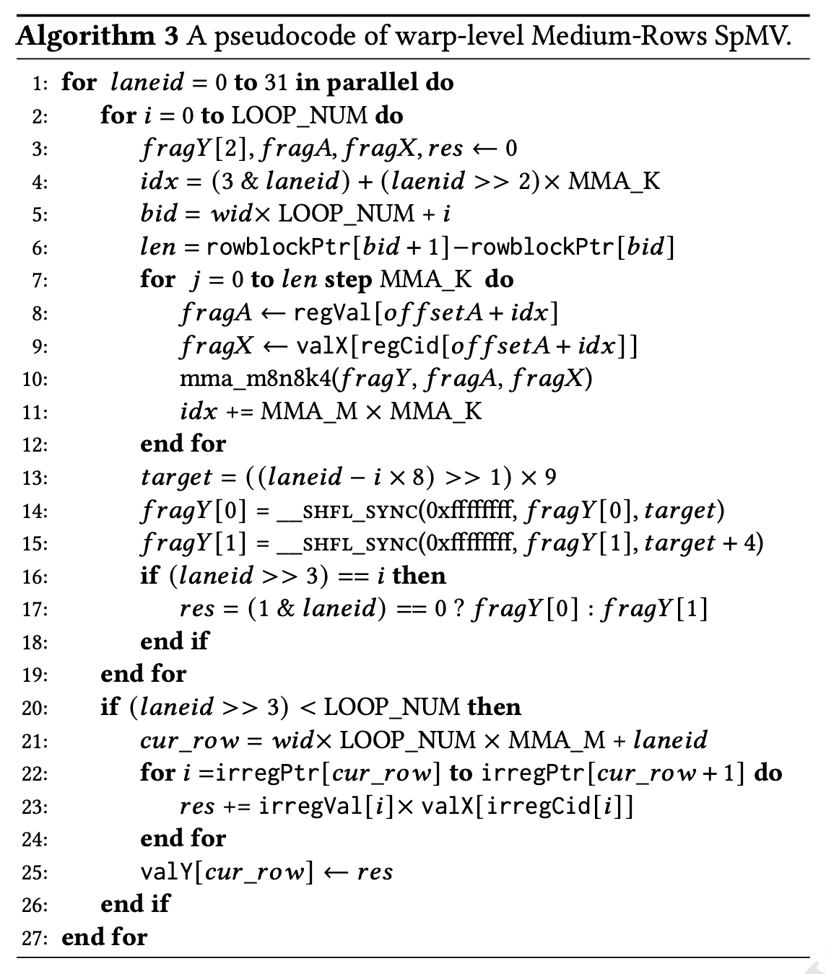
DASP - Algorithm
Medium Rows: 𝐿𝑂𝑂𝑃_𝑁𝑈𝑀, indicates the number of row-blocks that a warp needs to calculate.
· #medium_rows<59,990, LOOP_NUM = 1;
· 59,990≤#medium_rows<400,000, LOOP_NUM = 2;
· #medium_rows≥400,000, LOOP_NUM = 4.

Slide 25
DASP - Algorithm
Medium Rows: 𝐿𝑂𝑂𝑃_𝑁𝑈𝑀, indicates the number of row-blocks that a warp needs to calculate.
· #medium_rows<59,990, LOOP_NUM = 1;
· 59,990≤#medium_rows<400,000, LOOP_NUM = 2;
· #medium_rows≥400,000, LOOP_NUM = 4.
① Load regular data to the corresponding thread's register;

Slide 26
DASP - Algorithm
Medium Rows: 𝐿𝑂𝑂𝑃_𝑁𝑈𝑀, indicates the number of row-blocks that a warp needs to calculate.
· #medium_rows<59,990, LOOP_NUM = 1;
· 59,990≤#medium_rows<400,000, LOOP_NUM = 2;
· #medium_rows≥400,000, LOOP_NUM = 4.
① Load regular data to the corresponding thread's register;
② Call the MMA instruction calculation;

Slide 27
DASP - Algorithm
Medium Rows: 𝐿𝑂𝑂𝑃_𝑁𝑈𝑀, indicates the number of row-blocks that a warp needs to calculate.
· #medium_rows<59,990, LOOP_NUM = 1;
· 59,990≤#medium_rows<400,000, LOOP_NUM = 2;
· #medium_rows≥400,000, LOOP_NUM = 4.
① Load regular data to the corresponding thread's register;
② Call the MMA instruction calculation;
③ Write the calculation result to the register of successive threads via the Shuffle instruction;

Slide 28
DASP - Algorithm
Medium Rows: 𝐿𝑂𝑂𝑃_𝑁𝑈𝑀, indicates the number of row-blocks that a warp needs to calculate.
· #medium_rows<59,990, LOOP_NUM = 1;
· 59,990≤#medium_rows<400,000, LOOP_NUM = 2;
· #medium_rows≥400,000, LOOP_NUM = 4.
① Load regular data to the corresponding thread's register;
② Call the MMA instruction calculation;
③ Write the calculation result to the register of successive threads via the Shuffle instruction;
④ Calculate the irregular part, one thread for one row; and the result is accumulated to the corresponding res;

Slide 29
DASP - Algorithm
Medium Rows: 𝐿𝑂𝑂𝑃_𝑁𝑈𝑀, indicates the number of row-blocks that a warp needs to calculate.
· #medium_rows<59,990, LOOP_NUM = 1;
· 59,990≤#medium_rows<400,000, LOOP_NUM = 2;
· #medium_rows≥400,000, LOOP_NUM = 4.
① Load regular data to the corresponding thread's register;
② Call the MMA instruction calculation;
③ Write the calculation result to the register of successive threads via the Shuffle instruction;
④ Calculate the irregular part, one thread for one row; and the result is accumulated to the corresponding res;
⑤ Write the result back to y;

Slide 30
DASP - Algorithm
Short Rows: the data is further grouped to four categories, corresponding to four CUDA kernels.
Load data
to registers
Call mma instruction,
perform calculation
Extract results
Write back results
Different kernels have different computational resource
and different times of data movement…
 | Call mma /Warp | Load data /Warp(A,x) | Block /Warp | y /Warp
1&3 | 4 | 2,4 | 2 | 32
4 | 4 | 4,4 | 4 | 32
2&2 | 4 | 2,4 | 2 | 32
num
type
CUDA Cores are used to calculate rows with one nonzero, and one thread is used to calculate one row.

Slide 31
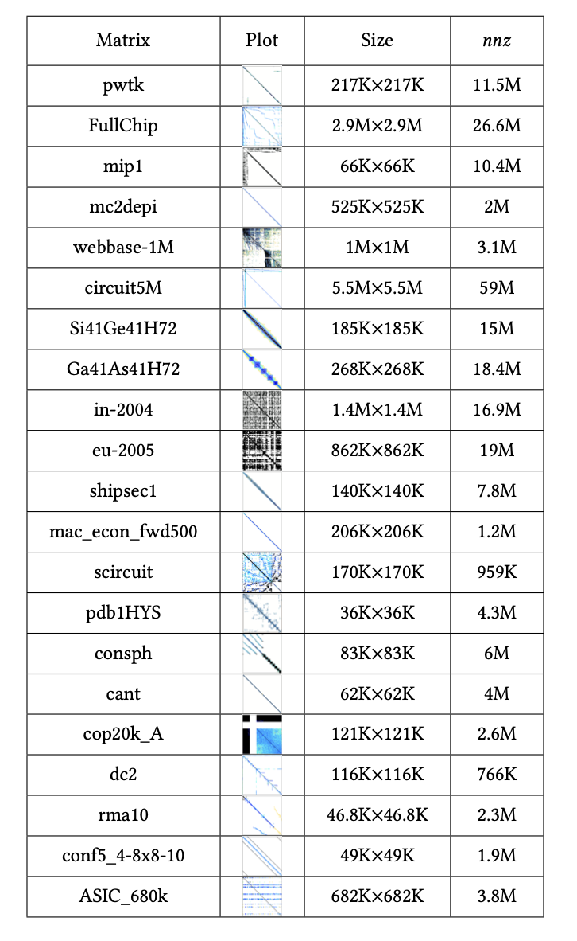
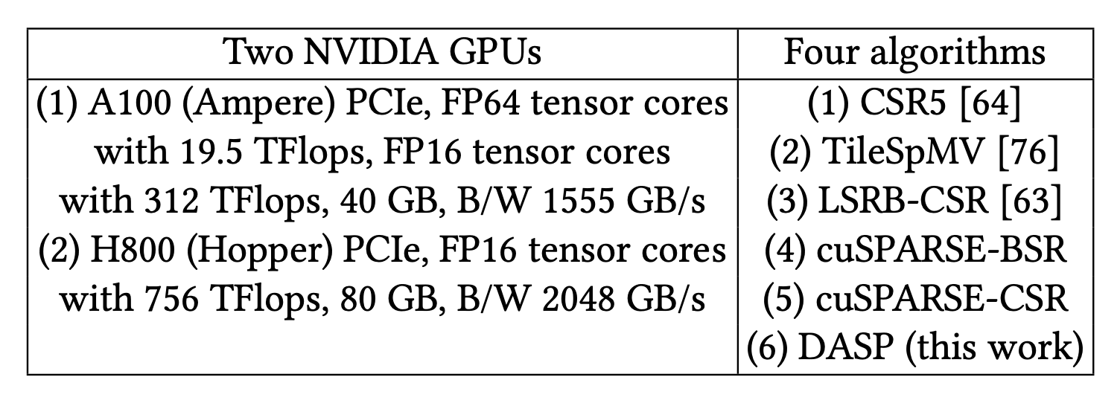
Performance Evaluation - Experimental Setup
· Our experimental dataset includes all 2893 matrices in the SuiteSparse Matrix Collection[21].
· List 21 representative matrices to analyze the performance of our DASP more deeply.
[21] T. A. Davis and Y. Hu. The university of florida sparse matrix collection. ACM Trans. Math. Softw., 38(1), 2011.
[64] W. Liu and B. Vinter. Csr5: An efficient storage format for cross-platform sparse matrix-vector multiplication. In ICS ’15, pages 339–350, 2015.
[76] Y. Niu, Z. Lu, M. Dong, Z. Jin, W. Liu, and G. Tan. Tilespmv: A tiled algorithm for sparse matrix-vector multiplication on gpus. In IPDPS ’21, pages 68–78, 2021.
[63] L. Liu, M. Liu, C. Wang, and J. Wang. Lsrb-csr: A low overhead storage format for spmv on the gpu systems. In ICPADS ’15, 2015.

Slide 32
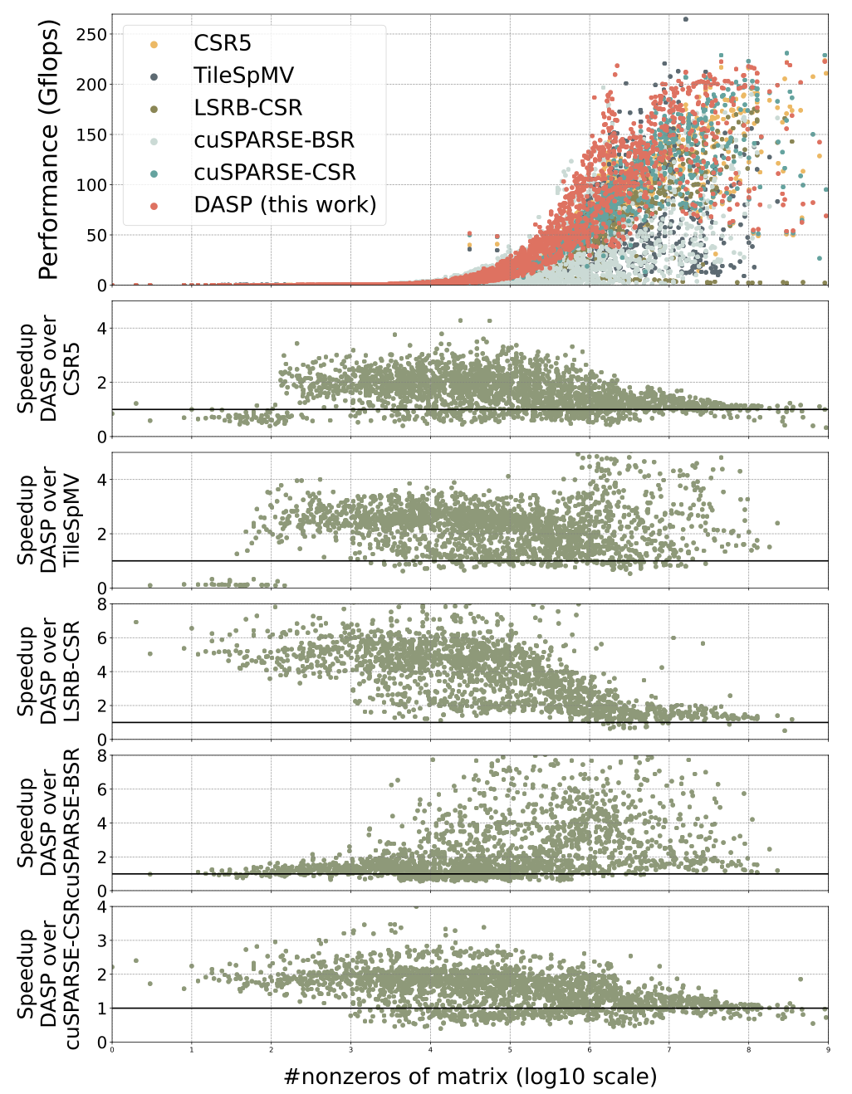
Performance Comparison over Existing Work
(a) Half precision DASP performance and speedups on NVIDIA A100 GPU
(b) Half precision DASP performance and speedups on NVIDIA H800 GPU
On A100 and H800, DASP with half precision runs faster than cuSPARSE on 2578 and 2576 matrices, respectively.
DASP is on average 1.70x and 1.75x (geometric mean) and achieves up to 26.47x and 65.95x over cuSPARSE on the two GPUs, respectively.
On A100, DASP with double precision runs faster than CSR5, TileSpMV, LSRB-CSR, cuSPARSE BSR and cuSPARSE CSR on 2403, 2579, 2251, 2340 and 2344 matrices, respectively.
DASP is on average 1.46x, 2.09x, 3.29x, 2.08x, 1.52x (geometric mean) and achieves up to 12.64x, 17.48x, 90.59x, 283.92x and 6.94x over CSR5, TileSpMV, LSRB-CSR, cuSPARSE BSR and cuSPARSE CSR, respectively.
(c) Double precision DASP performance and speedups on NVIDIA A100 GPU

Slide 33
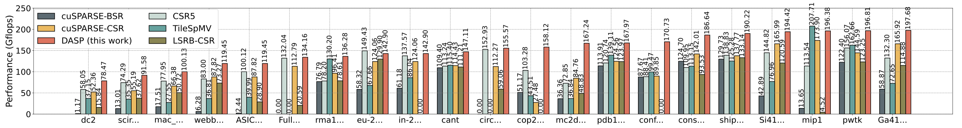
Performance Evaluation
The performance comparison of performing double precision SpMV operation of the 21 representative matrices on NVIDIA A100 GPU
The ratio of rows in different categories
The ratio of nonzeros in different categories

Slide 34
Performance Evaluation
The performance comparison of performing double precision SpMV operation of the 21 representative matrices on NVIDIA A100 GPU
The ratio of rows in different categories
The ratio of nonzeros in different categories
For matrices where Short Rows account for most of all rows, the performance using the DASP method can significantly outperform the comparison methods;
Take ‘mc2depi’ for example, all rows of this matrix belong to the short rows category, and the FP64 precision performance of this matrix can achieve 2.29x, 4.54x, 3.42x, 4.60x and 1.97x speedups over CSR5, TileSpMV, LSRB-CSR, cuSPARSE BSR and cuSPARSE CSR on A100 GPU;

Slide 35
Performance Evaluation
The performance comparison of performing double precision SpMV operation of the 21 representative matrices on NVIDIA A100 GPU
The ratio of rows in different categories
The ratio of nonzeros in different categories
For matrices consisting almost entirely of the Medium Rows category, the performance using the DASP method can still be better than the competitors;
Take ‘cop20k_A’ for example, it consists of 99,843 medium rows and 21,349 empty rows (rows without a nonzero), and its FP64 precision performance achieves 1.53x, 3.63x, 3.08x and 5.75x speedups over CSR5, TileSpMV, cuSPARSE BSR and cuSPARSE CSR on A100 GPU.

Slide 36
Performance Evaluation
The performance comparison of performing double precision SpMV operation of the 21 representative matrices on NVIDIA A100 GPU
The ratio of rows in different categories
The ratio of nonzeros in different categories
For matrices consisting mainly of Long Rows category, it can still show competitive performance on these matrices.
Take ‘Ga41As41H72’ for example, the FP64 precision performance of this matrix can achieve 1.49x, 2.71x, 1.72x, 3.36x and 1.19x speedups over CSR5, TileSpMV, LSRB-CSR, cuSPARSE BSR and cuSPARSE CSR on A100 GPU;

Slide 37
Performance Evaluation
The performance comparison of performing double precision SpMV operation of the 21 representative matrices on NVIDIA A100 GPU
The ratio of rows in different categories
The ratio of nonzeros in different categories
For matrices which consist of at least two categories, take the larger matrix ‘circuit5M’ and the moderately sized matrix ‘dc2’ as example:
The FP64 performance of ‘circuit5M’ achieves 1.02x, 2.63x and 1.39x speedup over CSR5, LSRB-CSR and cuSPARSE CSR on A100;
The FP64 performance of ‘dc2’ gains 1.35x, 2.11x, 4.95x, 66.89x and 1.50x speedup over CSR5, TileSpMV, LSRB-CSR, cuSPARSE BSR and cuSPARSE CSR on A100.

Slide 38
Preprocessing Overhead Comparison
Comparison of preprocessing costs (converting the basic CSR format to a new data structure) of SpMV methods
The preprocessing of DASP is almost always faster than that of TileSpMV and cuSPARSE, and faster than CSR5 (converting the CSR data format in-place on GPU) when the number of nonzeros in the matrix is less than about 10^{4.5}.
Even though the preprocessing time of DASP can be longer than CSR5 when the matrix is large, it is deemed acceptable if more SpMV kernel calls are needed in an iterative solver.

Slide 39
Conclusion
We identify that the compute part could be a critical performance bottleneck of SpMV and MMA as a novel hardware unit could bring higher performance;
We propose the DASP algorithm that makes the irregular data layout in sparse matrices regular for efficiently exploiting the MMA units;
The experimental results on the latest NVIDIA Ampere and Hopper GPUs show that our DASP brought significant speedups over state-of-the-art SpMV work on most matrices.

Slide 40

Thanks for Listening
Any Questions?
https://github.com/SuperScientificSoftwareLaboratory/DASP

