Slide 1
HASpGEMM: Heterogeneity-Aware Sparse General Matrix-Matrix Multiplication on Modern Asymmetric Multicore Processors
Helin Cheng, Wenxuan Li, Yuechen Lu, Weifeng Liu
Super Scientific Software Laboratory, China University of Petroleum-Beijing, China
52nd International Conference on Parallel Processing
Salt Lake City, Utah, USA - August 7-10, 2023
10 August 2023
1

Slide 2
Background & Challenge
Micro-Benchmark & Motivation
HASpGEMM
Experimental results
Conclusion
Outline
Cheng et al., HASpGEMM: Heterogeneity-Aware Sparse General Matrix-Matrix Multiplication on Modern Asymmetric Multicore Processors
2

Slide 3
Background & Challenge
SpGEMM
AMP
Three basic accumulator kernels
Micro-Benchmark & Motivation
HASpGEMM
Experimental results
Conclusion
Outline
Cheng et al., HASpGEMM: Heterogeneity-Aware Sparse General Matrix-Matrix Multiplication on Modern Asymmetric Multicore Processors
3

Slide 4
Sparse General Matrix-Matrix Multiplication (SpGEMM)
SpGEMM is an operation that multiplies two sparse matrices 𝐴 and 𝐵 and gives a resulting sparse matrix 𝐶.
1
2
a
b
1a
2d
1b+2e
3
c
3c
X
=
d
e
4f
5
f
5c
A (4x4)
Nnz = 5
B (4x4)
Nnz = 6
C (4x4)
Cheng et al., HASpGEMM: Heterogeneity-Aware Sparse General Matrix-Matrix Multiplication on Modern Asymmetric Multicore Processors
4

Slide 5
Sparse General Matrix-Matrix Multiplication (SpGEMM)
SpGEMM is an operation that multiplies two sparse matrices 𝐴 and 𝐵 and gives a resulting sparse matrix 𝐶.
1b+2e
Intermediate product
1a
2d
1b
1
2
a
b
3
c
1a
2d
1b+2e
d
e
3c
5
f
4f
A (4x4)
Nnz = 5
B (4x4)
Nnz = 6
5c
C (4x4)
Cheng et al., HASpGEMM: Heterogeneity-Aware Sparse General Matrix-Matrix Multiplication on Modern Asymmetric Multicore Processors
5

Slide 6
Sparse General Matrix-Matrix Multiplication (SpGEMM)
SpGEMM is operation that multiplies two sparse matrices 𝐴 and 𝐵 and gives a resulting sparse matrix 𝐶.
1b+2e
Intermediate product
1a
2d
1b
1
2
a
b
Challenge 1: The sparsity of the matrix can lead to load imbalance.
3
c
1a
2d
1b+2e
d
e
3c
5
f
4f
A (4x4)
Nnz = 5
B (4x4)
Nnz = 6
5c
C (4x4)
Cheng et al., HASpGEMM: Heterogeneity-Aware Sparse General Matrix-Matrix Multiplication on Modern Asymmetric Multicore Processors
6

Slide 7
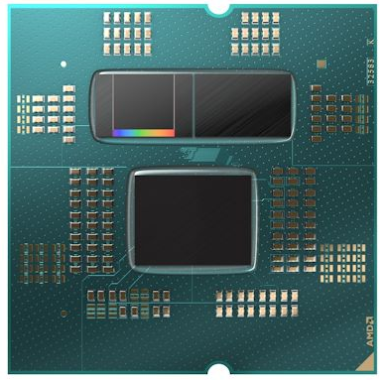
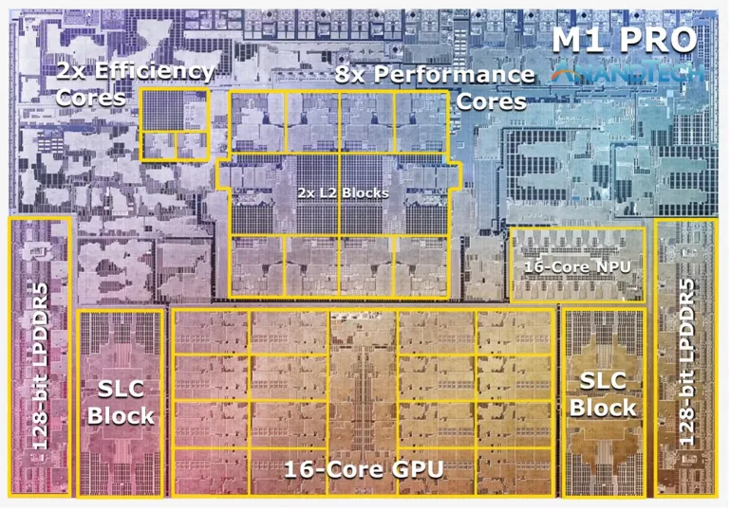
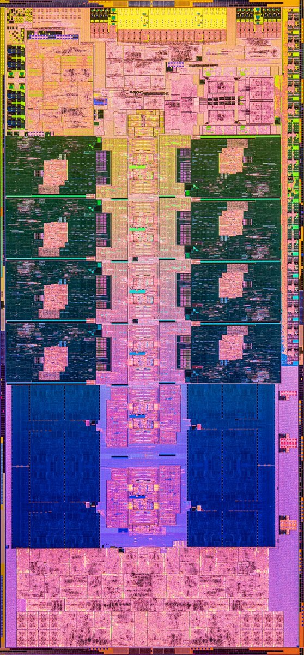
Asymmetric Multicore Processor (AMP)
8x Performance cores
3D
V-Cache
16x Efficient cores
Apple M1 Pro with Performance Cores and Efficiency Cores
Intel Core i9-13900KF with Performance Cores and Efficient Cores
AMD Ryzen 9 7950X3D with 3D V-Cache
Cheng et al., HASpGEMM: Heterogeneity-Aware Sparse General Matrix-Matrix Multiplication on Modern Asymmetric Multicore Processors
7

Slide 8
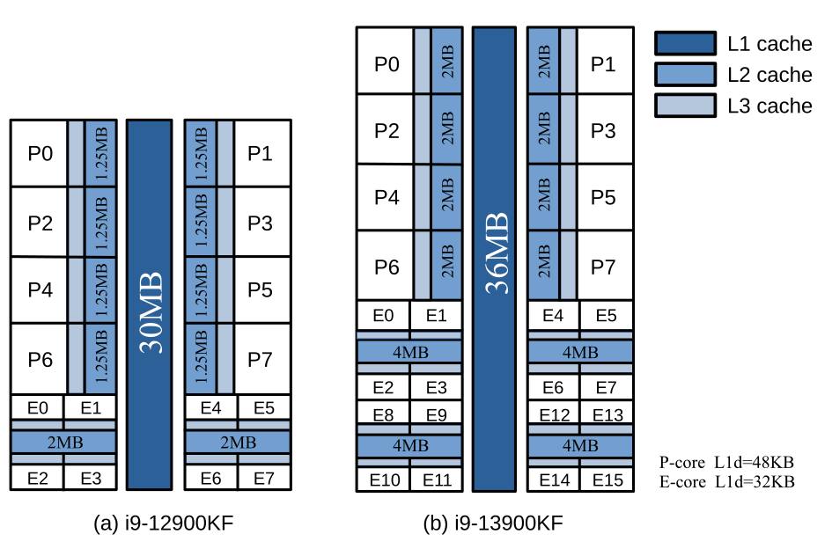
Asymmetric Multicore Processor (AMP)
 | i9-12900KF | i9-13900KF
#Cores | 8 P-cores + 8 E-cores | 8 P-cores + 16 E-cores
L2 Cache Size / MB | 14 | 32
L3 Cache Size / MB | 30 | 36
Frequency (Max/Base) / GHz | P-cores: 5.10/3.2 E-cores: 3.90/2.4 | P-cores: 5.40/3.0 E-cores: 4.30/2.2
Performance core
Efficient core
5.10/3.2
5.40/3.0
3.90/2.4
4.30/2.2
Intel Core i9-12900KF Intel Core i9-13900KF
Cheng et al., HASpGEMM: Heterogeneity-Aware Sparse General Matrix-Matrix Multiplication on Modern Asymmetric Multicore Processors
8

Slide 9
Asymmetric Multicore Processor (AMP)
 | i9-12900KF | i9-13900KF
#Cores | 8 P-cores + 8 E-cores | 8 P-cores + 16 E-cores
L2 Cache Size / MB | 14 | 32
L3 Cache Size / MB | 30 | 36
Frequecny (Max/Base) / GHz | P-cores: 5.10/3.2 E-cores: 3.90/2.4 | P-cores: 5.40/3.0 E-cores: 4.30/2.2
Challenge 2: The asymmetry of AMP can result in a more complex load balancing.
Performance core
Efficient core
5.10/3.2
5.40/3.0
3.90/2.4
4.30/2.2
Intel Core i9-12900KF Intel Core i9-13900KF
Cheng et al., HASpGEMM: Heterogeneity-Aware Sparse General Matrix-Matrix Multiplication on Modern Asymmetric Multicore Processors
9

Slide 10
Basic Accumulator Kernels - SPA
The SPA kernel[2,3] uses a binary mask to map a segment of memory for storing intermediate products, and then removes zero elements to obtain a sparse structure.
1
2
a
b
0
0
0
0
1
1
1
Mask
3
c
X
4
d
e
Intermediate product
1a
2d
1b
1b+2e
5
f
A (4x4)
Nnz = 5
B (4x4)
Nnz = 6
Cheng et al., HASpGEMM: Heterogeneity-Aware Sparse General Matrix-Matrix Multiplication on Modern Asymmetric Multicore Processors
10

Slide 11
Basic Accumulator Kernels - SPA
The SPA kernel uses a binary mask to map a segment of memory for storing intermediate products, and then removes zero elements to obtain a sparse structure.
1
2
a
b
0
0
0
0
1
1
1
Mask
3
c
4
d
e
Intermediate product
1a
2d
1b+2e
5
f
A (4x4)
Nnz = 5
B (4x4)
Nnz = 6
Cheng et al., HASpGEMM: Heterogeneity-Aware Sparse General Matrix-Matrix Multiplication on Modern Asymmetric Multicore Processors
11

Slide 12
Basic Accumulator Kernels - HASH
The HASH kernel[4,5] uses a hash table to store column indices of intermediate products, and then obtains the computation results through a sorting operation.
1
2
a
b
0
0
0
Hash table
(column id)
1
4
2
3
c
X
4
d
e
Intermediate product
1a
1b+2e
2d
1b
5
f
A (4x4)
Nnz = 5
B (4x4)
Nnz = 6
column id = 4
column id = 2
column id = 4
column id = 1
capacity = 3
Cheng et al., HASpGEMM: Heterogeneity-Aware Sparse General Matrix-Matrix Multiplication on Modern Asymmetric Multicore Processors
12

Slide 13
Basic Accumulator Kernels - HASH
The HASH kernel uses a hash table to store column indices of intermediate products, and then obtains the computation results through a sorting operation.
1
2
a
b
0
Hash table
(column id)
1
2
4
3
c
X
4
d
e
Intermediate product
1a
2d
1b+2e
5
f
A (4x4)
Nnz = 5
B (4x4)
Nnz = 6
Sorting
Cheng et al., HASpGEMM: Heterogeneity-Aware Sparse General Matrix-Matrix Multiplication on Modern Asymmetric Multicore Processors
13

Slide 14
Basic Accumulator Kernels - ESC
The ESC kernel[6,7] expands the intermediate products, and then obtains the computation results through a single sorting and compression operation.
1
2
a
b
0
0
0
0
Column id
1
4
2
4
3
c
X
4
d
e
Intermediate product
1a
1b
2d
2e
5
f
A (4x4)
Nnz = 5
B (4x4)
Nnz = 6
Expansion
Cheng et al., HASpGEMM: Heterogeneity-Aware Sparse General Matrix-Matrix Multiplication on Modern Asymmetric Multicore Processors
14

Slide 15
Basic Accumulator Kernels - ESC
The ESC kernel expands the intermediate products, and then obtains the computation results through a single sorting operation and compression.
1
2
a
b
0
0
Column id
1
2
4
4
3
c
X
4
d
e
Intermediate product
1a
2d
1b
2e
5
f
A (4x4)
Nnz = 5
B (4x4)
Nnz = 6
Sorting
Cheng et al., HASpGEMM: Heterogeneity-Aware Sparse General Matrix-Matrix Multiplication on Modern Asymmetric Multicore Processors
15

Slide 16
Basic Accumulator Kernels - ESC
The ESC kernel expands the intermediate products, and then obtains the computation results through a single sorting operation and compression.
1
2
a
b
0
2
4
Column id
1
3
c
X
4
d
e
Intermediate product
1a
2d
1b+2e
5
f
A (4x4)
Nnz = 5
B (4x4)
Nnz = 6
Compression
Cheng et al., HASpGEMM: Heterogeneity-Aware Sparse General Matrix-Matrix Multiplication on Modern Asymmetric Multicore Processors
16

Slide 17
Basic Accumulator Kernels - Pros and Cons
Kernel Type | Memory Overhead | Performance (High Density) | Performance (Low Density) | Conflict Issue
SPA | Small | Good | Poor | Frequent
HASH | Modest | Moderate | Poor | Conflicts
ESC | Large | Poor | Good | Moderate
Cheng et al., HASpGEMM: Heterogeneity-Aware Sparse General Matrix-Matrix Multiplication on Modern Asymmetric Multicore Processors
17

Slide 18
Basic Accumulator Kernels - Pros and Cons
Kernel Type | Memory Overhead | Performance (High Density) | Performance (Low Density) | Conflict Issue
SPA | Small | Good | Poor | Frequent
HASH | Modest | Moderate | Poor | Conflicts
ESC | Large | Poor | Good | Moderate
Challenge 3: The choice of kernel also affects the performance of SpGEMM.
Cheng et al., HASpGEMM: Heterogeneity-Aware Sparse General Matrix-Matrix Multiplication on Modern Asymmetric Multicore Processors
18

Slide 19
Background & Challenge
Micro-Benchmark & Motivation
Performance Comparison of P- and E-cores
Memory Access Overhead and Computational Overhead
Features of the three kernels.
HASpGEMM
Experiment
Conclusion
Outline
Cheng et al., HASpGEMM: Heterogeneity-Aware Sparse General Matrix-Matrix Multiplication on Modern Asymmetric Multicore Processors
19

Slide 20
Challenge 1: The sparsity of the matrix can lead to load imbalance.
Task allocation based on rows. Partition matrix by the number of rows.
Task allocation based on rows. Partition matrix by the number of rows.
Challenge 2: The asymmetry of AMP can result in a more complex load balancing.
Challenge 3: The choice of kernel also affects the performance of SpGEMM.
Is there a way to accurately measure task load?
Cheng et al., HASpGEMM: Heterogeneity-Aware Sparse General Matrix-Matrix Multiplication on Modern Asymmetric Multicore Processors
20

Slide 21
Memory Access Overhead and Computational Overhead
We partition the matrices based on row computation (number of intermediate products) and memory access cost (cache line consumption) respectively, and observe the speedup of the latter over the former.
I9-12900KF
1
1
1
I9-13900KF
1
1
1
Cheng et al., HASpGEMM: Heterogeneity-Aware Sparse General Matrix-Matrix Multiplication on Modern Asymmetric Multicore Processors
21

Slide 22
Memory Access Overhead and Computational Overhead
We partition the matrices based on row computation (number of intermediate products) and memory access cost (cache line consumption) respectively, and observe the speedup of the latter over the former.
I9-12900KF
Motivation 1：It is necessary to consider two partitioning strategies to achieve load balancing.
1
1
1
I9-13900KF
1
1
1
Cheng et al., HASpGEMM: Heterogeneity-Aware Sparse General Matrix-Matrix Multiplication on Modern Asymmetric Multicore Processors
22

Slide 23
Assign asymmetric load to AMP’s two types of cores can solve this challenge.
Challenge 1: The sparsity of the matrix can lead to load imbalance.
Challenge 2: The asymmetry of AMP can result in a more complex load balancing.
Challenge 3: The choice of kernel also affects the performance of SpGEMM.
Is there a fixed value that measures the performance gap between the two cores?
Cheng et al., HASpGEMM: Heterogeneity-Aware Sparse General Matrix-Matrix Multiplication on Modern Asymmetric Multicore Processors
23

Slide 24
Performance Comparison of P- and E-cores
We use SPA, HASH, and ESC SpGEMM kernels to test the speedup of P-cores to E-cores.
I9-12900KF
80%
I9-13900KF
1.25
1.25
1.25
90%
Cheng et al., HASpGEMM: Heterogeneity-Aware Sparse General Matrix-Matrix Multiplication on Modern Asymmetric Multicore Processors
24

Slide 25
Performance Comparison of P- and E-cores
We use SPA, HASH, and ESC SpGEMM kernels to test the speedup of P-cores to E-cores.
I9-12900KF
Motivation 2：It is possible to find a threshold to measure the asymmetry of AMP’s two types of cores.
80%
I9-13900KF
1.25
1.25
1.25
90%
Cheng et al., HASpGEMM: Heterogeneity-Aware Sparse General Matrix-Matrix Multiplication on Modern Asymmetric Multicore Processors
25

Slide 26
It is necessary to figure out how these three kernels perform on AMP.
Challenge 1: The sparsity of the matrix can lead to load imbalance.
Is there a method for selecting the best kernel for different situations?
Challenge 2: The asymmetry of AMP can result in a more complex load balancing.
Challenge 3: The choice of kernel also affects the performance of SpGEMM.
Cheng et al., HASpGEMM: Heterogeneity-Aware Sparse General Matrix-Matrix Multiplication on Modern Asymmetric Multicore Processors
26

Slide 27
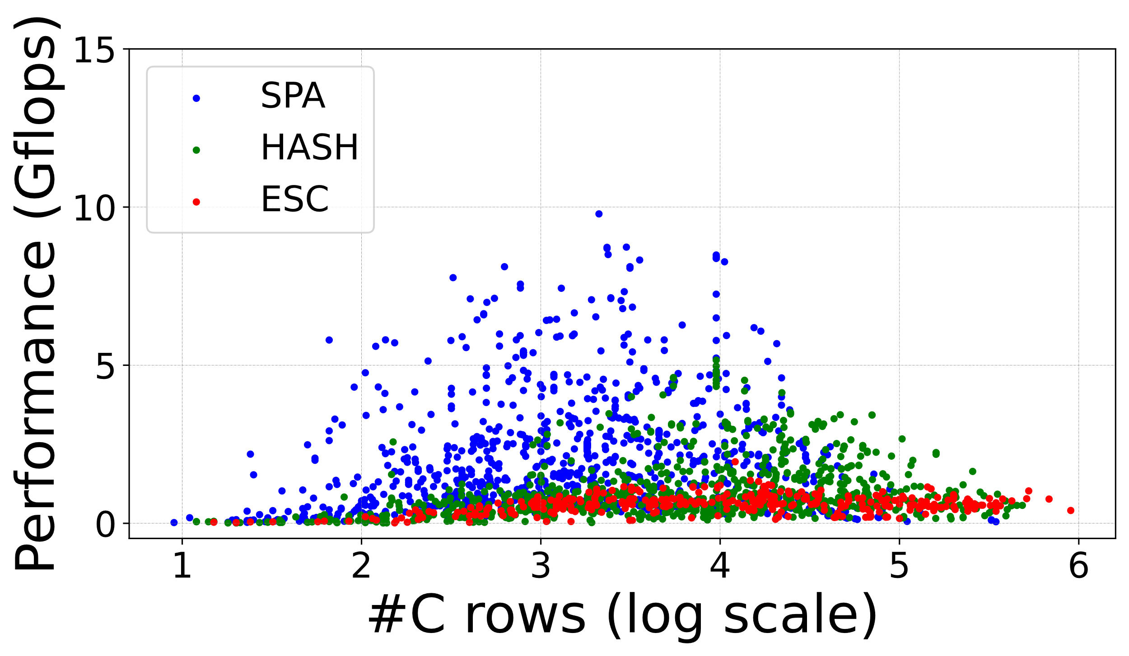
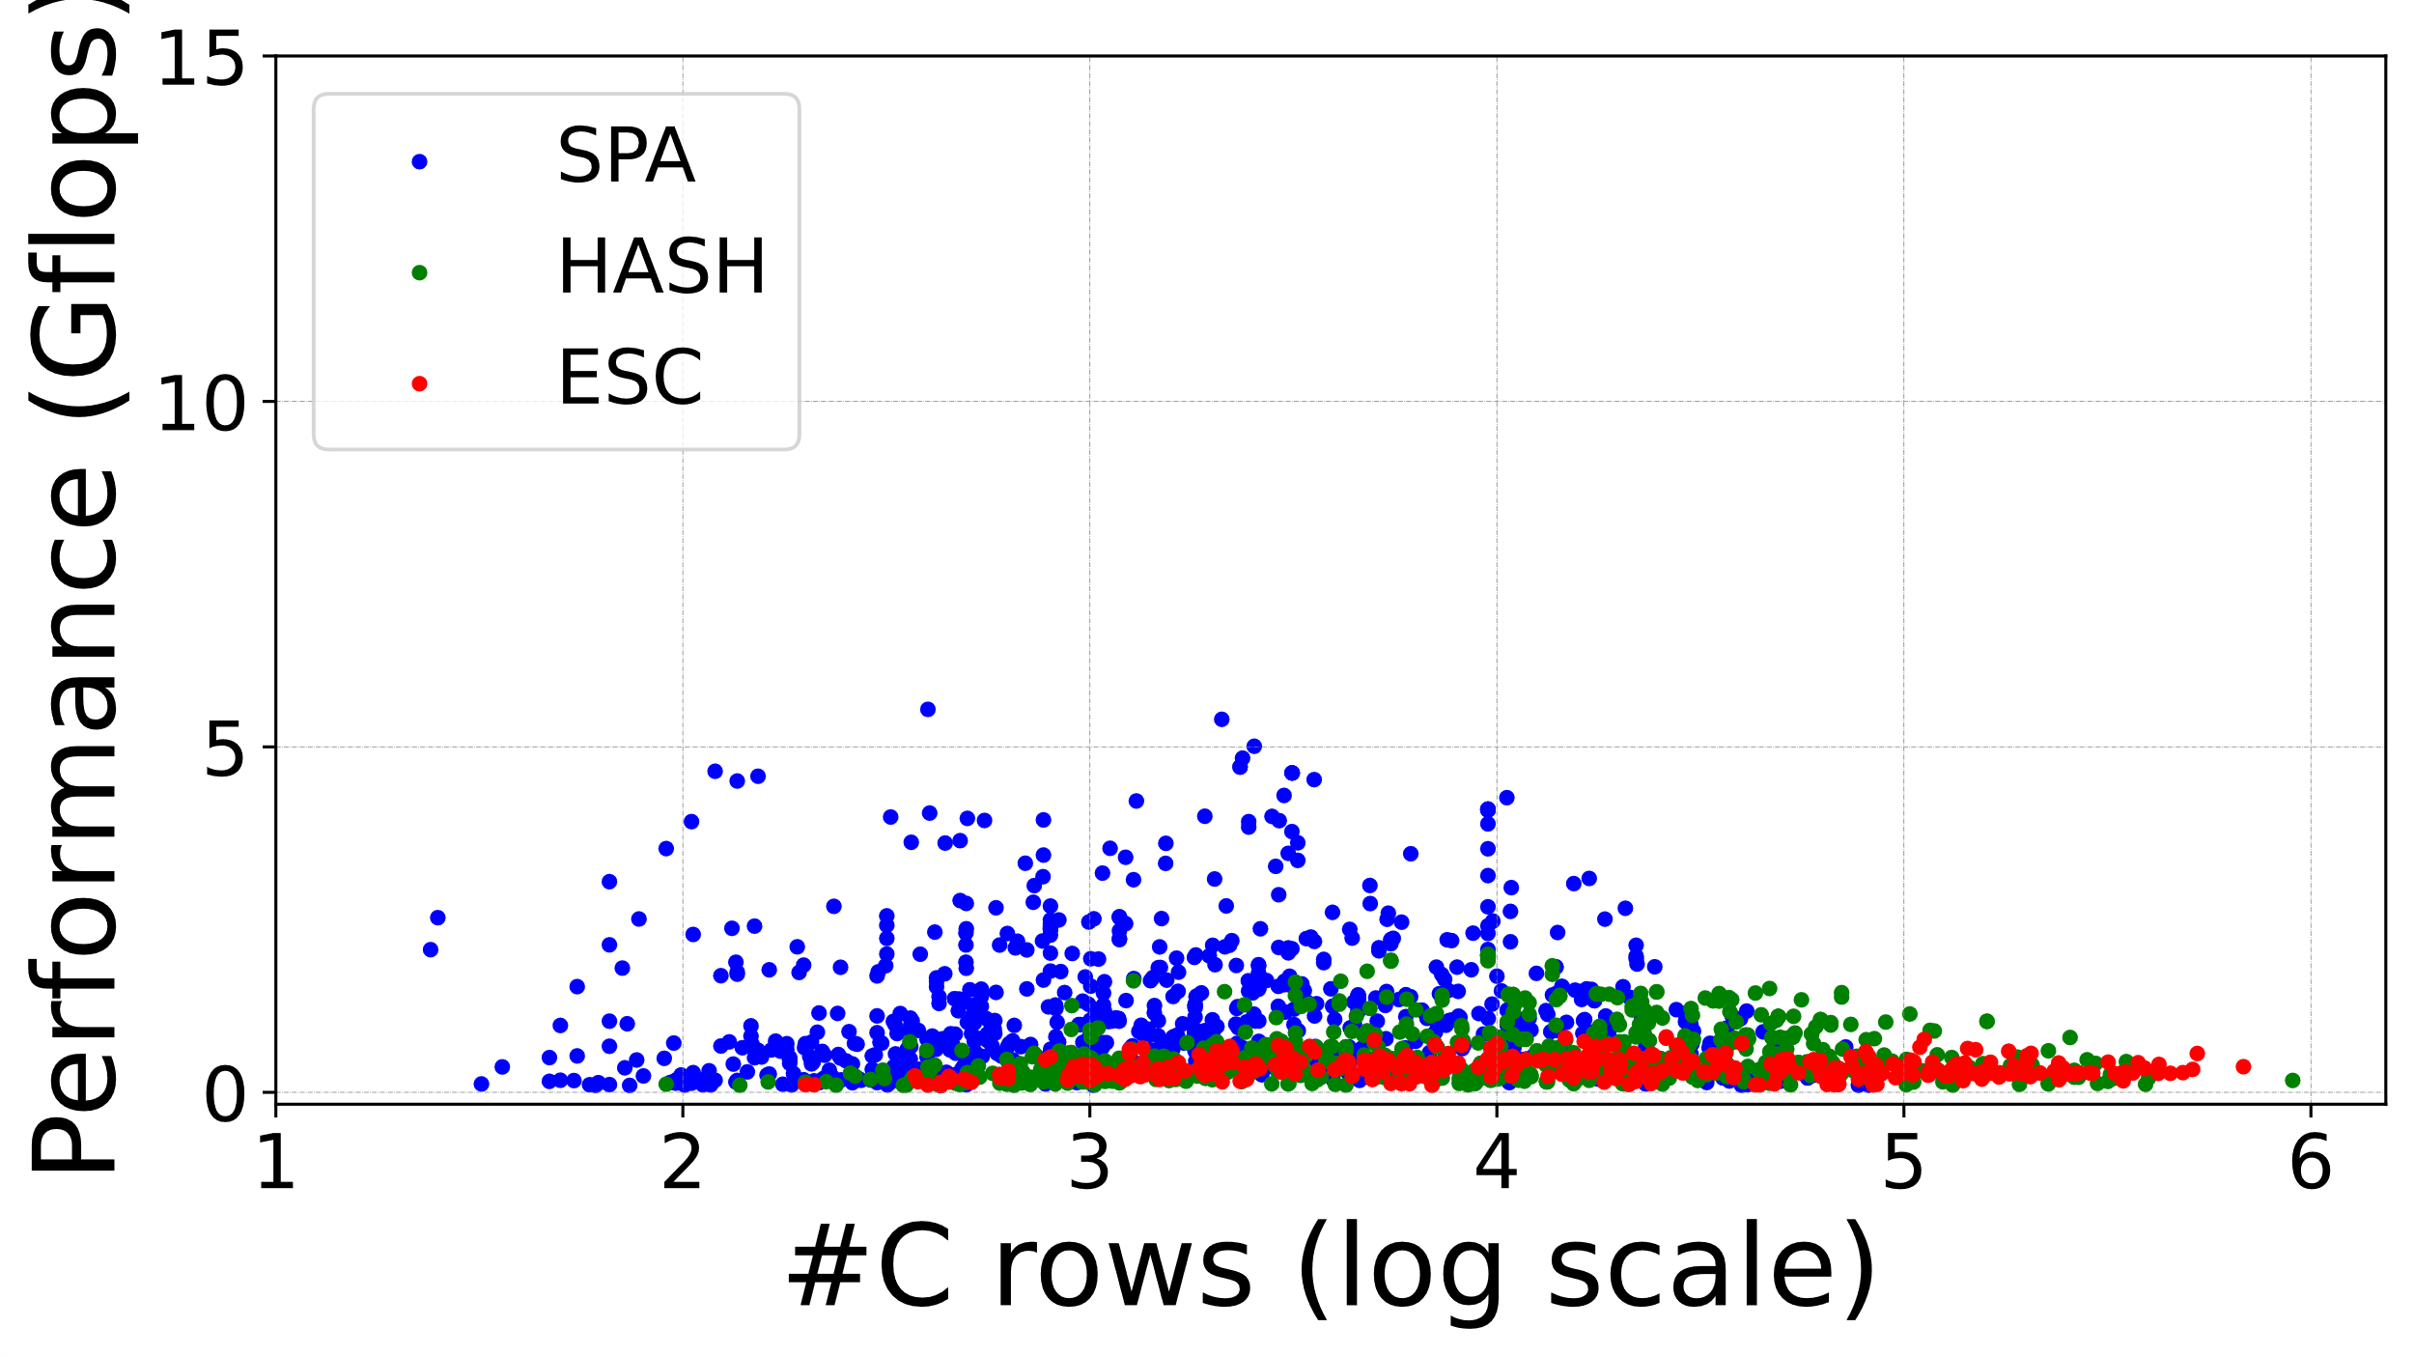
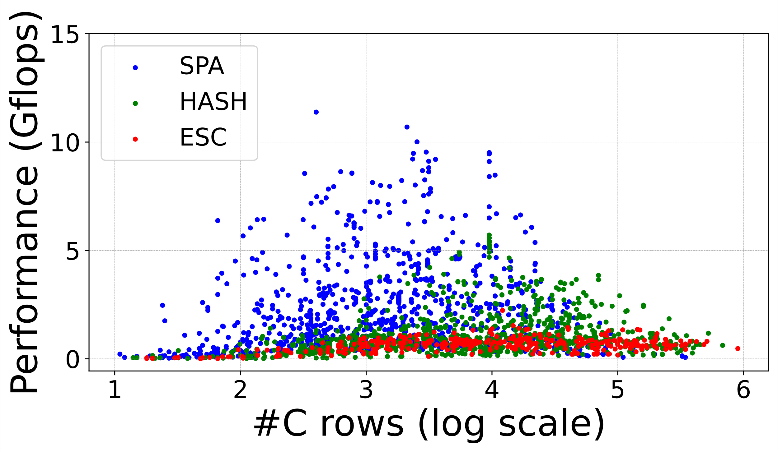
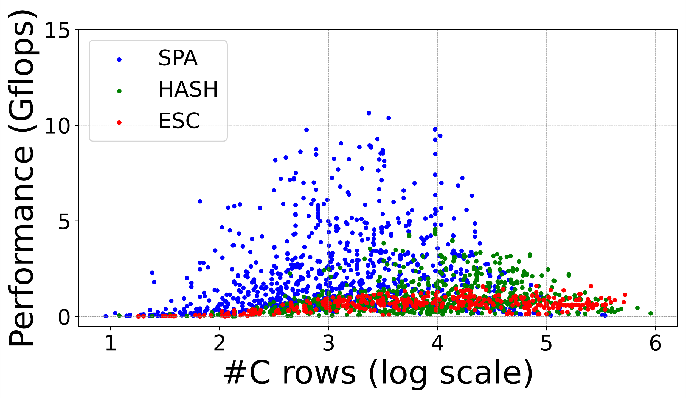
Features of the three kernels.
The optimal kernel when the number of matrix rows is different.
(a) All P-cores in i9-12900KF
(b) All E-cores in i9-12900KF
(c) All P-cores in i9-13900KF
(d) All E-cores in i9-13900KF
Cheng et al., HASpGEMM: Heterogeneity-Aware Sparse General Matrix-Matrix Multiplication on Modern Asymmetric Multicore Processors
27

Slide 28
Features of the three kernels.
The optimal kernel when the number of matrix rows is different.
(b) All E-cores in i9-12900KF
Cheng et al., HASpGEMM: Heterogeneity-Aware Sparse General Matrix-Matrix Multiplication on Modern Asymmetric Multicore Processors
28

Slide 29
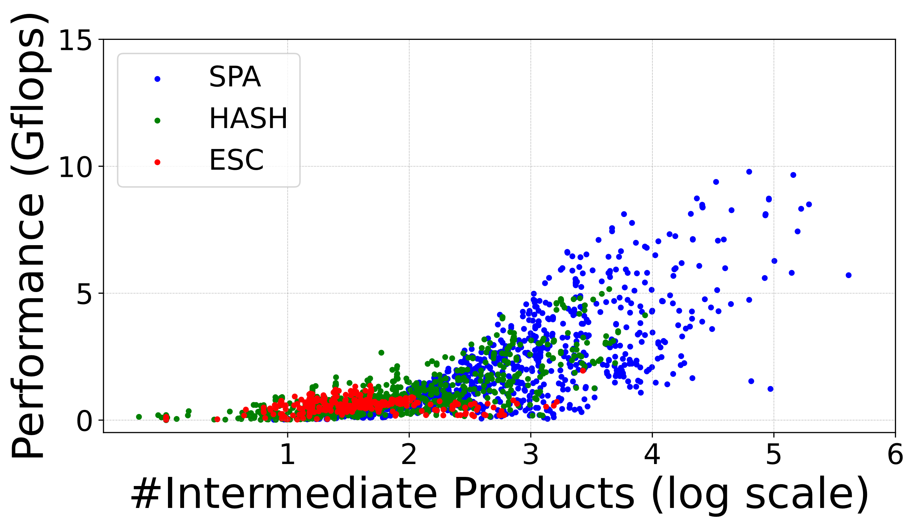
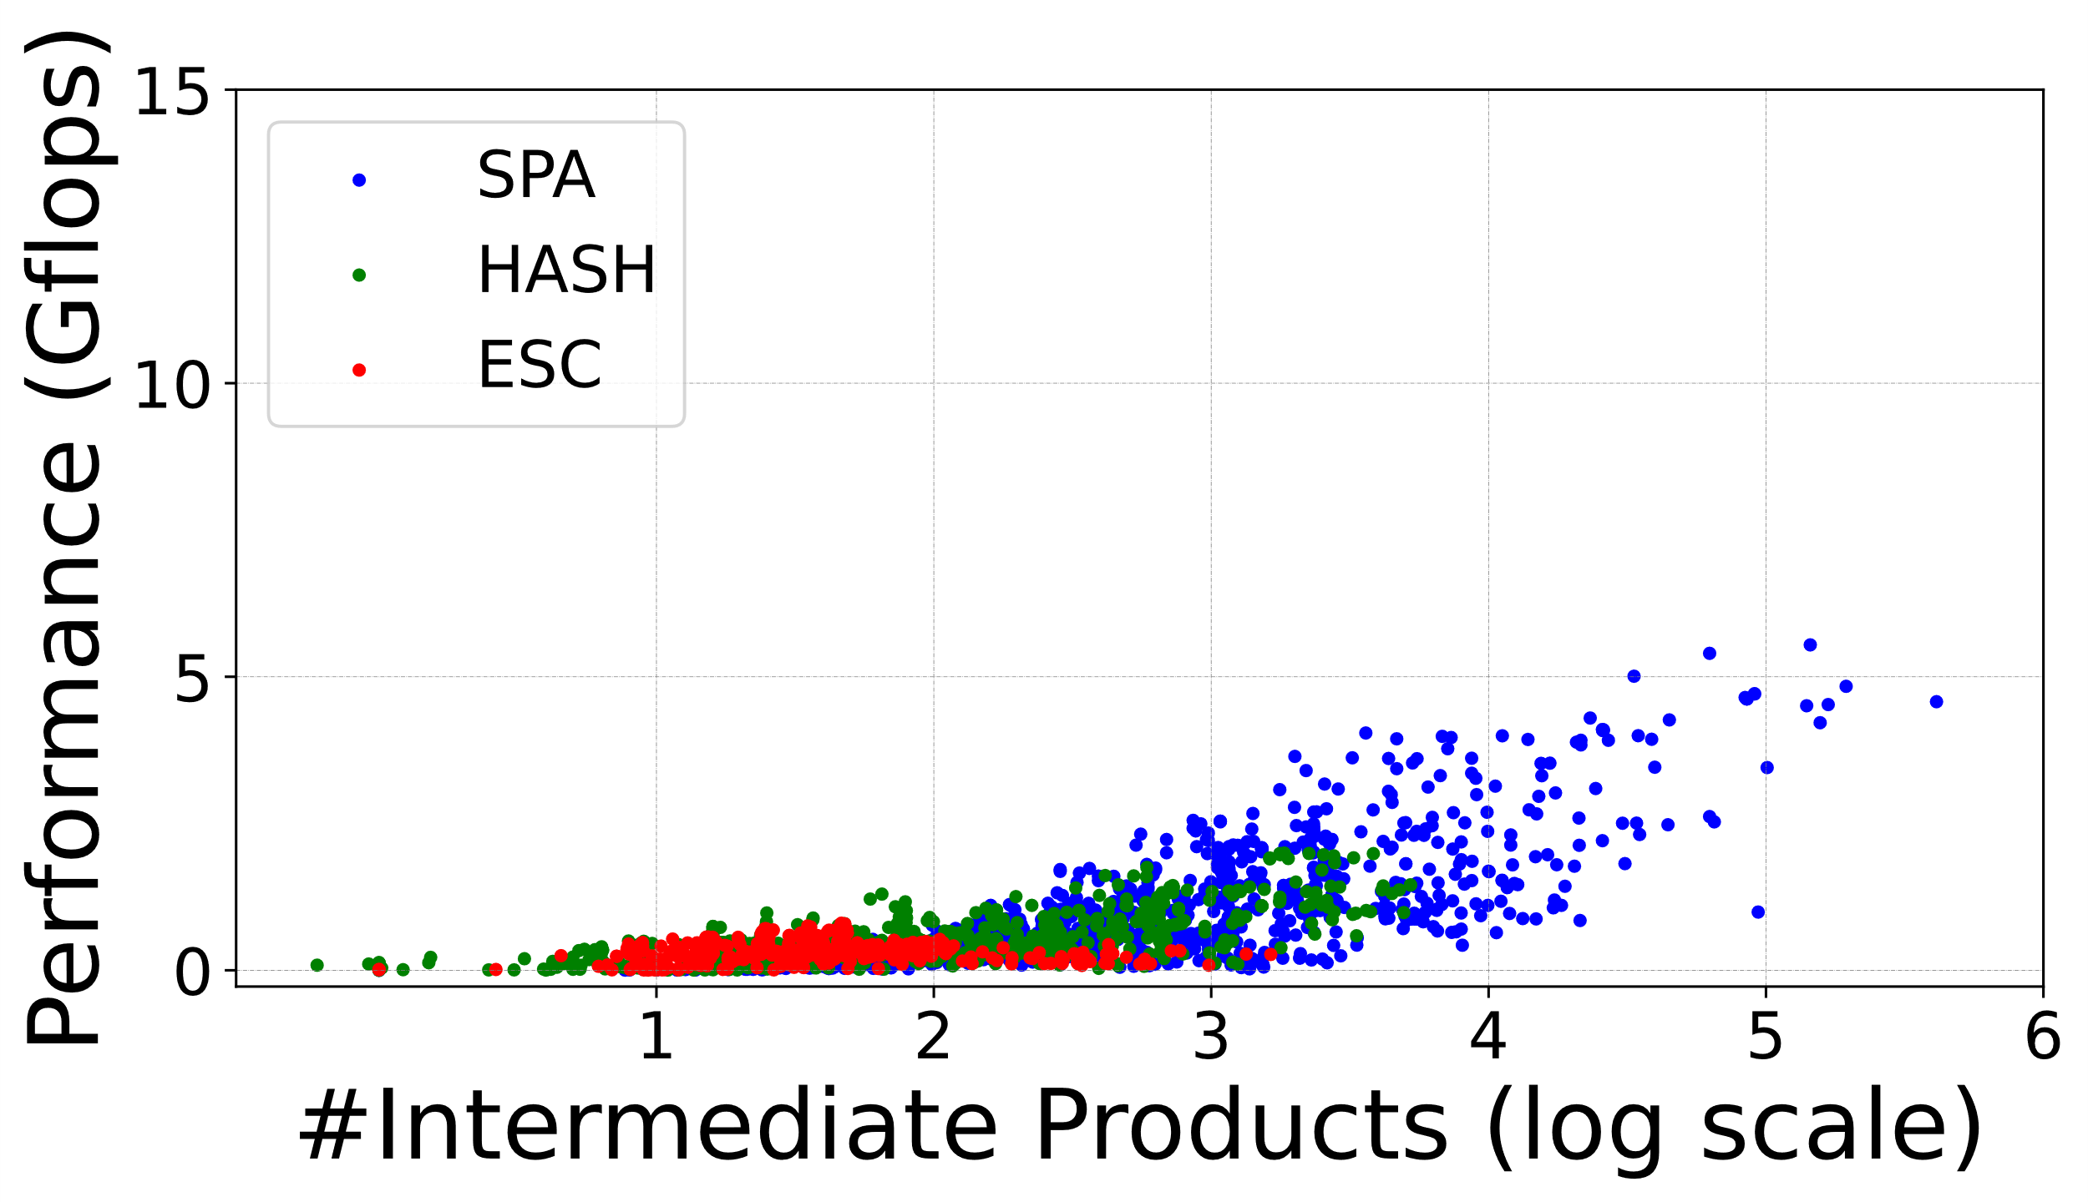
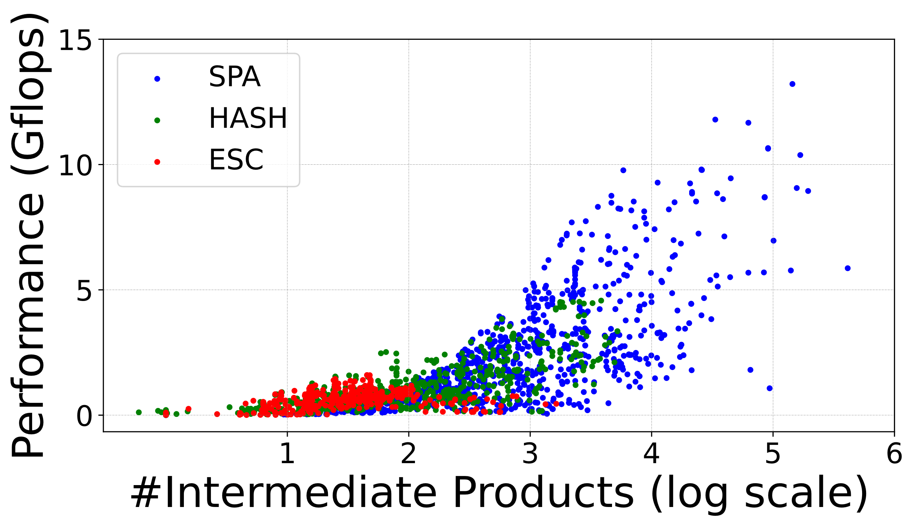
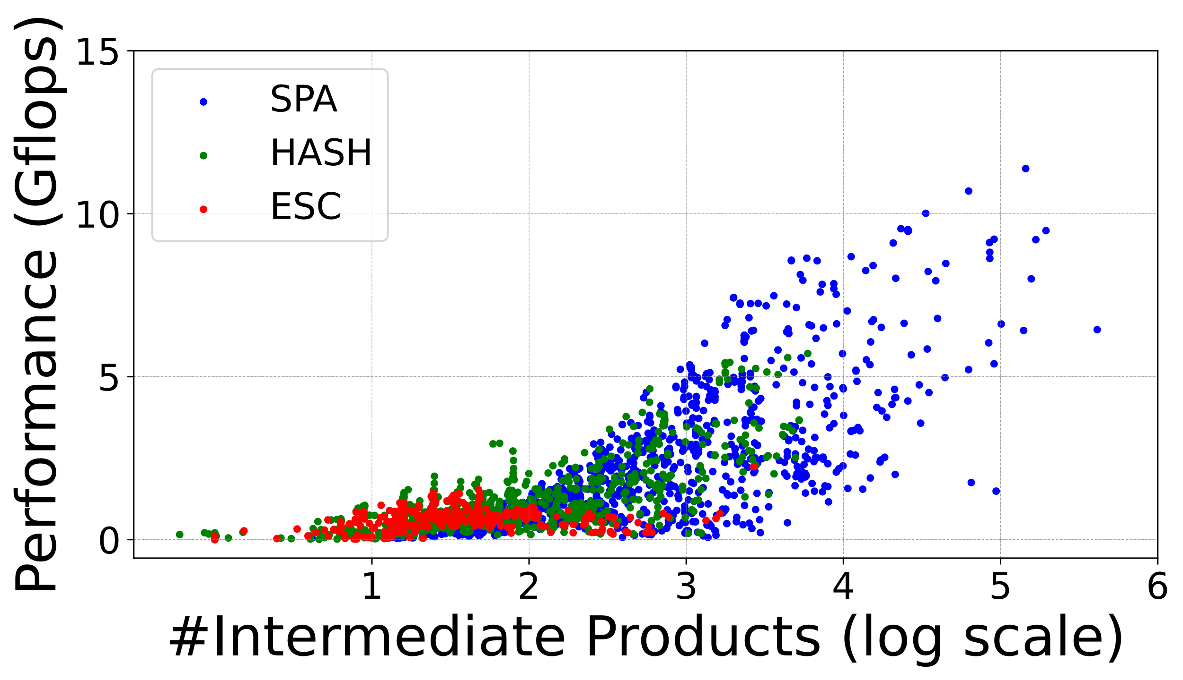
Features of the three kernels.
The optimal kernel when the number of intermediate products is different.
SPA
SPA
HASH
HASH
ESC
ESC
(a) All P-cores in i9-12900KF
(b) All E-cores in i9-12900KF
SPA
SPA
HASH
HASH
ESC
ESC
(c) All P-cores in i9-13900KF
(d) All E-cores in i9-13900KF
Cheng et al., HASpGEMM: Heterogeneity-Aware Sparse General Matrix-Matrix Multiplication on Modern Asymmetric Multicore Processors
29

Slide 30
i
Features of the three kernels.
The optimal kernel when the number of intermediate products is different.
SPA
SPA
HASH
HASH
ESC
Motivation 3：Kernel selection can be made according to the matrix structure.
ESC
(a) All P-cores in i9-12900KF
(b) All E-cores in i9-12900KF
SPA
SPA
HASH
HASH
ESC
ESC
(c) All P-cores in i9-13900KF
(d) All E-cores in i9-13900KF
Cheng et al., HASpGEMM: Heterogeneity-Aware Sparse General Matrix-Matrix Multiplication on Modern Asymmetric Multicore Processors
30

Slide 31
Background & Challenge
Micro-Benchmark & Motivation
HASpGEMM
Algorithm Design
Analysis Phase
Execution Phase
Experiment
Conclusion
Outline
Cheng et al., HASpGEMM: Heterogeneity-Aware Sparse General Matrix-Matrix Multiplication on Modern Asymmetric Multicore Processors
31

Slide 32
Algorithm Design
Analysis Phase
Using the sum of intermediate product count and consumed cache line count as row weights to measure the workload.
Allocate the workload to the two types of cores based on the acceleration ratio of P-cores to E-cores.
Motivation 1：It is necessary to consider two partitioning strategies to achieve load balancing.
Motivation 2：It is possible to find a threshold to measure the asymmetry of AMP’s two types of cores.
Motivation 3：kernel selection can be made according to the matrix structure.
Execution Phase
Utilize an adaptive kernel selection method to choose the optimal kernel based on the matrix structure.
Cheng et al., HASpGEMM: Heterogeneity-Aware Sparse General Matrix-Matrix Multiplication on Modern Asymmetric Multicore Processors
32

Slide 33
Analysis Phase
Utlizing a new weight(weight) to measure the workload, which is the sum of intermediate product count (ipc) and consumed cache line(ccl).
a
b
…
d
e
cache line
ipc ccl weight
1 2 3 4
1
2
a
b
1a
2d
1b
2e
4
2
6
3
c
3c
1 1 2
X
=
4
d
e
4f
1 1 2
5
f
5c
1 1 2
A (4x4)
Nnz = 5
B (4x4)
Nnz = 6
Intermediate product of C
Cheng et al., HASpGEMM: Heterogeneity-Aware Sparse General Matrix-Matrix Multiplication on Modern Asymmetric Multicore Processors
33

Slide 34
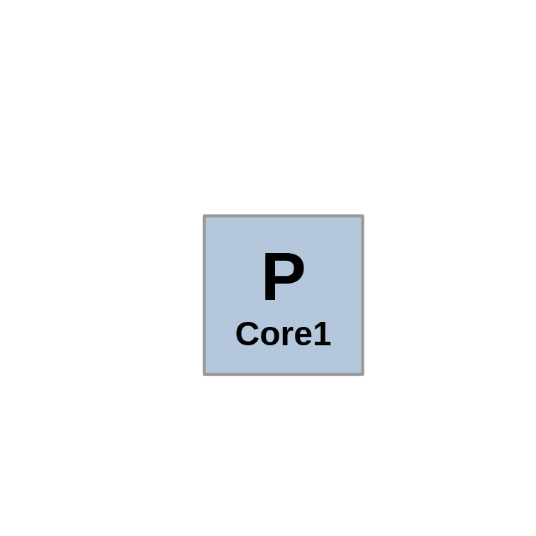
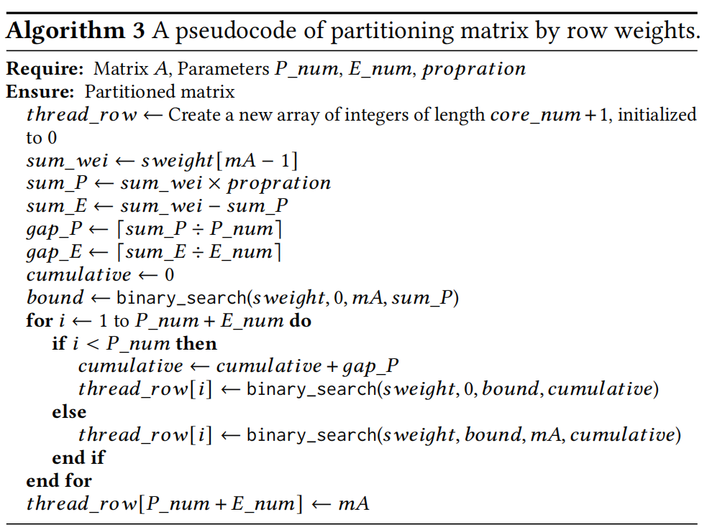
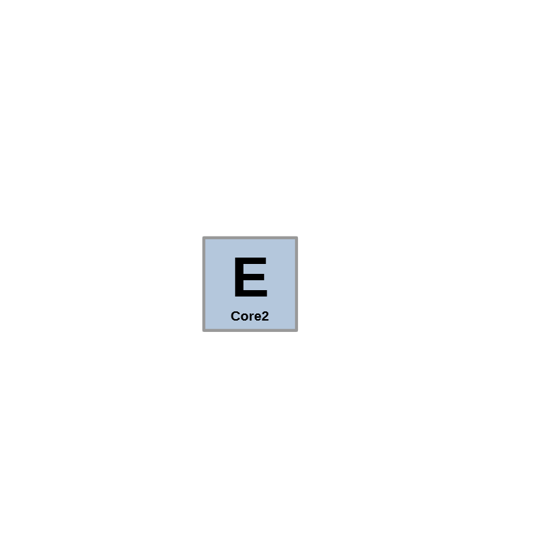
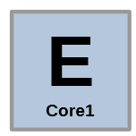
Analysis Phase
Allocate the workload to the two types of cores based on a certain proportion.
Weight
Load proportion P:E = 2:1
1a
2d
1b+2e
6
3c
2
4f
2
5c
2
C (4x4)
thread_row[] = { 0, 2, 3, 4 }
Cheng et al., HASpGEMM: Heterogeneity-Aware Sparse General Matrix-Matrix Multiplication on Modern Asymmetric Multicore Processors
34

Slide 35
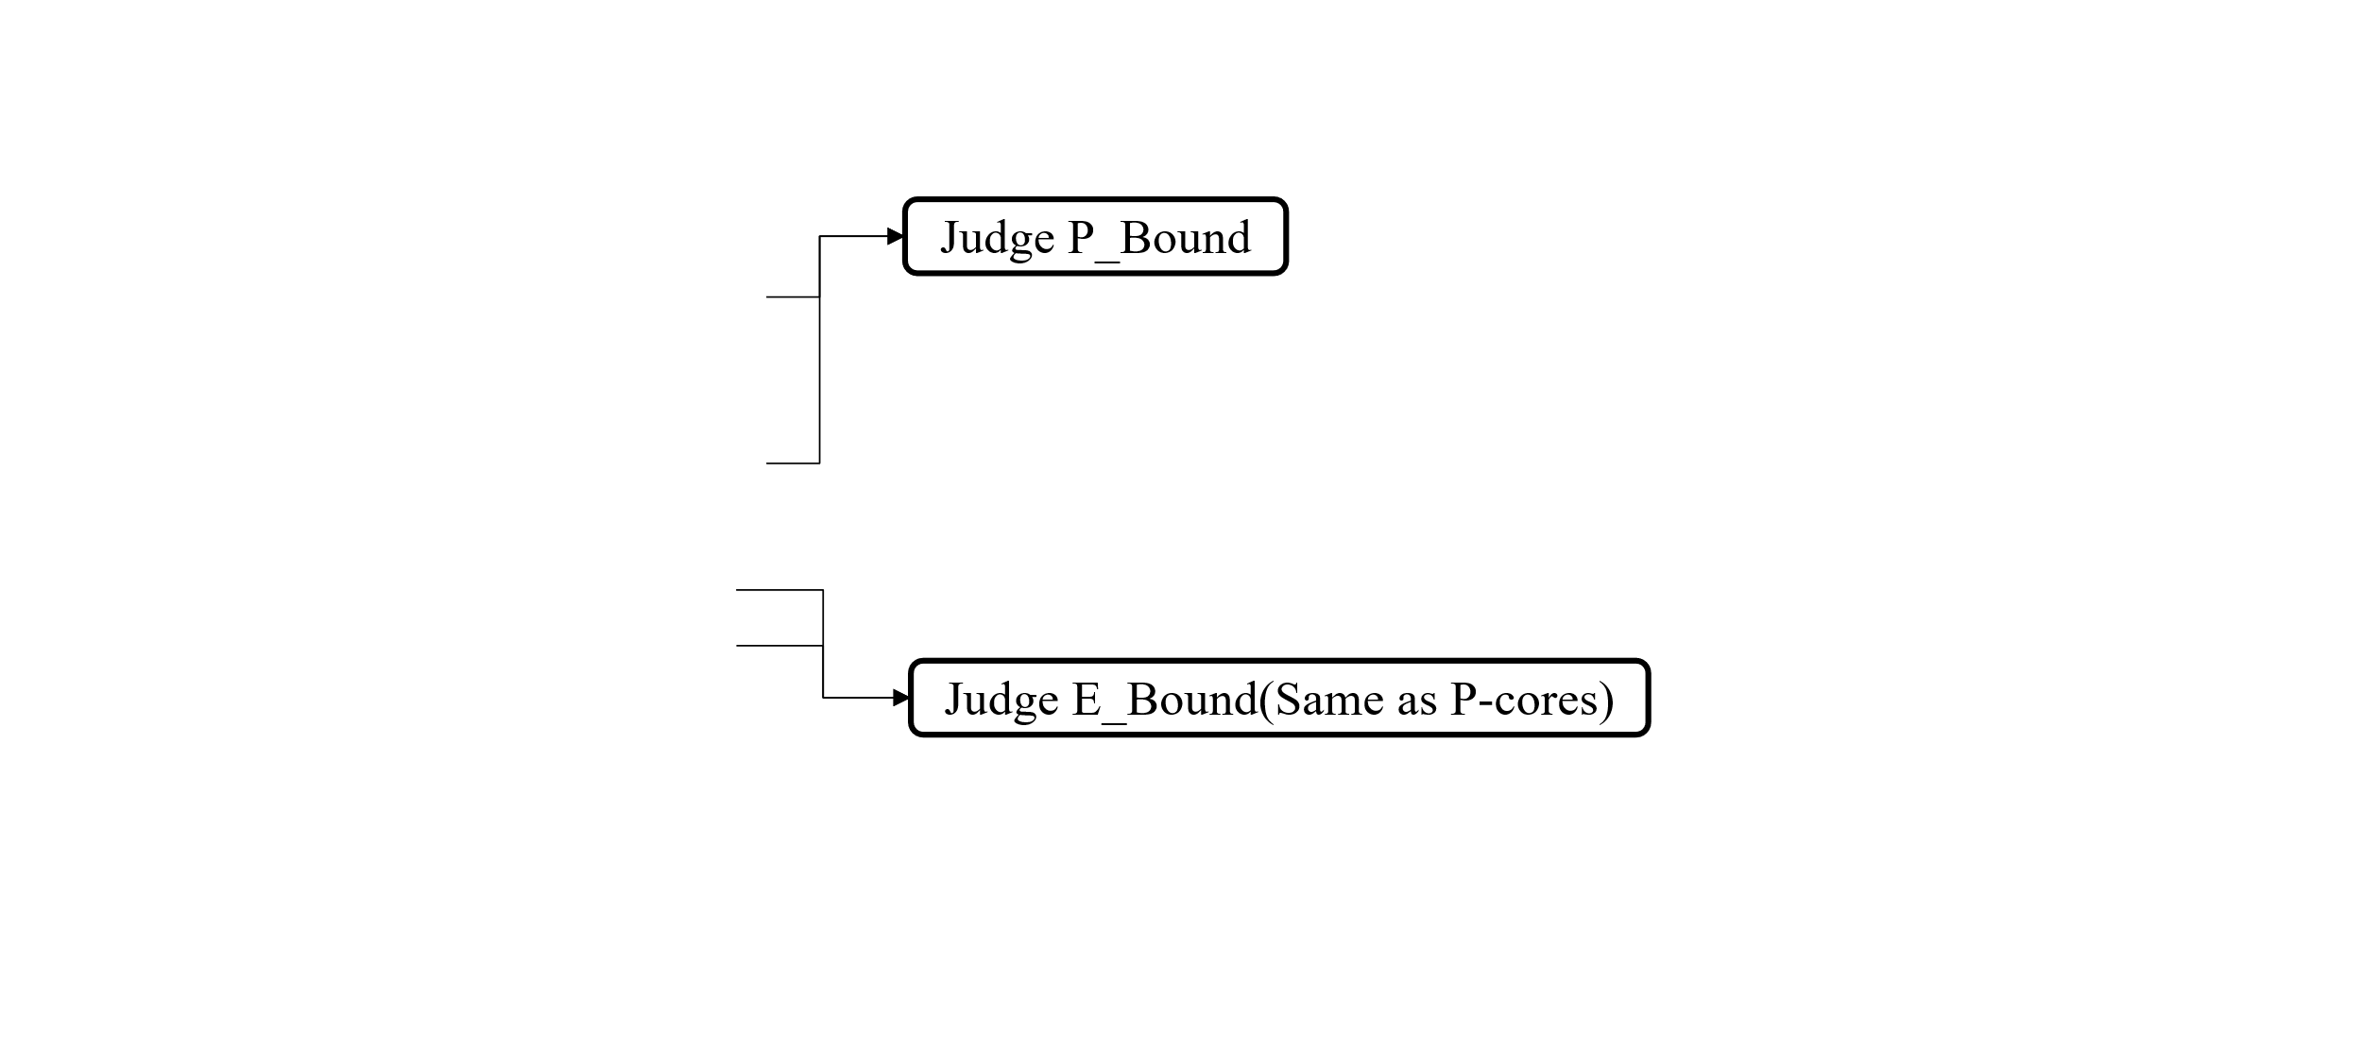
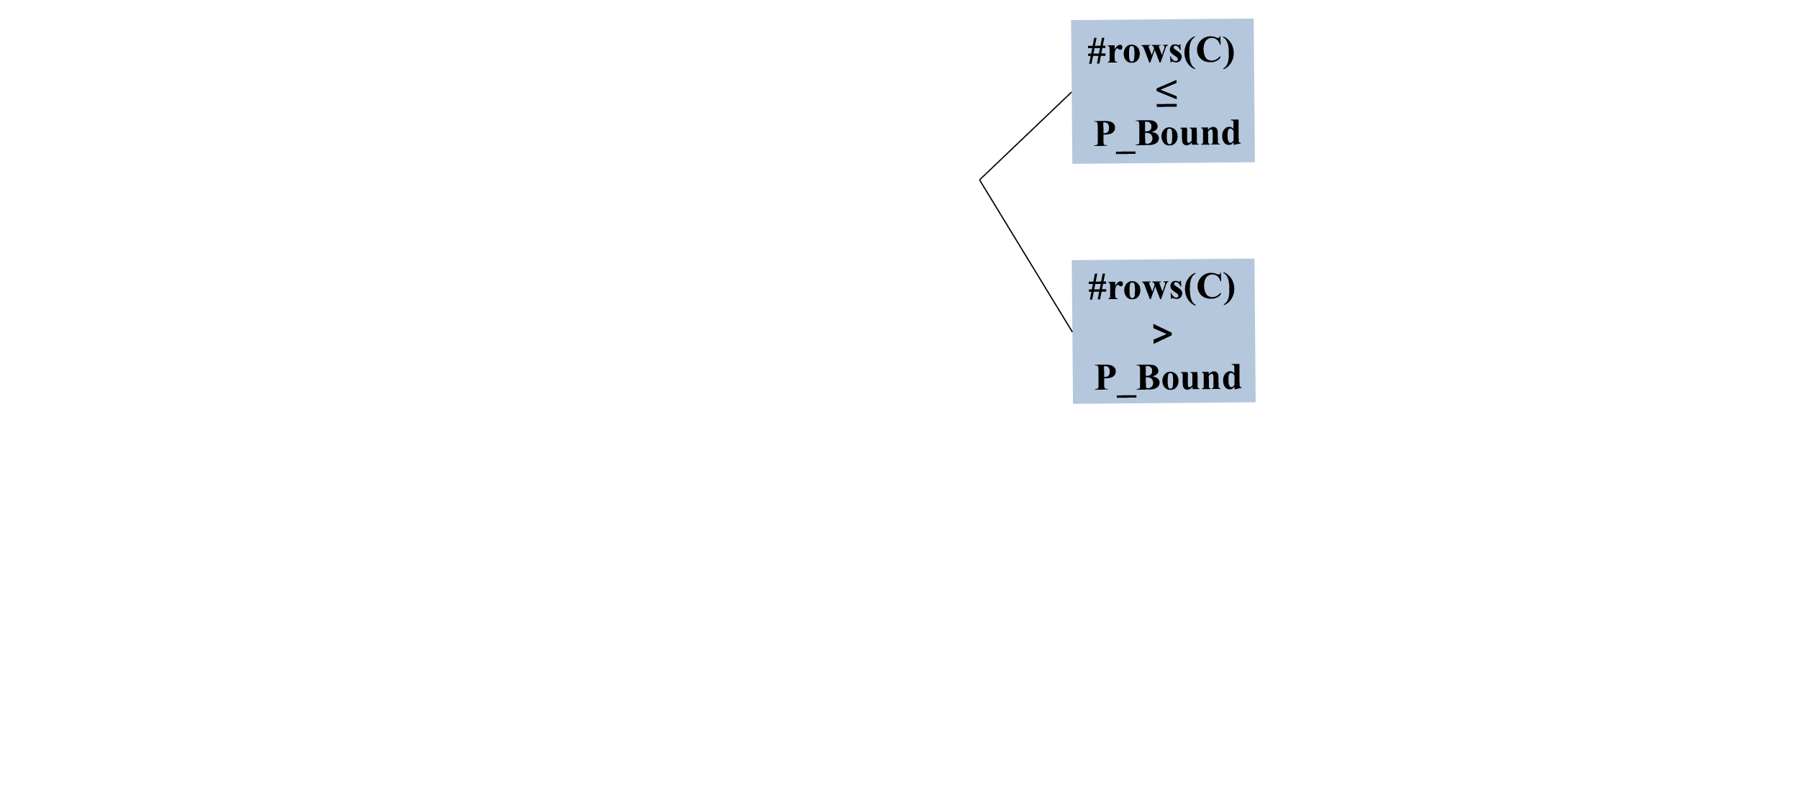
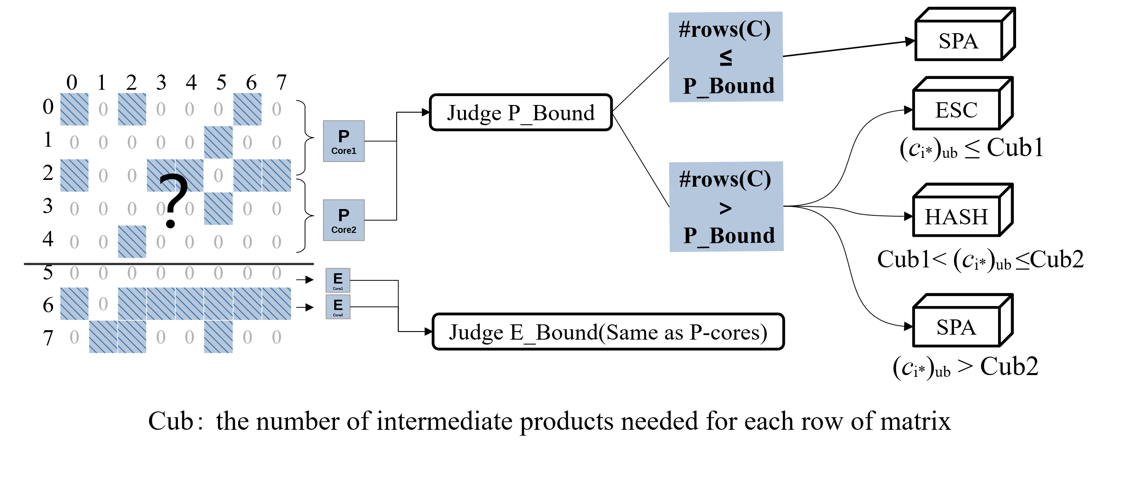
Execution Phase
Utilize an adaptive kernel selection method to choose the optimal kernel based on the matrix structure.
Cheng et al., HASpGEMM: Heterogeneity-Aware Sparse General Matrix-Matrix Multiplication on Modern Asymmetric Multicore Processors
35
31

Slide 36
Background & Challenge
Micro-Benchmark & Motivation
HASpGEMM
Experiment
Setup
Result
Conclusion
Outline
Cheng et al., HASpGEMM: Heterogeneity-Aware Sparse General Matrix-Matrix Multiplication on Modern Asymmetric Multicore Processors
36

Slide 37
Experimental setup
Processor | Intel Core i9-12900KF | Intel Core i9-13900KF
#Cores System memory Bandwidth | 8P and 8E 128 GB DDR5 76.8 GB/s | 8P and 16E 128 GB DDR5 89.6 GB/s
System software and library | Ubuntu 22.10, gcc 12.2.0 Intel oneMKL v2023.0
Cheng et al., HASpGEMM: Heterogeneity-Aware Sparse General Matrix-Matrix Multiplication on Modern Asymmetric Multicore Processors
37

Slide 38
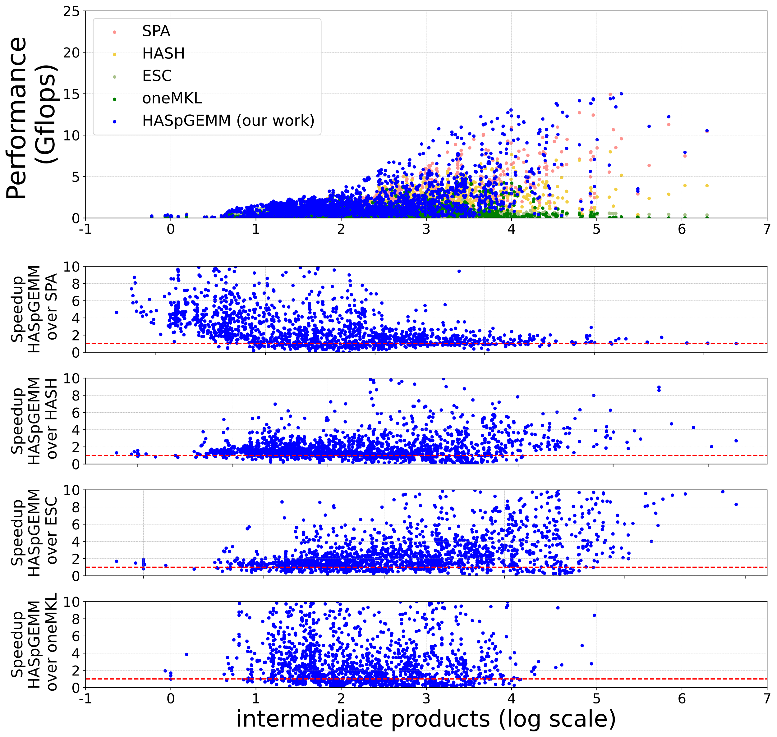
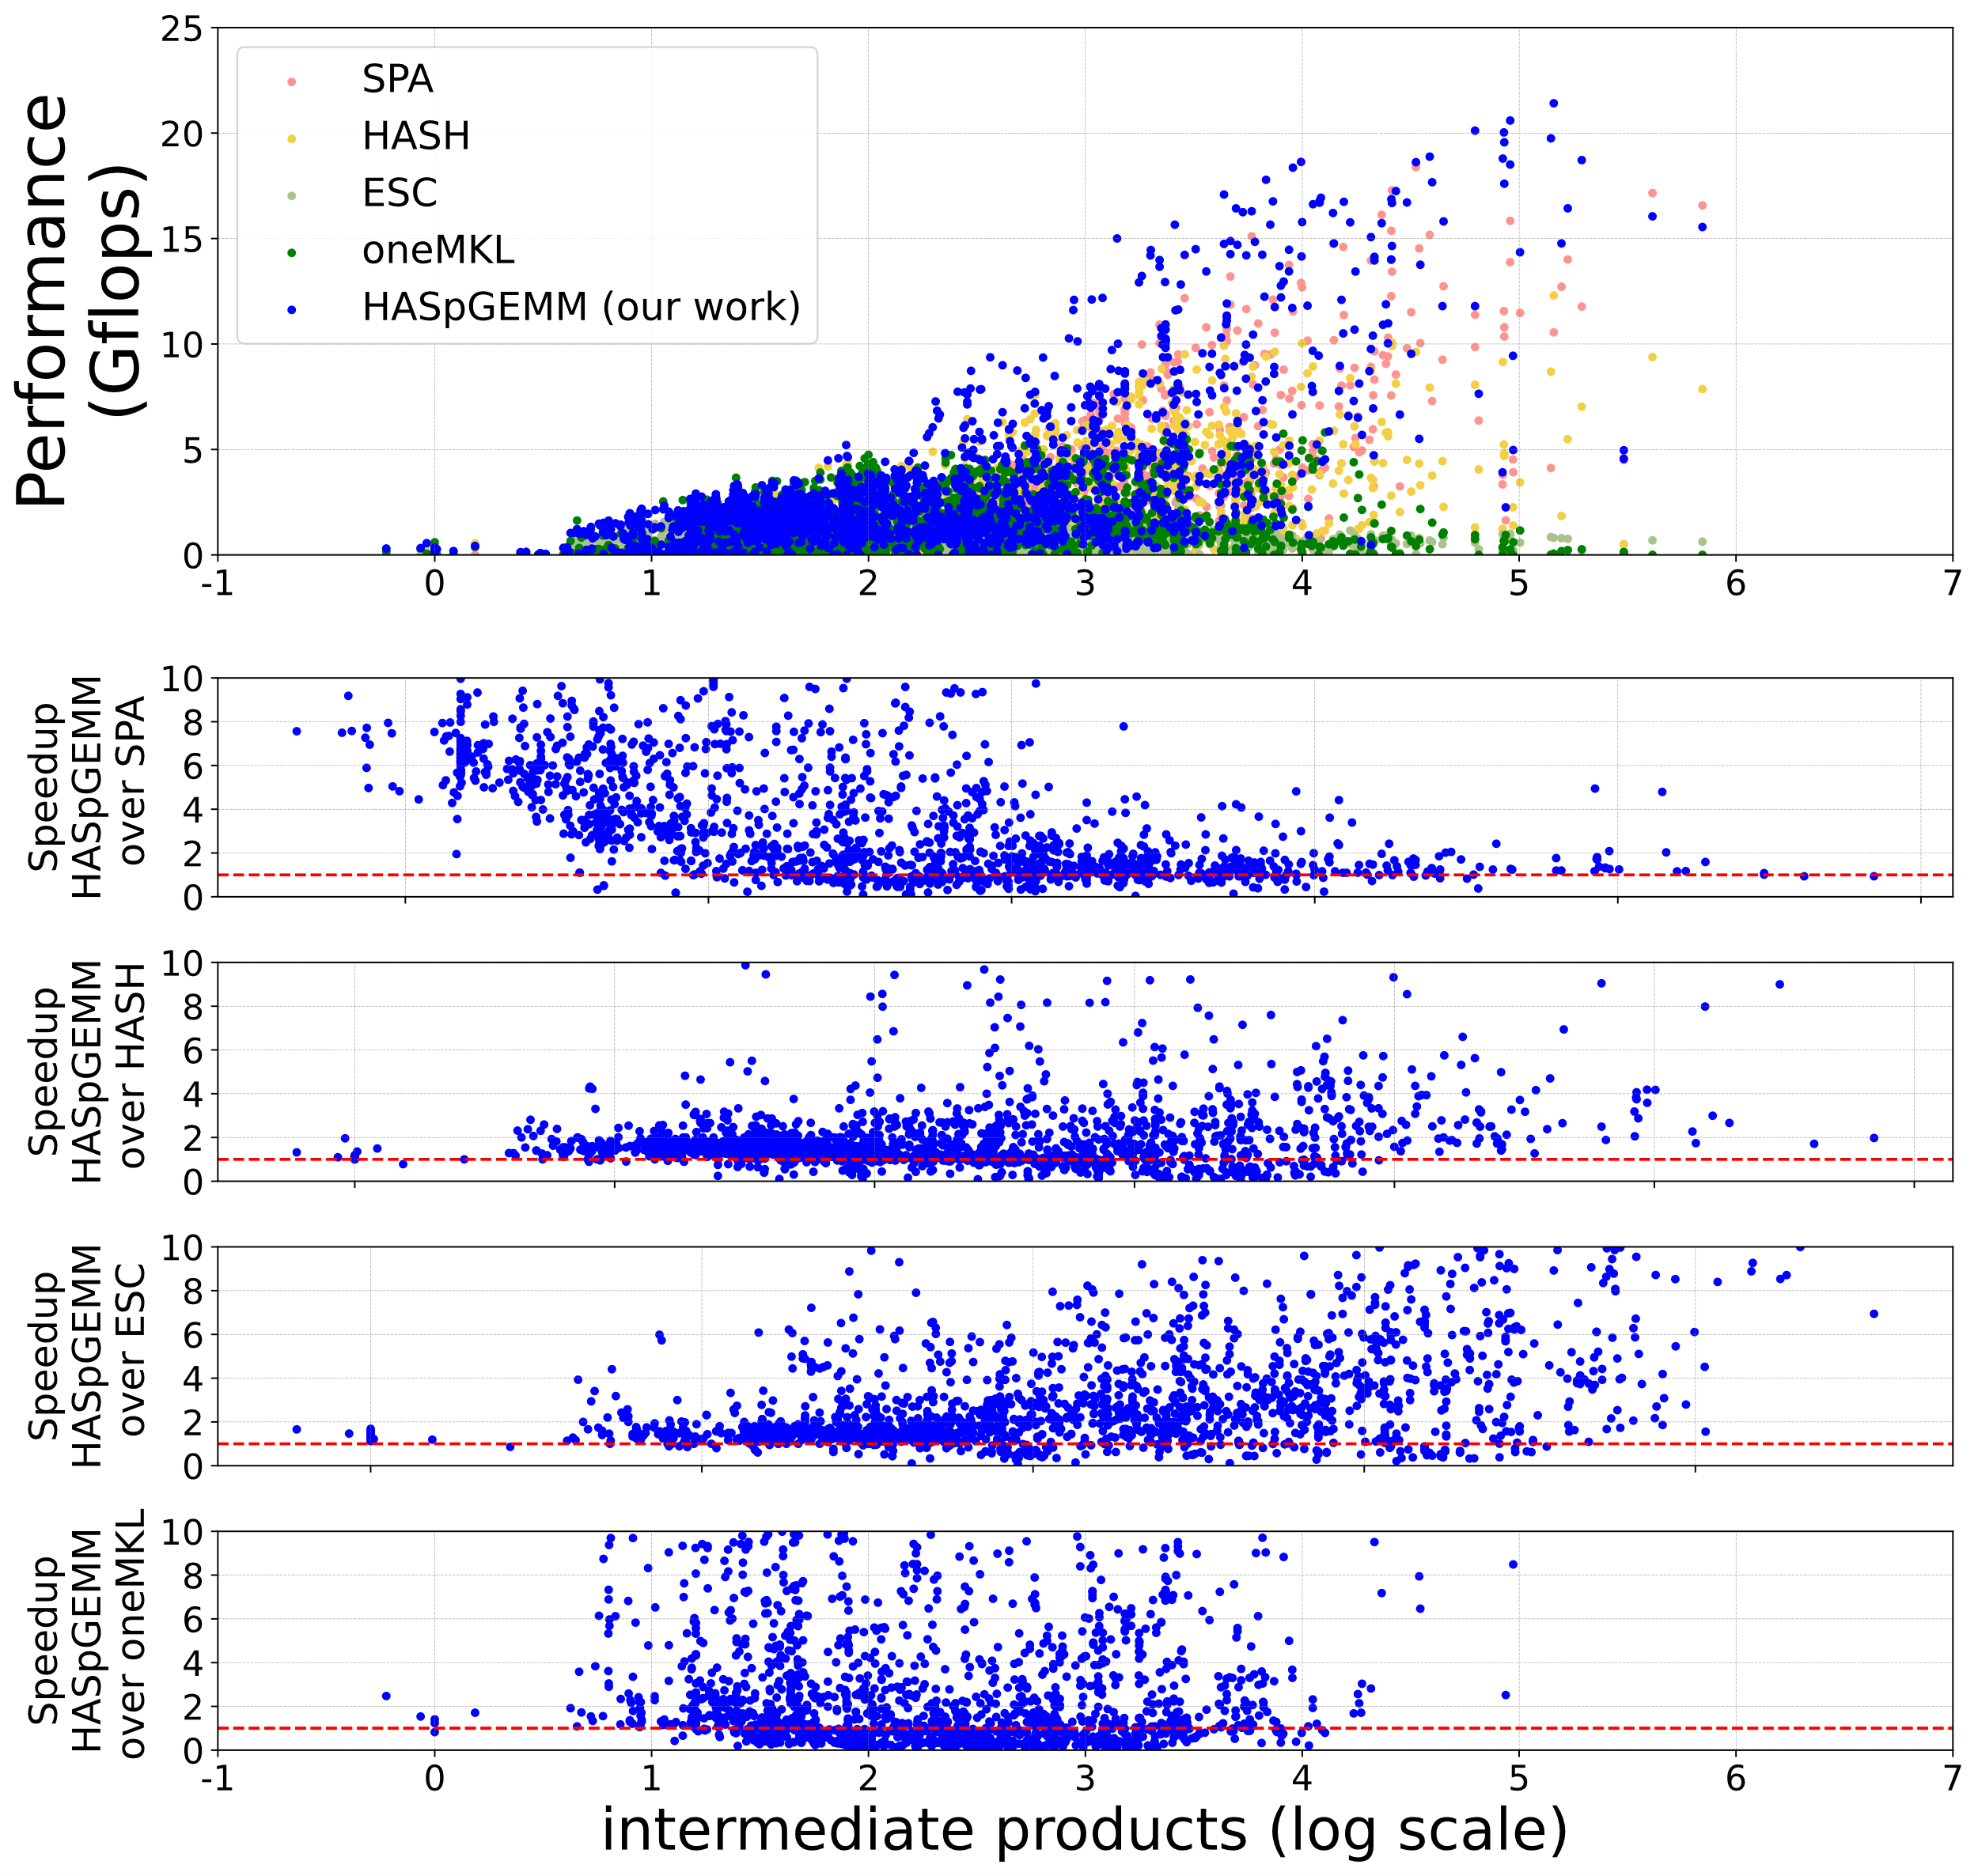
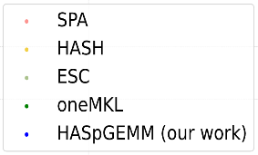
Experimental result
Testing with 2888 matrix from Suitsparse Matrix Collection[1]. Control group: SPA, HASH, ESC, and the latest oneMKL.
 | SPA | HASH | ESC | oneMKL
i9-12900KF | 2164 | 2127 | 2260 | 1278
 | 2.83x | 1.85x | 3.85x | 1.88x
i9-13900KF | 2159 | 2153 | 2380 | 1460
 | 4.06x | 2.21x | 4.56x | 2.23x
over SPA
over SPA
over HASH
over HASH
over ESC
over ESC
Compared to other works, HASpGEMM achieved an average speedup of 1.85x - 3.85x on the i9-12900KF, and 2.21x - 4.56x on the i9-13900KF.
over oneMKL
over oneMKL
i9-12900KF
i9-13900KF
Cheng et al., HASpGEMM: Heterogeneity-Aware Sparse General Matrix-Matrix Multiplication on Modern Asymmetric Multicore Processors
38

Slide 39
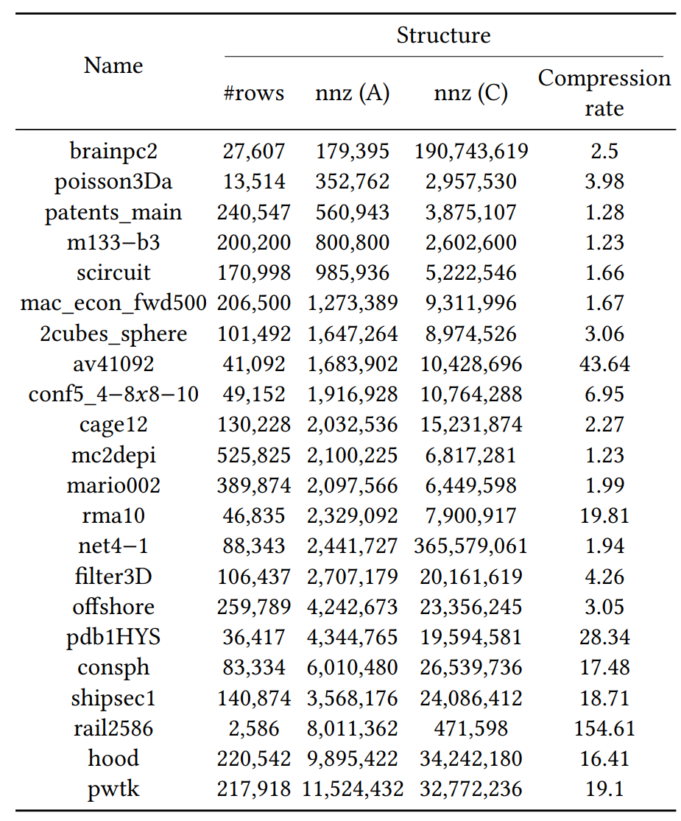
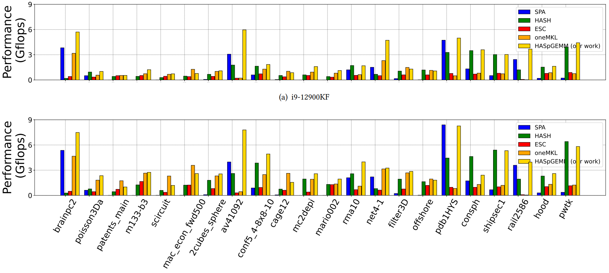
Experimental result
Testing with 22 representative matrices. Control group: SPA, HASH, ESC, and the latest oneMKL.
Compression rate = #intermediate product / #row
i9-12900KF
i9-13900KF
Cheng et al., HASpGEMM: Heterogeneity-Aware Sparse General Matrix-Matrix Multiplication on Modern Asymmetric Multicore Processors
39

Slide 40
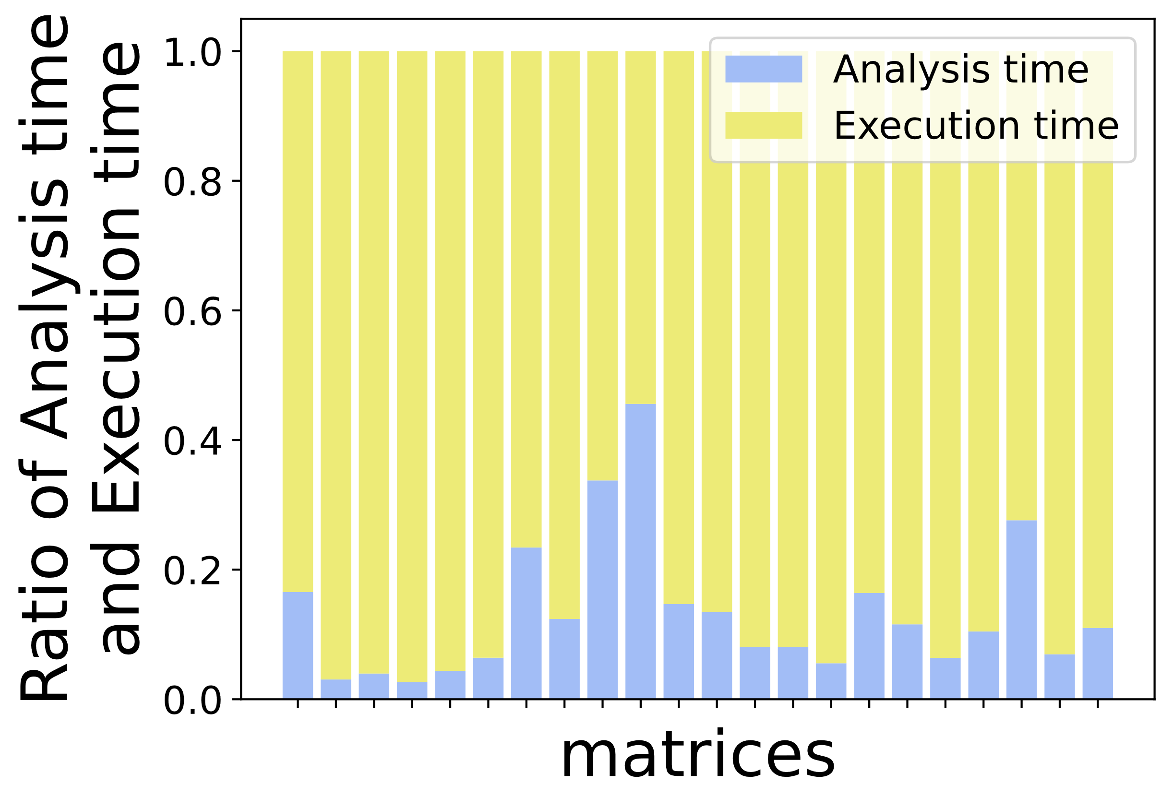
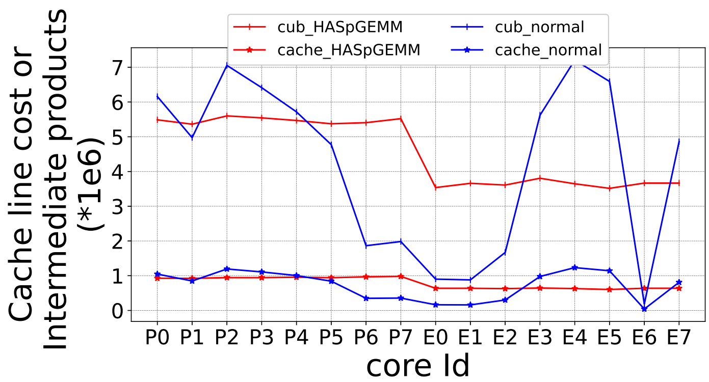
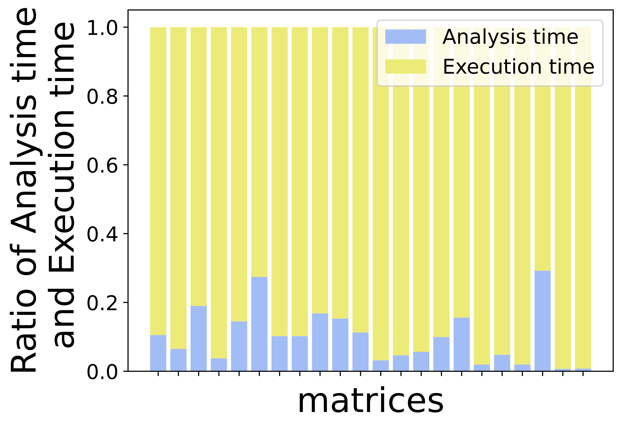
Experimental result
We have achieved load-balanced task allocation and reduced analysis time.
This work
Normal omp
i9-13900KF
Actual task workload under different strategies.
i9-12900KF
Cheng et al., HASpGEMM: Heterogeneity-Aware Sparse General Matrix-Matrix Multiplication on Modern Asymmetric Multicore Processors
40

Slide 41
Background & Challenge
Micro-Benchmark & Motivation
HASpGEMM
Experiment
Conclusion
Outline
Cheng et al., HASpGEMM: Heterogeneity-Aware Sparse General Matrix-Matrix Multiplication on Modern Asymmetric Multicore Processors
41

Slide 42
Conclusion
We obtain a large amount of performance data through conducting micro-benchmarks of three basic kernels on two latest AMPs for guiding algorithm design.
We propose the HASpGEMM algorithm that achieves overall load balancing and selects appropriate kernels according to compute and memory access costs of rows.
We evaluate a variety of SpGEMM algorithms by running the full sparse matrix collection and show that HASpGEMM gains significant speedups over the existing work.
Cheng et al., HASpGEMM: Heterogeneity-Aware Sparse General Matrix-Matrix Multiplication on Modern Asymmetric Multicore Processors
42

Slide 43
[1] Timothy A. Davis and Yifan Hu. The University of Florida Sparse Matrix Collection. TOMS 38, 1 (2011)
[2] John R. Gilbert, Cleve Moler, and Robert Schreiber. Sparse Matrices in MATLAB: Design and Implementation. SIMAX 13, 1 (1992).
[2] Fred G. Gustavson. Two Fast Algorithms for Sparse Matrices: Multiplication and Permuted Transposition. TOMS 4, 3 (1978).
[3] Pham Nguyen Quang Anh, Rui Fan, and Yonggang Wen. Balanced Hashing and Efficient GPU Sparse General Matrix-Matrix Multiplication. In ICS ’16.
[4] Mehmet Deveci, Christian Trott, and Sivasankaran Rajamanickam. Multithreaded Sparse Matrix-Matrix Multiplication for Many-Core and GPU Architectures. PARCO 78 (2018).
[5] Nathan Bell, Steven Dalton, and Luke N. Olson. Exposing Fine-Grained Parallelism in Algebraic Multigrid Methods. SISC 34, 4 (2012).
[6] Steven Dalton, Luke Olson, and Nathan Bell. Optimizing Sparse Matrix-Matrix Multiplication for the GPU. TOMS 41, 4 (2015).
Cheng et al., HASpGEMM: Heterogeneity-Aware Sparse General Matrix-Matrix Multiplication on Modern Asymmetric Multicore Processors
43

Slide 44
Thanks！
Cheng et al., HASpGEMM: Heterogeneity-Aware Sparse General Matrix-Matrix Multiplication on Modern Asymmetric Multicore Processors
44

