Slide 1
HASpMV: Heterogeneity-Aware Sparse Matrix-Vector Multiplication on Modern Asymmetric Multicore Processors
Wenxuan Li, Helin Cheng, Zhengyang Lu, Yuechen Lu and Weifeng Liu
Super Scientific Software Laboratory
China University of Petroleum-Beijing, China
IEEE CLUSTER 2023
November 2, 2023, Santa Fe, New Mexico, USA
https://github.com/SuperScientificSoftwareLaboratory/HASpMV

Slide 2
OUTLINE
Ⅰ
Ⅱ
Ⅲ
Ⅳ
Ⅴ
Background and Challenges: AMP & SpMV
Three Micro-Benchmarks and Motivations
Our Algorithm: HASpMV
Comparison with Other SpMV Methods
Conclusion

Slide 3
OUTLINE
Ⅰ
Ⅱ
Ⅲ
Ⅳ
Ⅴ
Background and Challenges: AMP & SpMV
Three Micro-Benchmarks and Motivations
Our Algorithm: HASpMV
Comparison with Other SpMV Methods
Conclusion

Slide 4
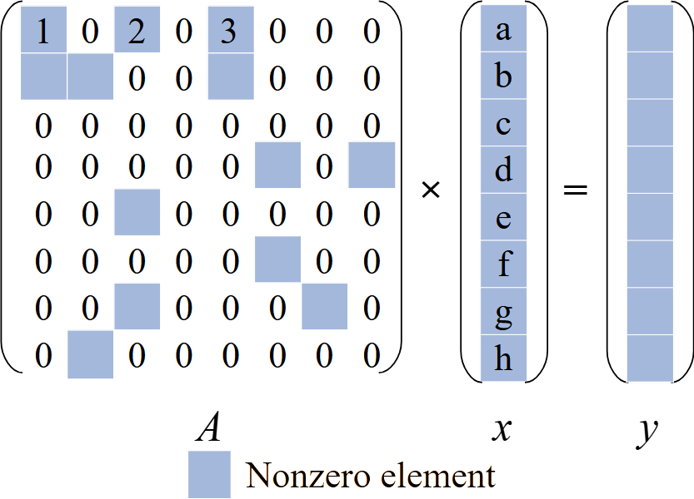
Background - Sparse Matrix-Vector Multiplication (SpMV)
· SpMV is an operation to multiply a sparse matrix A and a dense vector x and to give a resulting dense vector y.
· One of the most time-consuming routines in iterative sparse solvers and graph frameworks.
· Widely studied on homogeneous parallel processors, such as CPUs and GPUs.

Slide 5
Background - Sparse Matrix-Vector Multiplication (SpMV)
SpMV is an operation to multiply a sparse matrix A and a dense vector x and to give a resulting dense vector y. Widely studied on homogeneous parallel processors and long vector processors.
An Example of Simple CSR SpMV
= 1a+2c
csrRowPtr
csrVal
x
csrColIdx
= [0, 3, 6, 6, 8, 9, 10, 12, 13]
= [1, 2, 3, …]
= [a, b, c, d, e, f, g]
= [0, 2, 4, …]
= 1a
= 1a+2c+3e
y[0]
= 0
The result of the accumulation exists in the array 'y'
in parallel do
Move the pointer to find nonzero elements
Using parallel operations may result in highly imbalanced workloads

Slide 6
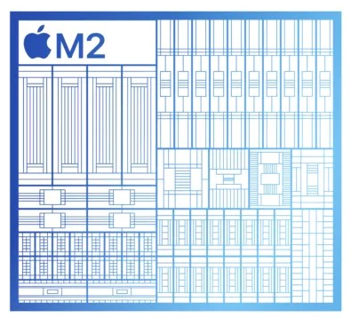
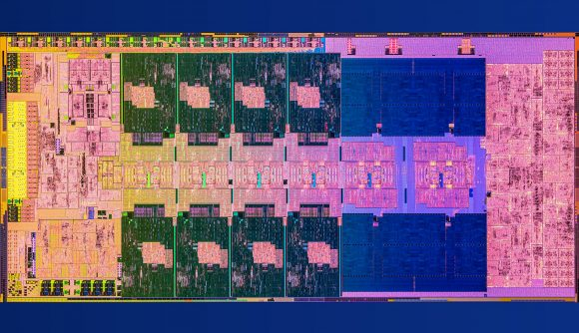
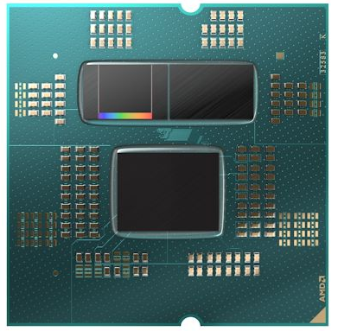
Background - Asymmetric Multicore Processor (AMP)
AMPs typically include at least two types of cores with different numbers of cores, frequencies, SIMD units, cache capacities and core-group settings.
3D V-Cache
Apple M2
Intel i9-13900KF
AMD R9 7950x3D
Cores with different cache structures
Performance and efficient cores

Slide 7
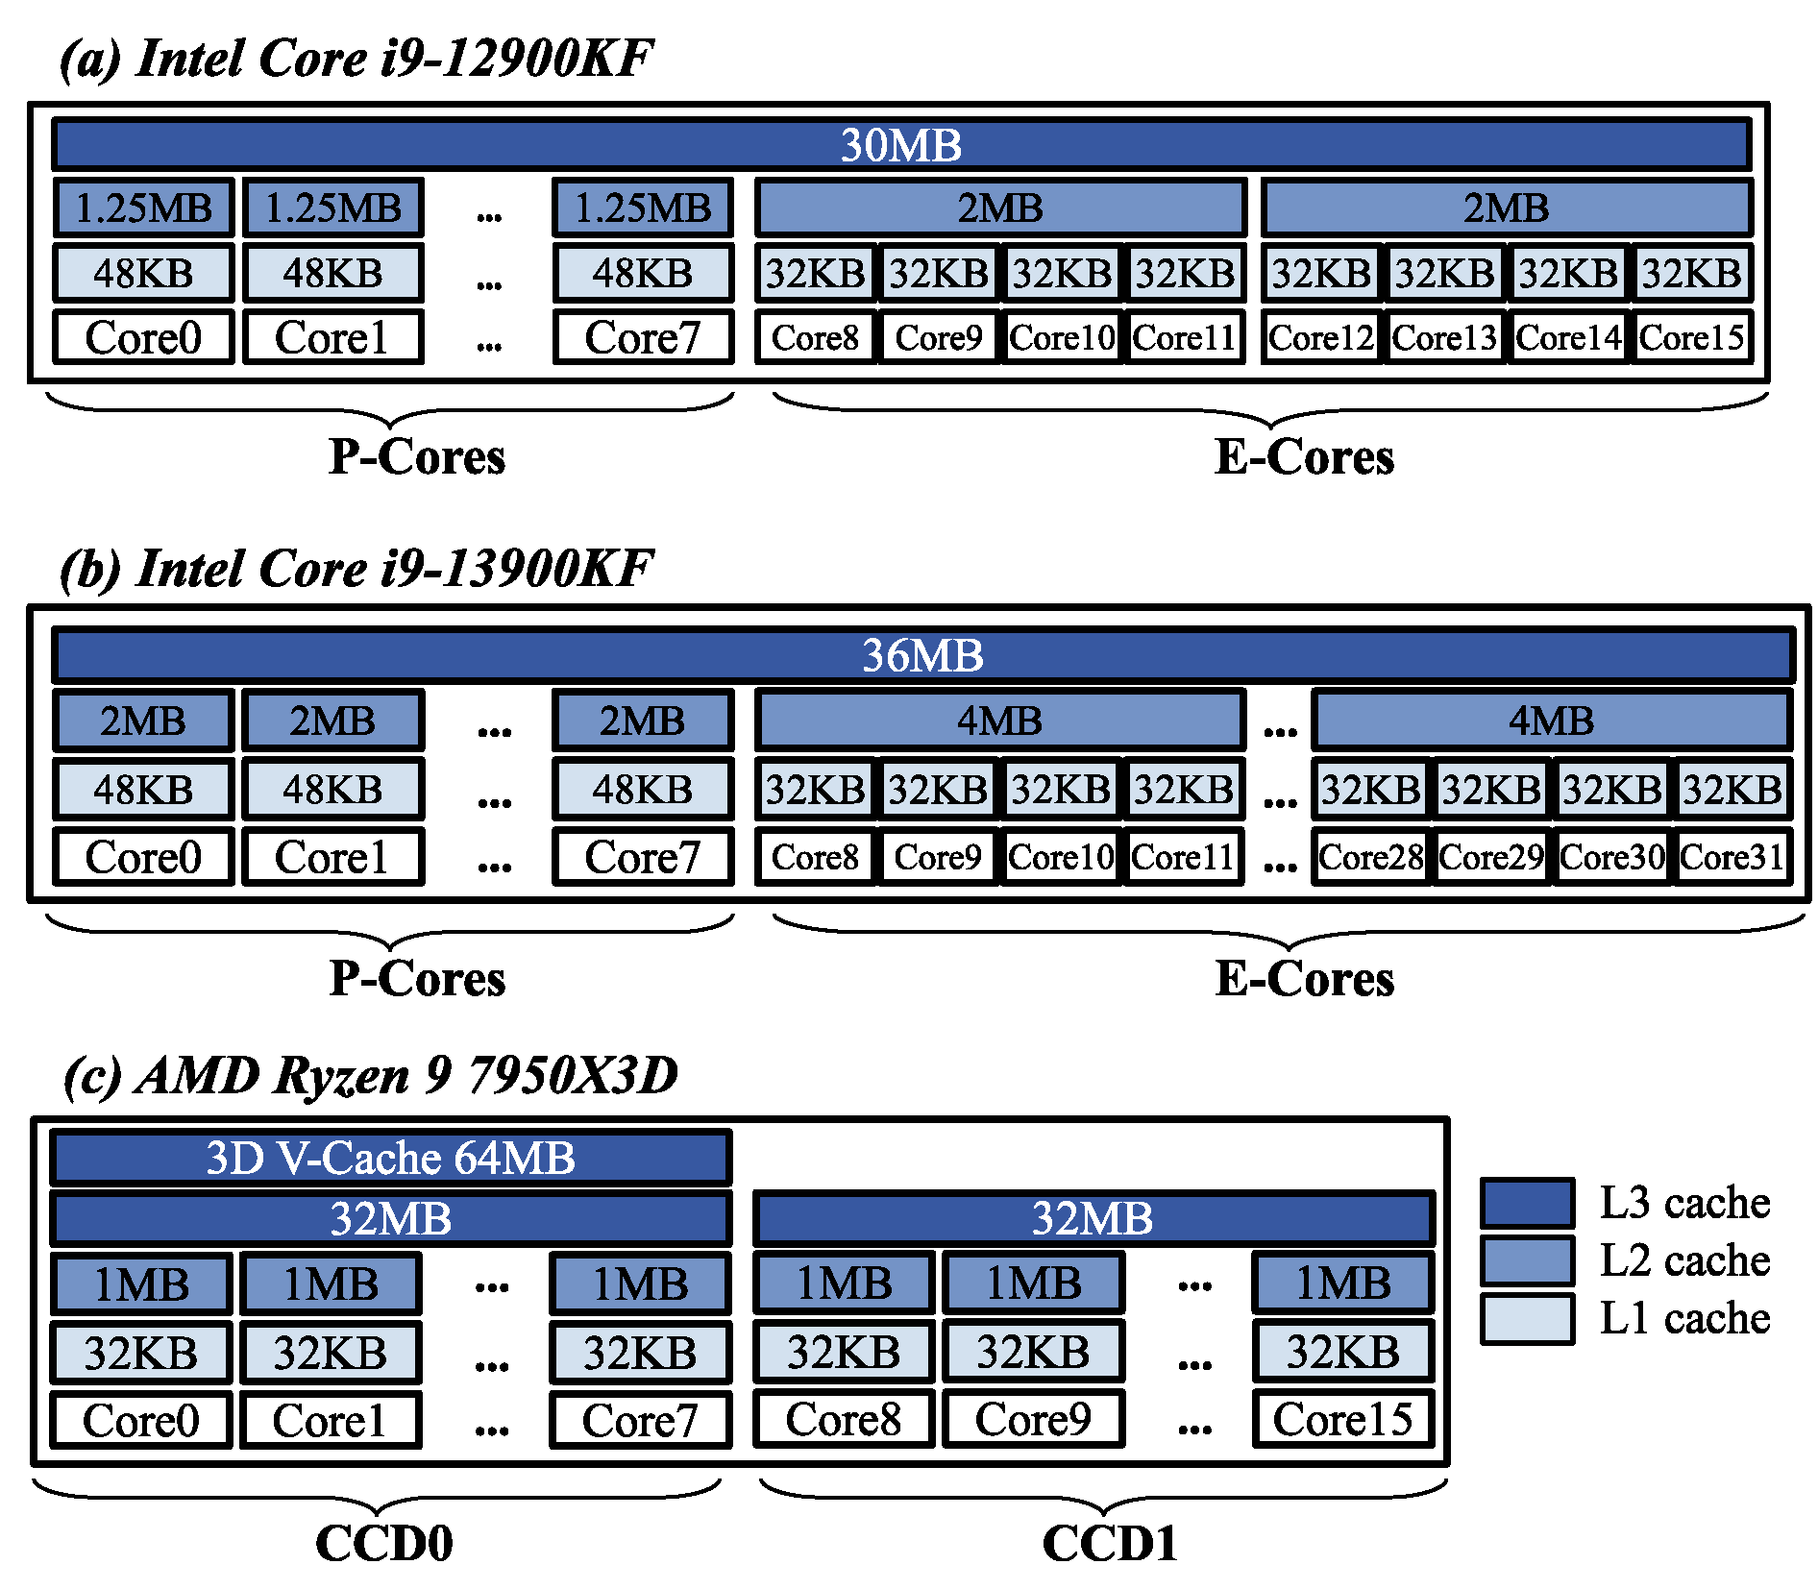
Background - Asymmetric Multicore Processor (AMP)
The Topology of Three AMPs
Base, Max Frequency (GHz) | P-cores / CCD0 | E-cores / CCD1
i9-12900KF | 5.1, 3.2 | 3.9, 2.4
i9-13900KF | 5.4, 3.0 | 4.3, 2.2
AMD 7950X3D | 5.7, 4.2 | 5.7, 4.2
Different Cache Capacities
Different Frequencies
Two different cores of modern AMPs will very likely lead to task assignment and load balancing problems
Different Numbers of Cores
Different Cache Structures

Slide 8
Challenges
Irregularity on the matrix
Irregularity on the processor
SpMV
The irregularity from the two sides makes accelerating SpMV on AMPs more difficult than on homogeneous processors.

Slide 9
OUTLINE
Ⅰ
Ⅱ
Ⅲ
Ⅳ
Ⅴ
Background and Challenges: AMP & SpMV
Three Micro-Benchmarks and Motivations
Our Algorithm: HASpMV
Comparison with Other SpMV Methods
Conclusion

Slide 10
Micro-Benchmark 1 and Motivation 1
① Stream triad bandwidth test:
P-cores, E-cores and P&E-cores (Intel AMPs)
CCD0, CCD1 and CCD0 & CCD1 (AMD AMPs)
Dataset: 2888 matrices from the SuiteSparse Matrix Collection
Processing capabilities for the same matrix are different
Maximum bandwidth utilizations are different
The declining trends are different
P-cores
P&E-cores
E-cores
Intel Core i9-12900KF
Intel Core i9-13900KF
AMD Ryzen9 7950X3D
First Motivation
To assign the best workload to different cores

Slide 11
Micro-Benchmark 2 and Motivation 2
② Simple Parallel SpMV Performance Test:
P-cores, E-cores and P&E-cores (Intel AMPs)
CCD0, CCD1 and CCD0 & CCD1 (AMD AMPs)
Dataset: 2888 matrices from the SuiteSparse Matrix Collection
P-cores are still overall the fastest
Using two types of cores is the fastest
One type of cores is still faster than all cores
P-cores
i9-12900KF
i9-13900KF
AMD Ryzen9 7950X3D
Second Motivation
To achieve higher cache utilization of the workload

Slide 12
Micro-Benchmark 3 and Motivation 3
③ Correlation of row length and single core SpMV performance test
Dataset: 2888 matrices from the SuiteSparse Matrix Collection
A P-core gives 2x-2.5x performance over an E-core
# nonzeros per row: Impacts the amount of each workload and cache behavior of accessing the vector x
The speedups decrease to 1.0
P-core is almost always 2x faster than an E-core
No obvious speedup
2.0
1.0
i9-12900KF
i9-13900KF
AMD Ryzen9 7950X3D
Third Motivation
To give rows of the 'best' lengths to most suitable cores

Slide 13
OUTLINE
Ⅰ
Ⅱ
Ⅲ
Ⅳ
Ⅴ
Background and Challenges: AMP & SpMV
Three Micro-Benchmarks and Motivations
Our Algorithm: HASpMV
Comparison with Other SpMV Methods
Conclusion

Slide 14
Algorithm Design
Motivations
Algorithm Design
Assign the best workload to different cores
Cache Line Cost
Utilize the as the basis for matrix partitioning
Achieve higher cache utilization of the workload
Give rows of the 'best' lengths to most suitable cores

Slide 15
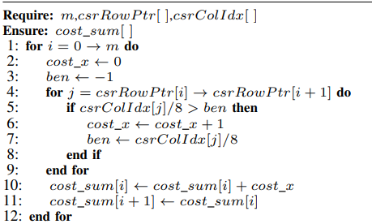
Cache Line Cost
Quantifying memory access overhead incurred by the consumption of cache lines by vector x
64 bytes cache line (8 doubles) is the basic working unit
We store the sum of cache lines used at the end of each row.
The numbers summed can help find the rows for matrix partitioning.

Slide 16
Algorithm Design
Motivations
Algorithm Design
Cache Line Cost
Assign the best workload to different cores
Utilize the as the basis for matrix partitioning
Achieve higher cache utilization of the workload
Design a
Partitioning Method
Two-level Matrix
Give rows of the 'best' lengths to most suitable cores

Slide 17
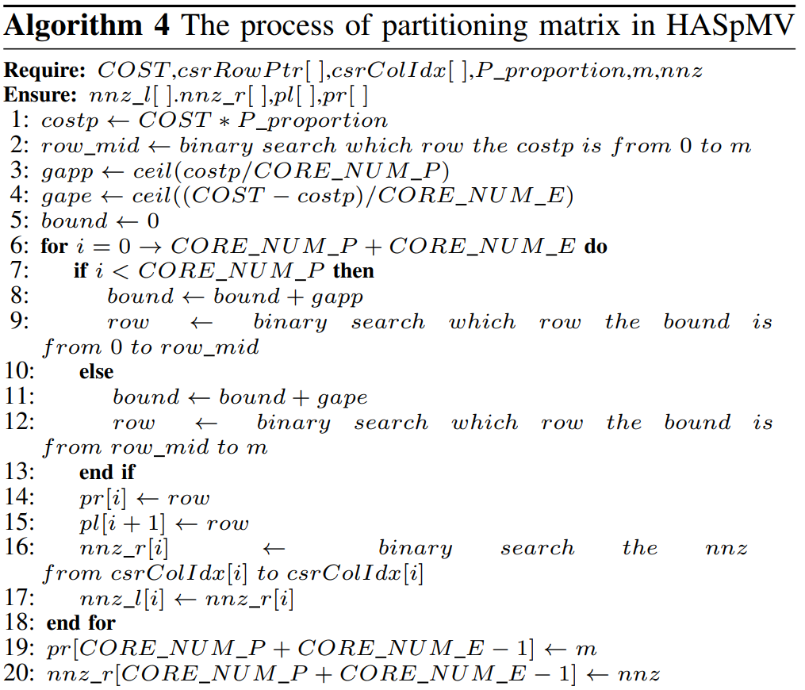
Two-level Matrix
Partitioning Method
Level 1
Partition the matrix into two parts based on the bandwidth test
Level 2
Assign an equal amount of cache lines to each core within the same group

Slide 18
Two-level Matrix
Partitioning Method
Record the starting nonzero id and ending nonzero id of the assigned tasks
nnz_l[]
Record the starting line id and ending line id of the assigned tasks
pl[]
nnz_r[]
pr[]
Level 2
Assign an equal amount of cache lines to each core within the same group

Slide 19
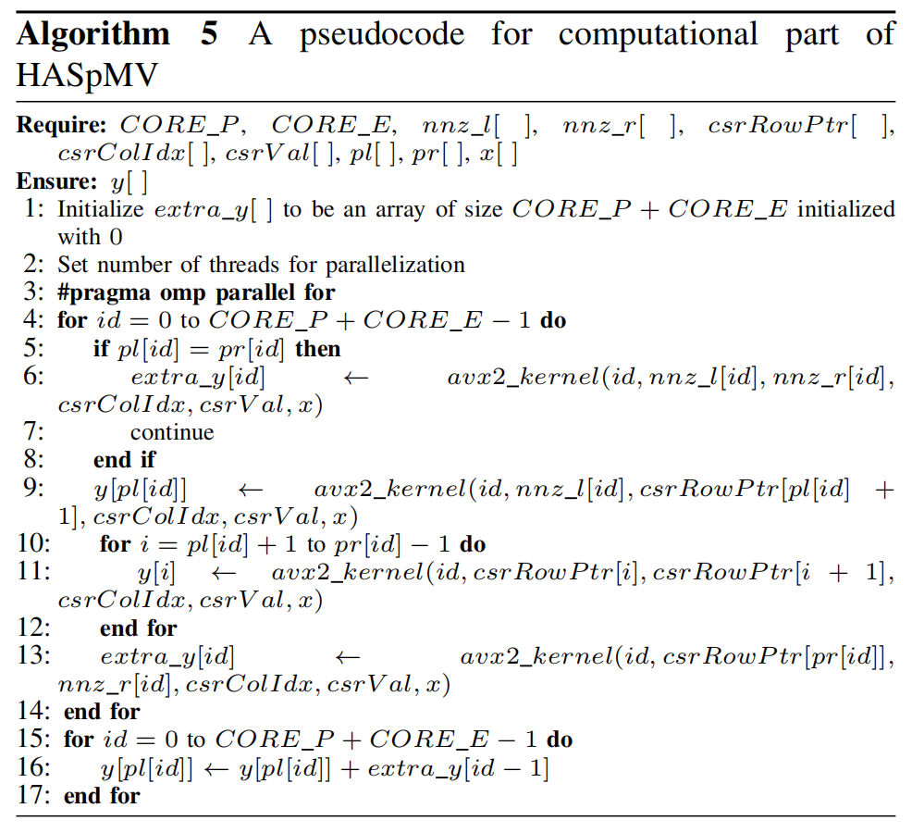
Two-level Matrix
Partitioning Method
The results from these two parts both need to be accumulated into y[x], hence, causing a 'write conflict' issue
extra_y[0]
extra_y[1]
So we use an extra_y[] array to store the values from these two parts
Level 2
Assign an equal amount of cache lines to each core within the same group

Slide 20
Algorithm Design
Motivations
Algorithm Design
Assign the best workload to different cores
Cache Line Cost
Utilize the as the basis for matrix partitioning
Achieve higher cache utilization of the workload
Design a
Partitioning Method
Two-level Matrix
Give rows of the 'best' lengths to most suitable cores
Reorder the matrix to obtain the
HACSR Format

Slide 21
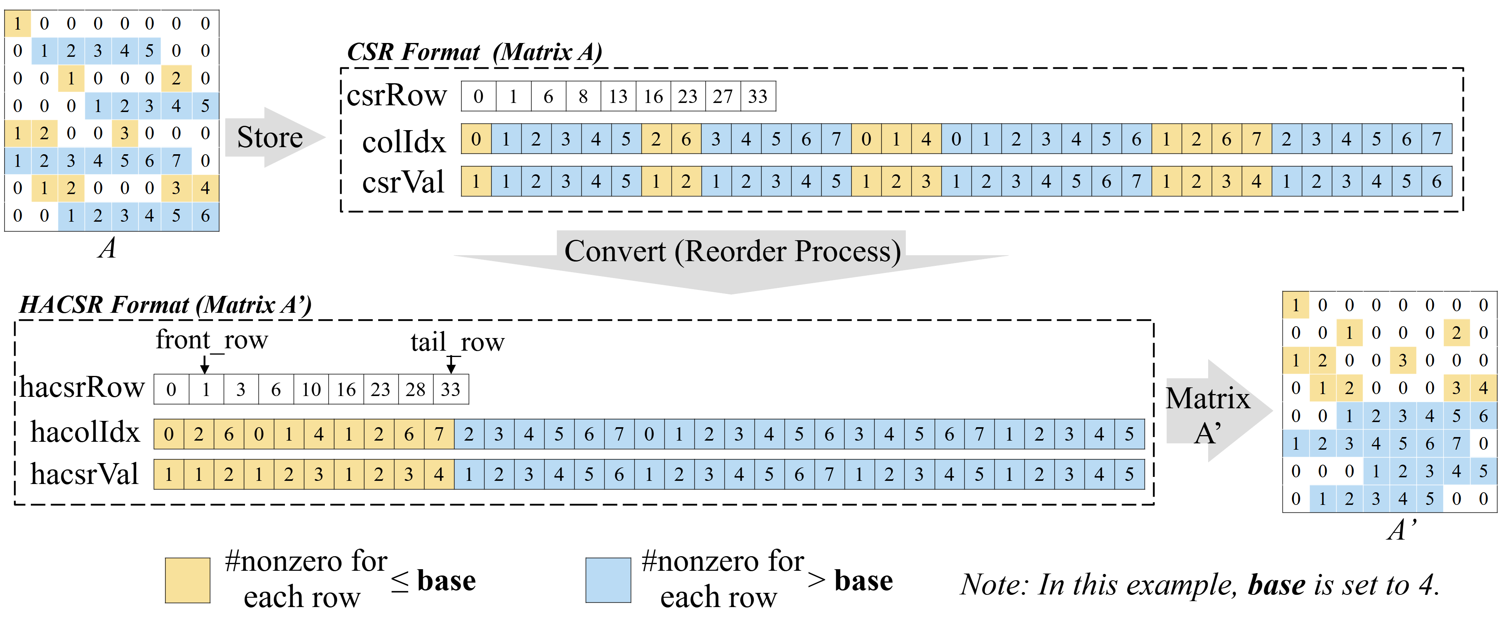
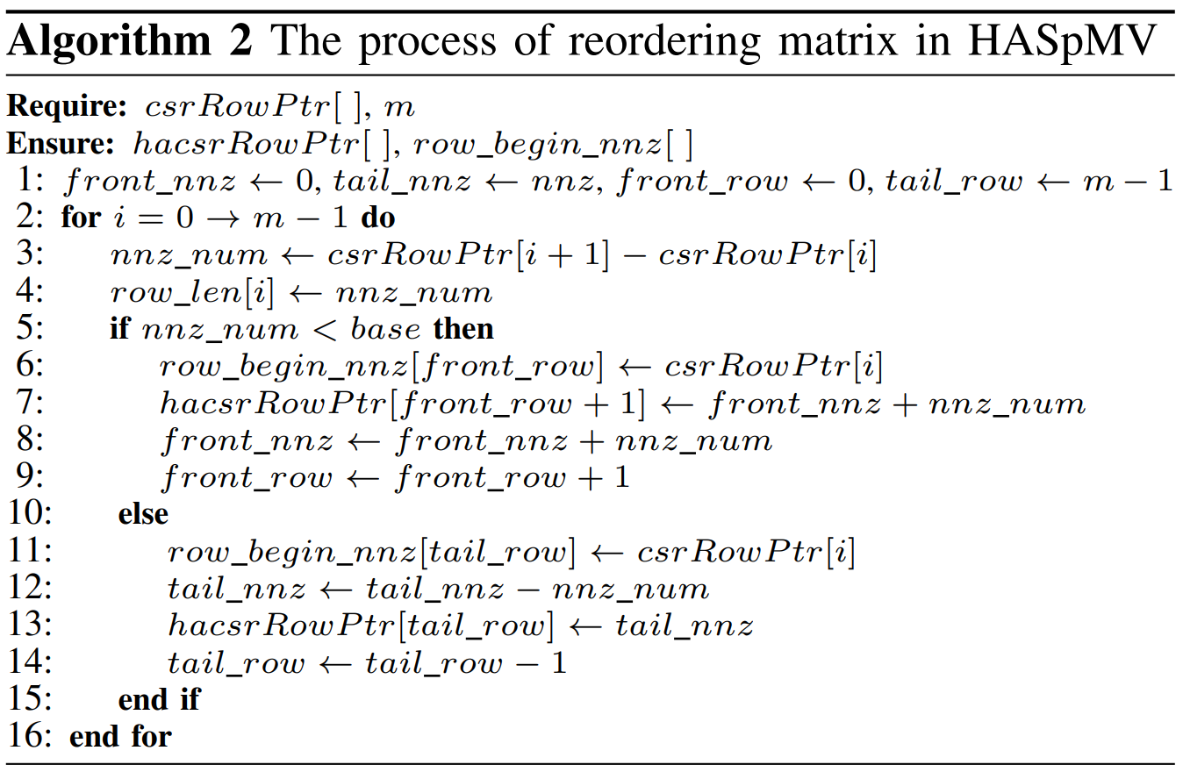
HACSR Format
If #nonzeros in a row is < 4, then place it in the front
If #nonzeros in a row is ≥ 4, then place it in the end
Then we can obtain the matrix reordered

Slide 22
Three Kinds of Acceleration Techniques
To further improve the algorithm performance, we also utilize the AVX2 and loop unrolling technologies in the implementation
AVX2 + Loop unrolling
Serial
AVX2

Slide 23
Three Kinds of Acceleration Techniques
Performance with various optimizations
Gflops

Slide 24
OUTLINE
Ⅰ
Ⅱ
Ⅲ
Ⅳ
Ⅴ
Background and Challenges: AMP & SpMV
Three Micro-Benchmarks and Motivations
Our Algorithm: HASpMV
Comparison with Other SpMV Methods
Conclusion

Slide 25
Experimental Setup
Three groups of AMPs
Experimental dataset
2888 matrices from the SuiteSparse Matrix Collection.

Slide 26
SpMV Performance Comparison
All matrices.
In the experiment, it can be observed that our algorithm has a clear advantage
(a) i9-12900KF
(b) i9-13900KF
(c) R9 7950X3D & R9 7950X
 |  | oneMKL | Merge-SpMV | CSR5 | AOCL
i9-12900KF | #Matrices with higher perf. | 2331 | 2175 | 2750 | -
 | Speedup (geomean) | 2.61x | 2.31x | 3.73x | -
i9-13900KF | #Matrices with higher perf. | 2498 | 2399 | 2028 | -
 | Speedup (geomean) | 3.17x | 1.52x | 2.23x | -
R9 7950X3D | #Matrices with higher perf. | - | 2491 | 1978 | 2235
 | Speedup (geomean) | - | 1.3x | 1.29x | 1.43x
Notes:
In the experiment, it can be observed that our algorithm has a clear advantage

Slide 27
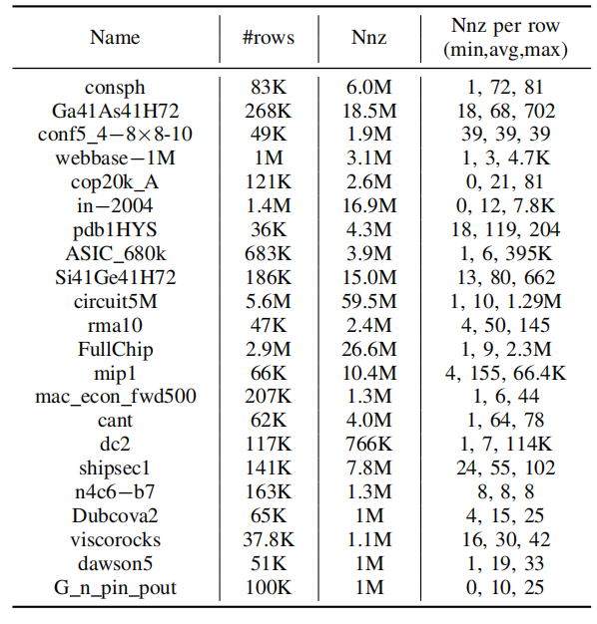
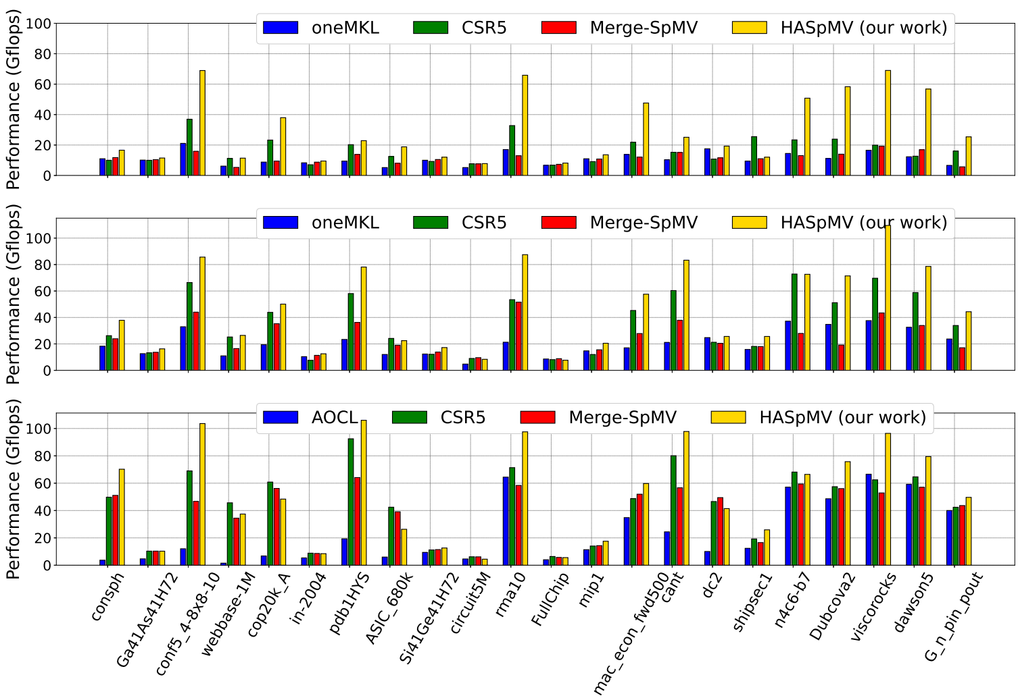
SpMV Performance Comparison
For matrices with uneven distribution of nonzero elements, HASpMV consistently demonstrates significant performance improvements
22 representative matrices.

Slide 28
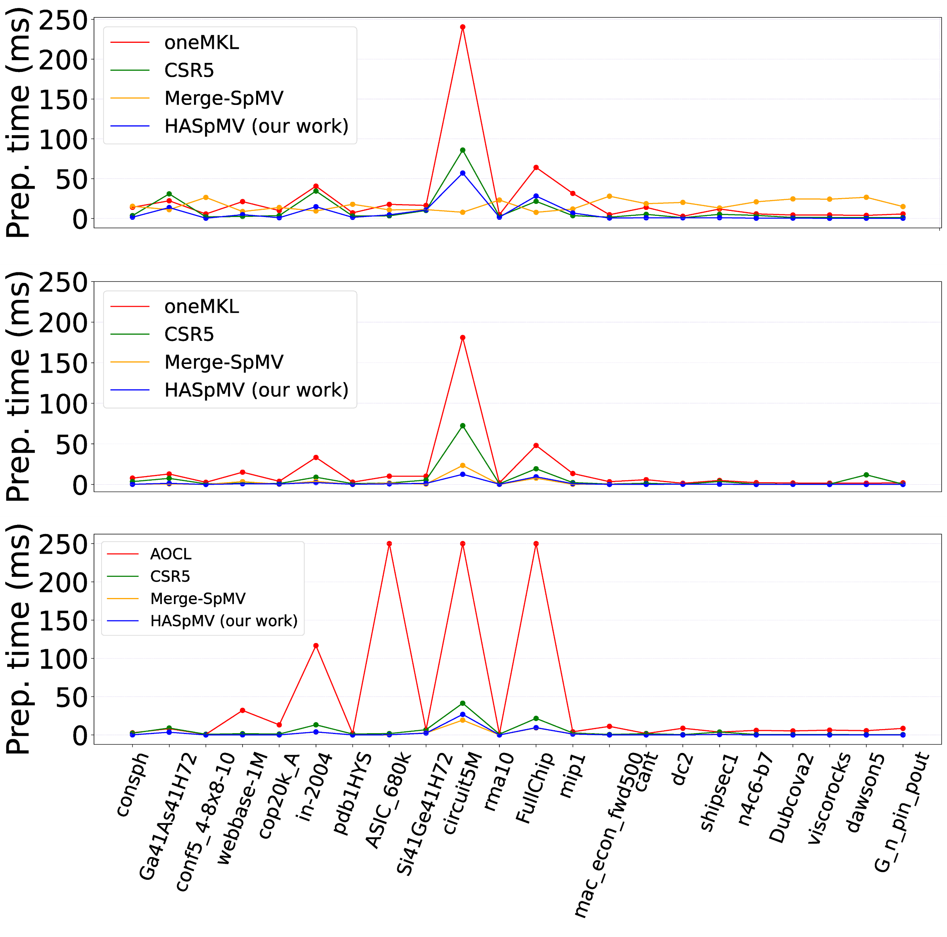
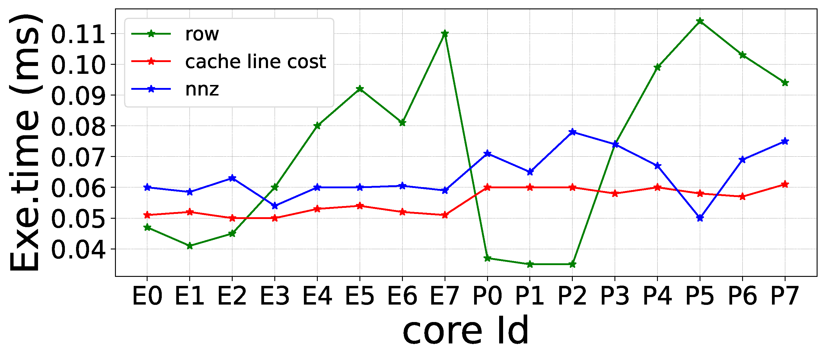
SpMV Performance Comparison
Analysis of preprocessing time.
Our preprocessing cost is much lower than other methods.
∞
Analysis of load-balanced task allocation.
Partitioning through cache line cost is more balanced.
Matrix ‘rma10’
∞

Slide 29
OUTLINE
Ⅰ
Ⅱ
Ⅲ
Ⅳ
Ⅴ
Background and Challenges: AMP & SpMV
Three Micro-Benchmarks and Motivations
Our Algorithm: HASpMV
Comparison with Other SpMV Methods
Conclusion

Slide 30
Conclusion
• We understand key performance behaviors of SpMV on two kinds of different cores in Intel and AMD AMPs through micro-benchmarking.
• We propose the HASpMV algorithm and the HACSR sparse format for better cache locality and load balancing in SpMV on AMPs.
• We achieve significant performance gain on 2888 matrices over existing SpMV work on the latest Intel and AMD AMPs.

Slide 31
HASpMV: Heterogeneity-Aware Sparse Matrix-Vector Multiplication on Modern Asymmetric Multicore Processors
Thanks!
Contact us: Wenxuan.li@student.cup.edu.cn
https://github.com/SuperScientificSoftwareLaboratory/HASpMV

