Slide 1


TSA-TICER:A Two-Stage TICER Acceleration Framework for Model Order Reduction
Pengju Chenª, Dan Niuª, Zhou Jin^{b}, Changyin Sun^{c}, Qi Liª and Hao Yan^{d}
a. School of Automation, Southeast University, Nanjing, China.
b. School of Information Science and Engineering, China University of Petroleum-Beijing, Beijing, China.
c. School of Artificial Intelligence, Anhui University, Hefei, China.
d. School of Integrated Circuits, Southeast University, Nanjing, China.
Notes:
Hello everyone, my name is Pengju Chen, I am an undergraduate student from the School of Automation in Southeast University. I am pleased to present our work “TSA-TICER: A Two-Stage TICER Acceleration Framework for Model Order Reduction” .

Slide 2
Contents
Background and Motivation
BCTu-GAT based Node Classification
Adaptive Merging Strategy for Fill-in Capacitors
Experiments and Conclusion
Notes:
Let us started with the background and motivation!

Slide 3
Contents
Background and Motivation
BCTu-GAT based Node Classification
Adaptive Merging Strategy for Fill-in Capacitors
Experiments and Conclusion

Slide 4
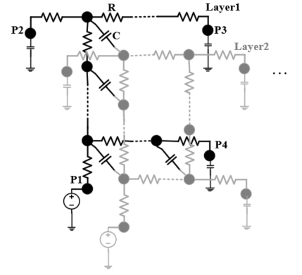
Background
Model Order Reduction
Substitute the original Network with an equivalent one with fewer nodes.
Three main categories:
Krylov-subspace based via
moment matching^{[1]}
Node elimination based methods^{[2,3]}
Multigrid-like or node aggregation
based method^{[4]}
Original
Reduced
[1] A. Odabasioglu, M. Celik and L. T. Pileggi, “PRIMA: passive reducedorder interconnect macromodeling algorithm,” IEEE Transactions on Computer-Aided Design of Integrated Circuits and Systems, vol. 17, pp. 645-654, 1998.
[2] C. Antoniadis, N. Evmorfopoulos and G. Stamoulis, “A rigorous approach for the sparsification of dense matrices in model order reduction of RLC circuits,” in 2019 56th ACM/IEEE Design Automation Conference (DAC), pp. 1-6, 2019.
[3] B. N. Sheehan, “TICER: realizable reduction of extracted RC circuits,” in 1999 IEEE/ACM International Conference on Computer-Aided Design(ICCAD), pp. 200-203, 1999.
[4] Q. Huang, X. Li, C. Fang, F. Yang, Y. Su, and X. Zeng, “An aggregating based model order reduction method for power grids,” Integration, vol. 55, pp. 449–454, 2016.
Notes:
First, I’d like to introduce the background. Model order reduction (MOR) is one of the most efficient way to enhance the calculation efficiency and reduce the memory footprint in the post-simulation by replacing the original network with a fewer nodes one, and this picture shows the order reduction progress in a coupled RC mesh network.
Recently, various MOR methods can be divided into three categories: Krylov-subspace based MOR via moment matching, multigrid-like or node aggregation-based methods and node elimination-based methods such as famous TICER.

Slide 5
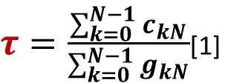
Challenges
TICER ^{[1]} (Time-Constant Equilibration Reduction)
Time-consuming calculation of time constant τ
$τ=\frac{\sum_{k=0}^{N−1}{c_{kN}}}{\sum_{k=0}^{N−1}{g_{kN}}}$[1]
N
Eliminate the reduced node N
Reconnect the topology
[1] B. N. Sheehan, “TICER: realizable reduction of extracted RC circuits,” in 1999 IEEE/ACM International Conference on Computer-Aided Design(ICCAD), pp. 200-203, 1999.
Notes:
The TICER (Time-Constant Equilibration Reduction) algorithm is a efficient topological RC method, which directly works on the network topology and is more suitable for multiple-port passive networks. It achieves the reduction of RC networks by selectively preserving nodes within a specific frequency range while eliminating the nodes with few neighbours and small nodal time constants /tau. Consider an N-terminal star network, and the N terminals are labelled 0 to N-1. The time constant of centre node N can be calculated as the equation.
However, due to that the connection of topology and RC information of the adjacent nodes will be varied after one node is eliminated, for a large-scale parasitic RC network , the calculation of /tau for all nodes is quite time-consuming.

Slide 6
Challenges
TICER^{[1]} (Time-Constant Equilibration Reduction)
A number of generated fill-in capacitors
Time-consuming calculation of the fill-in RC
Increase the density of the network
Fill-in capacitors and resistors^{[1]}
N
Eliminate the reduced node N
Reconnect the topology
[1] B. N. Sheehan, “TICER: realizable reduction of extracted RC circuits,” in 1999 IEEE/ACM International Conference on Computer-Aided Design(ICCAD), pp. 200-203, 1999.
Notes:
In addition, in order to maintain the simulation of the RC networks after the node elimination, new resistors and capacitors will be inserted between the former neighbors of eliminated node N. The insertion process also takes too much time and increase the density of the network especially when a large number of new capacitors/resisters are generated and added.

Slide 7
Solutions
GAT based node classification(BCTu-GAT)
Betweenness centrality metric (BC)-based sample selection strategy
Bi-level aggregation scheme based topology updating (BiTu) method
Adaptive merging strategy(AMS)
Merging new small capacitors by adaptive threshold
186.434X↑
average speedup
10.46X↑
0.031%↓
and
maximum speedup
maximum accuracy loss
Notes:
To overcome such challenges, we propose the TSA-TICER. We design improved GAT based node classification framework (named BCTu-GAT), which equipped with betweenness centrality metric (BC)-based sample selection strategy and bi-level aggregation scheme based topology updating (BiTu) method. It determines all eliminated nodes one time and completely removes the time-consuming time constant calculations and achieves 186.434 times average speedup over TICER.
And in the insertion stage, we design an adaptive merging strategy (named AMS) to deal with the new small capacitors by adaptive threshold to decrease the amount of fill-ins, which achieves 10.46 times maximum insertion speedup over TICER but with just slight accuracy loss.

Slide 8
Contents
Background and Motivation
BCTu-GAT based Node Classification
Adaptive Merging Strategy for Fill-in Capacitors
Experiments and Conclusion
Notes:
To better understand TSA-TICER, I’d like to introduce our BCTu-GAT based Node Classification framework.

Slide 9
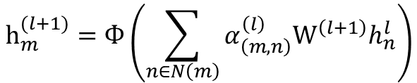
GAT
Graph Attention Network
Attention mechanism
Capture the structural dependencies
of circuit topology
[1]
$$h_{m}^{(l+1)}=Ф\left(\sum_{n∈N\left(m\right)}{α_{\left(m,n\right)}^{\left(l\right)}W^{\left(l+1\right)}h_{n}^{l}}\right)$$
GAT^{[1]}
[1] P. Velickovi ˇ c, G. Cucurull, A. Casanova, A. Romero, P. Li ´ o and Y. ` Bengio, “Graph attention networks,” in International Conference on Learning Representations (ICLR) 2018, 2018.
Notes:
Firstly, what is GAT? Graph Attention Network (GAT) is a presentive class of GNNs that introduce attention mechanism in feature aggregation. Recently, GAT has been affectively used as feature extractor in EDA since it can capture the structural dependencies of circuit topology.
In GAT, each node embedding is computed with all the neighbors by the self-attention mechanism. The node embedding process can be mathematically represented by the following equation
:
where h(l+1) m represents (l + 1)-th layer embedding of node m, φ is the non-linear activation function, α(l) (m,n) denotes the normalized attention score of the node n to m that is obtained using the l-th attention mechanism, and W(l) represents the trainable matrice that learns features of the neighbors.

Slide 10
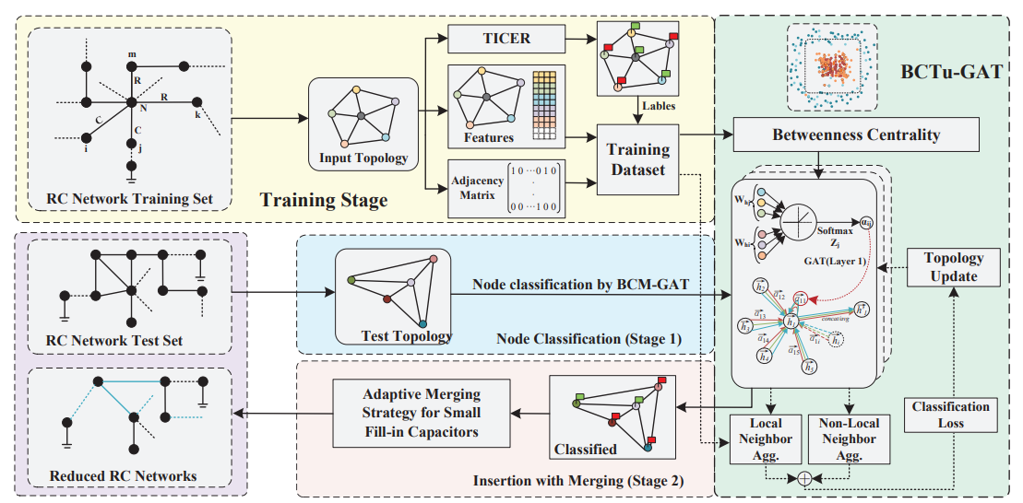
BCTu-GAT based Node Classification
Framework
Notes:
The two-stage acceleration framework TSA-TICER for order reduction of parasitic RC networks is shown in this picture.

Slide 11
BCTu-GAT based Node Classification
Framework
Node classification
Notes:
And the node classification stage is shown in the red dotted box. In this stage, an improved graph attention network (named BCTu-GAT) equipped with betweenness centrality metric (BCM) based sample selection strategy and bi-level aggregation based topology updating scheme (BiTu) is proposed to quickly and accurately determine all the eliminated nodes one time in TICER.

Slide 12
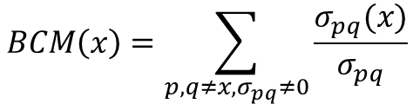
BCTu-GAT based Node Classification
BCM-based Training Sample Selection
Unbalanced training samples between two kinds of nodes
Random sampling selection BCM (Betweenness Centrality Metric )
executes only once
[1]
$$BCM\left(x\right)=\sum_{p,q≠x,σ_{pq}≠0}{\frac{σ_{pq}(x)}{σ_{pq}}}$$
[1] M. Barthelemy, “Betweenness centrality in large complex networks,” The European Physical Journal B - Condensed Matter, vol. 38, pp. 163–168, 2004
Notes:
In this eliminated-nodes classification task for model order reduction of parasitic RC networks, the different number of eliminated-labeled nodes and uneliminated-labeled nodes will lead to unbalanced training samples, which usually influences the training speed and convergence of graph neural network.
Betweenness Centrality Metric (BCM) is widely used to identify the important nodes of the network based on their structural positions. In this work, BC metric instead of the random sampling selection is designed to select important training nodes for GAT
The betweenness centrality metric BCM(x) of a node x is defined as the equation. Because the BCM only executes only once in pre-training stage, it isn’t expensive to compute in the whole progess.
where σpq is the number of shortest paths from p to q while σpq(x) stands for the number of these paths passing through x,

Slide 13
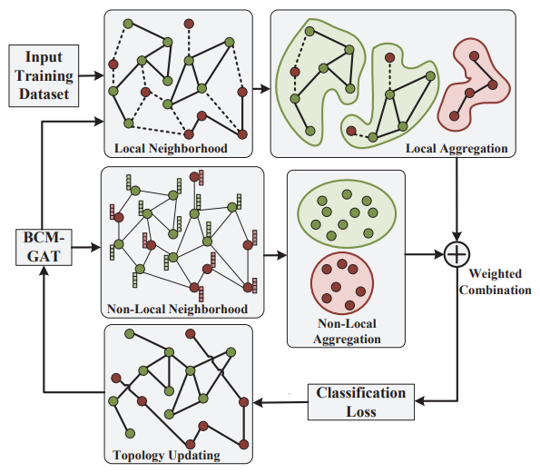
BCTu-GAT based Node Classification
Bi-level Aggregation-based Topology Updating
different types of nodes are usually mixed up
Local neighborhood
closely connected to the target node
related to each other in the feature space
Non-local neighborhood
the area containing nodes of the same type
not confined to local areas
Bi-level aggregation-based topology updating
Notes:
In the eliminated-node and uneliminated-node classification of parasitic RC networks, the different types of nodes are usually mixed up. Moreover, another problem in the node classification task is that the same type nodes might widely distribute in the topology of RC parasitic networks. In order to improve the connectivity of nodes of the same type, we propose the bi-level aggregation-based topology updating scheme (BiTu), as shown in this picture.
We define the local neighborhood as an area composed of nodes that are closely connected to the target node and are related to each other in the feature space. Apart from the local neighborhood, we also define the non-local neighborhood as the area containing nodes of the same type, and these nodes are not confined to local areas.

Slide 14
BCTu-GAT based Node Classification
Bi-level Aggregation-based Topology Updating
different types of nodes are usually mixed up
Local neighborhood
closely connected to the target node
related to each other in the feature space
Non-local neighborhood
the area containing nodes of the same type
not confined to local areas
Bi-level aggregation-based topology updating
Notes:
In order to improve the connectivity of nodes of the same type, we propose the bi-level aggregation-based topology updating scheme (BiTu), as shown in Fig. 2. The proposed BiTu combines the local aggregation and non-local aggregation, and considers the graph topology and feature-based correlations between nodes to update the RC network topology.

Slide 15
Contents
Background and Motivation
BCTu-GAT based Node Classification
Adaptive Merging Strategy for Fill-in Capacitors
Experiments and Conclusion
Notes:
After the eliminated nodes are determined by the abovementioned BCTu-GAT based node classification algorithm, node elimination and insertion of new resistors and capacitors between former neighbors of N will be conducted according to the TICER rules to maintain an approximate circuit-level equivalence

Slide 16


AMS
Inserted resistor and capacitor
$$g_{ij}=\frac{g_{iN}g_{jN}}{\sum_{k=0}^{N−1}{g_{kN}}}$$
$$c_{ij}=\frac{c_{iN}g_{jN}+g_{iN}c_{jN}}{\sum_{k=0}^{N−1}{g_{kN}}}$$
[1]
Large number of fill-in small capacitors
slight impact on the simulation accuracy
serious impact on the amount of successive fill-ins
further influence the reduction efficiency
[1] B. N. Sheehan, “TICER: realizable reduction of extracted RC circuits,” in 1999 IEEE/ACM International Conference on Computer-Aided Design(ICCAD), pp. 200-203, 1999.
Notes:
The value of new inserted conductor cij and capacitor cij can be calculated as the equation.
The large number of fill-in small capacitors usually have a relatively slight impact on the simulation accuracy, but have a serious impact on the amount of successive fill-ins (the creation of new resistors and capacitors when a node is eliminated) and further influence the reduction efficiency.
where giN and gjN represent the conductance of node i and node j connected to the node N, respectively. The ciN and cjN represent the capacitor of node i and node j connected to the node N, respectively.

Slide 17
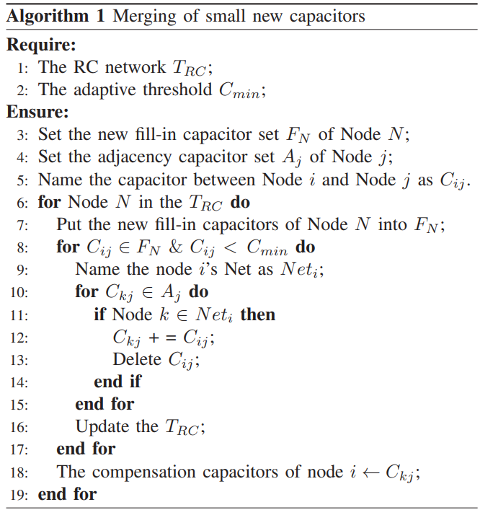
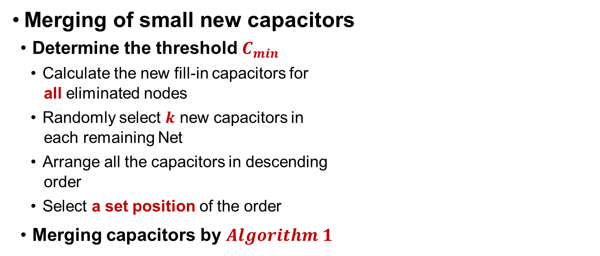
AMS
Merging of small new capacitors
Determine the threshold $C_{min}$
Calculate the new fill-in capacitors for
all eliminated nodes
Randomly select $k$ new capacitors in
each remaining Net
Arrange all the capacitors in descending
order
Select a set position of the order
Merging capacitors by $Algorithm 1$
Notes:
In this case, merging some new small capacitors will effectively reduce the fill-ins and enhance the insertion efficiency. In this work, the capacitor threshold Cmin is adaptively determined as follows. We compute the new fill-in capacitors for all eliminated nodes obtained from the above BCTu-GAT classification method and randomly select the k new capacitors in each remaining Net, and then arrange the k∗m new capacitors in descending order. The m is the number of remaining Net. The threshold Cmin can be adaptively determined by selecting at a set position of this descending order.
Next the new fill-in capacitors which smaller than the threshold Cmin will be merged. The detailed merging strategy is shown in Algorithm 1.

Slide 18
AMS
Merging of small new capacitors
Determine the threshold $C_{min}$
Calculate the new fill-in capacitors for
all eliminated nodes
Randomly select $k$ new capacitors in
each remaining Net
Arrange all the capacitors in descending
order
Select a set position of the order
Merging capacitors by $Algorithm 1$
Notes:
In all, by employing the proposed BCTu-GAT to quickly determine all the eliminated nodes one time in the node classification stage and the adaptive merging strategy (AMS) for new small capacitors in the insertion (fill-in) stage, the proposed two-stage acceleration framework (TSA-TICER) will significantly improve the reduction efficiency of the TICER for parasitic RC networks while keeping high reduction accuracy.

Slide 19
Contents
Background and Motivation
BCTu-GAT based Node Classification
Adaptive Merging Strategy for Fill-in Capacitors
Experiments and Conclusion
Notes:
In this work, to fully evaluate the computation efficiency and accuracy of MOR, the proposed TSA-TICER and the TICER method are tested on the parasitic RC networks with different orders.

Slide 20
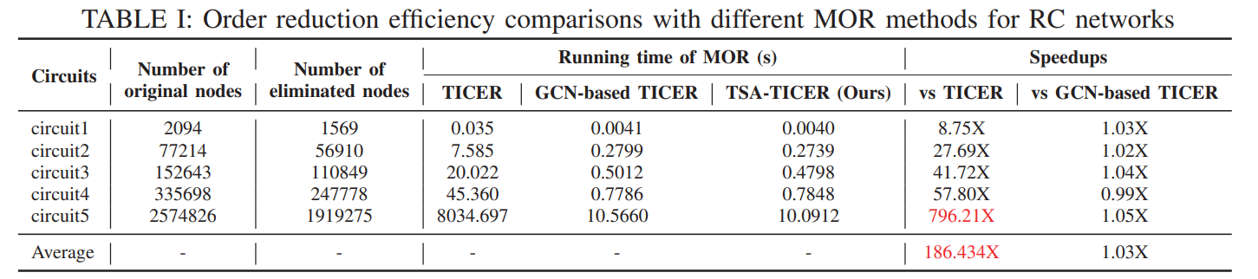
Performance
Order Reduction Efficiency
Five RC networks from 2k to 2 million nodes
Compared the performance among TICER(with the priority queue implementation to update the τ ), GCN-based TICER and TSA-TICER
Notes:
First, the running time for MOR is computed to verify the reduction efficiency. Moreover, the TICER with GCN-based classification and adaptive merging strategy (named GCNbased TICER) is also achieved. For comparison, the TICER, GCN-based TICER as well as the proposed TSA-TICER are tested on the different sizes of parasitic RC networks from 2k to 2 million nodes. The test results are shown in Table I.
In addition, multiple ports are set up in each benchmark to verify the output signal. In order to ensure the fairness, we use the priority queue implementation to update the τ in the TICER.

Slide 21
Performance
Order Reduction Efficiency
Five RC networks from 2k to 2 million nodes
Compared the performance among TICER(with the priority queue implementation to update the τ ), GCN-based TICER and TSA-TICER
Notes:
From this table, it is clear that both the GCN-based TICER and proposed TSA-TICER can significantly decrease the run time for MOR compared with the TICER, due to the removal of the time-consuming calculation for time constant τ and adaptive merging strategy for small fill-in capacitors. Note that, the speed-up ratio will sharply increase as the scale of RC networks increases and can reach nearly 800X in maximum.

Slide 22
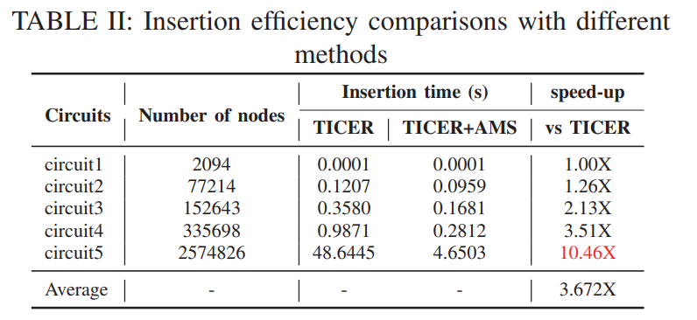
Performance
Order Reduction Efficiency
Ablation experiments
Verify the performance of adaptive merging strategy (AMS)
Notes:
In addition, ablation experiment is conducted to verify the fill-in acceleration performance of the adaptive merging strategy (AMS), which is shown in Table II. By comparing the insertion time of TICER and TICER with AMS, it is obvious that the proposed AMS can effectively reduce the number of fill-in capacitors and shorten the insertion time, and as the scale of RC network increases, the proposed AMS can achieve higher insertion acceleration.

Slide 23
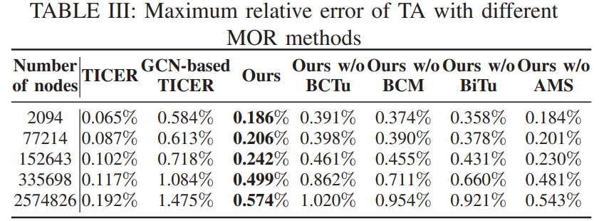
Performance
Order Reduction Accuracy
Transient analysis(TA)
Ablation experiments
TSA-TICER only with GAT
(ours without BCTu)
TSA-TICER without BCM
(ours without BCM)
TSA-TICER without BiTu
(ours without BiTu)
TSA-TICER without AMS
(ours without AMS)
Notes:
Next, to verify the reduction accuracy, we conduct the transient analysis (TA) using the Ngspice for the reduced RC networks, which are obtained by the TICER, GCN-based TICER and the proposed TSA-TICER. Moreover, in order to test the effectiveness of the GAT, the BCM, the BiTu and the AMS for the MOR accuracy, the ablation experiments are added. And the maximum relative errors in transient analysis using above-mentioned MOR methods are presented in Table III.

Slide 24
Performance
Order Reduction Accuracy
Transient analysis(TA)
Ablation experiments
TSA-TICER only with GAT
(ours without BCTu)
TSA-TICER without BCM
(ours without BCM)
TSA-TICER without BiTu
(ours without BiTu)
TSA-TICER without AMS
(ours without AMS)
Notes:
From this table, the maximum relative errors of those GNN based TICER are higher than that of the TICER, but our TSA-TICER transient analysis error are much lower than the GCN-baded TICER.
Moreover, by comparing the results among Ablation experiments, it is clear that both the BCM-based sample selection strategy, attention mechanism and the bi-level aggregation based topology updating scheme can enhance the node classification accuracy and further the order reduction accuracy. And AMS can largely increase the fill-in efficiency, but with just slight accuracy loss.

Slide 25
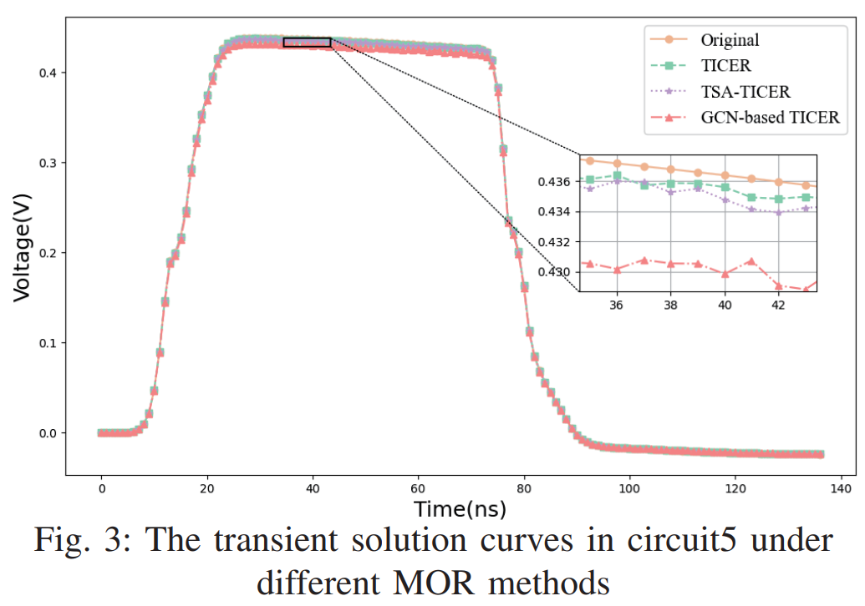
Conclusion
Conclusion
BCTu-GAT
Betweenness centrality metric (BC)
Bi-level aggregation-based topology
updating (BiTu)
AMS
Adaptive merging strategy for small
new capacitor
Notes:
Finally, a transient solution curve of example node in circuit5 is shown in Fig. 3.
In conclusion, we propose a two-stage TICER acceleration framework (TSA-TICER). First, an improved graph attention network named BCTu-GAT equipped with betweenness centrality metric (BC)-based sample selection strategy and bilevel aggregation-based topology updating (BiTu) scheme is proposed to speed up the eliminated-node classification stage in TICER.
Moreover, an adaptive merging strategy for small new capacitor is designed to decrease the fill-in amount and further improve the insertion efficiency. Test results demonstrate that the proposed TSA-TICER can significantly enhance the order reduction efficiency (up to 796.21X) while keeping high simulation accuracy.
If you have any questions regarding to the details of TSA-TICER, please refer to our paper or directly reach us, we are more than happy to discuss.

Slide 26
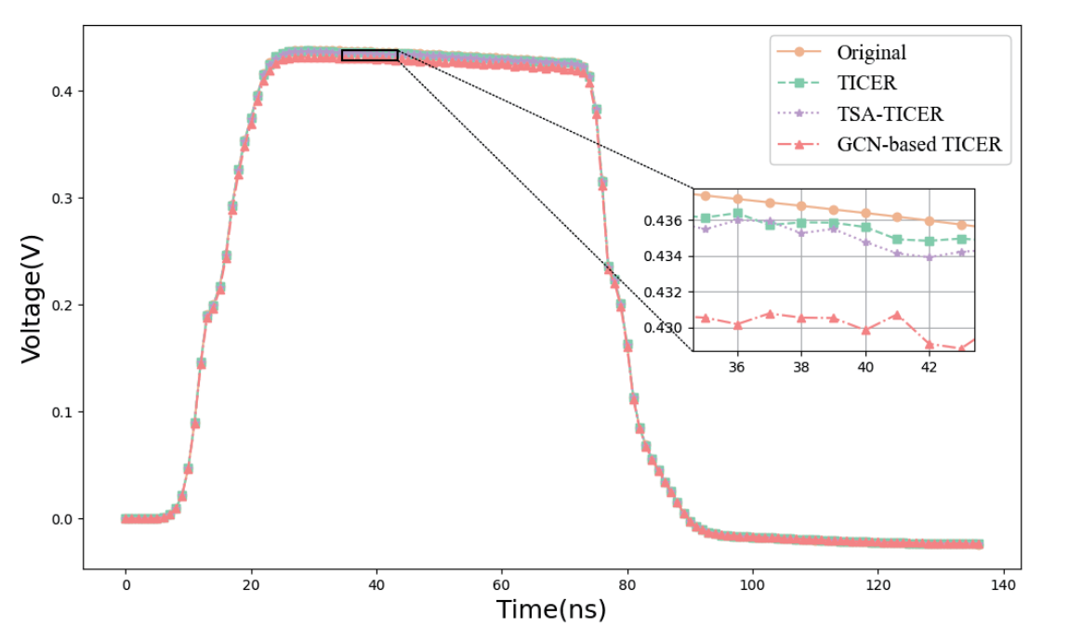
Summary
Application
Model order reduction
Challenge
Time-consuming calculation of time constant τ
Too much fill-in capacitors
Solution
Transforming the caculation of τ into node classification with improved GAT
Small fill-in capacitors merging
Results
186.434X↑
0.574%↓
and
average speedup
maximum relative error
Notes:
TSA-TICER aims to perform faster and more efficient model order reduction of large parasitic RC networks in the post-simulation. It overcomes the common challenges of time-consuming calculation of time constant /tau and too much fill-in capacitors in the TICER algorithm. With transforming the calculation of /tau into the node classification based improved graph attention network (GAT) and adaptive small fill-in capacitors merging strategy, the TSA-TICER achieves 186.434 times average speedup over TICER with lower than 0.574% maximum relative error.
In the following presentation, I will walk through the preliminaries of model order reduction problem and illustrate the core idea of our improve GAT based node classification strategy and the adaptive small fill-in capacitors merging design.

Slide 27
TSA-TICER
Thanks for Listening
TSA-TICER:A Two-Stage TICER Acceleration Framework for Model Order Reduction
Pengju Chen, Dan Niu, Zhou Jin, Changyin Sun, Qi Li and Hao Yan
^{February 6, 2024}
^{Contact: pjchen@seu.edu.cn}
Notes:
Thanks for listening, wish you a good day.

