Slide 1
Cuper: Customized Dataflow and Perceptual Decoding for Sparse Matrix-Vector Multiplication on HBM-Equipped FPGAs
Enxin Yi¹, Yiru Duan¹, Yinuo Bai¹, Kang Zhao², Zhou Jin¹, Weifeng Liu¹
¹Super Scientific Software Laboratory, China University of Petroleum-Beijing, China
²Department of Integrated Circuits, Beijing University of Posts and Telecommunications, China
13 March 2024

Slide 2
Outline
Background
Sparse Matrix-Vector Multiplication
Related Work and Challenges
Cuper
Customized Sparse Format
Reordering Algorithm and Dataflow Processing
Hardware Architecture Design
Experiment
Experiment Setup
Performance Evaluation
Conclusion

Slide 3
Outline
Background
Sparse Matrix-Vector Multiplication
Related Work and Challenges
Cuper
Customized Sparse Format
Reordering Algorithm and Dataflow Processing
Hardware Architecture Design
Experiment
Experiment Setup
Performance Evaluation
Conclusion

Slide 4
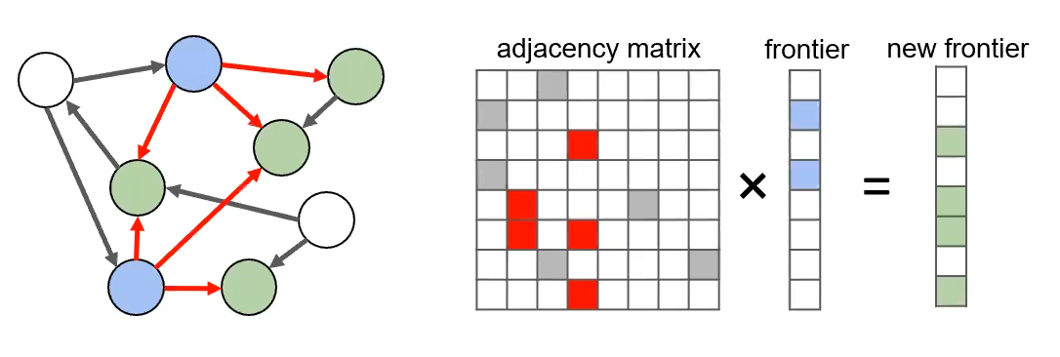
Sparse Matrix-Vector Multiplication
Sparse matrix-vector multiplication (SpMV) is pivotal in many scientific computing and engineering applications, and has a significant performance impact on graph computation, machine learning, information retrieval, and cloud computing, etc.
Graph traversals
Compressed neural networks

Slide 5
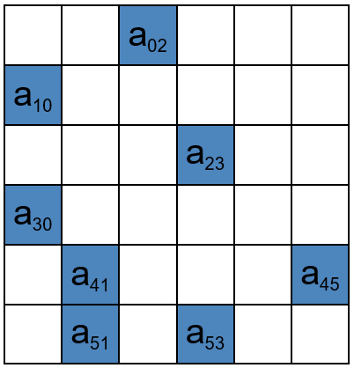
Sparse Matrix-Vector Multiplication
SpMV refers to the multiplication of a sparse matrix A with a dense vector x to obtain a dense vector y. In this process, y_{i} is computed as the dot product of a_{i*} (i.e., the ith row of the matrix A) with the dense vector x.
𝑦₀ = a₀₂ × 𝑥₂ + 𝑦₀
𝑦₁ = a₁₀ × 𝑥₀ + 𝑦₁
𝑦₂ = a₂₃ × 𝑥₃ + 𝑦₂
𝑦₃ = a₃₀ × 𝑥₀ + 𝑦₃
𝑦₄ = a₄₁ × 𝑥₁ + 𝑦₄
𝑦₄ = a₄₅ × 𝑥₅ + 𝑦₄
𝑦₅ = a₅₁ × 𝑥₁ + 𝑦₅
𝑦₅ = a₅₃ × 𝑥₃ + 𝑦₅
$$×$$
$$=$$
Sparse matrix A
Dense vector x
Dense vector y

Slide 6
Irregular Memory Access Patterns
The randomly distributed non-zeros in the sparse matrix A lead to irregular memory access patterns to its corresponding dense vector x and introduce poor data locality.
Irregular access patterns
𝑦₀ = a₀₂ × 𝑥₂ + 𝑦₀
𝑦₁ = a₁₀ × 𝑥₀ + 𝑦₁
𝑦₂ = a₂₃ × 𝑥₃ + 𝑦₂
𝑦₃ = a₃₀ × 𝑥₀ + 𝑦₃
𝑦₄ = a₄₁ × 𝑥₁ + 𝑦₄
𝑦₄ = a₄₅ × 𝑥₅ + 𝑦₄
𝑦₅ = a₅₁ × 𝑥₁ + 𝑦₅
𝑦₅ = a₅₃ × 𝑥₃ + 𝑦₅
$$×$$
$$=$$
Sparse matrix A
Dense vector x
Dense vector y

Slide 7
Low Compute-to-Access Ratio
In addition, SpMV is an memory-intensive operation with a low ratio of the number of floating-point operations to the number of memory accesses.
The difference in the number of computation and accesses
𝑦₀ = a₀₂ × 𝑥₂ + 𝑦₀
𝑦₁ = a₁₀ × 𝑥₀ + 𝑦₁
𝑦₂ = a₂₃ × 𝑥₃ + 𝑦₂
𝑦₃ = a₃₀ × 𝑥₀ + 𝑦₃
𝑦₄ = a₄₁ × 𝑥₁ + 𝑦₄
𝑦₄ = a₄₅ × 𝑥₅ + 𝑦₄
𝑦₅ = a₅₁ × 𝑥₁ + 𝑦₅
𝑦₅ = a₅₃ × 𝑥₃ + 𝑦₅
$$×$$
$$=$$
Sparse matrix A
Dense vector x
Dense vector y

Slide 8
Bandwidth Constrained
SpMV's irregular memory access patterns and low compute-to-access ratio make its performance severely limited by the system's memory bandwidth.
(2) Low compute-to-access ratio
𝑦₀ = a₀₂ × 𝑥₂ + 𝑦₀
𝑦₁ = a₁₀ × 𝑥₀ + 𝑦₁
𝑦₂ = a₂₃ × 𝑥₃ + 𝑦₂
𝑦₃ = a₃₀ × 𝑥₀ + 𝑦₃
𝑦₄ = a₄₁ × 𝑥₁ + 𝑦₄
𝑦₄ = a₄₅ × 𝑥₅ + 𝑦₄
𝑦₅ = a₅₁ × 𝑥₁ + 𝑦₅
𝑦₅ = a₅₃ × 𝑥₃ + 𝑦₅
$$×$$
$$=$$
Sparse matrix A
Dense vector x
Dense vector y
(1) Irregular memory access patterns

Slide 9
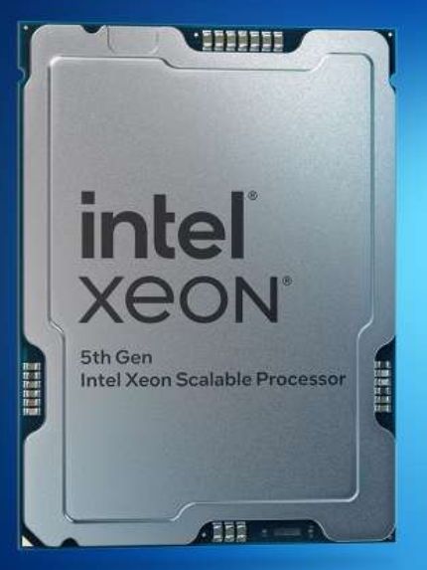
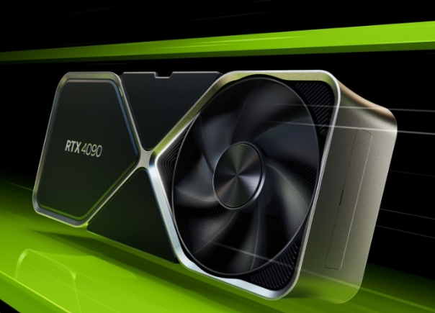
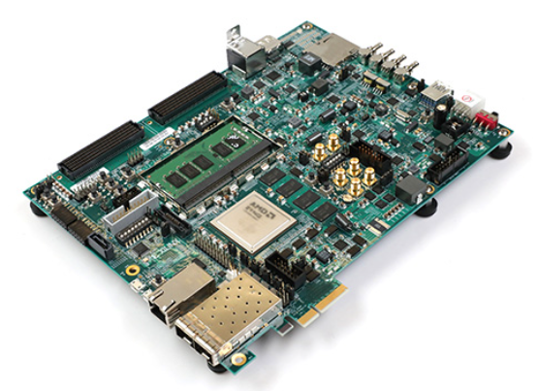
Limitations of CPUs and GPUs Platforms
Compared to CPUs and GPUs platforms, FPGAs platforms can fully leverage the parallelism potential of SpMV by customizing dataflow and memory structure^{[1][2][3]}. In addition, FPGAs typically have low power consumption and hold greater potential for edge computing and other fields.
CPUs
GPUs
FPGAs
[1] R. Dorrance, F. Ren, and D. Markovi ́c, “A scalable sparse matrix-vector multiplication kernel for energy-efficient sparse-blas on fpgas,” in FPGA, 2014.
[2] K. Lu, Z. Li, L. Liu, J. Wang, S. Yin, and S. Wei, “Redesk: A reconfigurable dataflow engine for sparse kernels on heterogeneous platforms,” in ICCAD, 2019.
[3] S. Li, D. Liu, and W. Liu, “Optimized data reuse via reordering for sparse matrix-vector multiplication on fpgas,” in ICCAD, 2021

Slide 10
Limitations of Conventional FPGAs Platforms
However, there are several challenges to accelerate SpMV on conventional FPGAs platforms^{[1]}.
Due to the limited number of independent memory channels, conventional FPGAs with DDR memory system are poor at concurrent memory accesses.
Irregular memory access patterns restrict the available memory bandwidth as the DDR is better suited for continuous memory accesses.
[1] C. Su, H. Liang, W. Zhang, K. Zhao, B. Ai, W. Shen, and Z. Wang, “Graph sampling with fast random walker on hbm-enabled fpga accelerators,” in FPL, 2021.

Slide 11
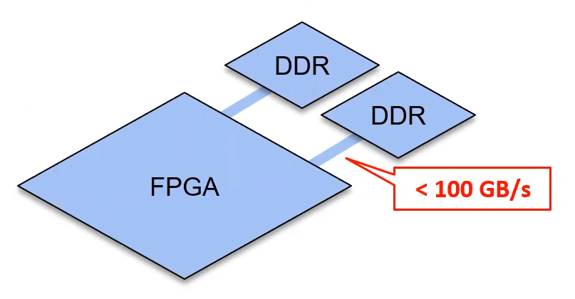
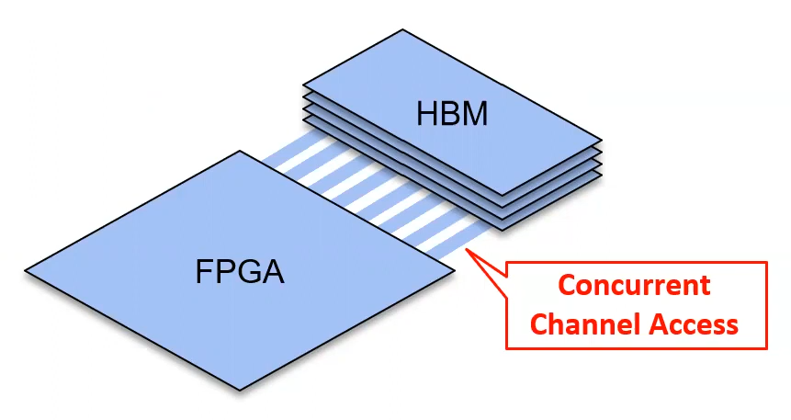
High Bandwidth Memory
The emergence of high bandwidth memory (HBM) presents a great opportunity to accelerate SpMV. Compared to FPGAs with DDR, which typically have bandwidth less than 100 GB/s, HBM offer more memory channels and larger memory bandwidth (e.g., Xilinx Alveo U280 FPGA offers 32 memory channels and 460 GB/s bandwidth). We therefore perform the SpMV accelerator design on HBM-equipped FPGAs.

Slide 12
Outline
Background
Sparse Matrix-Vector Multiplication
Related Work and Challenges
Cuper
Customized Sparse Format
Reordering Algorithm and Dataflow Processing
Hardware Architecture Design
Experiment
Experiment Setup
Performance Evaluation
Conclusion

Slide 13
HiSparse
HiSparse^{[1]} is a SpMV accelerator utilizing HBM. HiSparse leverages customized sparse format and a scalable on-chip buffer design to improve bandwidth utilization. HiSparse uses a load-store forwarding to mitigate read-after-write (RAW) conflicts, but inevitably introduces stall logic.
The hardware architecture of HiSparse
[1] Y. Du, Y. Hu, Z. Zhou, and Z. Zhang, “High-performance sparse linear algebra on hbm-equipped fpgas using hls: A case study on spmv,” in FPGA, 2022.

Slide 14
Serpens
Serpens^{[1]} is a general-purpose SpMV accelerator based on HBM. Serpens executes SpMV in column blocks, However, due to the lack of consideration for blank structures in sparse matrices, Serpens writes redundant vector elements into on-chip memory.
Column block
The hardware architecture of Serpens
[1] L. Song, Y. Chi, L. Guo, and J. Cong, “Serpens: A high bandwidth memory based accelerator for general-purpose sparse matrix-vector multiplication,” in DAC, 2022.

Slide 15
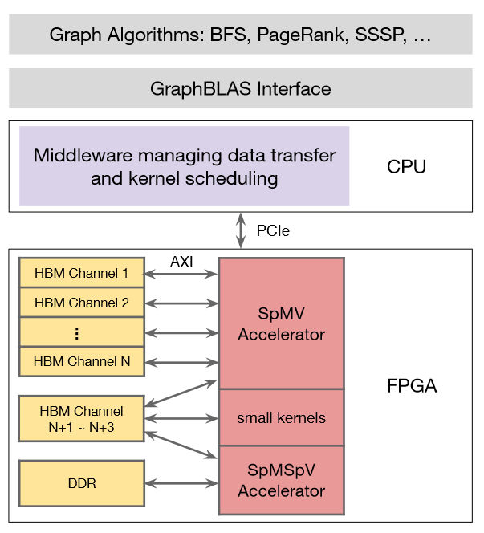
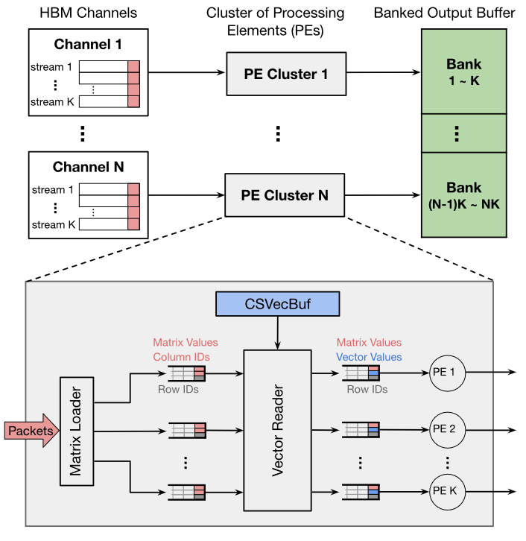
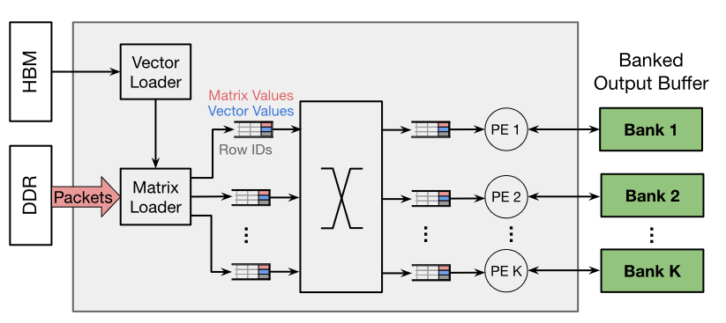
GraphLily
GraphLily^{[1]} designs the FPGA overlay to support a wide range of graph applications. GraphLily mainly optimizes the two dominant kernels SpMV and SpMSpV in GraphBLAS. However, certain general-purpose hardware allocations are idle during SpMV processing.
The architecture of GraphLily
The architecture of SpMV
The architecture of SpMSpV
[1] Y. Hu, Y. Du, E. Ustun, and Z. Zhang, “Graphlily: Accelerating graph linear algebra on hbm-equipped fpgas,” in ICCAD, 2021.

Slide 16
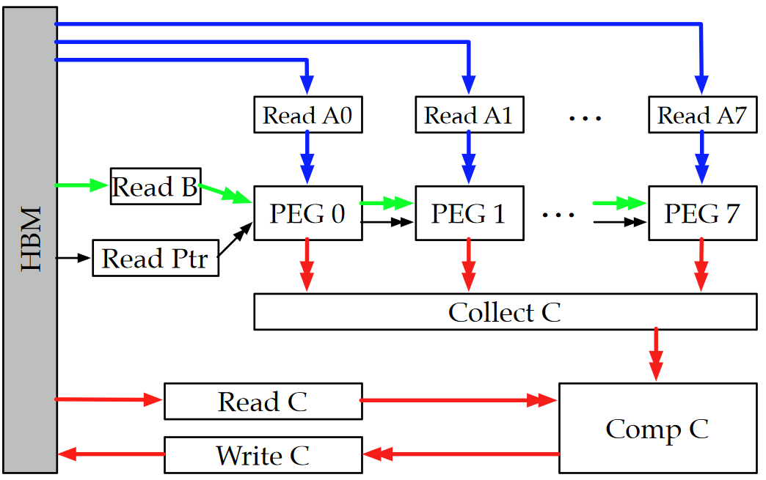
Sextans
Sextans^{[1]} serves as an accelerator for general-purpose sparse matrix-dense matrix multiplication (SpMM) processing. For streaming, memory channels have to be allocated for three matrices. Therefore, utilizing Sextans directly for SpMV processing results in redundant bandwidth allocation.
The hardware architecture of GraphLily
[1] L. Song, Y. Chi, A. Sohrabizadeh, Y.-k. Choi, J. Lau, and J. Cong, “Sextans: A streaming accelerator for general-purpose sparse-matrix dense-matrix multiplication,” in FPGA, 2022.

Slide 17
Challenge 1: Lack of a sparse format that fully utilizes HBM
To fully utilize HBM, it is essential to ensure streaming accesses to amortize latency. Compressed Sparse Row (CSR) is a commonly used sparse matrix storage format. The corresponding channel allocation method for CSR is contiguous allocation. However, contiguous allocation leads to channel conflicts, and the indirect accesses of CSR prevents streaming accesses, resulting in the inability to fully leverage the potential of HBM.
Indirect accesses to row pointers prevents streaming accesses
Accessing a channel at the same time leads to channel conflicts
Contiguous allocation
CSR
Non-zeros accesses

Slide 18
Challenge 2: Lack of an efficient strategy for mitigating RAW
The accumulation phase of SpMV unavoidably causes RAW conflicts. A subsequent instruction initiates a read request to the same register when the write operation of a register has not yet completed. The typical pipeline stall solution strategy^{[1]} leads to high latency and poor throughput.
𝑦₀ = a₀₂ × 𝑥₂ + 𝑦₀
𝑦₁ = a₁₀ × 𝑥₀ + 𝑦₁
𝑦₂ = a₂₃ × 𝑥₃ + 𝑦₂
𝑦₃ = a₃₀ × 𝑥₀ + 𝑦₃
𝑦₄ = a₄₁ × 𝑥₁ + 𝑦₄
𝑦₄ = a₄₅ × 𝑥₅ + 𝑦₄
𝑦₅ = a₅₁ × 𝑥₁ + 𝑦₅
𝑦₅ = a₅₃ × 𝑥₃ + 𝑦₅
RAW
Dense vector y
RAW
[1] Y. Du, Y. Hu, Z. Zhou, and Z. Zhang, “High-performance sparse linear algebra on hbm-equipped fpgas using hls: A case study on spmv,” in FPGA, 2022.

Slide 19
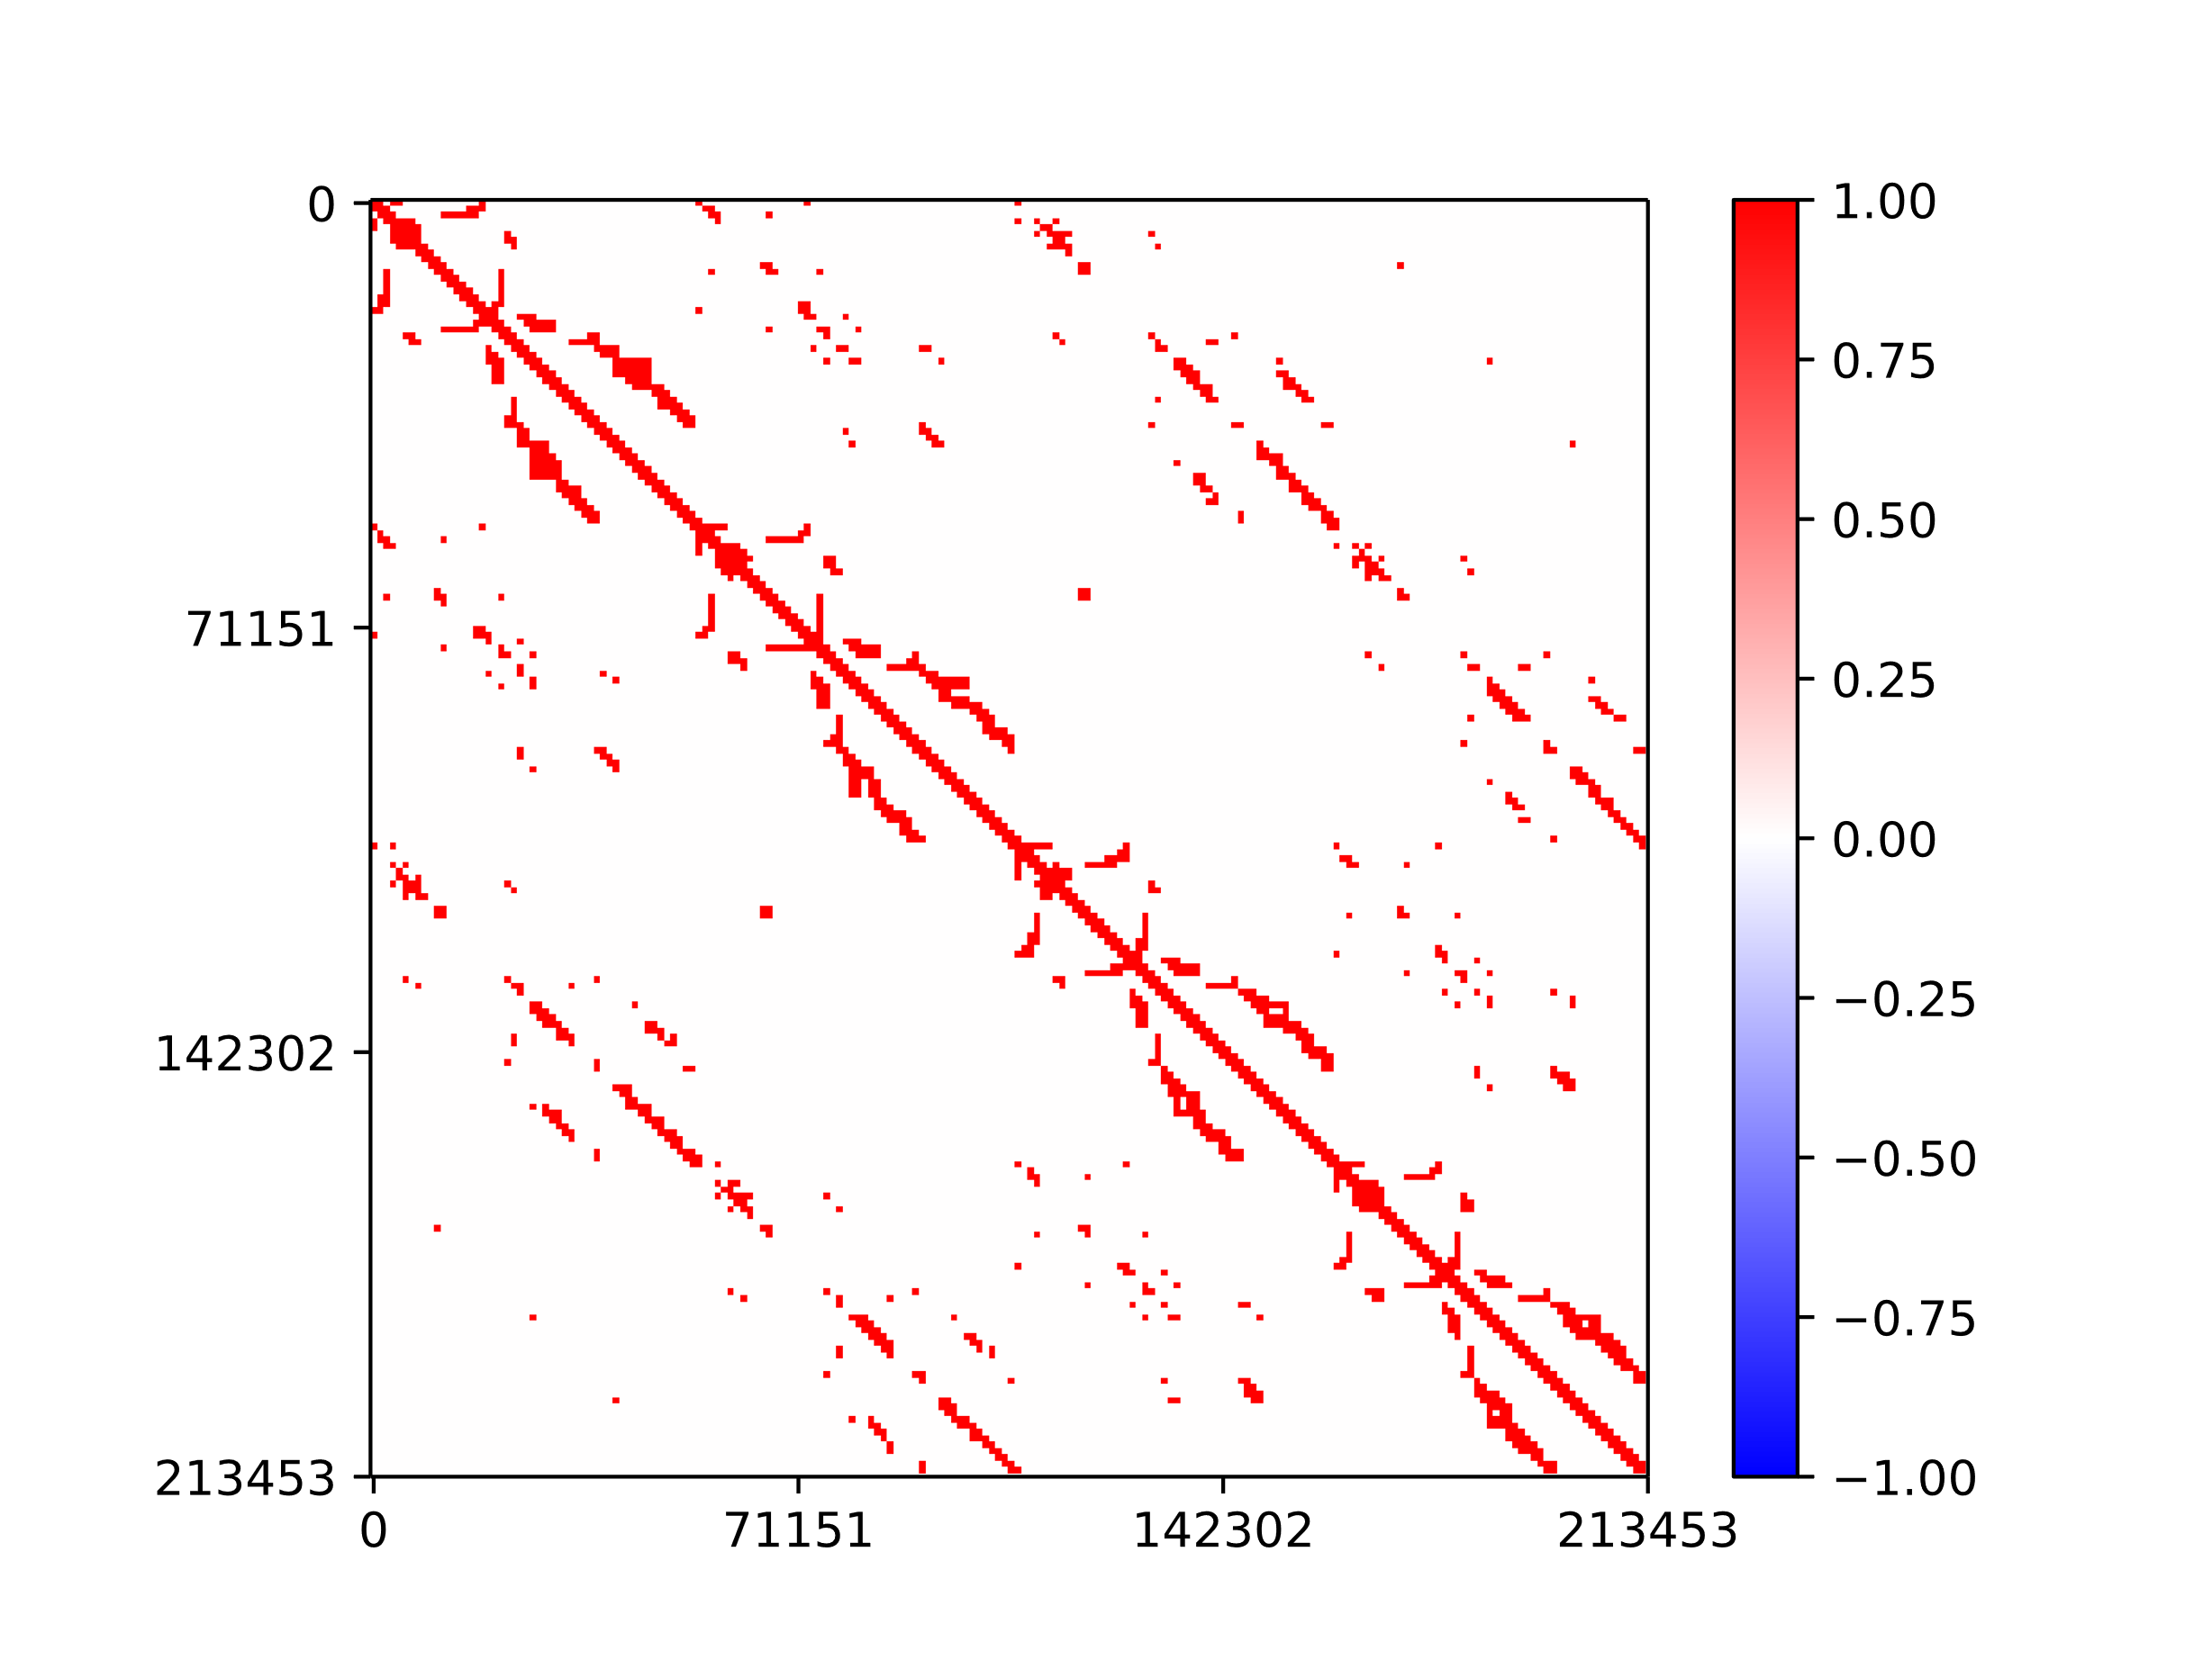
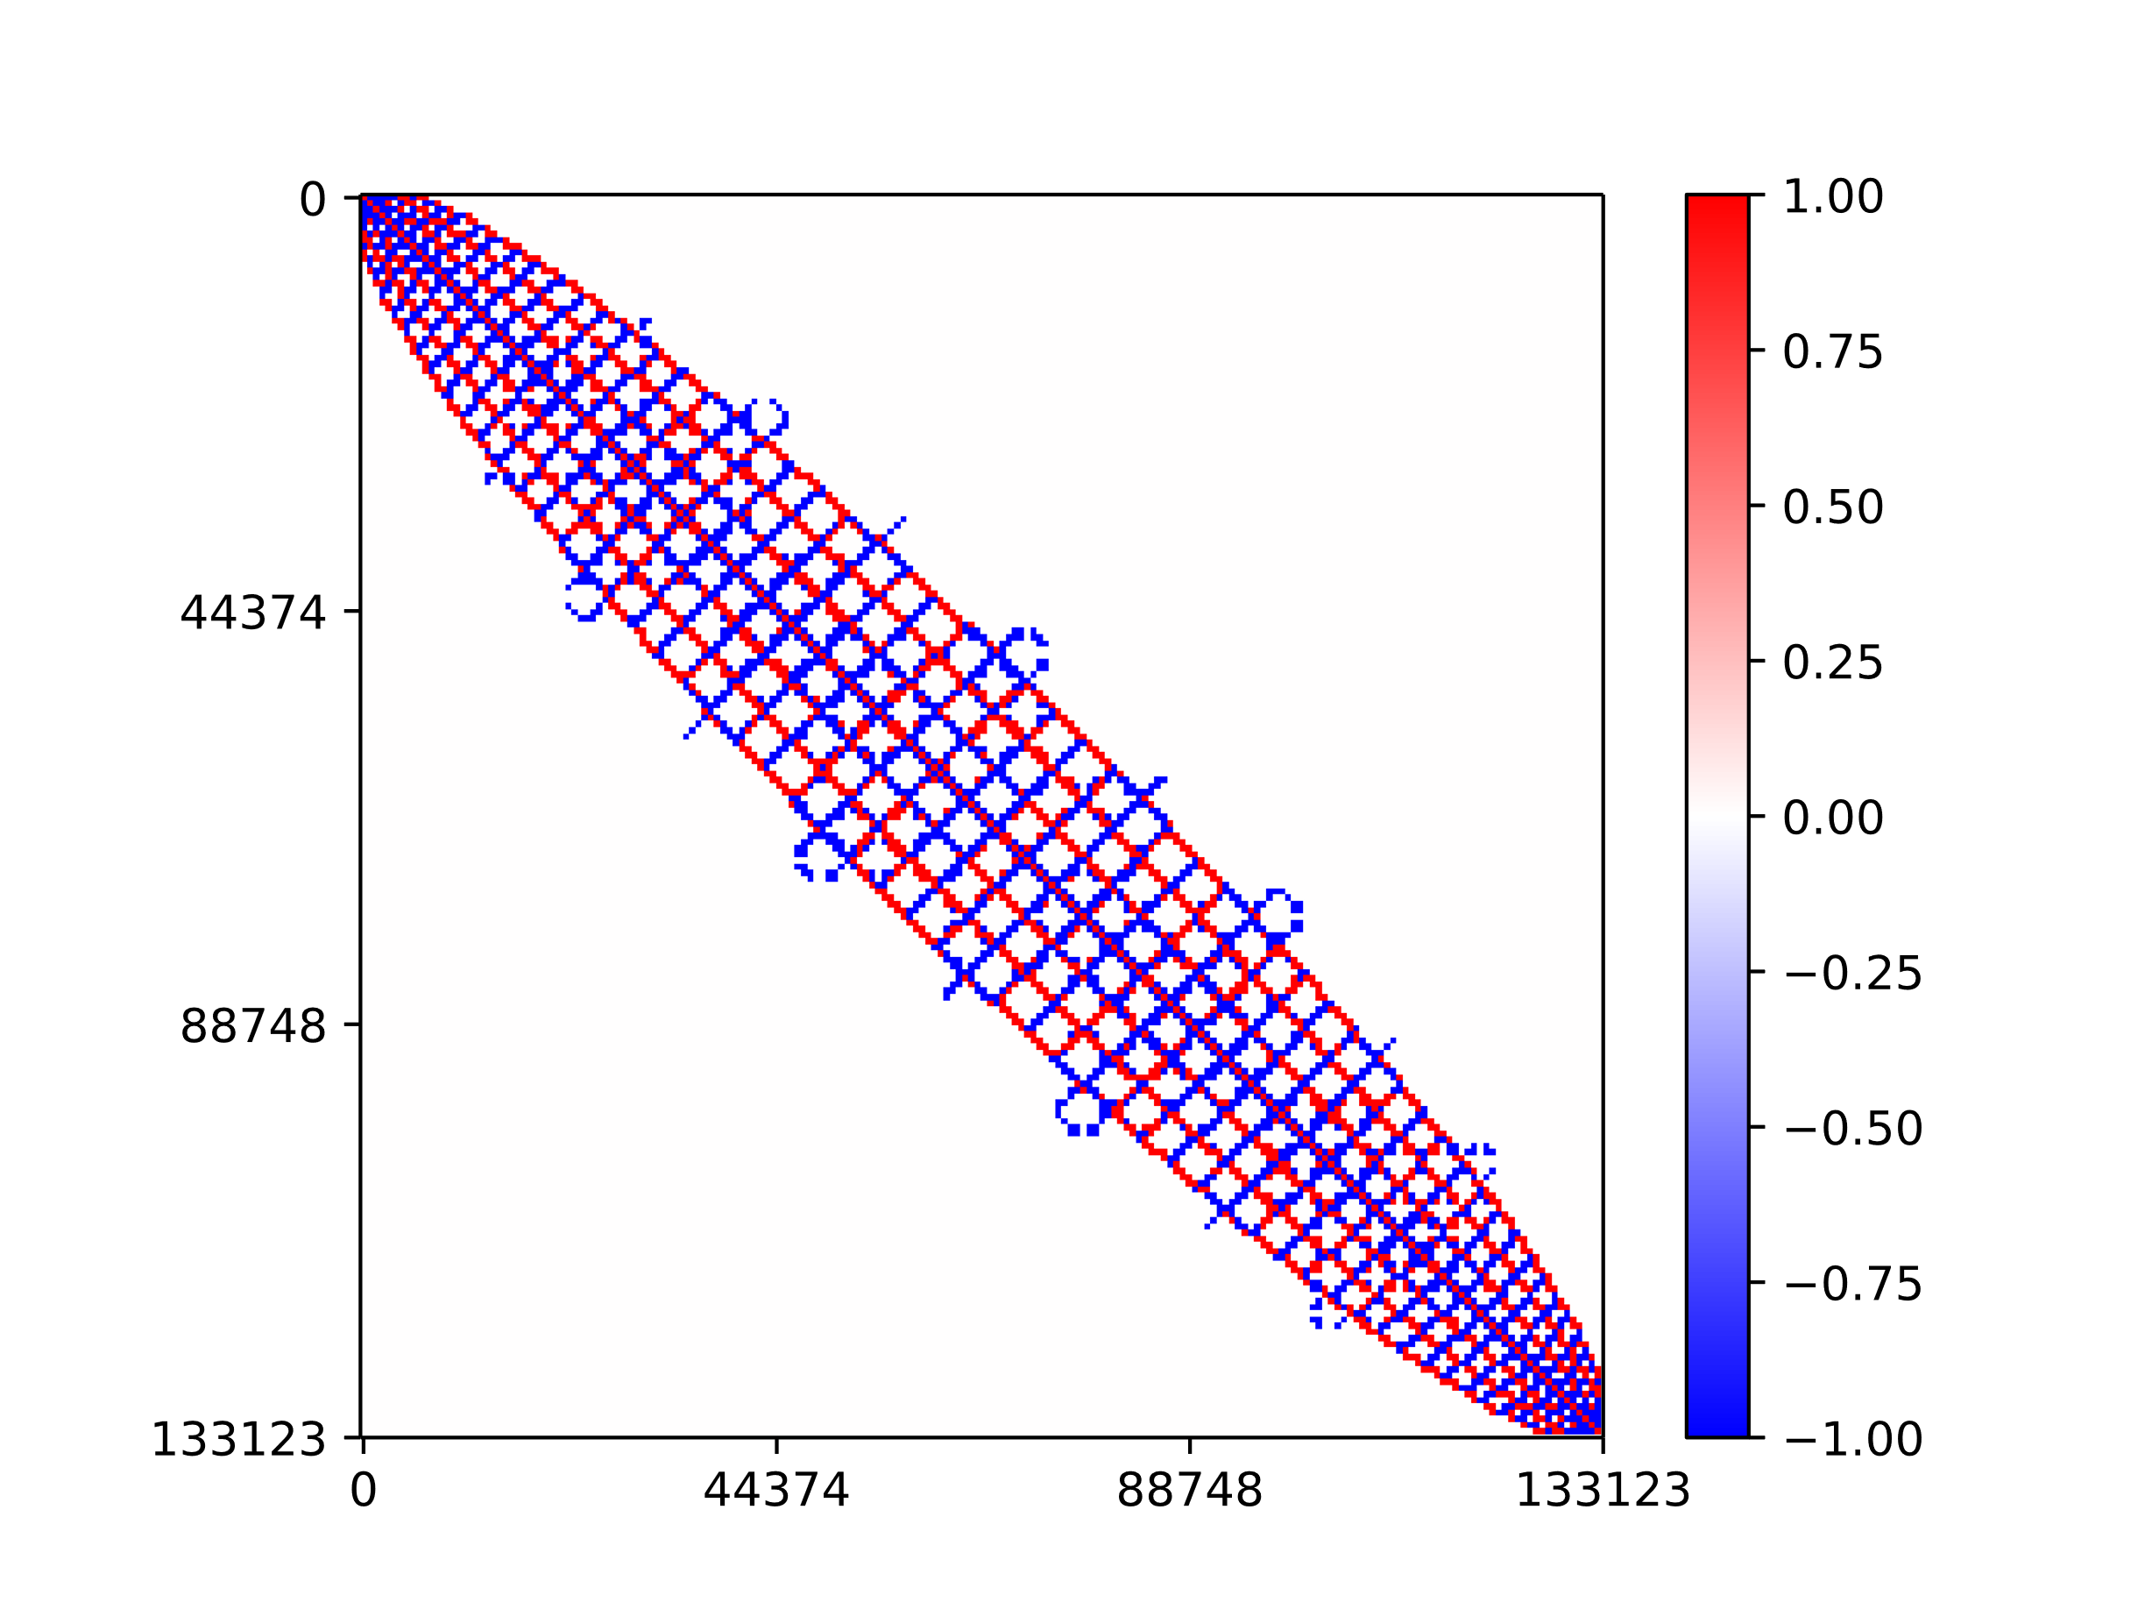
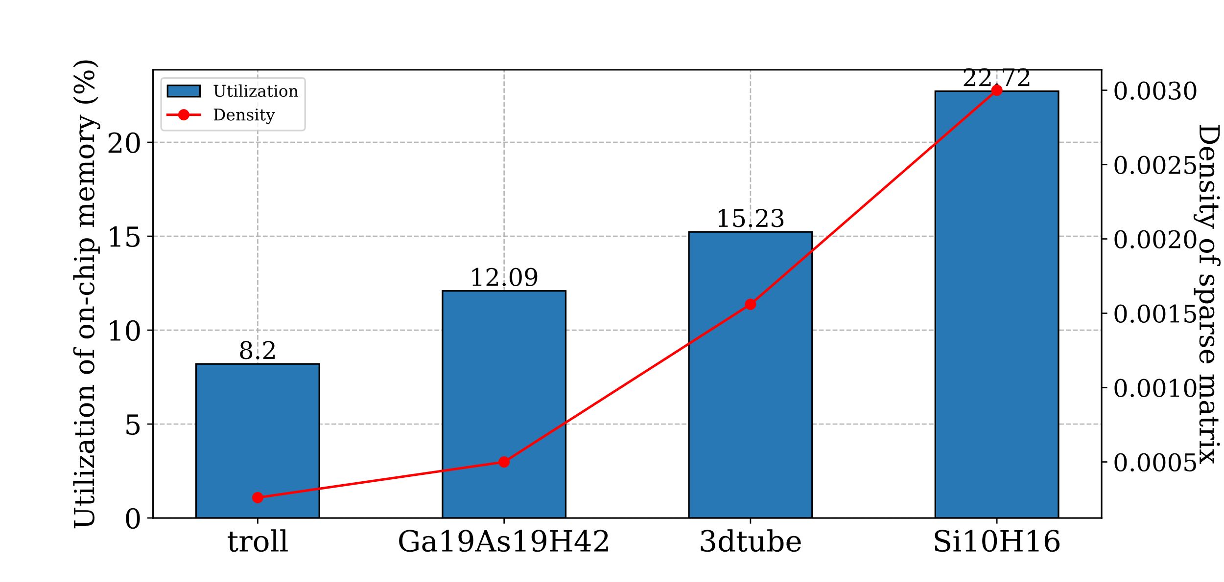
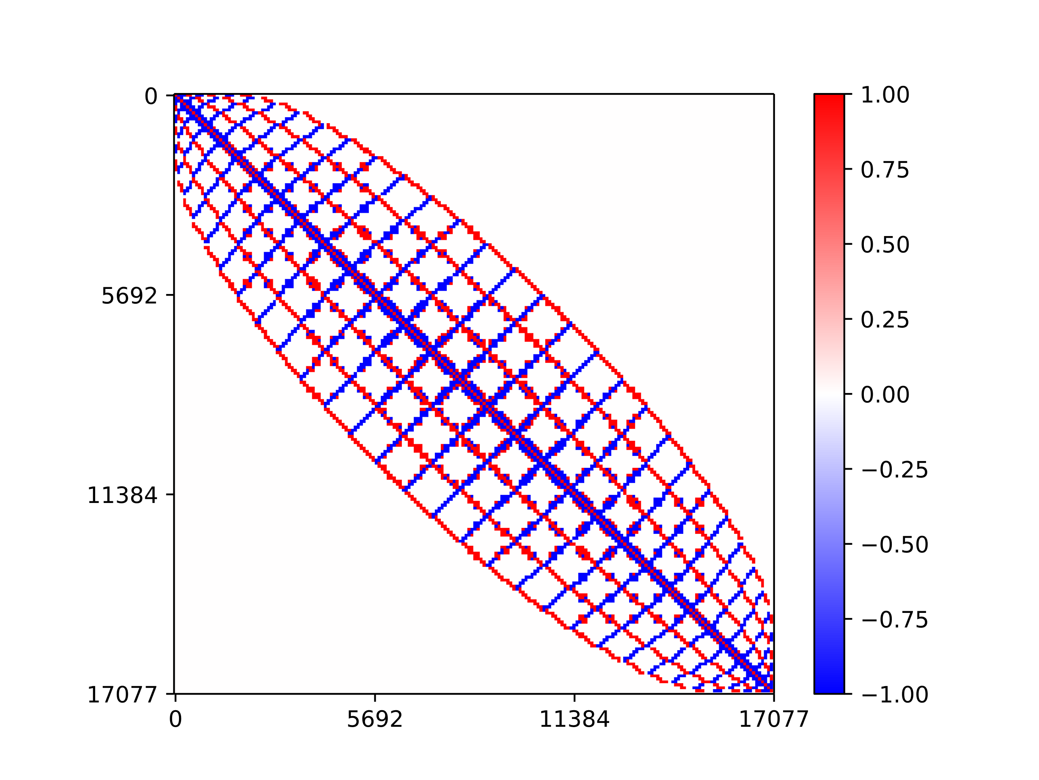
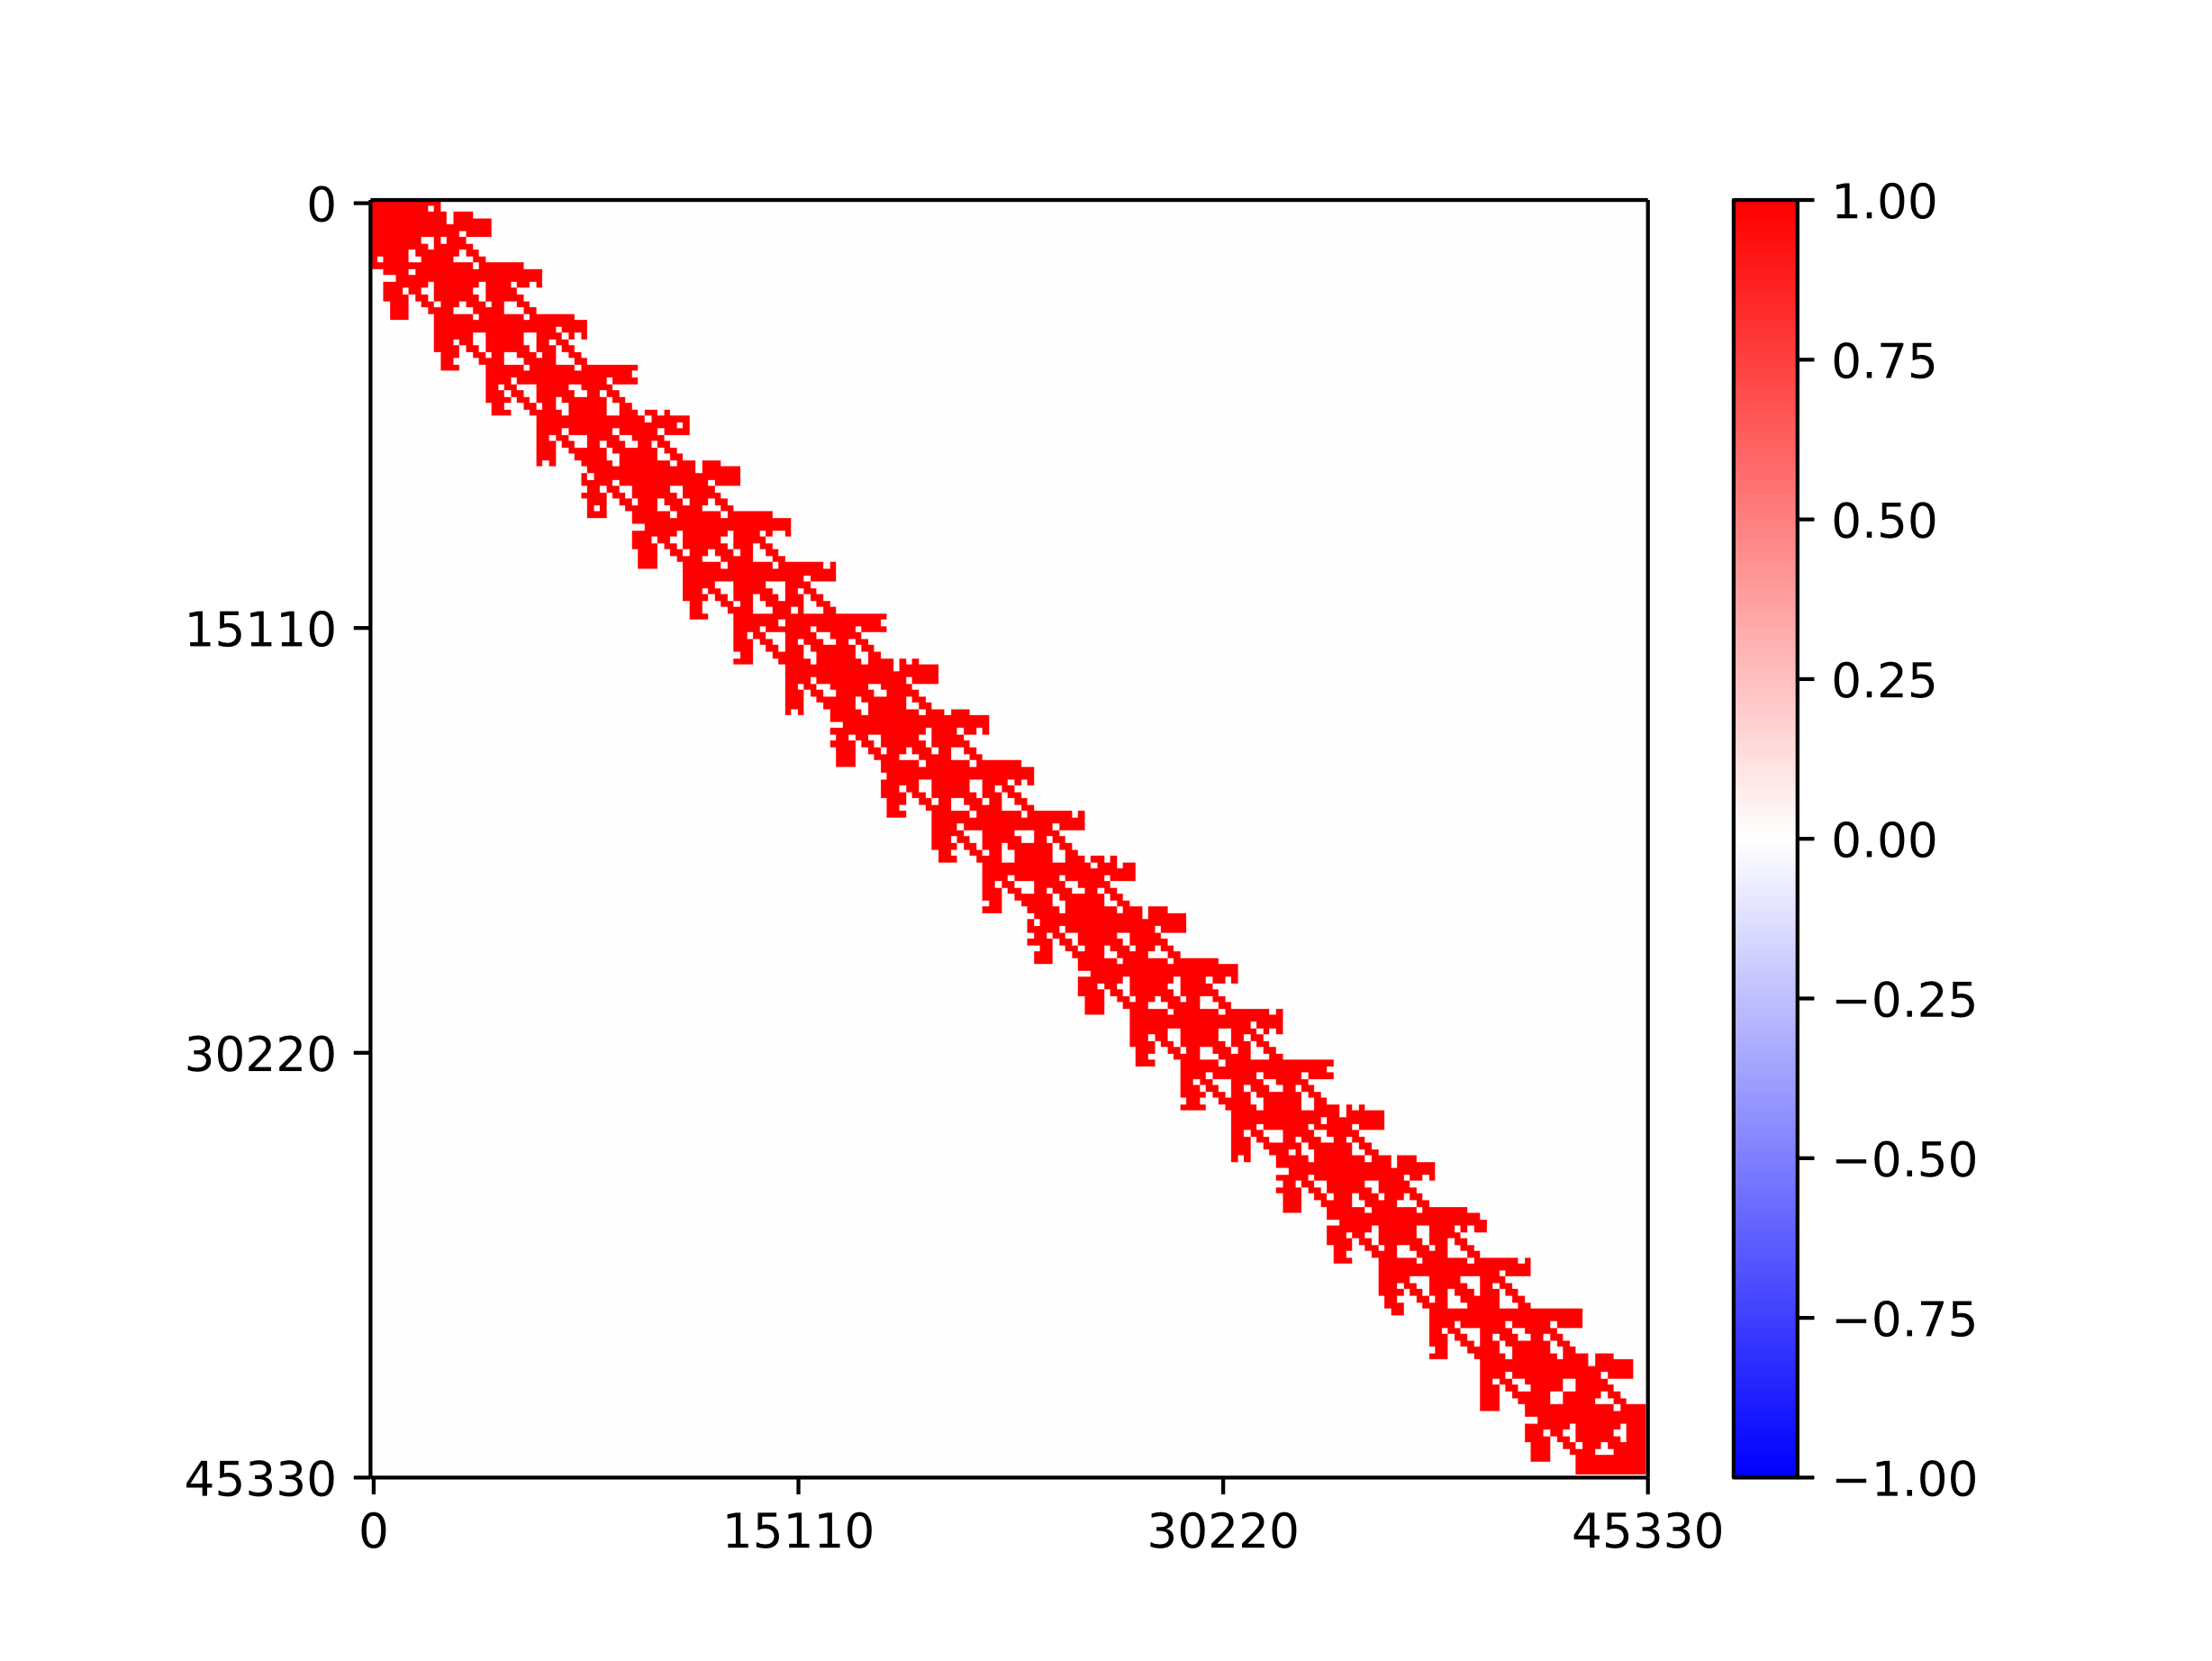
Challenge 3: Lack of efficient utilization of vector and on-chip memory
Existing accelerator^{[1][2]} mainly perform SpMV with column blocks. However, such an approach ignores the spatial structure of sparse matrices, leading to low vector reusability and redundant on-chip writes. For example, In Serpens, matrices with varying densities and spatial structures can impact the on-chip memory utilization of the input vector.
troll
Ga19As19H42
The trend of vector on-chip memory utilization with matrix density
Si10H16
3dtube
[1] L. Song, Y. Chi, L. Guo, and J. Cong, “Serpens: A high bandwidth memory based accelerator for general-purpose sparse matrix-vector multiplication,” in DAC, 2022.
[2] B. Liu and D. Liu, “Towards high-bandwidth-utilization spmv on fpgas via partial vector duplication,” in ASP-DAC, 2023.

Slide 20
Outline
Background
Sparse Matrix-Vector Multiplication
Related Work and Challenges
Cuper
Customized Sparse Format
Reordering Algorithm and Dataflow Processing
Hardware Architecture Design
Experiment
Experiment Setup
Performance Evaluation
Conclusion

Slide 21
Responding to Challenge 1
Challenge 1: Lack of a sparse format that fully utilizes HBM
Customized sparse format
Load balance and data locality
Fully streaming accesses
Reduce memory channel conflicts

Slide 22
Customized Sparse Format – Sparse slices as the basic unit
Load balance and date locality
The row-level parallelism method may exhibit significant disparities in the load between PEs due to the differences between dense long rows and sparse short rows. Sparse slices help alleviate the load imbalance. The fixed partition size of slice structure restricts the load between PEs to maintain a relatively balanced state.
Extreme load imbalance
Relative load balance
Original matrix
Row-level parallelism
Slice-level parallelism

Slide 23
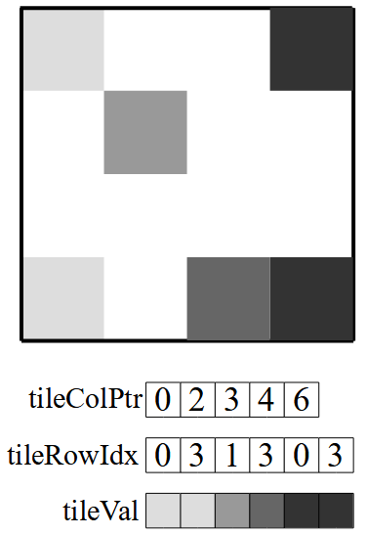
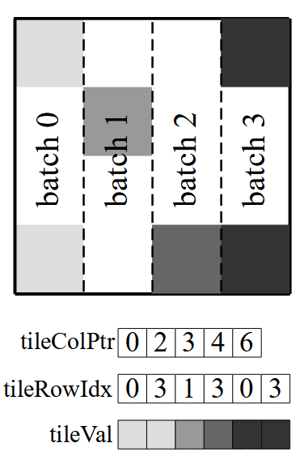
Customized Sparse Format – Sparse slices store by CSC
To utilize vector reusability, we store sparse slices by compressed sparse column (CSC). Furthermore, Due to on-chip resource limitations, we employ a batched approach to perform SpMV.
Sparse slices store by CSC
Batched approach

Slide 24
Customized Sparse Format – Non-zeros store by COO
Fully streaming accesses
In order to reduce extra control overhead, we utilize coordinate (COO) to store non-zero information in each sparse slice. Synchronized parsing of COO indices and values ensures full streaming accesses to each HBM channel.
Fully streaming accesses
Contiguous allocation
COO
Non-zeros accesses

Slide 25
Customized Sparse Format – Cyclic row allocation
Reduce memory channel conflicts
Contiguous row allocation leads to channel conflicts among PEs, resulting in high access latency. Therefore, we cyclically allocate rows to each channel.
No channel conflicts
Cyclic allocation
COO
Non-zeros accesses

Slide 26
Outline
Background
Sparse Matrix-Vector Multiplication
Related Work and Challenges
Cuper
Customized Sparse Format
Reordering Algorithm and Dataflow Processing
Hardware Architecture Design
Experiment
Experiment Setup
Performance Evaluation
Conclusion

Slide 27
Responding to Challenge 2 and Challenge 3
Challenge 2: Lack of an efficient strategy for mitigating RAW
Step 1. Conflict-Aware Row Reordering
Mitigate RAW conflicts
Challenge 3: Lack of efficient utilization of vector and on-chip memory
Step 2. Reuse-Aware Column Reordering
Enhance vector reusability

Slide 28
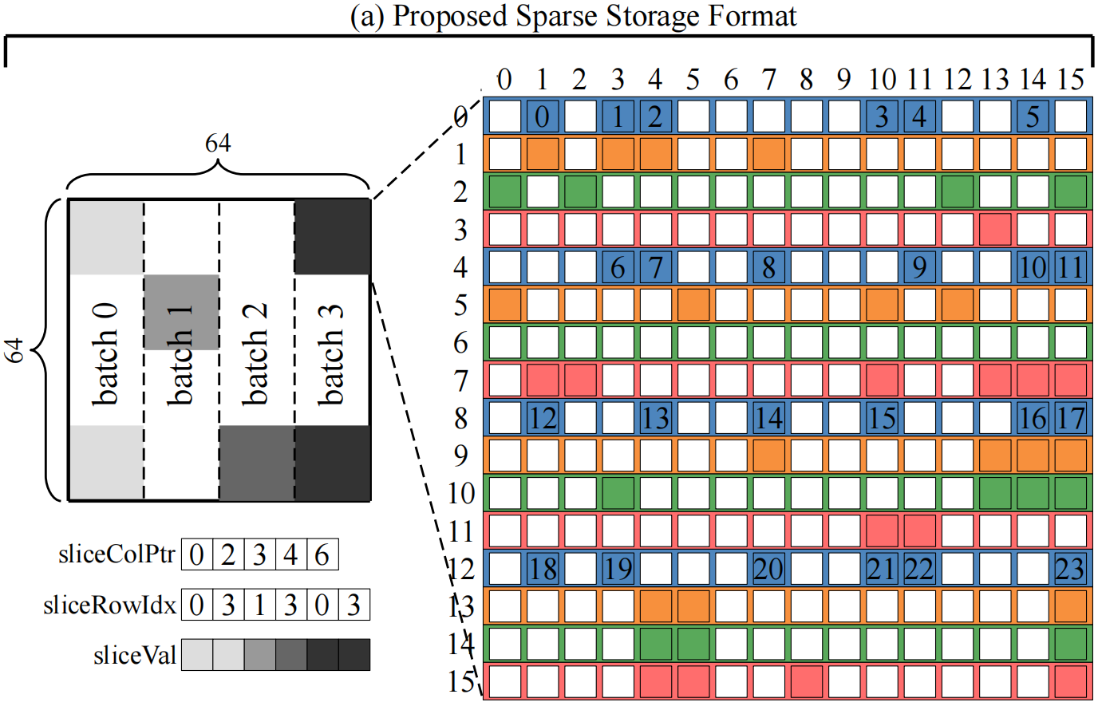
Two-Step Reordering – Step 1. Conflict-Aware Row Reordering
As an example, we take a 16-by-16 sparse slice from a sparse matrix of size 64-by-64.

Slide 29
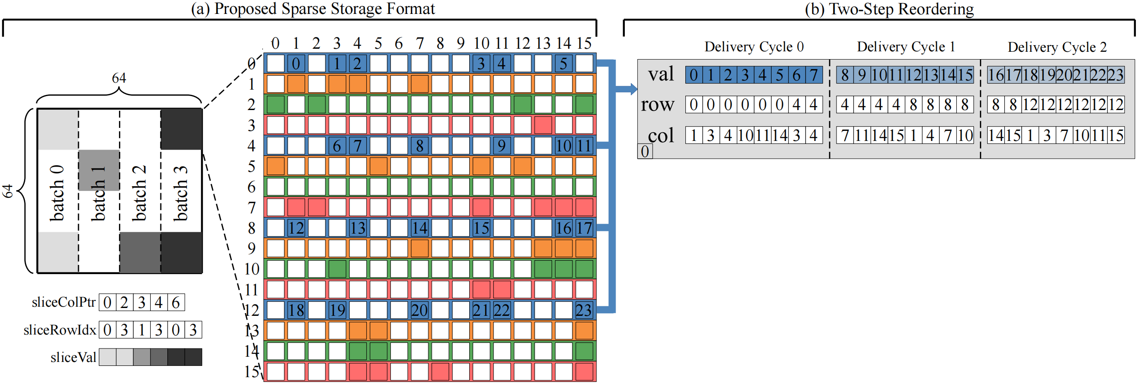
Two-Step Reordering – Step 1. Conflict-Aware Row Reordering
To fully utilize the 512-bit off-chip memory bandwidth. We aggregate the row and column indices into 32-bit, enabling us to encode a single non-zero element in 64-bit. With this strategy, eight non-zeros can be delivered to the chip per cycle. Thus, it takes three cycles to deliver the 24 non-zeros (in blue).

Slide 30
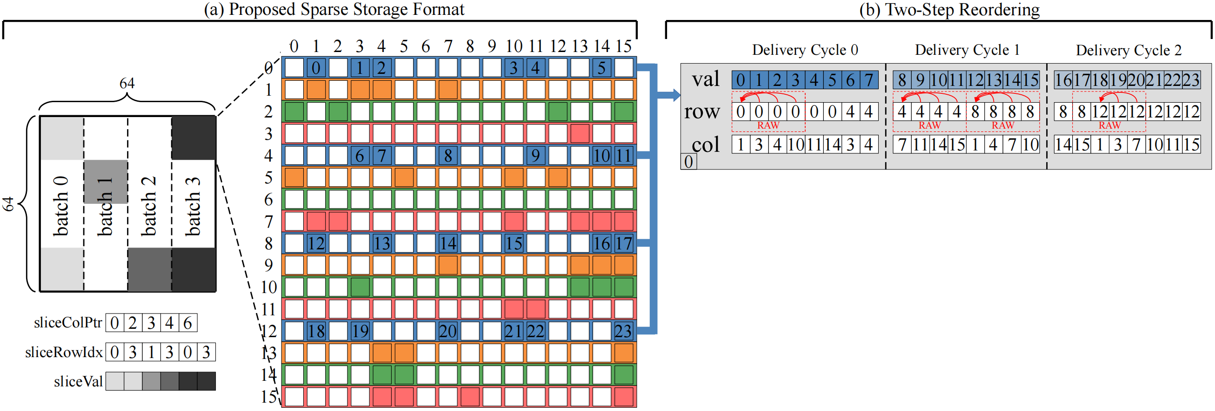
Two-Step Reordering – Step 1. Conflict-Aware Row Reordering
However, delivery in this order introduces a large number of RAW conflicts.

Slide 31
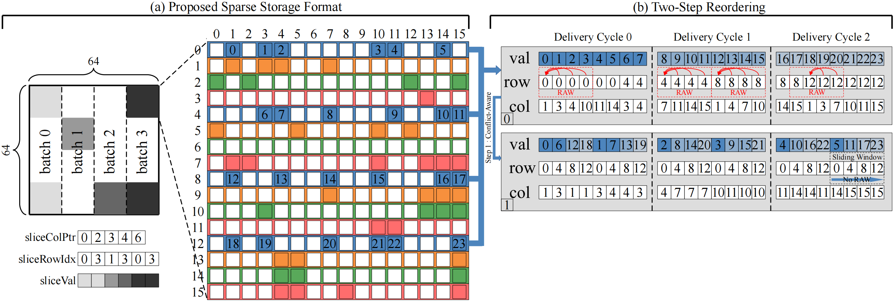
Two-Step Reordering – Step 1. Conflict-Aware Row Reordering
To effectively mitigate RAW, we propose a conflict-aware row reordering algorithm. It involves filling a sliding window of width four with consecutively selected conflict-free row addresses from the initial sequence. If there is no more matching address, the window is temporarily made idle.

Slide 32
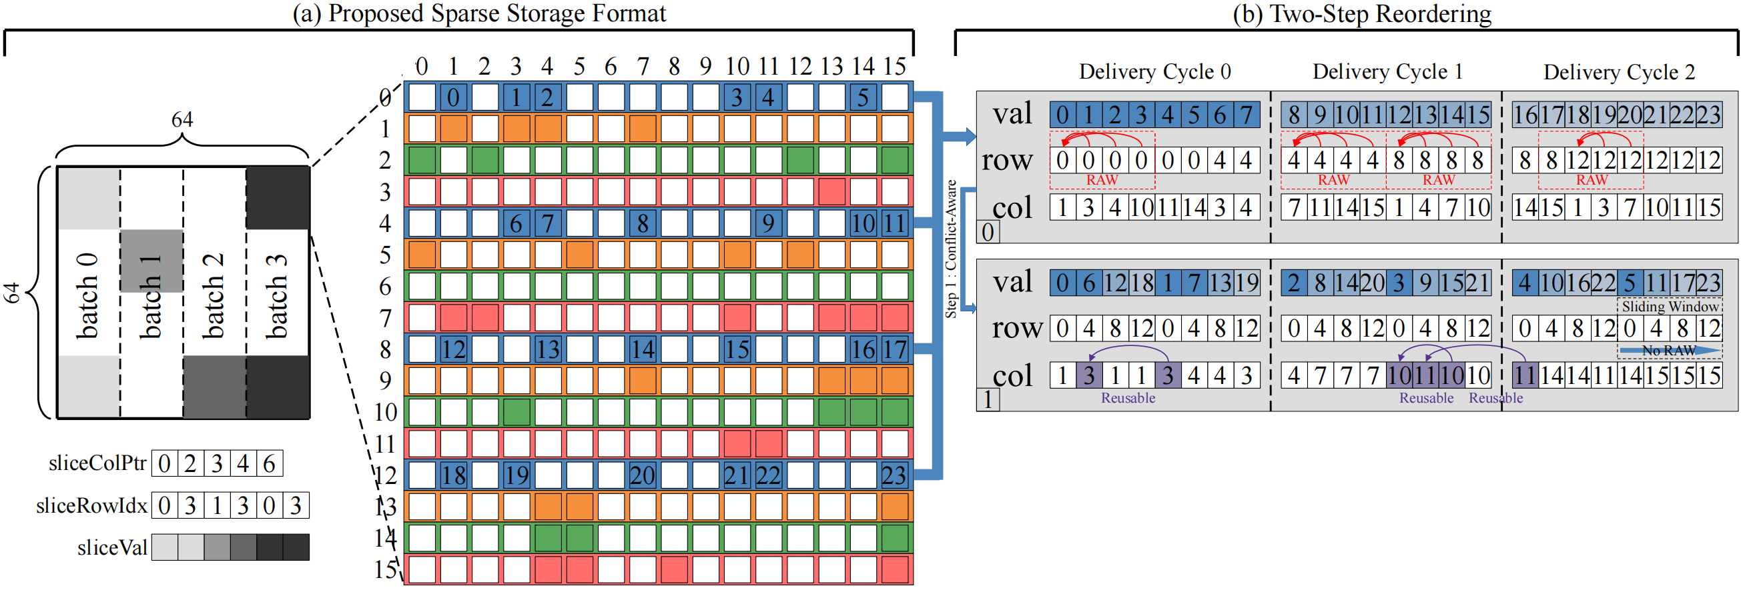
Two-Step Reordering – Step 2. Reuse-Aware Column Reordering
We further analyze the reordered sequence and find that there are reusable vector elements in it, as shown by the purple in figure.

Slide 33
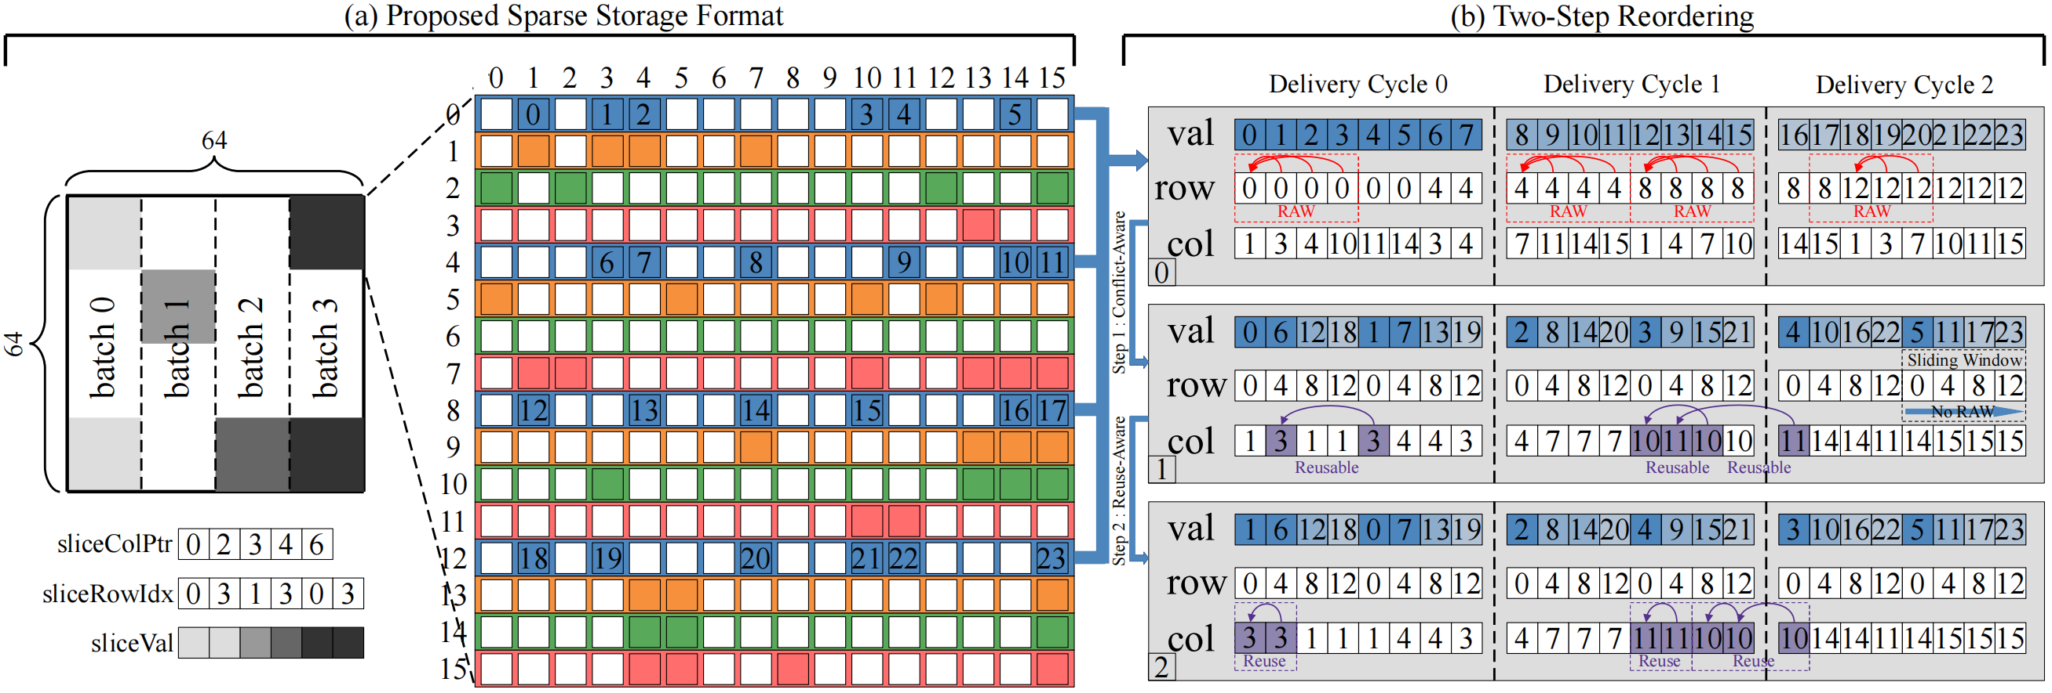
Two-Step Reordering – Step 2. Reuse-Aware Column Reordering
Therefore, we propose a reuse-aware column reordering algorithm. With the priority of step 1 reordering algorithm, we gather non-zeros with the same column index greatest possible to improve data locality. Continuous reuse of vector elements is achieved by setting flexible reuse registers in the hardware architecture.

Slide 34
Dataflow Processing – Packaging
Benefiting from the index aggregation strategy, we can pack eight non-zeros into a packet for vectorized delivery. These packets are then formed into dataflow and stored in the HBM channels.

Slide 35
Dataflow Processing – Dataflow processing
The last step is dataflow allocation, we cyclically allocate rows of dataflow to each channel.

Slide 36
Outline
Background
Sparse Matrix-Vector Multiplication
Related Work and Challenges
Cuper
Customized Sparse Format
Reordering Algorithm and Dataflow Processing
Hardware Architecture Design
Experiment
Experiment Setup
Performance Evaluation
Conclusion

Slide 37
Overall Architecture
The dataflow from the host platform stream to the FPGAs. The loader and writer are responsible for data interaction between HBM and FPGAs. Within each dedicated computational core, the perceptual decoder parses the index information and loads the input vector. Then, the accumulator merges multiplication. The partial sums are sorted by the multi-way sorting tree. Finally, the vector writer streams the final result to the host platform.

Slide 38
Hardware Architecture Design
Loader and Writer
Fully utilize memory channel bandwidth
Dedicated Computational Cores Array
Perceptual Decoder
Further enhance vector reusability and on-chip memory utilization
PE Group
Improve computational parallelism
Accumulator
Ping-Pong Buffers
Cover latency overhead
Multi-way Sorting Tree

Slide 39
Loader and Writer
The allocation and interconnection of HBM channels need to be carefully planned to benefit from HBM. We allocate 16 HBM channels for reading sparse matrix A, one channel for reading vector x, and one channel for writing back vector y.

Slide 40
Dedicated Computational Cores Array
HBM provides massive memory channels. However, the global accesses between channels introduce high latency. Therefore, we configure 16 highly parallel cores in dedicated computational cores array to facilitate independent concurrent access and optimize bandwidth utilization. Each core contain a perceptual decoder and a PE group.

Slide 41
Dedicated Computational Cores Array – Perceptual decoder
Enhance vector reusability
To implement the vector reuse strategy of the reordering algorithm, we set flexible reuse registers in the vector fetcher to save the last read vector value and column address.

Slide 42
Dedicated Computational Cores Array – Perceptual decoder
The controller verifies whether the column address of the vector to be acquired exists in the reuse register. If the match successes, the controller schedules the multiplexer (MUX) to directly export the vector element from the reuse register. If the match failures, the vector fetcher reads vector from the vector loader, while the contents of the reuse registers are replaced.

Slide 43
Dedicated Computational Cores Array – Perceptual decoder
Enhance on-chip memory utilization
Because the proposed sparse storage format is based on sparse slices, the perceptual decoder can skip the blank structures to reduce redundant vector writes for higher on-chip memory utilization.

Slide 44
Dedicated Computational Cores Array – PE group
Each packet contains eight groups of non-zeros. Therefore, eight PEs are configured in a PE group and each PE performs the multiplication operation of the matrix value with the vector value. As there is no data dependency during the multiplication phase of SpMV, all PEs can compute in parallel.

Slide 45
Accumulator
Due to the speed mismatch between data delivery and floating-point accumulations, we set up a FIFO for every adder to stockpile awaiting inputs and convey new inputs from the FIFO upon the adder completing the present computation.

Slide 46
Accumulator – Partial sums buffer
The accumulated results are promptly stored in the partial sums buffer, composed of ultra RAM (URAM), to support quick random accesses.

Slide 47
Accumulator – Ping-Pong buffers
Moreover, the batched approach of SpMV introduces memory switching latency between batches, for which we set up ping-pong buffers to cover this latency overhead. Once the current batch concludes, the partial sums stored in the ping buffer (in blue) are ready to be written to the partial sums buffer, and the pong buffer (in orange) is switched to calculate the partial sums of the next batch.

Slide 48
Multi-way Sorting Tree
The multi-way sorting tree consists of FIFOs and comparators for ordering partial sums results.

Slide 49
Outline
Background
Sparse Matrix-Vector Multiplication
Related Work and Challenges
Cuper
Customized Sparse Format
Reordering Algorithm and Dataflow Processing
Hardware Architecture Design
Experiment
Experiment Setup
Performance Evaluation
Conclusion

Slide 50
Cuper Implement
We develop Cuper using Vivado High-Level Synthesis (HLS) C++ and implement with Vitis Toolchain 2021.2.
LUT : Look Up Table
FF: Flip Flop
DSP: Digital Signal Processor
BRAM: Block RAM
URAM: UltraRAM
Resource utilization of Cuper on a Xilinx Alveo U280 FPGA

Slide 51
Baselines
FPGAs Baselines
We evaluate Cuper and the four state-of-the-art SpMV accelerators leveraging HBM FPGAs: HiSparse^{[1]}, GraphLily^{[2]}, Sextans ^{[3]}, and Serpens ^{[4]}.
GPUs Baselines
We also compare Cuper with an Nvidia Tesla K80 GPU.
The specification of the evaluated accelerators
[1] Y. Du, Y. Hu, Z. Zhou, and Z. Zhang, “High-performance sparse linear algebra on hbm-equipped fpgas using hls: A case study on spmv,” in FPGA, 2022.
[2] Y. Hu, Y. Du, E. Ustun, and Z. Zhang, “Graphlily: Accelerating graph linear algebra on hbm-equipped fpgas,” in ICCAD, 2021.
[3] L. Song, Y. Chi, A. Sohrabizadeh, Y.-k. Choi, J. Lau, and J. Cong, “Sextans: A streaming accelerator for general-purpose sparse-matrix dense-matrix multiplication,” in FPGA, 2022.
[4] L. Song, Y. Chi, L. Guo, and J. Cong, “Serpens: A high bandwidth memory based accelerator for general-purpose sparse matrix-vector multiplication,” in DAC, 2022.

Slide 52
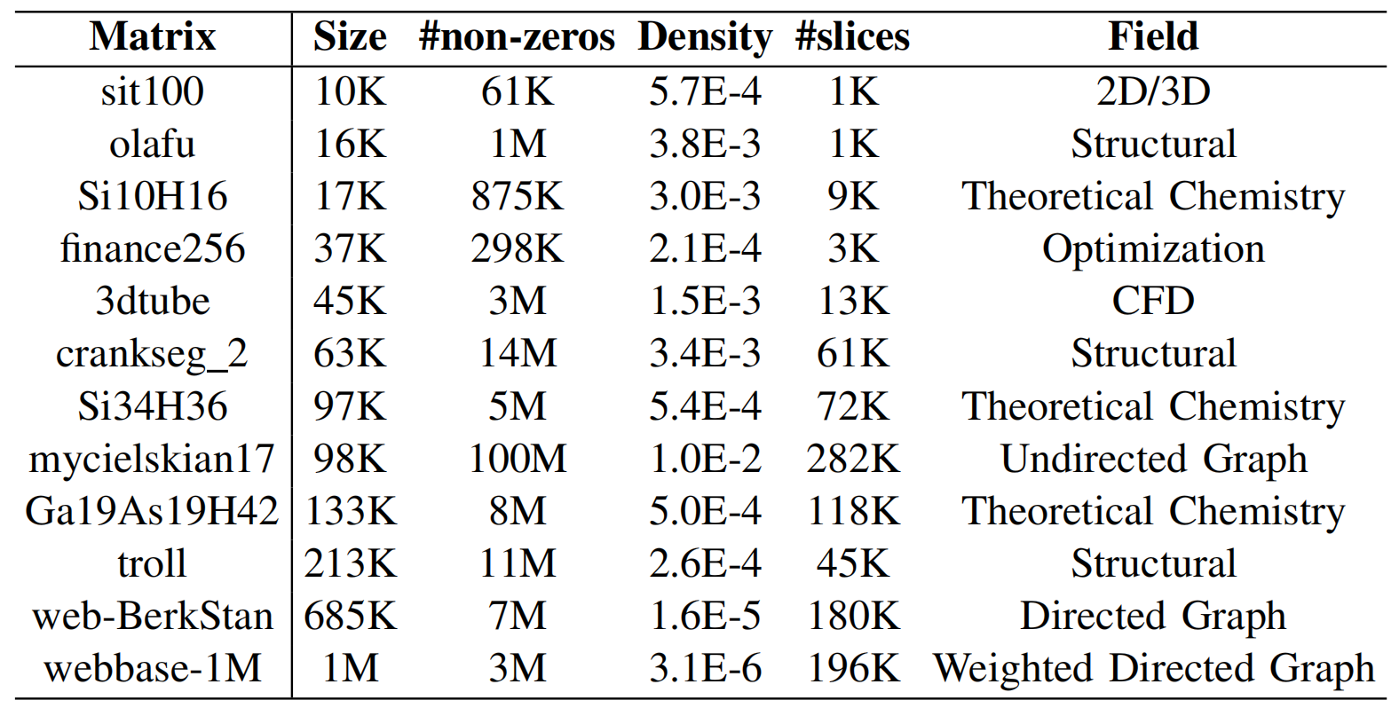
Datasets
To compare Cuper with the state-of-the-art FPGAs accelerators, we select 12 large-size matrices from the SuiteSparse Matrix Collection^{[1]} for evaluation. For the comparison of Cuper with K80 GPU, we select 2,757 matrices from SuiteSparse. The number of rows ranges from 1 to 1.5M and the number of non-zeros can be as high as 113M.
The information of the 12 evaluated matrices
[1] T. A. Davis and Y. Hu, “The university of florida sparse matrix collection,” TOMS, 2011.

Slide 53
Metrics
Throughput, measured as the number of billion floating-point operations per second (GFlops).
Bandwidth efficiency, measured by throughput per unit of memory bandwidth (MFlops/(GB/s)).
Energy efficiency, measured by throughput per watt (MFlops/W).

Slide 54
Outline
Background
Sparse Matrix-Vector Multiplication
Related Work and Challenges
Cuper
Customized Sparse Format
Reordering Algorithm and Dataflow Processing
Hardware Architecture Design
Experiment
Experiment Setup
Performance Evaluation
Conclusion

Slide 55
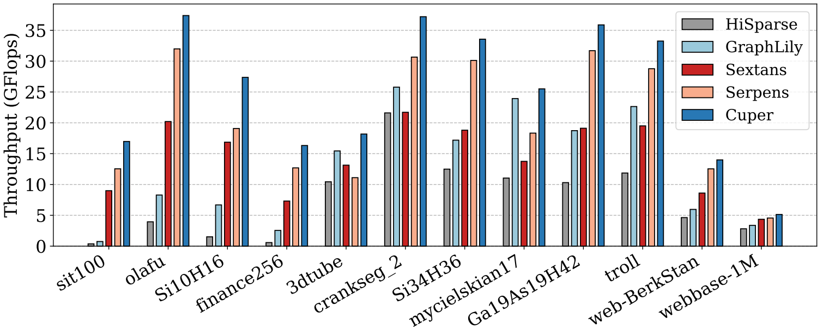
Comparison with FPGAs Accelerators – Throughput
We use throughput to normalize the performance of different accelerators. Our performance evaluation on 12 large matrices reveals that Cuper’s geomean throughput is 3.28×, 1.99×, 1.75×, and 1.44× higher compared with HiSparse, GraphLily, Sextans, and Serpens, respectively.

Slide 56
Comparison with FPGAs Accelerators – Bandwidth efficiency
Cuper achieves higher bandwidth efficiency with customized dataflow and a dedicated computational cores array. The geomean bandwidth efficiency of Cuper is improved over HiSparse, GraphLily, Sextans, and Serpens by 3.28×, 2.20×, 2.82×, and 1.31×, respectively.

Slide 57
Comparison with FPGAs Accelerators – Energy efficiency
Our reordering algorithm and perceptual decoder improve vector reusability, mitigating redundant on-chip reads and writes. Cuper demonstrates 3.59×, 2.08×, 2.21×, and 1.44× improvements in geomean energy efficiency compared with the four accelerators, respectively.

Slide 58
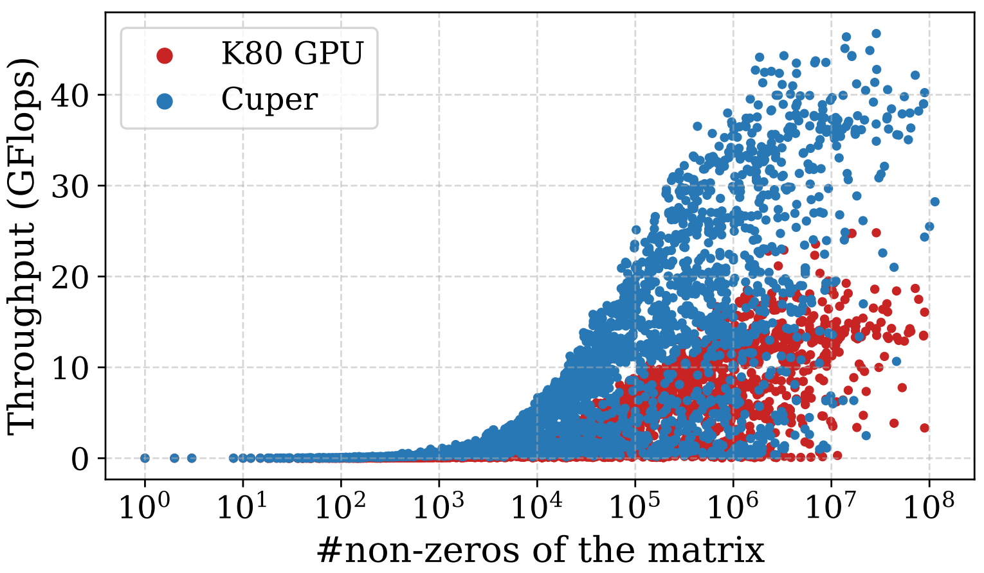
Comparison with K80 GPU
The K80 GPU is more advanced in frequency and memory bandwidth than Cuper. But, Cuper demonstrates superior performance on almost all matrices. The geomean throughput of Cuper compared with K80 GPU is 2.51×. Furthermore, the geomean energy efficiency of Cuper is 7.97× higher than K80 GPU.

Slide 59
Outline
Background
Sparse Matrix-Vector Multiplication
Related Work and Challenges
Cuper
Customized Sparse Format
Reordering Algorithm and Dataflow Processing
Hardware Architecture Design
Experiment
Experiment Setup
Performance Evaluation
Conclusion

Slide 60
Conclusion
We propose Cuper, a high-performance SpMV accelerator on HBM-equipped FPGAs.
We customize dataflow by employing the proposed sparse storage format to improve bandwidth utilization of HBM.
We introduce a two-step reordering algorithm for mitigating RAW conflicts and reusing vector.
We design a perceptual decoder in order to further enhance vector reusability and on-chip memory utilization.
The evaluation show that Cuper demonstrates significant enhancements in throughput, bandwidth efficiency, and energy efficiency compared with the four state-of-the-art SpMV accelerators and K80 GPU.

